Slide 1


JUST BASH IT!

Slide 2




CENTER FOR HEALTH DATA SCIENCE (HEADS)
Data Lab Supports Researchers at the Faculty
Consultation & Commission:
Data science and bioinformatics analyses
Teaching: Courses & Workshops, Seminars.
Henrike Zschach
Thilde Terkelsen
Diana Andrejeva
COPENHAGEN UNIVERSITY LIBRARY (KUB)
XXXXXX XXXXXX
XXXXXX XXXXXX
XXXXXX XXXXXX

Slide 3
JUST BASH IT!
PROGRAM
-
COURSE MATERIALS:
https://github.com/Center-for-Health-Data-Science/Just-Bash-It

Slide 4
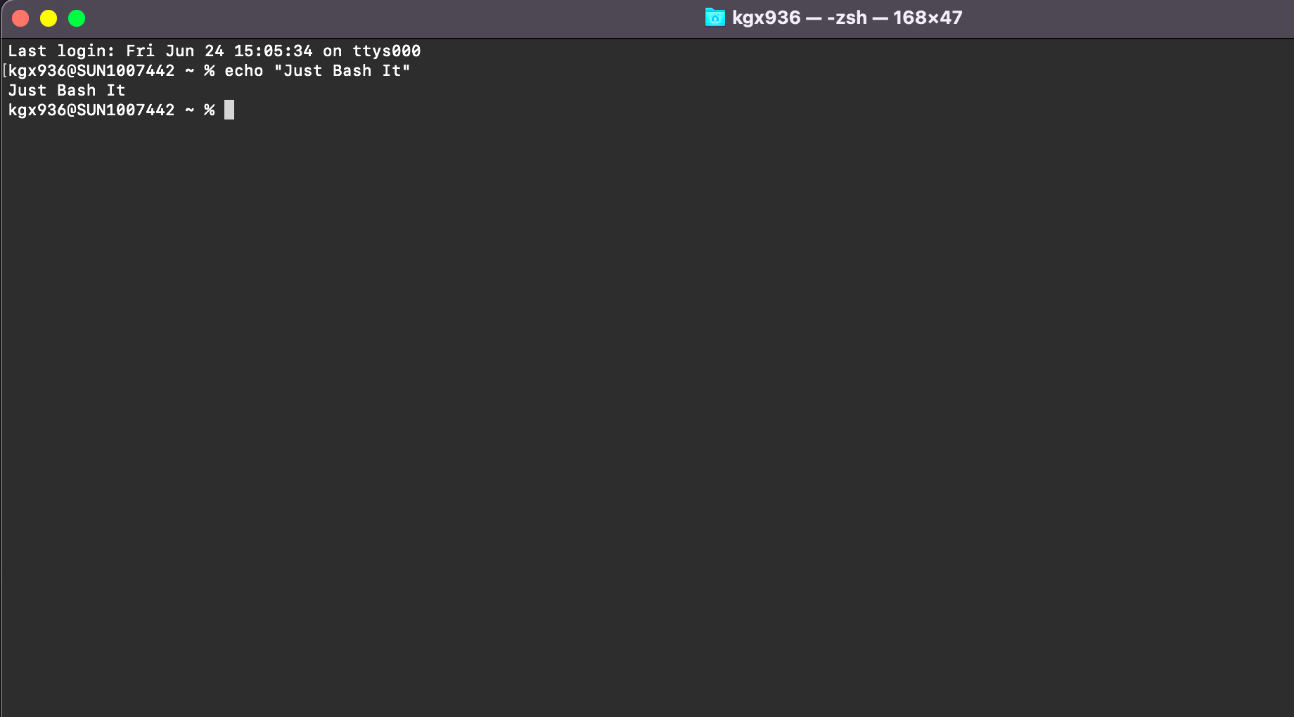
“
“What is a shell, a terminal, a command line, and what is bash?”
“How do these concepts connected to my computer?”

Slide 5
TERMINOLOGY
COMPUTER (Hardware)
BASH SHELL -
COMMAND INTEPRETER
OPERATING SYSTEM (GUI)
$_
TERMINAL -
WRAPPER FOR SHELL
FILES SOFWARE
COMMANDS
You open the terminal on your computer
You type bash commands
Commands are interpreted and feed to the OS
>
pwd
Notes:
Operating system may use a command-line interface (CLI) or graphical user interface (GUI).
Unix & Linux operating systems are CLI.
Windows, Mac OSX, Ubuntu, etc. are GUI.
Bash is a shell & command-line interpreter which interacts with the operating system on a computer.
Bash is may be used though a wrapper program which provides a text window, the terminal, where the user types commands which in terms cause actions on a computer.
Accesses runs softwares installed
File viewing & manipulation
The Bash shell is the default shell for the linux & unix operating systems. This is why you often hear these mentioned together, however most operating systems (also those with GUIs), contain a shell, where bash is the most popular.
Default on OSX and Ubuntu
Windows has a native windows shell as default, but a bash shell may easily be installed.

Slide 6
Wind
Flexible and works on any system
Automatised and Reproducible
SELL IT TO ME!
Benefits of bash & command line:
Do a lot with minimum effort on any system.
Reproducible, automated and parallelize your analysis.
Fast processes, less computationally intensive, no GUI.
Power to handle big data and heavy computations.
Handling Big Datasets
Not Resource Intensive
and Fast
HPC & Cloud Compute Power

Slide 7
A COUPLE OF EXAMPLES
1
2
3
REGISTRY DATA
SEQUENCING DATA
DATABASES
Drug adverse effects and mortality:
Person sensitive
Huge files, many columns
Different formats
Single Cell RNA from Cystic Fibrosis:
Paired-end sequencing
300 patients
Two fastq files per patient
Drug Databases - molecular structure & interaction:
Multiple large databases
Different formats
Maybe not downloadable

Slide 8
HOW DO I GET A BASH SHELL?
YEAH!
YOU HAVE A BASH SHELL & TERMINAL ALREADY.
YOU NEED TO INSTALL A BASH SHELL/TERMINAL:
MobaXterm: https://mobaxterm.mobatek.net/download.html
Cmder: https://cmder.net/
GOW (Cygwin): https://github.com/bmatzelle/gow
PuTTY: https://www.putty.org/
OS X or UBUNTU
WINDOWS
In this course Windows users will be working on MobaXterm.
You should have installed this shell via. instructions in the introduction email.

Slide 9
WHAT WILL WE LEARN TODAY?
STORAGE,
BACKUP & MORE…
SCRIPTS &
AUTOMATIZATION
MORE BASH
COMMANDS
ORGANIZATION
& STRUCTURE
The BASICS
OF BASH
Version Control
Local vs remove
Conda & homebrew
Pipe, stdin, stdout
Loops & Scripts
Pipelines
Write files
Manipulate files
Search, cut, paste
Set up directories
Paths & Permission
Utility manager
The terminal
Navigation w. bash
Read, copy, move
1
2
3
4
5

Slide 10
NAVIGATING
FILES & DIRECTORIES

Slide 11
HENRIKE
YEAH!
YOU HAVE A BASH SHELL & TERMINAL ALREADY.

Slide 12
PROJECT
ORGANIZATION
& BACKUP

Slide 13

IS YOUR COMPUTER A LAUNDRY BASKET?
Why should I care about directory structure and file naming?
Not nice to not “work” in a mess.
If your computer crashes it is MUCH easier to recover work if files/directories are structured.
If you apply a command (bash, R, Python) to a group of files/directories, naming is important!
Large files should be stored smartly to save space.

Slide 14
DO’S and DON’TS
Consistent and Logical Directory Structure and Naming
Don’t Use Symbols or Spaces in File/Directory Names
Consistant & Non-
redundant File Naming
Don’t store multiple copies of file, instead point to it (path).
Version Control System
git/GitHub & Backup
Don’t Store Large Data/Files on Your Local Computer
Clean and Update Your Computer Regularly
Don’t Store Sensitive Datasets on Your Computer

Slide 15
A SUGGESTION FOR STRUCTURE
HOME
USER
DRIVE
PROJECTS
NAME
RESULTS
SCRIPTS
DATA
SCRATCH
DOCX
TABLES
FIGURES
RAW
GENERATED
LITERATURE
DRAFTS

Slide 16
BACKUP
BIG DATA & SENSITIVE DATA:
Your own KU drives (S-drive)
ERDA & SIF (KU data storage)
Lab or department server
Lab or department cloud solution
SCRIPTS, MARKDOWNS:
git/GitHub
(KU drives)
DOCX, EXCEL, POWERPOINT:
Google Drive
Dropbox
(KU drives)
LARGE DATASETS
SENSITIVE DATA
DOCUMENTS & GRAPHICS
SCRIPTS REPORTS

Slide 17


GIT & GITHUB
Git is a version control software, created by Linus Torvalds for the management of the Linux kernel.
Other clients exist.
https://git-scm.com
GitHub is a web-based hosting service for version control that uses git
Other services exist.
https://github.com
git & GItHub not the same

Slide 18
WHAT IS A VERSION CONTROL SYSTEM?
VERSION 3
VERSION 2
FILE
FILE
GIT
VERSION 1
GIT
VERSION 3
VERSION DATABASE
VERSION 3
VERSION 2
GITHUB
VERSION 2
VERSION 1
VERSION 1
VERSION DATABASE
VERSION DATABASE
YOUR COMPUTER
COLLABORATOR

Slide 19

GIT WORKS FROM THE COMMAND LINE
git clone [your repository]
Username: [your user]
Password: [your password]
Git is used from the command line to edit directories & files in a version controlled way
A git command always begins with git
git status (status of the repo)
git add (add new files or changes)
git commit -m (commit the changes)
git push (push the changes to GitHub)
Git enables a local computer to interact with a cloud service (GitHub) to back up your work
Sounds cool, yes!
Take our ‘Introduction to git & GitHub’ Workshop and learn how to git

Slide 20
A SUGGESTION FOR STRUCTURE
LOCAL COMPUTER
EXTERNAL BACKUP
HOME
CLOUD
USER
DRIVE
GITHUB
PROJECTS
DRIVE
NAME
RESULTS
SCRIPTS
DATA
SCRATCH
DOCX
TABLES
FIGURES
RAW
GENERATED
LITERATURE
DRAFTS

Slide 21
YOU CAN WRITE HERE
OUR COMMON SERVICES
Business executives should have a plan for dealing with products at every stage.
YOUR TITLE ONE
Business executives should have a plan for dealing with products at every stage.
YOUR TITLE TWO
Business executives should have a plan for dealing with products at every stage.
Business executives should have a plan for dealing with products.

Slide 22
YOUR TITLE ONE
Business executives should have a plan for dealing with products at every stage. Our technology streamlines the workflow process and produces efficiencies.
YOUR TITLE ONE
Business executives should have a plan for dealing with products at every stage. Our technology streamlines the workflow process and produces efficiencies.

Slide 23
THANK
YOU
JEFF ANDERSON PRES

