Slide 1


JUST BASH IT!
Notes:
Maximize your computer's potential - Bash and commandline intro workshop

Slide 2




WHO ARE WE?
HEADS (SUND) DATA LAB
WEBSITE: https://heads.ku.dk/
Representation learning
Omics Data Analysis
Data Science in Epidemiology
HPC environments
Public & synthetic data
Courses and training
KUB DATA LAB
Henrike Zschach
Thilde Terkelsen
SANDBOX
RESEARCH GROUPS
SUND DATALAB
Courses, Consulting,
Commissions, Supervision
Helene Wegener

Slide 3
JUST BASH IT!
PROGRAM
Day 1
Day 2
08:45 | MORNING COFFEE
09:00 | INTRODUCTION TO COMMANDLINE
09:15 | PART 1: NAVIGATING FILES & DIRECTORIES
09:35 | EXERCISE 1
10:00 | PART 2: FILE OPERATIONS
10:15 | EXERCISE 2
10:30 | COFFEE BREAK
10:45 | PART 3: PROJECT ORGANIZATION & BACKUP
11:05 | EXERCISE 3
11:30 | PART 4: VIEWING AND EDITING FILES
12:00 | LUNCH
13:00 | EXERCISE 4
13:20 | PART 5: DATA WRANGLING
13:45 | COFFEE BREAK
14:00 | EXERCISE 5
15:00 | Q + A
08:45 | MORNING COFFEE
09:00 | PART 6: DATA WRANGLING 2
09:25 | EXERCISE 6
10:25 | COFFEE BREAK
10:40 | PART 7: REDIRECTION & PIPES
11:00 | EXERCISE 7
12:00 | LUNCH
13:00 | PART 8: SHELL SCRIPTS & LOOPS
13:30 | EXERCISE 8
14:15 | COFFEE BREAK
14:30 | PART 9: INSTALLATIONS, CONFIG FILES, WORKFLOW LANGUAGE
15:00 | EXERCISE 9
15:30 | BYE BYE
COURSE MATERIALS:
https://github.com/Center-for-Health-Data-Science/Just-Bash-It

Slide 4
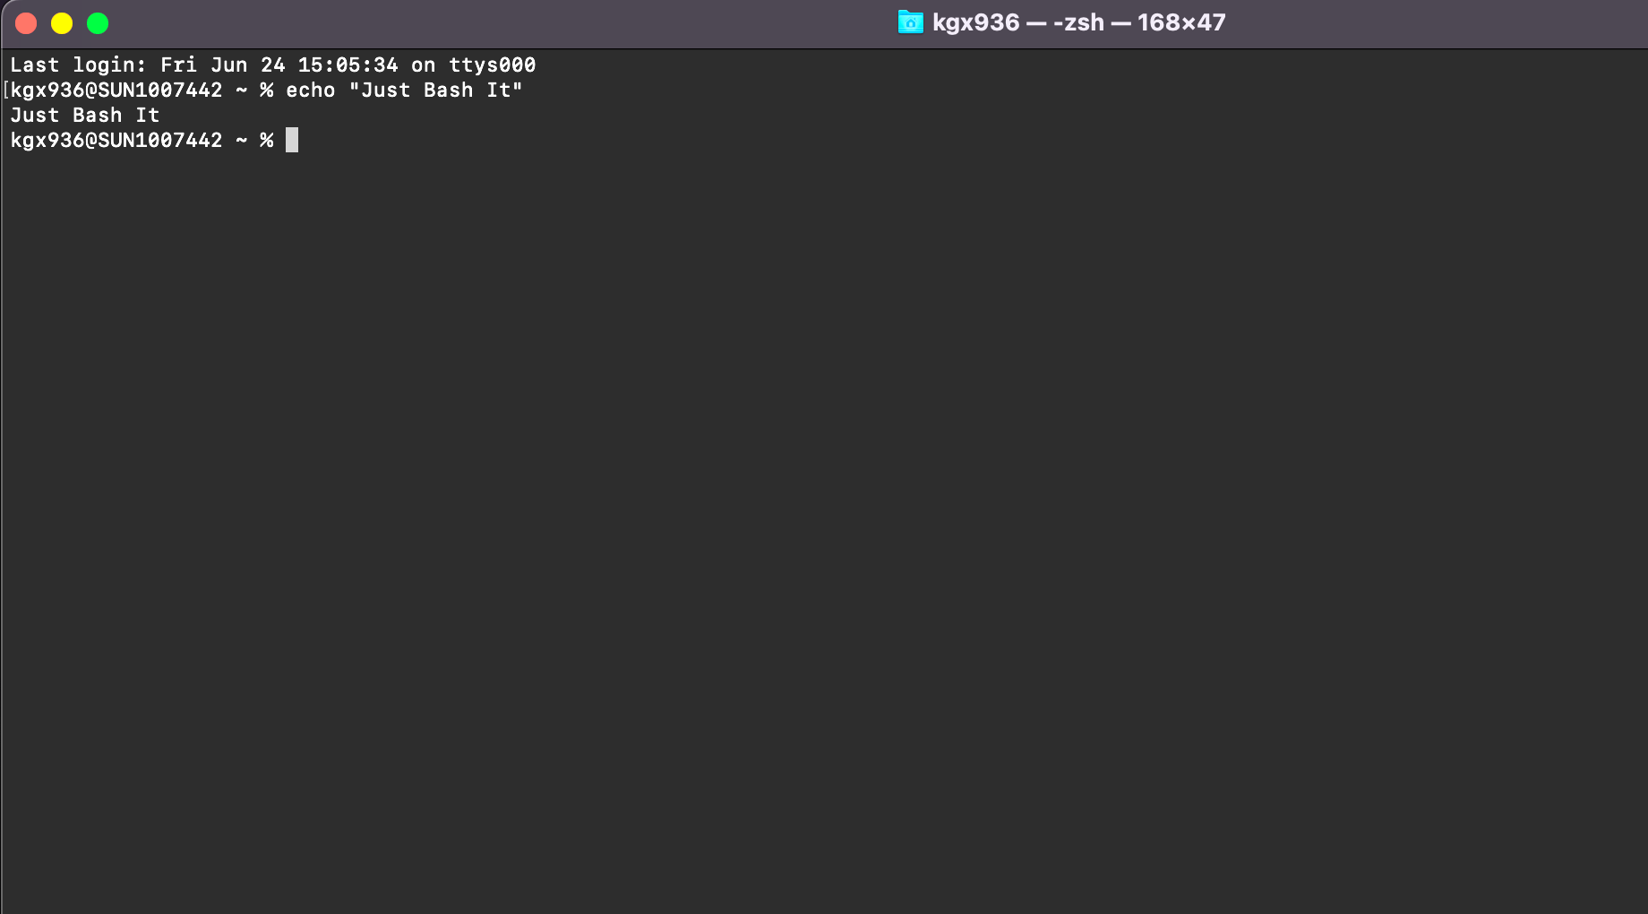
“
“What is a shell, a terminal, a command-line, and what is bash?”
“How do these concepts connect to my computer?”

Slide 5
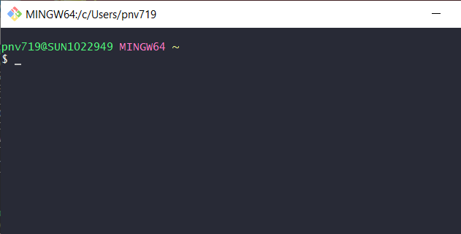
SET UP CHECK
You should all have a terminal. It looks like this…
During this course we will do exercises inside the terminal.
We will also show commands during the lecture.
We encourage you to open your terminal and try them out as we go along.

Slide 6
WHAT IS BASH?
In the beginning there was the word –
Not the graphical user interface!
The first computers had no graphical user interfaces (GUI) where you could click. Instead, you interacted with the computer via the terminal.
There are still computing environments that do not have a GUI.
Some scientific software do not have GUIs either. You need to execute them via the terminal.

Slide 7
TERMINOLOGY
COMPUTER (Hardware)
BASH SHELL &
COMMAND INTEPRETER
OPERATING SYSTEM (GUI)
$_
TERMINAL -
WRAPPER FOR SHELL
FILES &
SOFTWARE *
You open the terminal on your computer
Into the terminal you type bash commands
Commands are interpreted by the shell
>
* software == executable file
Notes:
Operating system may use a command-line interface (CLI) or graphical user interface (GUI).
Unix & Linux operating systems are CLI.
Windows, Mac OSX, Ubuntu, etc. are GUI.
Bash is a shell & command-line interpreter which interacts with the operating system on a computer.
Bash (Bourne again shell) is based on the Bourne shell (sh).
Bash is used though a wrapper program which provides a text window, the terminal, where the user types commands which in terms cause actions on a computer.
Accesses runs softwares installed
File viewing & manipulation
The Bash shell is the default shell for the linux & unix operating systems. This is why you often hear these mentioned together, however most operating systems (also those with GUIs), contain a shell, where bash is the most popular.
Default on OSX and Ubuntu
Windows has a native windows shell as default, but a bash shell may easily be installed.

Slide 8
Flexible and works on any system
Automatised and Reproducible
SELL IT TO ME!
Not Resource Intensive
and Fast
Benefits of bash & command line:
  Your analysis will be reproducible, automated and parallelised.
  Fast processes, less computationally intensive.
  Command line software.
  Power to handle big data and heavy computations.
Wind
Software & Big Datasets
Server, HPC & Cloud Compute Power

Slide 9

WORKING ON A REMOTE SERVER
Server or High Performance Computing (HPC) System.
When:
01
Not enough computational power (CPU, GPU)
02
Not enough memory (RAM) or storage (HDD)
03
Not secure, i.e. person sensitive data
04
Software is complicated to install and set up
Most servers and many HPCs do not have GUIs, you interact with them through the command line
9

Slide 10
A COUPLE OF EXAMPLES
1
2
3
REGISTRY DATA
SEQUENCING DATA
DATABASES
Drug adverse effects and mortality:
Person sensitive
Huge files, many variables
Different formats
Single Cell RNA from Cystic Fibrosis:
Paired-end sequencing
300 patients
Two fastq files per patient
Drug Databases - molecular structure & interaction:
Multiple large databases
Different formats
Maybe not downloadable

Slide 11

HOW DO I GET A BASH SHELL?
>= WINDOWS 10 - Windows Subsystem for Linux:
https://www.laptopmag.com/articles/use-bash-shell-windows-10
OR INSTALL A BASH SHELL/TERMINAL:
Gitbash: https://gitforwindows.org
MobaXterm: https://mobaxterm.mobatek.net/download.html
Cygwin: https://www.cygwin.com/index.html
Cmder: https://cmder.net/
PuTTY: https://www.putty.org/
YEAH!
YOU HAVE A BASH SHELL & TERMINAL ALREADY.
Search for terminal on your laptop and open it.
OS X or UBUNTU
WINDOWS
In this course Windows users will be working on gitbash

Slide 12
WHAT WILL I LEARN IN THIS COURSE?
STORAGE,
BACKUP & MORE…
SCRIPTS &
AUTOMATIZATION
MORE BASH
COMMANDS
ORGANIZATION
& STRUCTURE
The BASICS
OF BASH
Manage Software
Workflows
Backups
Computing Power
Stdin & Stdout
Piping
Loops & Scripts
Pipelines
Manipulate files
Subset, Count
Print, Sort, Match
Cut, Paste, Split
Directory Structure
Paths & Permission
Reproducibility
The terminology
Navigation w. bash
Read, Edit, Copy

Slide 13
1. NAVIGATING
FILES & DIRECTORIES

Slide 14




THE ANATOMY OF A COMPUTER
Software
Henrike
Data
Documents
Pictures
Hardware
Exp1.csv
Teaching
Research
CPU + RAM
Hard drive
my_data.csv
File tree

Slide 15
THE FILE TREE
All data is stored inside the file tree.
Branching and hierarchical structure
The topmost place is called the 'root’ - written as '/'.
/
Users
tmp
The scheme shown here and on the slides corresponds to what you have in ‘Files’ of the git hub repo.
Sometimes not all folders are shown on the scheme.
Henrike
Data
Documents
Pictures
Notes:
* Depending on your system the structure might be bit different from the illustration.

Slide 16
PATHS
Each file and directory exist in one specific place on the file tree.
One could say they have an 'address' which is called their path.
Paths can be full/absolute or relative.
/
Users
tmp
/Users/Henrike/Documents
Henrike
Data
Documents
Pictures
Courses
Projects

Slide 17
CURRENT DIRECTORY
When you operate on the terminal you are always in a certain directory.
The directory you are currently in is the working directory and you can print it with:
$ pwd
/
Users
Henrike
/Users/Henrike
Data
Documents
Pictures
Notes:
* Depending on your system the structure might be bit different from the illustration.

Slide 18
THE HOME DIRECTORY
The home directory is a special place in the file tree. It is your user name and is typically a subfolder of the ‘users’ folder.
This is where you will be when you open your terminal
The path to the home directory can be abbreviated with the symbol: ~
/
Users
[you]
Data
Documents
Pictures
Notes:
* Depending on your system the structure might be bit different from the illustration.

Slide 19
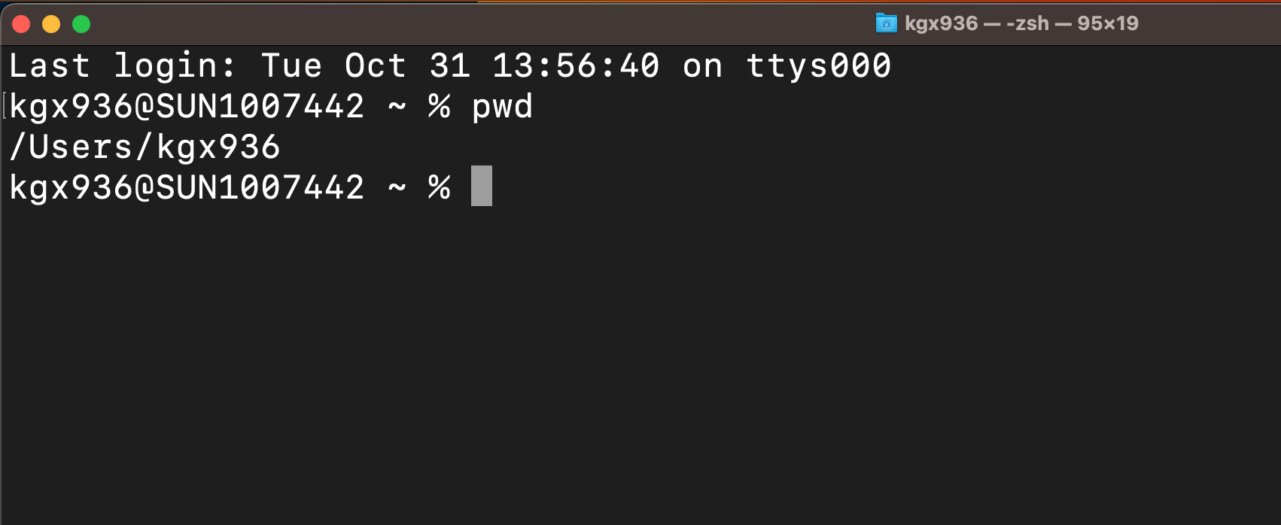
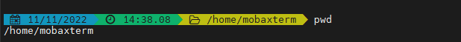
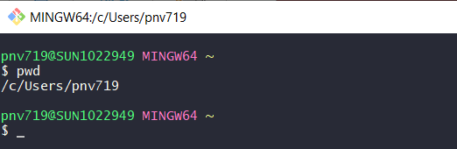
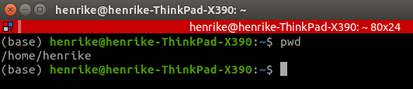
THE HOME DIRECTORY
What the home directory is called can differ between operating systems and computers.
All home directories are beautiful <3!
As a rule of thumb, the home directory is generally two steps from the root '/' and it is personal.
When there are several users on the same machine each has their own home directory.
Notes:
* Depending on your system the structure might be bit different from the illustration.

Slide 20
FULL PATHS
Full paths start at the root. They are unambiguous because they describe the entire 'journey' starting from the root.
Remember, ~ represents the path to your home directory.
/Users/[you]/Documents
and
~/Documents
Are the same place and the same path and are both full paths.
Any path starting with '/' or '~' is a full path.
/
Users
tmp
[you]
Data
Documents
Pictures
Courses
Projects

Slide 21
RELATIVE PATHS
A relative path is an address relative to the current wd.
If in ‘Documents’, I address the file ‘Commandline.pptx’ as:
Courses/Just-Bash-It/Commandline.pptx
[you]
1
Data
Documents
Pictures
Relative paths can include going up the directory tree:
../Pictures/summer2022/Bornholm
This notation does not make sense for full paths as they start from the root and go downwards.
Courses
Projects
summer2022
2
2
Just-Bash-It
Bornholm
1
Commandline.pptx

Slide 22
LISTING CONTENT
To list the contents of a directory:
$ ls
Example on the right will give you the Data, Documents and Pictures folders.
List directories you are NOT currently inside of by specifying the path to them:
$ ls /Users $ ls ~/Data
ls has many useful options (–l, -t and –h, -F).
/
Users
[you]
Data
Documents
Pictures
Notes:
We’ll talk about paths in a bit

Slide 23
CHANGING DIRECTORIES
From your wd, move into any subdirectory:
$ cd Documents
/
You can also move several directories down:
$ cd Documents/Courses
Users
tmp
[you]
To move ‘up' in the directory tree you use '../' . Each time you write this, you go one level up.
$ cd ../../tmp
Data
Documents
Pictures
Courses
Projects

Slide 24
CHANGING DIRECTORIES
/
cd without any arguments will always bring you to your home directory
$ cd
Users
tmp
cd with a dash will bring you to the last directory you were in:
$ cd -
[you]
Data
Documents
Pictures
Courses
Projects

Slide 25
COMMANDS
We interact with the computer by issuing commands to it. You have already tried some like ls, pwd.
Some commands stand by themselves like pwd, but often they have arguments and options/flags:
$ ls –lh ~/Documents/Courses
The command:
List contents
The options/flags:
Long format &
Human-readable size
The argument:
Path to the directory to work on
We put a space it means we are proceeding to new part of the command.
File and directory names cannot contain spaces, they will be misinterpreted!

Slide 26
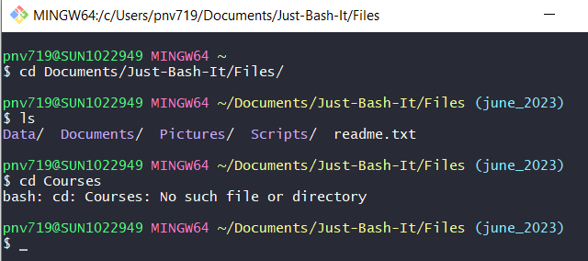
WHEN THINGS GO WRONG
Assuming I am in my home directory and I write:
$ cd Courses
What will happen?
/
Users
tmp
[you]
Data
Documents
Pictures
Courses
Projects

Slide 27
WHEN THINGS GO WRONG
1
Don’t panic!
2
Read the error message
3
Try to correct your error
4
If lost, google or read the help page

Slide 28
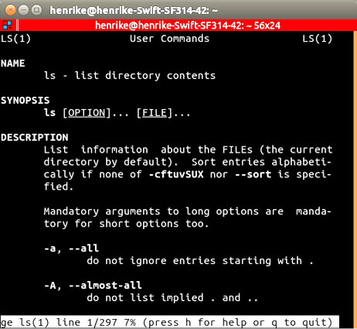
GETTING HELP
Many commands have a help page, i.e. a manual:
$ man ls
The man page includes:
    A description of what the command does
    Explanation for arguments
    Usage examples (the syntax of the command, what goes where)
man is not included in gitbash but you can try
--help or -h instead.
You can always search the web if all else fails!

Slide 29
CHEAT SHEET 1
WHERE & WHAT
pwd # print working dir
cd # go to home dir
cd [path] # change dir (remember path)
ls # list dir content
man [cmd] # get info about command
[cmd] --help # view the help for command
FILE/DIR BASICS

Slide 30
“
Let’s Bash It!
Open your terminal on your computer and do Exercise 1.
We’re here to help if you get stuck!

Slide 31
2. FILE OPERATIONS

Slide 32

MOVING FILES AND DIRS
Go into the ‘Documents' folder under the ‘Files’ of the github repo.
You can move files (directories) with mv:
$ mv pancakes.txt ../recipes
Documents
mv can also be used for renaming:
$ mv pancakes.txt fluffy_cakes.txt
bills
recipes
Do NOT move or remove your home directory or other system critical dirs. This may have unintended consequences.
pancakes.txt
pancakes.txt
fluffy_cakes.txt

Slide 33
COPY
Files can be copied with cp:
First argument is the file and the second argument is the destination
$ cp fluffy_cakes.txt new_recipe.txt
Documents
To copy a directory (and its contents!) use –r:
$ cp -r recipes recipies_copy
bills
recipes
recipes_copy
You must specify a destination when you copy.
The destination can be the name of the new file, or another directory:
$ cp fluffy_cakes.txt ../recipies_copy/
fluffy_cakes.txt
new_recipe.txt

Slide 34
REMOVE
To remove files and dirs, use rm
$ rm new_recipe.txt
Documents
Just like when copying, you need the -r flag when removing a directory:
$ rm -r recipes_copy
bills
recipes
recipes_copy
rm is permanent! You cannot recover a removed file and you will not be asked whether you are sure you want it gone.
fluffy_cakes.txt
new_recipe.txt

Slide 35
CREATING FILES AND DIRECTORIES
To create a new directory we use mkdir:
$ mkdir new_dir
Documents
The new directory will not have any content.
Many ways to create files, mostly as output from programs, but you can always create an empty with touch:
$ touch a_new_file.txt
bills
recipies
fluffy_cakes.txt
new_dir

Slide 36
OPERATING ON SEVERAL FILES
We can also interact with several at once!
This would take all files named something .txt and move them one directory up:
$ mv *.txt ../
The star ‘*’ is called a wildcard. It matches every character (letter, number, ect).
Documents
bills
recipes
buns
.txt
french_
toast
.txt
banana
_bread
.txt
buns.txt
french_toast.txt
banana_bread.txt

Slide 37
OPERATING ON SEVERAL FILES
Use the wildcard ‘*’ to restrict actions to certain files and directories.
By default ‘ls’ lists the entire directory.
If we only want to see files with names ending in .md we can specify that:
$ ls *.md
Just-Bash-It
Files
Exercises
.html
Exercises
.md
Readme
.md

Slide 38
CHEAT SHEET 2
WHERE & WHAT
FILE/DIR BASICS
pwd # print working dir
cd # go to home dir
cd [path] # change dir (remember path)
ls # list dir content
man [cmd] # get info about command
[cmd] --help # view the help for command
rm [name] # remove file
rm -r [name] # remove dir
cp [name] # copy a file/dir
mv [name] [path] # move file/dir
mkdir [name] # make dir
touch [name] # create file

Slide 39
“
Let’s Bash It!
Time for Exercise 2!

Slide 40
3. PROJECT
ORGANIZATION
& BACKUP

Slide 41

IS YOUR COMPUTER A LAUNDRY BASKET?
Why should I care about directory structure and file naming?
Not nice to not “work” in a mess.
If your computer crashes it is MUCH easier to recover work if files/directories are structured.
If you apply a command (bash, R, Python) to a group of files/directories, naming is important!
Large files should be stored smartly to save space (storage & memory).

Slide 42
DO’S and DON’TS
Consistent and Logical Directory Structure
Don’t Use Symbols or Spaces in File/Directory Names
Consistant & Non-
redundant File Naming
Don’t store multiple copies of file, instead point to it (path).
Version Control System
git/GitHub & Back-up
Don’t Store Large Data/Files on Your Local Computer
Clean and Update Your Computer Regularly
Don’t Store Sensitive Datasets on Your Computer

Slide 43
A SUGGESTION FOR STRUCTURE
LOCAL COMPUTER
HOME
USER
DRIVE
PROJECTS
Proj. Name
Results
Scripts
Data
Scratch
Docs
Tables
Figures
Raw
Generated
Literature
Drafts
43
43

Slide 44
STORAGE & BACKUP
BIG DATA & SENSITIVE DATA:
              Your own KU drives (S-drive)
              ERDA & SIF (KU data storage)
              Lab or department server
              Lab or department cloud solution
DOCX, EXCEL, POWERPOINT:
              Google Drive
              Dropbox
              KU drives
SCRIPTS:
              git/GitHub
              (KU drives)
LARGE DATASETS
SENSITIVE DATA
DOCUMENTS & GRAPHICS
SCRIPTS REPORTS

Slide 45


GIT & GITHUB
Git is a version control software, created by Linus Torvalds for the management of the Linux kernel.
Other clients exist.
https://git-scm.com
GitHub is a web-based hosting service for version control that uses git
Other services exist.
https://github.com
git & GitHub not the same

Slide 46
WHAT IS A VERSION CONTROL SYSTEM?
VERSION 3
VERSION 2
FILE
FILE
GIT
VERSION 1
GIT
VERSION 3
VERSION DATABASE
VERSION 3
VERSION 2
GITHUB
VERSION 2
VERSION 1
VERSION 1
VERSION DATABASE
VERSION DATABASE
YOUR COMPUTER
COLLABORATOR

Slide 47

GIT WORKS FROM THE COMMAND LINE
git clone [your repository]
Username: [your user]
Password: [your password]
Git is used from the command line to edit directories & files in a version controlled way
A git command always begins with git
git status (status of the repo)
git add (add new files or changes)
git commit -m (commit the changes)
git push (push the changes to GitHub)
Git enables a local computer to interact with a cloud service (GitHub) to back up your work
Sounds cool, yes!
Take our ‘Introduction to git & GitHub’ Workshop and learn how to git

Slide 48
A SUGGESTION FOR STRUCTURE
LOCAL COMPUTER
EXTERNAL BACKUP
HOME
KU DRIVE
USER
DRIVE
GITHUB
PROJECTS
SERVER
Proj. Name
Readme
Results
Scripts
Data
Scratch
Docs
Tables
Figures
Raw
Generated
Literature
Drafts
48

Slide 49
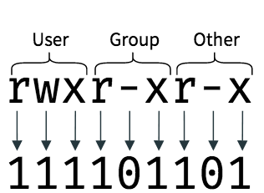
USERS, GROUPS & PERMISSIONS
Permission settings denote who can read, write (edit) and execute a file/dir
On linux-based systems (Mac, Ubuntu) you can use the chmod command to set permissions IF you are a system administrator (sys admin).
      Private computer : You are sys admin
      KU computer : You may be the system admin
      Shared KU drives : You are not sys admin
      HPCs, Servers & Clouds : You are not sys admin
chmod +rwx [filename]
chmod -wx [directoryname]
chmod u+rw [filename]
chmod g-w [filename]
chmod o-rw [filename]
On Windows there are alternatives to set permissions with powershell (you can google this if needed).
49
Notes:
Files & directories have permission settings which you can see with the ls -l command

Slide 50
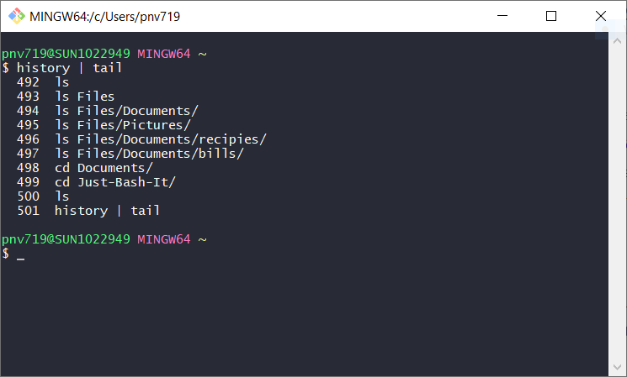
BACK TO THE PAST
“Those who don’t know history are doomed to retype their commands.”
history command brings up a list of previously used commands
The most recent command is last, the oldest command is first
Can use head/tail to only see the beginning/end
Pro tip:
Use the ‘grep’ command to search your history or bring up the interactive ‘reverse-i-search’ with ctrl+r.
50

Slide 51
CHEAT SHEET 3
WHERE & WHAT
FILE/DIR BASICS
pwd # print working dir
cd # go to home dir
cd [path] # change dir (remember path)
ls # list dir content
man [cmd] # get info about command
[cmd] --help # view the help for command
rm [name] # remove file or dir
cp [name] # copy a file/dir
mv [name] [path] # move file/dir
touch [name] # make a file
mkdir [name] # make a dir
SPECIAL CHARACTERS
SIZE & PERMISSION
* # select everything
/ # forward slash paths
\ # escape character (don’t use for now)
.. # one dir up/back
. # current dir
- # denotes a flag/argument
ls -lh * # all sizes
ls -lh [name] # file/dir size
du -hA # disk space
chmod +rwx [name] # add permission
chmod -rwx [name] # remove permission
chmod ugo+rw [name] # specify who, add permission

Slide 52
“
Exercise 3, you know the drill…

Slide 53
4. VIEWING AND EDITING FILES

Slide 54
VIEWING FILES
echo
Many roads lead to Rome… For viewing files we can use:
less [file]:
Prints N first lines of file. You can change the default N. Interactive viewing.
Exit with q
cat [file]:
(concatenation), prints all lines of file.
Interrupt with ctrl + c
head/tail [file]:
Prints n first / last lines of file. You can change the default n. Static viewing.
less
tail
head
cat
FILE CONTENT
54

Slide 55
VIEW - SUBSET & RENAME
head &
tail
head myfile.txt
tail -n 20 myfile.txt
less myfile.txt
cat myfile.txt
less &
cat
Patient | Age | Sex | Smoker | Grade
ID1 | 61 | Female | No | G2
ID2 | 58 | Female | Yes | G3
. | . | . | . | .
> = Redirect - Save output to new file.
More on this later.
echo
echo 'Hello, World!' > hello.txt

Slide 56
EDITING FILES
ano
Nano [file]:
Simple and easy to use
Limited functionality
Exit with Ctrl + x (Y + enter)
VIM or VI [file]:
Many functionalities, i.e. complex
Keyboard shortcuts
Exit with :q (:wq or :q!)
EMACS [file]:
Oldest editor
Keyboard shortcuts, Ctrl, Alt/Esc + [L]
Exit with Ctrl + x + Ctrl + c (Ctrl + s)
OTHER [file]:
There are many other editors …
IM
Q: What is an editor?
A: Software that allows you to edit a file
macs
OTHER

Slide 57


COMPRESSED FILES
.gz
Compresses a file with standard gzip (GNU zip) compression.
.tar
Combines all files within a directory in one, single archive file.
.tar.gz (.tgz)
gzip and tar together. Compresses multiple files and puts them into one, single file archive.
Fun fact: tar stands for tape archive

Slide 58
CHEAT SHEET 4
View Files
Ctrl + c # quit process
q # quit less command
:q (:w) # quit (and save) vim editor
Ctrl + x (Y + enter) # quit (and save) nano editor
less [file] # view file content
cat [file] # view file content (full)
head / tail -n 10 [file] # view n first/last lines
nano [file] # https://www.nano-editor.org/dist/latest/cheatsheet.html
vim | vi [file] # https://vim.rtorr.com/
Quit & Save
gzip [file] # Create compressed gzip file
gunzip [file] # Unpack compressed gzip file
gunzip -k [file] # Unpack but also keep compressed file
zip/unzip [file] # create/decompress .zip files
zless [file] # view compressed file w/o decompression
tar -czvf [file.tar.gz] [dir] # Create a compressed tar archive of [dir] at [file.tar.gz]
tar -xvf [file.tar.gz] # Unpack a compressed tar archive
tar -tf [file.tar.gz] # List files inside a compressed tar archive
Compressed Files

Slide 59
“
Refreshed from lunch we do Exercise 4!

Slide 60
5. DATA
WRANGLING 1

Slide 61
FROM FILE NAVIGATION TO MANIPULATION
FILES & DIRECTORIES:
      Move & Copy
      Make & Remove
      Open & Read
      Edit & Save
      Subset & Rename
      View & Change Permissions
NAVIGATE THE TERMINAL
&
FILE MANAGEMENT
FILES:
      Sort
      Count Lines & Entries
      Merge & Concatenate
      Find & Replace Patterns
      Cut & Paste
      Insert & Delete
FILE MANIPULATION, WRANGLING, SUMMATION
61

Slide 62
A LITTLE TERMINOLOGY
What arguments does the command take?
Argument: what to act on
Option/Flag: how to act
name ; age ; height
Tom ; 31 ; 183
Julie ; 35 ; 168
Fields = 3
Delimiter = ;
Regular expression (RegEx)= sequence of characters that specify a flexible search pattern
Argument option, flag
[ ] Input >
Output
Field &
Delimiter
String &
Quotes
Pattern &
RegEx
Command
What to do
Examples:
cd
touch
cp
less
Input = dir / file
[ ] = command -flag
> = from to (redirect)
Output = dir / file
Some arguments are strings, denoted with double “” or single quotes ‘’.

Slide 63
BASH COMMANDS
Select field of each line
Paste corresponding or
subsequent lines of files
cut
wc
Search, replace, extract, manipulate
awk is tool & a command
paste
Count lines & words
Search & Extract pattern in file
awk
sed
Find and replace,
insertion or deletion
grep
Sort a file/column
Number, character, mixed
Search for pattern in file &
directory name(s).
find
Sort
uniq
Report unique entries only
https://ss64.com/bash/

Slide 64

WC – NO…, NOT THAT ONE
Word count (wc) lets us know how many words, lines and bytes there are in a file.
$ wc patients.txt
1
2
3
4
5
6
We can also specify which count we want. For example only the lines:
$ wc –l patients.txt

Slide 65
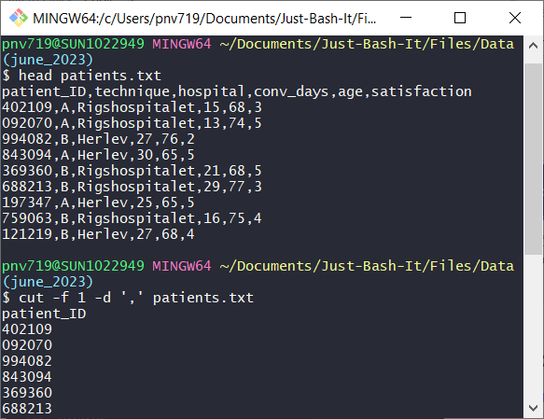

CUT – GETTING COLUMNS OUT
Cut slices a column out of a file. What a ‘column’ is, depends on the field separator:
$ cut –f 1 –d ',' patients.txt
We can also specify a range of columns:
$ cut –f 1-3 –d ',' patients.txt
The opposite of cut is paste, putting columns together.

Slide 66
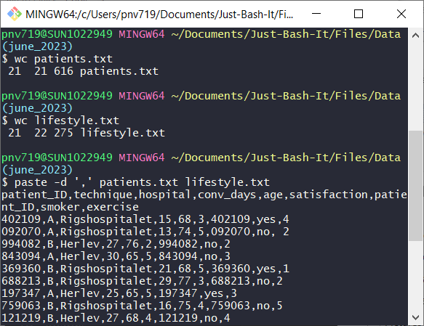
PASTE – GLUE THINGS TOGETHER
Paste two or more files together line by line. Default delimiter is space:
$ paste patients.txt lifestyle.txt
Specify another delimiter for pasting together files:
$ paste –d ',' patients.txt lifestyle.txt

Slide 67
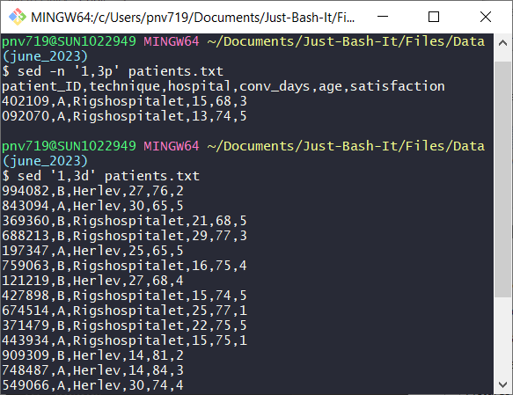
SED – THE STREAM EDITOR
Sed is a powerful tool used to manipulate files without the manual labor of a text editor.
A common use it to display only specific lines:
$ sed –n '1,3p' patients.txt
Or to delete them!
$ sed '1,3d' patients.txt
NB! We haven’t saved the output, it is just displayed.
One very powerful use of sed is to edit files with regular expressions
Notes:
d = delete
p = print
s = substitute
g= globally
SED is a powerful text stream editor. Can do insertion, deletion, search and replace(substitution).
SED command in unix supports regular expression which allows it perform complex pattern matching.

Slide 68
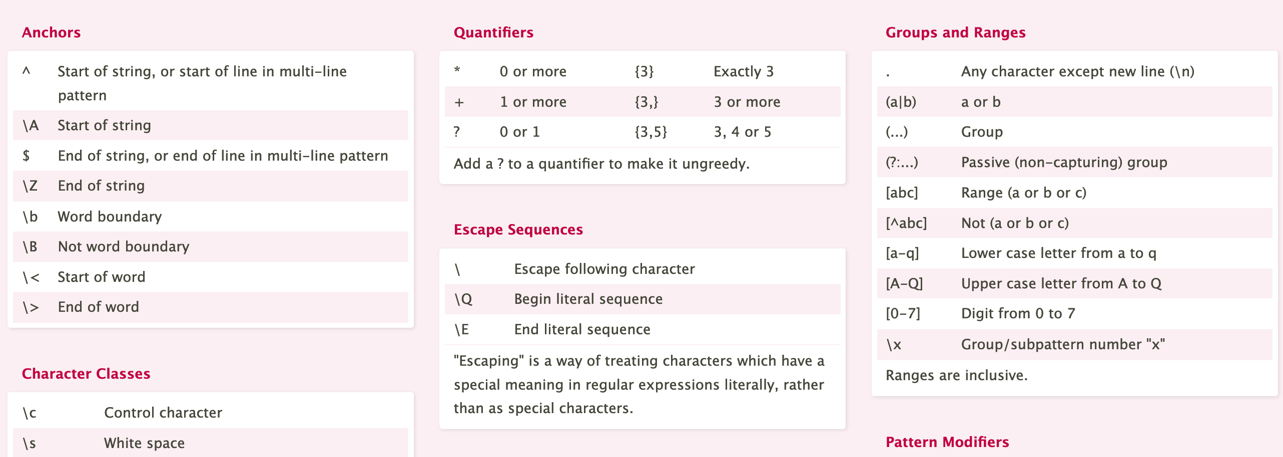
REGULAR EXPRESSIONS
Regular expression (RegEx) = sequence of characters that specify a flexible search pattern
https://cheatography.com/davechild/cheat-sheets/regular-expressions/
Regex Testers :
https://regexr.com/
https://regex101.com/

Slide 69
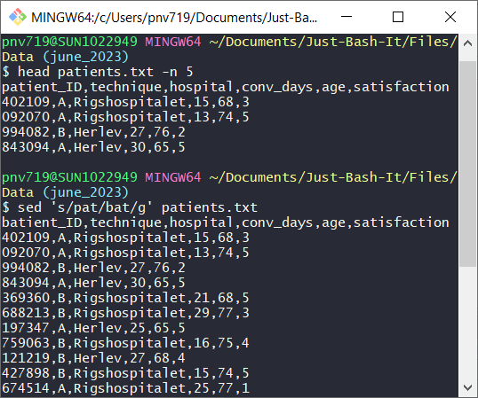
SED – THE STEAM EDITOR
Search and replace patterns with sed.
Changing ‘pat’ to ‘bat’:
$ sed 's/pat/bat/g' patients.txt
Using anchors we can be specific about the exact pattern we want to hit:
$ sed 's/^40/XX/g' patients.txt
You should be as specific as possible to avoid changing the wrong part.
You can find many examples here:
https://www.howtogeek.com/666395/how-to-use-the-sed-command-on-linux/

Slide 70
CHEAT SHEET 5
View Files
Compressed Files
less [file] # view file content
cat [file] # view file content (full)
head / tail -n 10 [file] # view n first/last lines
nano [file] # https://www.nano-editor.org/dist/latest/cheatsheet.html
vim [file] # https://vim.rtorr.com/
tar -[f] [file] # .tar files
gzip -[f] [file] # (de)compress (.tar).gz files
unzip -[f] [file] # decompress .zip files
zless -[f][file] # view .gz file w/o decompression
gunzip -[f] [file] # uncompress and keep original
others: zcat, zmore, gzcat
Manipulating Files
wc -[f][file] # Count lines, characters, bits
sort -[f][file] # Sort file (by field/column)
uniq -[f][file] # Return unique values
cut -[f][file]: # Extract field/column
paste -[f][files]: # Merge file lines
sed -[f]'command'[file] # Insertion, deletion, …
grep -[f]['pattern'][file] # Search for pattern
awk '{pattern}'[file] # Search, replace, extract, …
find -[f][path]['pattern'] # Search pattern in file name

Slide 71
“
Last exercise for today, Exercise 5 let’s go!

Slide 72



SEE YOU TOMORROW
HOW TO PICK AN OPERATING SYSTEM
Are you rich?
Yes,
And I love pretty (useless) things
No,
I work in science
Would you like a working computer?
Nah,
I’m good…
Yes,
And I want it to be overly complicated to use

Slide 73
6. DATA WRANGLING 2

Slide 74
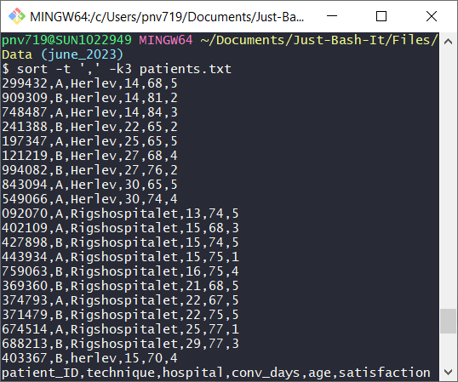
SORT - GUESS WHAT, IT SORTS!
Sort produces a sorted output.
We need to specify the field separator as the default separator in sort is a space.
The column to sort on is given by -k.
$ sort -t ',' –k3 patients.txt
Sort is alphanumeric, i.e. 10 is smaller than 9 since 1 < 9.
To switch to numeric sort, use the -n option:
$ sort –t ',' –n -k4 patients.txt
Notes:
The -n can also be placed directly with the -k4 to specify numeric sort on only this column. This matters when you sort by multiple columns.

Slide 75
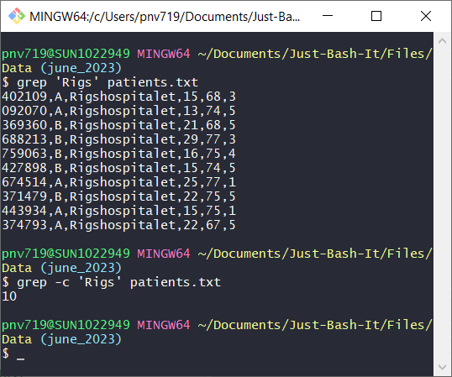
GREP – LOOKING FOR SOMETHING
The grep searches files for matches to a pattern and by default returns the entire line:
$ grep 'Rigs' patients.txt
Has option for counting the number of matching lines:
$ grep -c 'Rigs' patients.txt
grep understands regex (like sed) so you can make exact patterns. You may need the –P option to get grep to compile the expression in Perl style

Slide 76
REGULAR EXPRESSIONS
Regular expression (RegEx) = sequence of characters that specify a flexible search pattern
https://cheatography.com/davechild/cheat-sheets/regular-expressions/
Regex Testers :
https://regexr.com/
https://regex101.com/

Slide 77
AWK – THE FIX EVERYTHING OR DIE TRYING
awk is a ‘scripting’ language made of one-liners that is often used for file manipulation.
It can be used for selecting lines, cutting and pasting files together and even perform arithmetic on file content!
$ awk '/,5$/ {print}' patients.txt
$ awk -F ',' '{print $2,$3}' patients.txt
$ awk -F ',' '{if ($4 >15) {print}}' patients.txt
Why use awk instead a general-purpose programming language?
Because, you can directly invoke it on the command line without needing a script and input/output file handling. It’s convenient and effcient!
Notes:
Domain specific language as opposed to general purpose programming languages like R and python
Now it’s mostly a commandline file manipulation tool
OFS=Output Field Separator Variable

Slide 78
“
First exercise of today, Exercise 6 let’s go!

Slide 79
7. REDIRECTION & PIPES

Slide 80
A TALE OF THREE STREAMS
Data in unix always moves along one of three (data) streams:
      stdin (Standard In) – the stream along which input to commands moves
      stdout (Standard out) - the output of commands moves along this stream
      stderr (Standard error) – error messages move via this stream
Each of the streams can be redirected separately.
stdin
Keyboard
Program
YEAH!
YOU HAVE A BASH SHELL & TERMINAL ALREADY.
stderr
Program
Display
stdout

Slide 81
A TALE OF THREE STREAMS
ls *
stderr
stdout (standard out) - the output of commands moves along this stream
stderr (standard error) – error messages move via this stream
By default stdout points to the display, your terminal window
Program
Display
stdout
Your terminal
BashFigure1.jpeg
Commandline_Workshop.pptx
Data
Examples
Just_Bash_It_Exercises.md
Just_Bash_It_Exercises.Rmd
Just_Bash_It_Presentations.md
Just_Bash_It_Presentations.Rmd
LICENSE

Slide 82
REDIRECTING OUTPUT AND ERRORS
But stdout and stderr can be redirected to i.e. a file:
Redirect stdout:
$ ls > list_results.txt
Redirect stderr:
$ ls 2> err.txt
Redirect both into different files:
$ ls 2> err.txt > list_results.txt
Redirect both into the same file:
$ ls &> both
ls *
stderr
Program
'2>' will redirect
stderr.
'>'
Display
Your terminal
stdout
File

Slide 83
WHAT ABOUT STDIN?
stdin
Keyboard
Many commands require input data to work on, i.e. wc works on a file.
Usually input data comes from the keyboard, i.e. the name of the file to word count.
But it can also come directly from another program!
Program
YEAH!
YOU HAVE A BASH SHELL & TERMINAL ALREADY.
Program

Slide 84

CHAINING (PIPING) COMMANDS
file1.txt
$ wc *.txt > file_lengths
wc *
file2.txt
$ sort –n file_lengths
file3.txt
But now we have an intermediate file we don't need!
File1.txt 10
File2.txt 5
File3.txt 8
sort

Slide 85
CHAINING (PIPING) COMMANDS
file1.txt
Instead we can use a pipe :
wc *
file2.txt
$ wc *.txt | sort –n
pipe symbol = |
file3.txt
File1.txt 10
File2.txt 5
File3.txt 8
sort

Slide 86
CHAINING (PIPING) COMMANDS
wc *
sort -n
List of files and their number of words
Sorted list of files and their number of words
$ wc *.txt | sort -n
stdout
stdin
stdout
Pipe
Display
pipe symbol = |

Slide 87
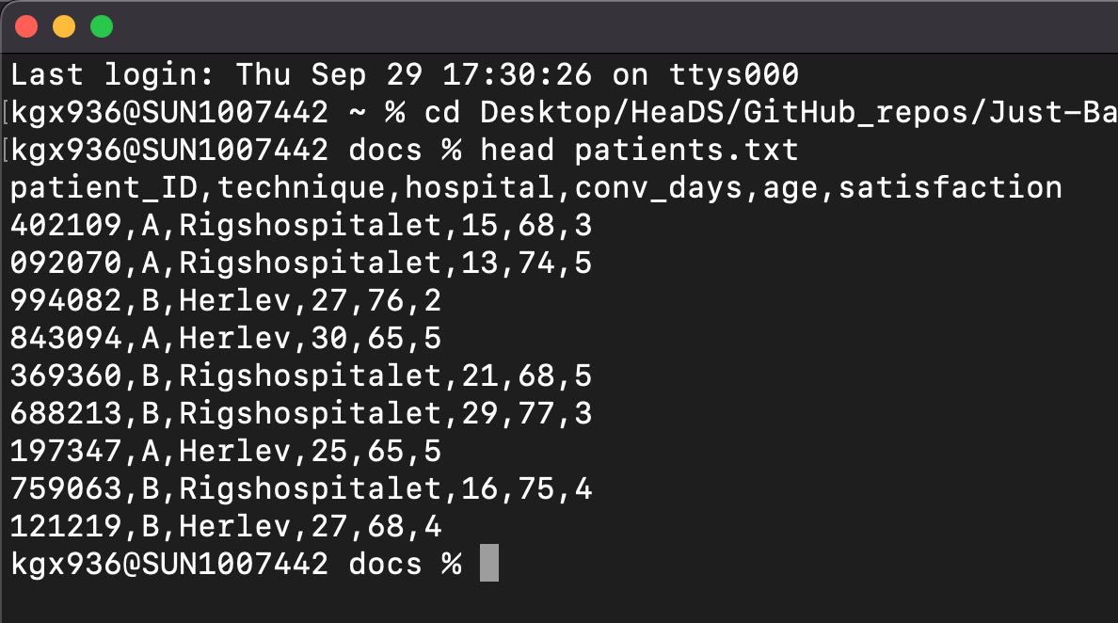
CHAINING (PIPING) COMMANDS
Some examples:
Take the second column and count how often each
element occurs:
$ cut -d ',' -f 2 patients.txt | sort | uniq -c
Get only lines containing 'Herlev' and sort by age:
$ grep 'Herlev' patients.txt | sort -t ',' -n -k5
If we don’t want the entire line we could also cut out the
age column before sorting:
$ grep 'Herlev' patients.txt | cut -d ',' -f 5 | sort -n

Slide 88
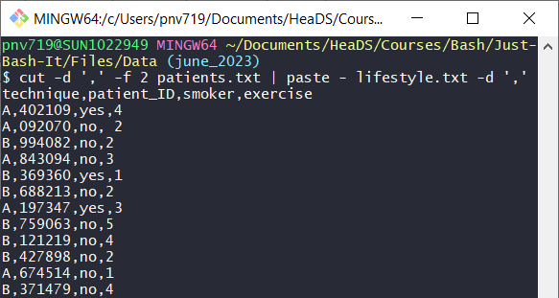
CHAINING (PIPING) COMMANDS
What about commands that require an input file because of their syntax?
Take the second column of patients and add it as a column to the lifestyle file:
$ cut -d ',' -f 2 patients.txt | paste ?? Lifestyle.txt
Solution: we replace the filename with '-'
$ cut -d ',' -f 2 patients.txt | paste - Lifestyle.txt
Technically '-' means 'read from stdin' which many commands do by default.

Slide 89
CHEAT SHEET 2
View Files
Compressed Files
less [file] # view file content
cat [file] # view file content (full)
head / tail -n 10 [file] # view n first/last lines
nano [file] # https://www.nano-editor.org/dist/latest/cheatsheet.html
vim [file] # https://vim.rtorr.com/
tar -[f] [file] # .tar files
gzip -[f] [file] # decompress (.tar).gz files
unzip -[f] [file] # decompress .zip files
zless -[f][file] # view .gz file w/o decompression
others: zcat, zmore, gzcat
Manipulating Files
wc -[f][file] # Count lines, characters, bits
sort -[f][file] # Sort file (by field/column)
uniq -[f][file] # Return unique values
cut -[f][file]: # Extract field/column
paste -[f][files]: # Merge file lines
sed -[f]'command'[file] # Insertion, deletion, …
grep -[f]['pattern'][file] # Search for pattern
awk '{pattern}'[file] # Search, replace, extract, …
find -[f][path]['pattern'] # Search pattern in file name

Slide 90
“
Now we are getting ‘fancy’ and chaining some commands, Exercise 7!

Slide 91
8. SHELL SCRIPTS & LOOPS

Slide 92
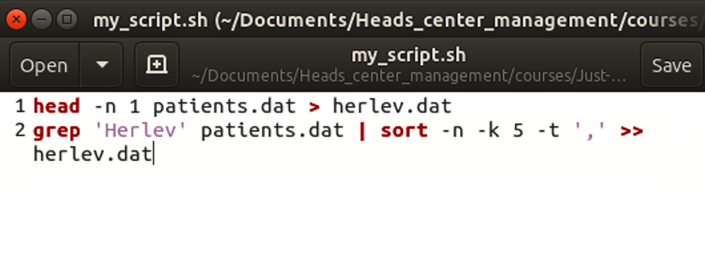
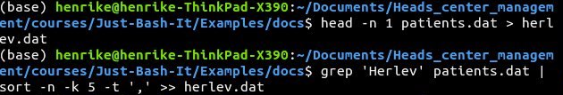
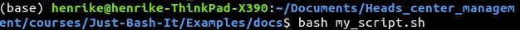
WRITING SCRIPTS
Example: I want to create a file with only Herlev patients but also the header.
Save your commands for later use!
Re-run anytime, always same result
Check your script if you don't remember the steps of an analysis
Back-up your scripts on i.e. github, KU drive, ect.

Slide 93
COMMAND LINE INPUT
A script is executed with bash (or simply sh).
Add arguments when you execute your script, these will be passed to it.Useful if you want to specify the file you want to run the script on.
The first argument after the script name will be $1 inside the script.
The second argument will be $2 and so on.
# Comment line script 1
# Usage: sort_this.sh [file_name]
sort -n $1
# Comment line script 2
# Usage: cut_col.sh [file_name] [column_number]
cut -d ',' -f $2 $1
$ bash sort_this.sh patients.txt
$ bash sort_this.sh my_textfile.txt
$ bash –x cut_col.sh patients.txt 3
Notes:
Use -x when you execute the script to show the commands and progression

Slide 94
LOOP IN BASH
#example of a for loop in bash
for file in *.txt
do
echo $file
wc $file
done
#the general syntax of a for loop is:
for [iterator] in [generator]
do
commands
done
Loops allow you to repeat the same action several times, once for each file for example.
Many bash commands can be run on several files, i.e.
$ wc *.txt
However, a loop is useful if you want to execute several commands for each file.

Slide 95
OTHER SCRIPTING
$ bash my_script.sh
This is a bash script. It's basically just a text file but we tell the computer to use bash to interpret it by calling it with 'bash my_script.sh'
We can also run scripts in other languages from the command line, i.e. python:
Scripts in the R language are called with the command ‘Rscript':
You need to have R and python installed on your computer in order to be able to call them on the command line.
$ python align_reads.py
$ Rscript deSEQ_cancer_Data.R

Slide 96
“
Let’s make a script, Exercise 8!

Slide 97
9. SOFTWARE INSTALLATION UPKEEP & MORE

Slide 98

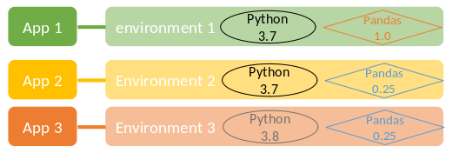

Conda is an open source package & environment management system.
Many softwares exist as conda packages, you can use conda to install them and their dependencies.
An environment is a specific combination of packages in a specific version.
IF you do not update the packages, running an analysis in the same environment will give the same result.
Be aware that some channels are not free to use for organizations
PROS
Comprehensive, many options
Environment management
Well documented
CONS
Can be overwhelming
Some channels are not free

Slide 99
conda, the software program for package and environment management
conda, the software program for package and environment management, is free to use by anyone.
So what is free?
conda, the software program for package and environment management
packages in conda-forge and Bioconda channels
What is paid?
The conda-compatible packages in the default channel and Anaconda Distribution (if > 200 people)

Slide 100

APT-GET
Homebrew - source software package management system, for OS X, Ubuntu (Linux).
NOT an environment manager, package manager only.
Creates separate directories for libs and configurations, adds symlinks to user/local.
Manage all installed softwares via the terminal, install, check, update, remove…
apt-get is a command-line tool for handling packages in Linux (Ubuntu, ‘Windows’).
APT = Advanced Packaging Tool
Upgrade and remove of packages along with their dependencies.
NOT an environment manager, package manager only.
PROS
CONS
PROS
CONS
Easy to use
Good documentation
Commands a few and logical
Packages, NOT environments
Works like any linux command
No installation (is default)
Robust to OS updates
Packages, NOT environments

Slide 101
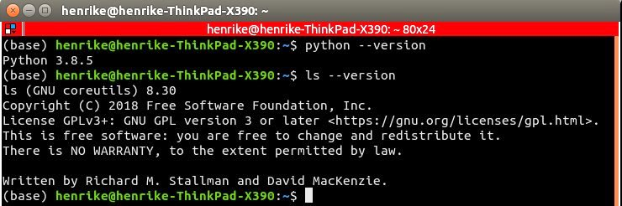
SOFTWARE VERSION
You can generally check the version of installed software with:
[name of software] --version

Slide 102


KEEPING THINGS UP TO DATE
Update your software with the same tool you used to install it:
Installed with conda: (update only the current environment)
$ conda update [software]
Installed with homebrew (updates a software):
With Windows App store:
Update via
Windows App store
$ brew upgrade [software]
Installed with apt-get:
$ apt-get update [software]

Slide 103
OPENING APPS & RUNNING SOFTWARE
Some (not all) files can be opened without specifying an app.
Many apps can be launched with open -a.
Some software are designed to run on both the command line and in a GUI, others are not.
1. open myfile.xlsx
2. open -a 'Google Chrome'
Monitor processes, find them, check memory & ‘kill’ them when necessary:
3. man open
$ top (htop)
$ ps aux (processes for all users)
$ ps aux | grep 'Google Chrome'
$ kill [pid]

Slide 104


CONFIGURATION FILES
UBUNTU - BASH SHELL
/etc
/User
Config files are used to specify parameters, options, settings and preferences applied to your OS or a software.
Types of config files; system-wide, program-specific, user-specific.
Extension will pertain to what is configured.
Rarely permission to change system-wide files. Software-specific files you can usually edit.
N.B config files are ‘hidden’, i.e. ls -la (or similar) to see them.
.profile
.profile
.bashrc
.bashrc
.bash_profile
.bash_profile
OS X - Z SHELL (BASH +)
/etc
/User
.zprofile
.zprofile
.zshrc
.zshrc
.zsh_profile
.zsh_profile
WINDOWS - GITNBASH
/User
.bash_profile
Notes:
https://landoflinux.com/linux_bash_configuration_files.html

Slide 105
CHEAT SHEET 3
Applications & Scripts
top # display running processes in ‘real time’
ps (aux) [file] # snapshot of processes
open –a [application] # open an application
kill [pid] # kill/stop a process using pid
bash [file.sh] or sh [file.sh # Execute/run bash script
[software] --version # check software version
brew install [software] # OS X install software on Mac
apt-get[software] # OS X install software on Ubuntu/Linux
conda # software and environment management system for Windows, Ubuntu & OS X

Slide 106
“
Last exercise, let’s install and run a software using the command line, Exercise 8!

Slide 107
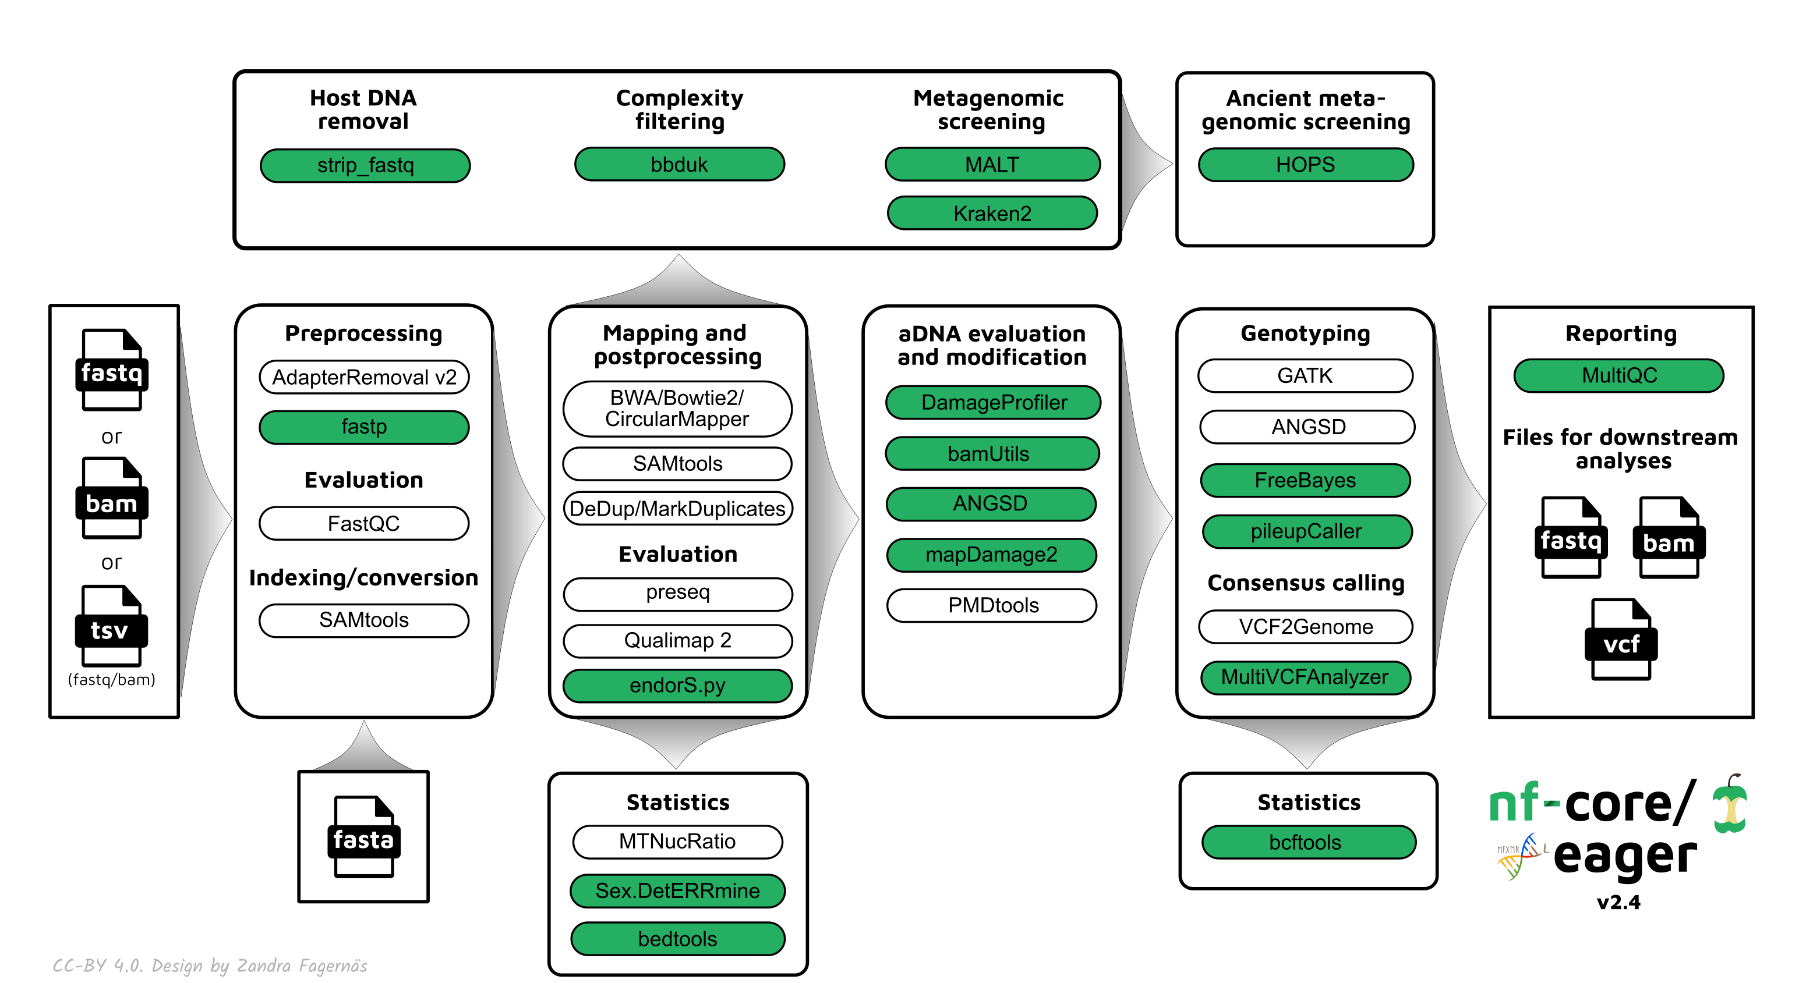


WORKFLOW LANGUAGES
Workflow languages:
            Tools to create reproducible pipelines – more robust bash scripts.
Workflow languages allow you to:
Control the flow of your pipeline
Restart at various defined points
Ensure previous commands have executed without error
Logging and reporting jobs
snakemake
https://snakemake.readthedocs.io/en/stable/
https://www.nextflow.io/

Slide 108

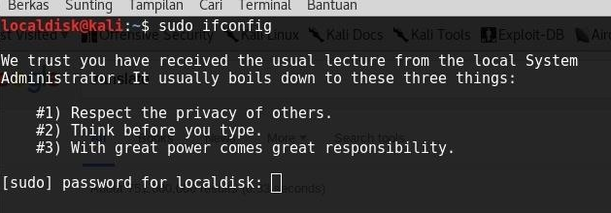
SUDO THE ULTIMATE POWER MOVE – JUST DON’T!
sudo == ‘super user do!’
This command forces an action and it is meant to be used only by system administrators.
The sudo command has ‘elevated privileges’
Using this command usually requires a confirm in terms of typing a system/computer password.
Sudo rights are required to alter root administrative system files, i.e. configuration files.
You may get reported to the admin!

Slide 109
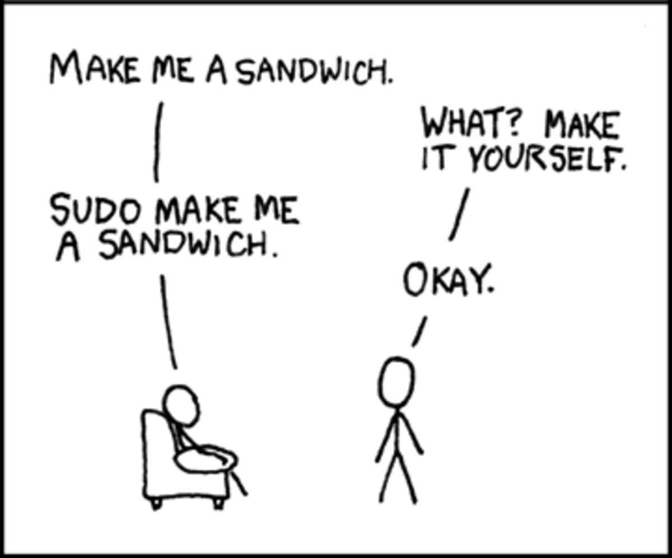
THANK YOU FOR TODAY

