Slide 1
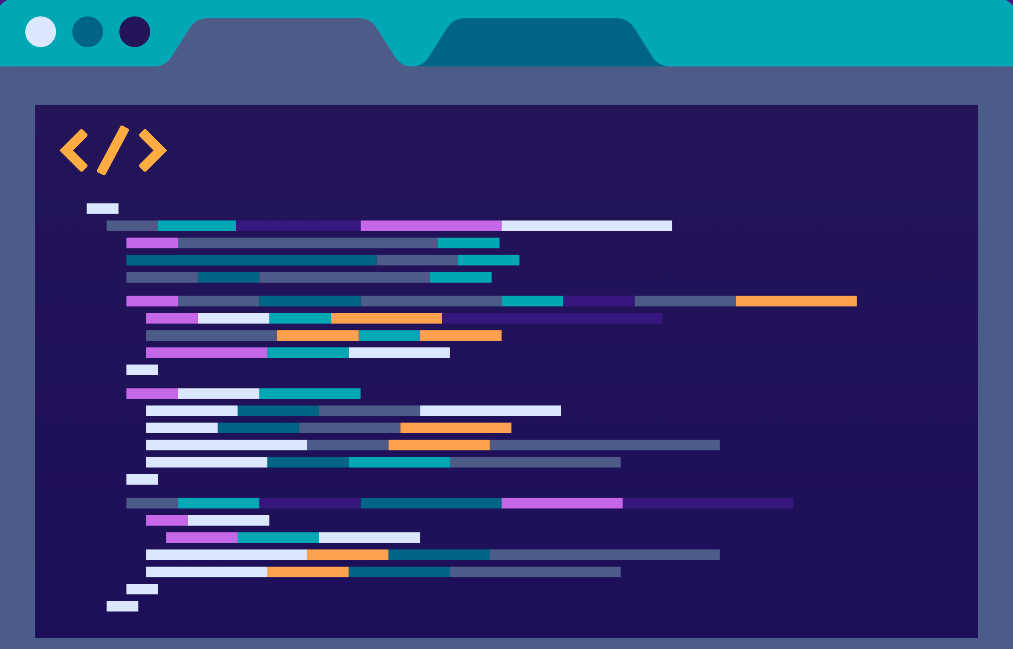

JUST BASH IT!

Slide 2




CENTER FOR HEALTH DATA SCIENCE (HEADS)
Data Lab Supports Researchers at the Faculty
Consultation & Commission:
Data science and bioinformatics analyses
Teaching: Courses & Workshops, Seminars.
Henrike Zschach
Thilde Terkelsen
Diana Andrejeva
COPENHAGEN UNIVERSITY LIBRARY (KUB)
XXXXXX XXXXXX
XXXXXX XXXXXX
XXXXXX XXXXXX

Slide 3
JUST BASH IT!
PROGRAM
-
COURSE MATERIALS:
https://github.com/Center-for-Health-Data-Science/Just-Bash-It

Slide 4
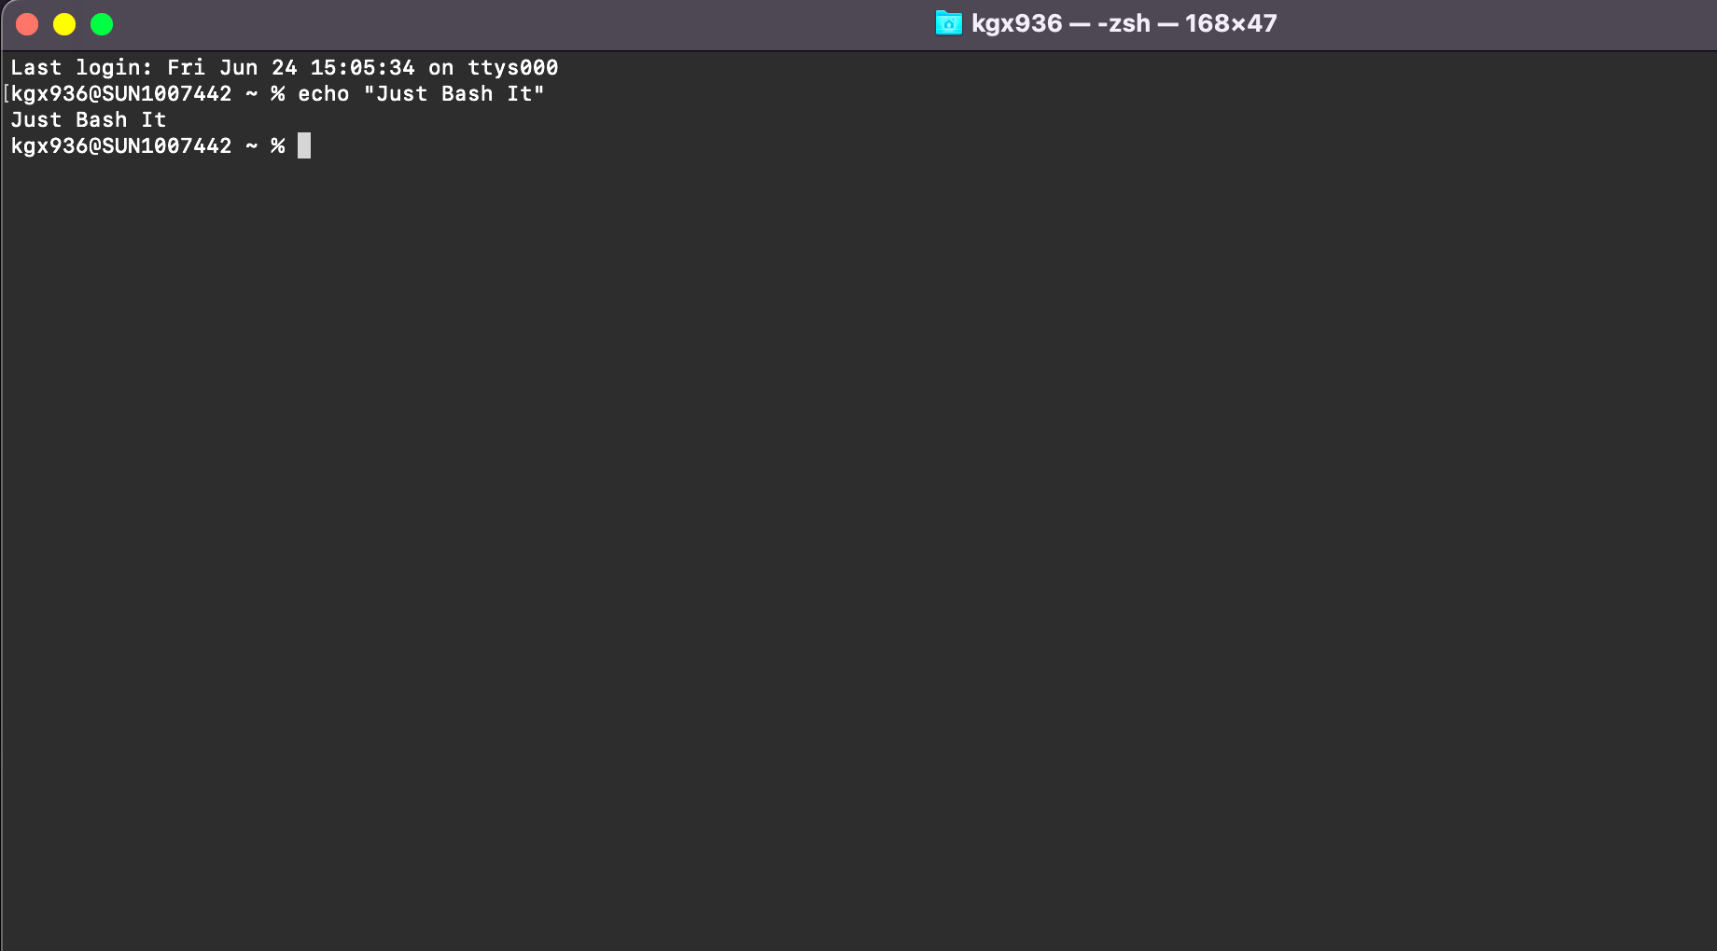
“
“What is a shell, a terminal, a command line, and what is bash?”
“How do these concepts connected to my computer?”

Slide 5
Terminology
COMPUTER (Hardware)
BASH SHELL -
COMMAND INTEPRETER
OPERATING SYSTEM (GUI)
$_
TERMINAL -
WRAPPER FOR SHELL
FILES SOFWARE
COMMANDS
You open the terminal on your computer
You type bash commands
Commands are interpreted and feed to the OS
>
pwd
Notes:
Operating system may use a command-line interface (CLI) or graphical user interface (GUI).
Unix & Linux operating systems are CLI.
Windows, Mac OSX, Ubuntu, etc. are GUI.
Bash is a shell & command-line interpreter which interacts with the operating system on a computer.
Bash is may be used though a wrapper program which provides a text window, the terminal, where the user types commands which in terms cause actions on a computer.
Accesses runs softwares installed
File viewing & manipulation
The Bash shell is the default shell for the linux & unix operating systems. This is why you often hear these mentioned together, however most operating systems (also those with GUIs), contain a shell, where bash is the most popular.
Default on OSX and Ubuntu
Windows has a native windows shell as default, but a bash shell may easily be installed.

Slide 6
OTHER THINGS WE NEED
TO SAY ABOUT TERMINOLOGY??
YEAH!
YOU HAVE A BASH SHELL & TERMINAL ALREADY.

Slide 7
Wind
Flexible and works on any system
Automatised and Reproducible
SELL IT TO ME!
Benefits of bash & command line:
Do a lot with minimum effort on any system.
Reproducible, automated and parallelize your analysis.
Fast processes, less computationally intensive, no GUI.
Power to handle big data and heavy computations.
Handling Big Datasets
Not Resource Intensive
and Fast
HPC & Cloud Compute Power

Slide 8
A COUPLE OF EXAMPLES
1
2
3
REGISTRY DATA
SEQUENCING DATA
DATABASES
Drug adverse effects and mortality:
Person sensitive
Huge files, many columns
Different formats
Single Cell RNA from Cystic Fibrosis:
Paired-end sequencing
300 patients
Two fastq files per patient
Drug Databases - molecular structure & interaction:
Multiple large databases
Different formats
Maybe not downloadable

Slide 9
HOW DO I GET A BASH SHELL?
YEAH!
YOU HAVE A BASH SHELL & TERMINAL ALREADY.
YOU NEED TO INSTALL A BASH SHELL/TERMINAL:
MobaXterm: https://mobaxterm.mobatek.net/download.html
Cmder: https://cmder.net/
GOW (Cygwin): https://github.com/bmatzelle/gow
PuTTY: https://www.putty.org/
OS X or UBUNTU
WINDOWS
In this course Windows users will be working on MobaXterm.
You should have installed this shell via. instructions in the introduction email.

Slide 10
WHAT WILL WE LEARN TODAY?
STORAGE,
BACKUP & MORE…
SCRIPTS &
AUTOMATIZATION
MORE BASH
COMMANDS
ORGANIZATION
& STRUCTURE
The BASICS
OF BASH
Version Control
Local vs remove
Conda & homebrew
Pipe, stdin, stdout
Loops & Scripts
Pipelines
Write files
Manipulate files
Search, cut, paste
Set up directories
Paths & Permission
Utility manager
The terminal
Navigation w. bash
Read, copy, move
1
2
3
4
5

Slide 11
NAVIGATING
FILES & DIRECTORIES

Slide 12
HENRIKE
YEAH!
YOU HAVE A BASH SHELL & TERMINAL ALREADY.

Slide 13
PROJECT
ORGANIZATION

Slide 14
THILDE
YEAH!
YOU HAVE A BASH SHELL & TERMINAL ALREADY.

