Slide 1


JUST BASH IT!

Slide 2



CENTER FOR HEALTH DATA SCIENCE (HEADS)
Data Lab Supports Researchers at the Faculty
Consultation & Commission:
Data science and bioinformatics analyses
Teaching: Courses & Workshops, Seminars.
Henrike Zschach
Thilde Terkelsen
XXXXXX XXXXXX
COPENHAGEN UNIVERSITY LIBRARY (KUB)
XXXXXX XXXXXX
XXXXXX XXXXXX
XXXXXX XXXXXX

Slide 3
JUST BASH IT!
PROGRAM
-
COURSE MATERIALS:
https://github.com/Center-for-Health-Data-Science/Just-Bash-It

Slide 4
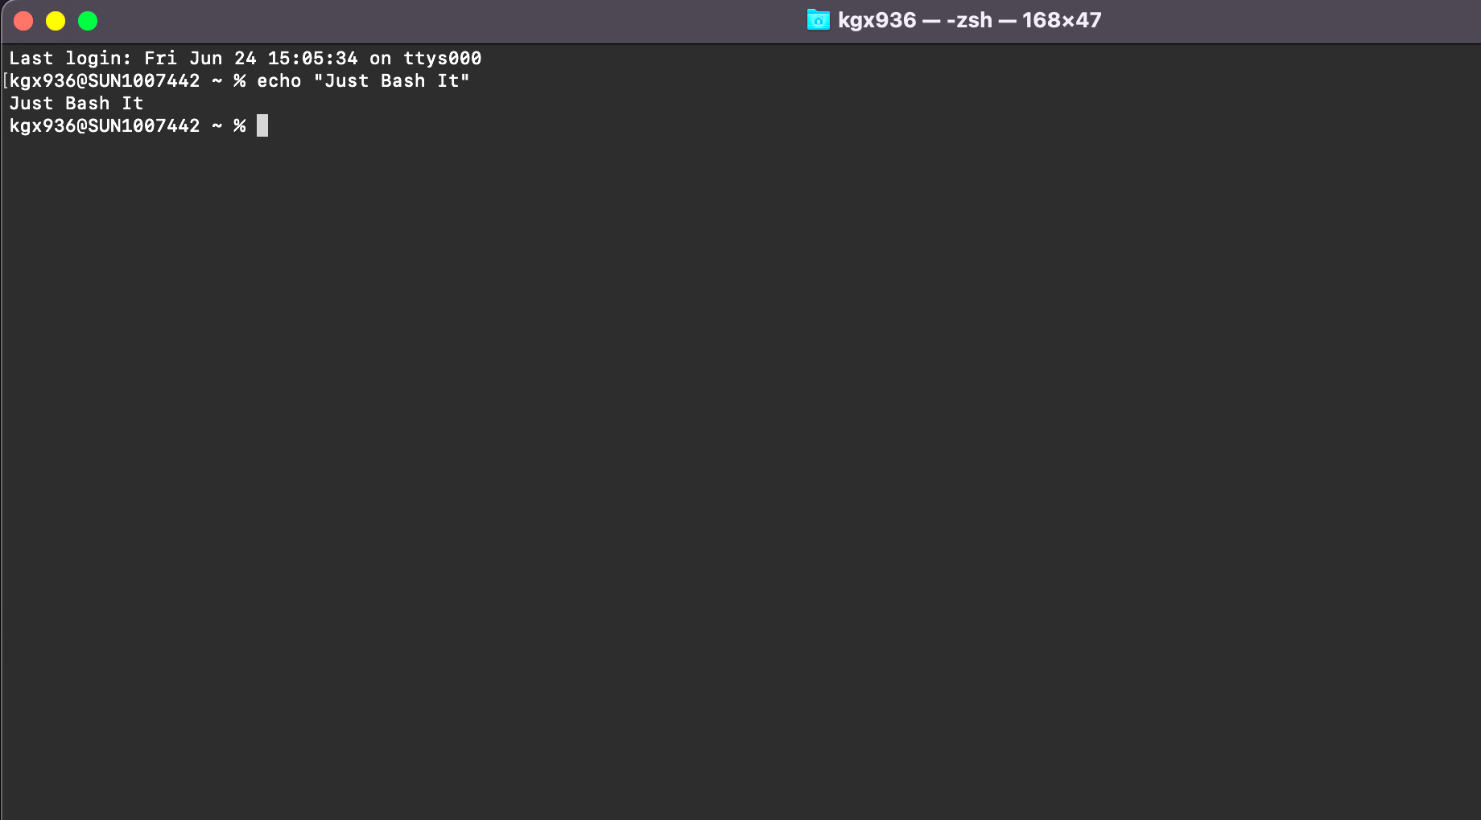
“
“What is a shell, a terminal, a command-line, and what is bash?”
“How do these concepts connected to my computer?”

Slide 5
TERMINOLOGY
COMPUTER (Hardware)
BASH SHELL -
COMMAND INTEPRETER
OPERATING SYSTEM (GUI)
$_
TERMINAL -
WRAPPER FOR SHELL
FILES SOFWARE
You open the terminal on your computer
You type bash commands
Commands are interpreted and feed to the OS
>
Notes:
Operating system may use a command-line interface (CLI) or graphical user interface (GUI).
Unix & Linux operating systems are CLI.
Windows, Mac OSX, Ubuntu, etc. are GUI.
Bash is a shell & command-line interpreter which interacts with the operating system on a computer.
Bash is may be used though a wrapper program which provides a text window, the terminal, where the user types commands which in terms cause actions on a computer.
Accesses runs softwares installed
File viewing & manipulation
The Bash shell is the default shell for the linux & unix operating systems. This is why you often hear these mentioned together, however most operating systems (also those with GUIs), contain a shell, where bash is the most popular.
Default on OSX and Ubuntu
Windows has a native windows shell as default, but a bash shell may easily be installed.

Slide 6
Wind
Flexible and works on any system
Automatised and Reproducible
SELL IT TO ME!
Benefits of bash & command line:
Do a lot with minimum effort on any system.
Reproducible, automated and parallelize your analysis.
Fast processes, less computationally intensive, no GUI.
Power to handle big data and heavy computations.
Handling Big Datasets
Not Resource Intensive
and Fast
HPC & Cloud Compute Power

Slide 7
A COUPLE OF EXAMPLES
1
2
3
REGISTRY DATA
SEQUENCING DATA
DATABASES
Drug adverse effects and mortality:
Person sensitive
Huge files, many columns
Different formats
Single Cell RNA from Cystic Fibrosis:
Paired-end sequencing
300 patients
Two fastq files per patient
Drug Databases - molecular structure & interaction:
Multiple large databases
Different formats
Maybe not downloadable

Slide 8
HOW DO I GET A BASH SHELL?
YEAH!
YOU HAVE A BASH SHELL & TERMINAL ALREADY.
Search for terminal on your laptop and open it.
YOU NEED TO INSTALL A BASH SHELL/TERMINAL:
MobaXterm: https://mobaxterm.mobatek.net/download.html
Cmder: https://cmder.net/
GOW (Cygwin): https://github.com/bmatzelle/gow
PuTTY: https://www.putty.org/
OS X or UBUNTU
WINDOWS
In this course Windows users will be working on MobaXterm.
You should have installed this shell via. instructions in the introduction email.

Slide 9
WHAT WILL I LEARN TODAY?
STORAGE,
BACKUP & MORE…
SCRIPTS &
AUTOMATIZATION
MORE BASH
COMMANDS
ORGANIZATION
& STRUCTURE
The BASICS
OF BASH
Version Control
Local vs remove
Conda & homebrew
Pipe, stdin, stdout
Loops & Scripts
Pipelines
Write files
Manipulate files
Search, cut, paste
Set up directories
Paths & Permission
Utility manager
The terminal
Navigation w. bash
Read, copy, move
1
2
3
4
5

Slide 10
NAVIGATING
FILES & DIRECTORIES

Slide 11
HENRIKE

Slide 12
PROJECT
ORGANIZATION
& BACKUP

Slide 13

IS YOUR COMPUTER A LAUNDRY BASKET?
Why should I care about directory structure and file naming?
Not nice to not “work” in a mess.
If your computer crashes it is MUCH easier to recover work if files/directories are structured.
If you apply a command (bash, R, Python) to a group of files/directories, naming is important!
Large files should be stored smartly to save space.

Slide 14
DO’S and DON’TS
Consistent and Logical Directory Structure and Naming
Don’t Use Symbols or Spaces in File/Directory Names
Consistant & Non-
redundant File Naming
Don’t store multiple copies of file, instead point to it (path).
Version Control System
git/GitHub & Back-up
Don’t Store Large Data/Files on Your Local Computer
Clean and Update Your Computer Regularly
Don’t Store Sensitive Datasets on Your Computer

Slide 15
A SUGGESTION FOR STRUCTURE
HOME
USER
DRIVE
PROJECTS
NAME
RESULTS
SCRIPTS
DATA
SCRATCH
DOCX
TABLES
FIGURES
RAW
GENERATED
LITERATURE
DRAFTS

Slide 16
BACKUP
BIG DATA & SENSITIVE DATA:
Your own KU drives (S-drive)
ERDA & SIF (KU data storage)
Lab or department server
Lab or department cloud solution
SCRIPTS, MARKDOWNS:
git/GitHub
(KU drives)
DOCX, EXCEL, POWERPOINT:
Google Drive
Dropbox
(KU drives)
LARGE DATASETS
SENSITIVE DATA
DOCUMENTS & GRAPHICS
SCRIPTS REPORTS

Slide 17


GIT & GITHUB
Git is a version control software, created by Linus Torvalds for the management of the Linux kernel.
Other clients exist.
https://git-scm.com
GitHub is a web-based hosting service for version control that uses git
Other services exist.
https://github.com
git & GItHub not the same

Slide 18
WHAT IS A VERSION CONTROL SYSTEM?
VERSION 3
VERSION 2
FILE
FILE
GIT
VERSION 1
GIT
VERSION 3
VERSION DATABASE
VERSION 3
VERSION 2
GITHUB
VERSION 2
VERSION 1
VERSION 1
VERSION DATABASE
VERSION DATABASE
YOUR COMPUTER
COLLABORATOR

Slide 19

GIT WORKS FROM THE COMMAND LINE
git clone [your repository]
Username: [your user]
Password: [your password]
Git is used from the command line to edit directories & files in a version controlled way
A git command always begins with git
git status (status of the repo)
git add (add new files or changes)
git commit -m (commit the changes)
git push (push the changes to GitHub)
Git enables a local computer to interact with a cloud service (GitHub) to back up your work
Sounds cool, yes!
Take our ‘Introduction to git & GitHub’ Workshop and learn how to git

Slide 20
A SUGGESTION FOR STRUCTURE
LOCAL COMPUTER
EXTERNAL BACKUP
HOME
CLOUD
USER
DRIVE
GITHUB
PROJECTS
DRIVE
NAME
README
RESULTS
SCRIPTS
DATA
SCRATCH
DOCX
TABLES
FIGURES
RAW
GENERATED
LITERATURE
DRAFTS

Slide 21
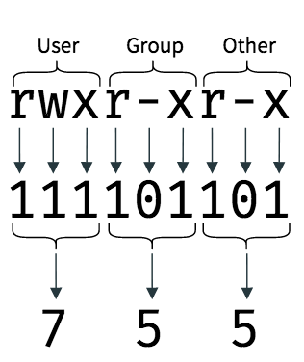
USERS, GROUPS & PERMISSIONS
Files & directories have permission settings
Permissions denote who can read, write (edit) and execute a file/dir
Permissions can be changed IF your are a system administrator (sys admin).
Private computer : You are sys admin
KU computer : You may be the system admin
Shared KU drives : You are not sys admin
HPCs, Servers & Clouds : You are not sys admin
chmod +rwx [filename]
chmod -wx [directoryname]

Slide 22
CHEAT SHEET 1
WHERE & WHAT
touch [file] # make a file
mkdir [file] # make a dir
rm (-r) [file] # remove a file or dir
cp [file] # copy a file/dir
mv [file] [path] # move file/dir
FILE/DIR BASICS
pwd # print working dir
cd [path] # change dir (remember path)
ls # list dir content
man [command] # get info about command
SPECIAL CHARACTERS
SIZE & PERMISSION
* # select everything
/ # forward slash paths
\ # escape character (don’t use for now)
.. # one dir up/back
. # current dir
- # denotes a flag/argument
ls -lh * # all sizes
ls -lh [file/dir] # file/dir size
du -sh # total size
chmod +rwx [file/dir] # add a permission
chmod -rwx [file/dir] # remove a permission

Slide 23
WORKING WITH FILES AND DIRECTORIES

Slide 24
VIEWING FILES
Many roads lead to Rome… For viewing files we can use:
less [file]:
Prints N first lines of file. You can change the default N. Interactive viewing.
Exit with q
cat [file]:
(concatenation), prints all lines of file. Interactive viewing.
Exit with ctrl + c
head/tail [file]:
Prints N first lines of file. You can change the default N. Static viewing.
less
cat
tail
head
FILE CONTENT

Slide 25
EDITING FILES
ano
Nano [file]:
Simple and easy to use
Limited functionality
Exit with Ctrl + x (Y + enter)
VIM [file]:
Many functionalities, i.e. complex
Keyboard shortcuts
Exit with :q (:w or :q!)
EMACS [file]:
Oldest editor
Keyboard shortcuts, Ctrl, Alt/Esc + [L]
Exit with Ctrl + x (Ctrl + s)
OTHER [file]:
There are many other editors …
IM
Q: What is an editor?
A: Software that allows you to edit a file
macs
OTHER

Slide 26

COMPRESSED FILES
.GZ
EXPAND
Standard gzip (GNU zip) compression.
May contain multiple files & directories
gunzip -k [file.gz]
gzip -dk [file.gz]
tar -xvf [file.tar.gz]
gzcat [file.gz]
.TAR
An archive of multiple files put together inside a single file.
.TAR.GZ
A compressed archive of multiple files put together inside a single file.

Slide 27
COMMANDS REDIRECTION & PIPES

Slide 28
HENRIKE

Slide 29
CHEAT SHEET 2
VIEW FILES
EDIT, COMPRESS & EXPAND
nano [file] # editor
vim [file] # editor
emacs [file] # editor
gzip [-o][file] # compress/expand .gz
gunzip [-o][file] # expand .gz
tar [-o][file] # compress/expand & tar.gz
less [file] # view head of file (interactive)
cat [file] # view full file (interactive)
head -n [file] # view head of file (static)
gzcat [file] # view .gz file (interactive)

Slide 30
MORE BASH COMMANDS

Slide 31
cut [-o] [file]
Cuts field and section of a file
WORKING WITH FILES -
USEFUL COMMANDS
AWK
CUT
awk ‘{print $}’ [file]
Scripting language: split, match & print field
FIND
SED
find [path] [-o] [p]
Match a regex or pattern of a filename in a dir
sed [-o] [x]
Versatile command: replace, delete, append
GREP
COUNT
SORT
wc [-o] [file]
Count lines, words, characters or bytes
(x)grep [-o] [p] [file]
Multiple versions:
Match a regex or pattern in lines of a file
sort [-o] [file]
Sort a file on field, line or record

Slide 32
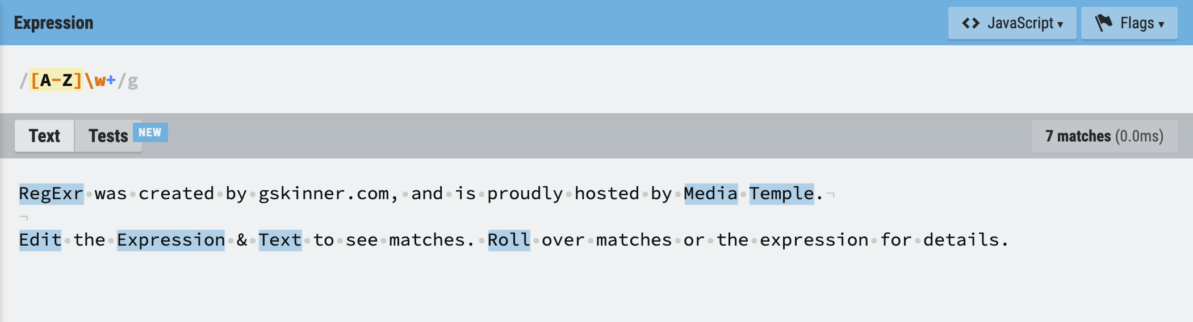
REGULAR EXPRESSION (REGEX)
A regex is a combination of characters which match a pattern in a text.
Mostly consistent across different programming languages with small variations.
Match for example:
Numbers or delimiters in a text (Peter - Address 134B Jubilee Road,
Words with a specific substring (cellRanger, single-cell, extracellular)
Capital letter words:

Slide 33
SHELL SCRIPTS

Slide 34
HENRIKE
YEAH!
YOU HAVE A BASH SHELL & TERMINAL ALREADY.

Slide 35
LOOPS & WORKFLOW LANGUAGE

Slide 36
HENRIKE
YEAH!
YOU HAVE A BASH SHELL & TERMINAL ALREADY.

Slide 37
SOFTWARE INSTALLATION UPKEEP & MORE

Slide 38
BOTH
YEAH!
YOU HAVE A BASH SHELL & TERMINAL ALREADY.

