Slide 1


Get started with Python
Local installation

Slide 2
Basic UNIX/OS X and DOS commands
UNIX/OS X | DOS | Description
cd | cd | On Windows, prints the current directory. On Unix returns the user to his home directory.
cd dirname | cd dirname | Change directory. Can also give path (/path/to/folder).
ls | dir | List contents of current directory
pwd | cd | Tells you where you currently are (full path).
mkdir dirname | mkdir dirname | Make a new directory.
cp filename1 filename2 | copy filename1 filename2 | Copies filename1 to filename2 (filename2 can be replaced with whatever name you want to give the new file).
rm filename | del filename | Removes a file.
rm -r | deltree | Recursively deletes entire directory tree. Be very careful if using this!
more | more | Shows the first part of a file, just as much as will fit on one screen. Just hit the space bar to see more or q to quit. You can use /pattern to search for a pattern.
echo $PATH | echo %Path% set Path | Print the value of the environment variable (Path).

Slide 3
Setting up GitHub account
Create a GitHub account
https://github.com/join?ref_cta=Sign+up&ref_loc=header+logged+out&ref_page=%2F&source=header-home
Install Git locally
https://www.atlassian.com/git/tutorials/install-git
MacOS: ”Git for Mac Installer”
Windows: ” Git for Windows stand-alone installer”
GitHub Desktop: https://desktop.github.com/
Cloning a repository
$ git clone https://github.com/account_name/repository_name.git

Slide 4
Install Python
Python 3.11: https://www.python.org/
Anaconda:
https://docs.anaconda.com/anaconda/install/
https://docs.anaconda.com/navigator/tutorials/
MacOS
Windows
$ python --version
$ which python
> python --version
> where python
Notes:
C:\Users\your_user\AppData\Local\Continuum\anaconda3\python.exe
On Windows, I recommend installing and using the Anaconda distribution of Python. To download - https://www.anaconda.com/products/individual#Downloads - and follow the instructions from https://docs.anaconda.com/anaconda/install/windows/#
https://docs.anaconda.com/anaconda/user-guide/faq/#anaconda-faq-35

Slide 5
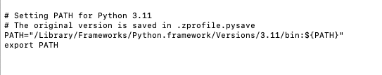
What is ”.zshrc” and how to use it
MacOS
Open the bash file (zshrc or zprofile)
$ vi ~/.zprofile
$ which python
Make the alias available in the session
$ source ~/.bash_profile
Notes:
PATH is an environment variable specifying a set of directories where executable programs are located.

Slide 6
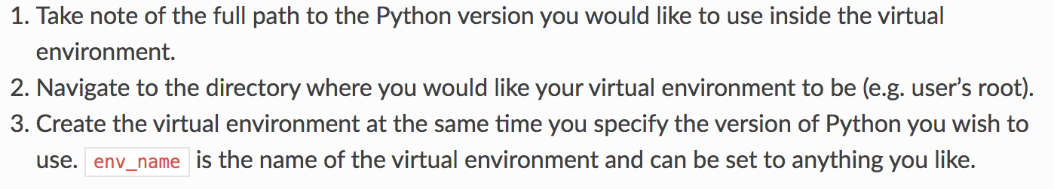
Creating a virtual environment
MacOS
Install virtualenv
Create a new virtual environment
$ python3.11 -m pip install virtualenv
$ virtualenv -p /path/to/python env_name
$ source path/to/env_name/bin/activate
$ deactivate

Slide 7
Creating a virtual environment
Windows
Create a new virtual environment using Conda installation
> conda create -n env_name python=3.11
> conda activate env_name
> conda deactivate

Slide 8
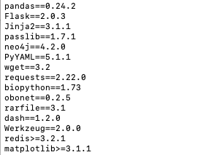
Install python packages
MacOS
$ pip3 install pandas
Or
$ pip3 install --ignore-installed -r requirements.txt
Windows
> conda install pandas
requirements.txt
Or
> conda install --file requirements.txt

Slide 9
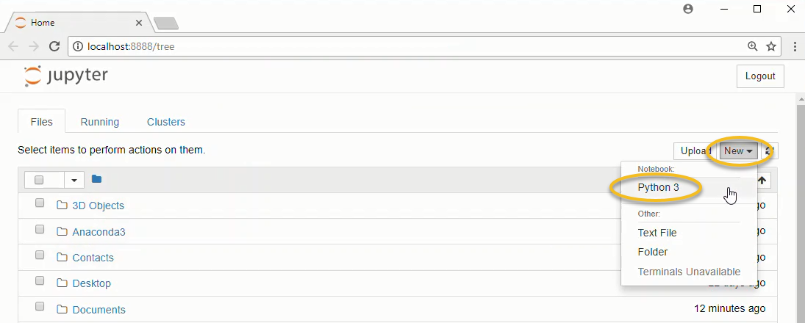
Start using jupyter notebooks
MacOS
$ pip3 install jupyter
$ jupyter-notebook

Slide 10
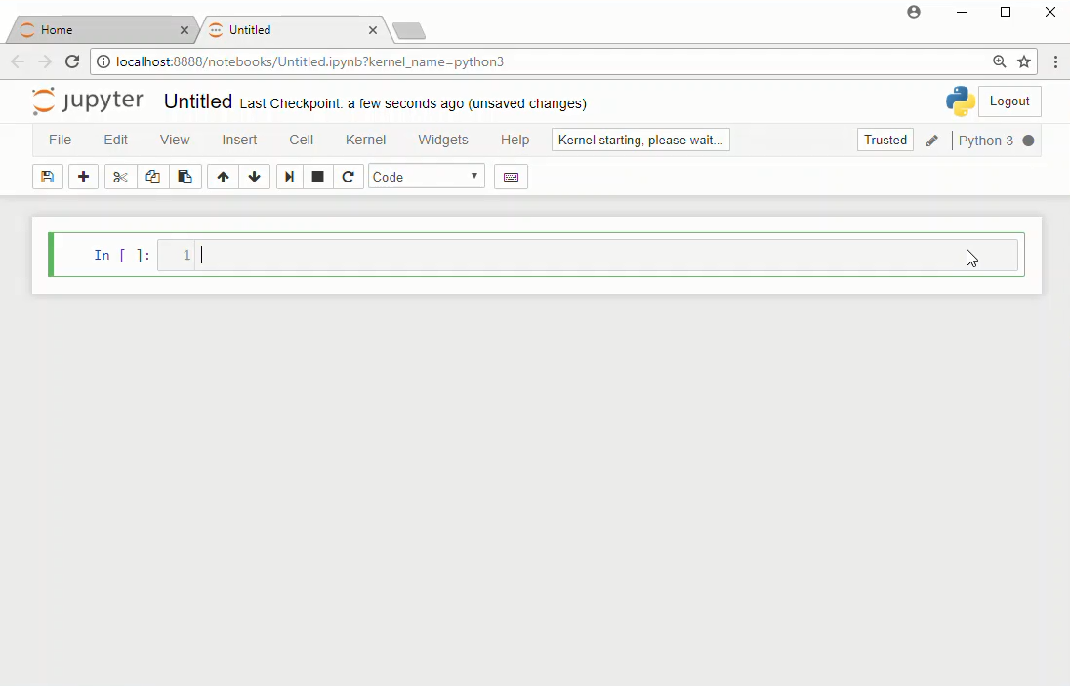
Start using jupyter notebooks
MacOS

Slide 11
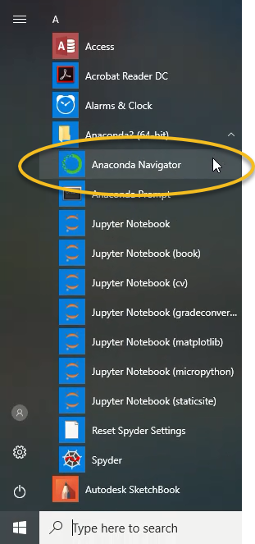
Start using jupyter notebooks
Windows (anaconda)

Slide 12
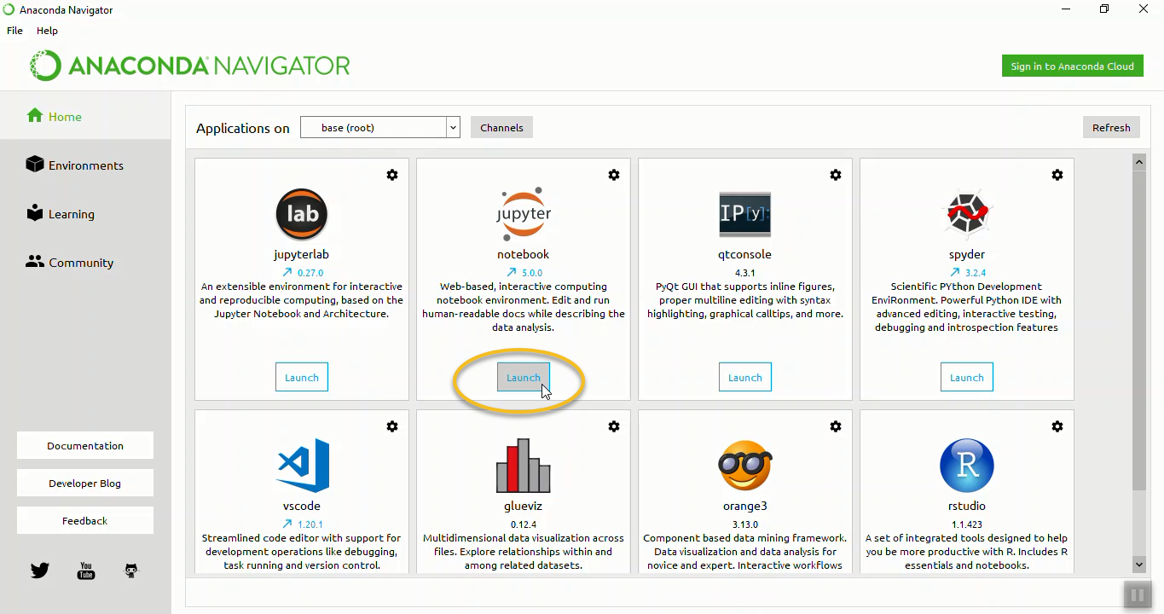
Start using jupyter notebooks
Windows (anaconda)

Slide 13
Start using jupyter notebooks
Windows (anaconda)

