Slide 1

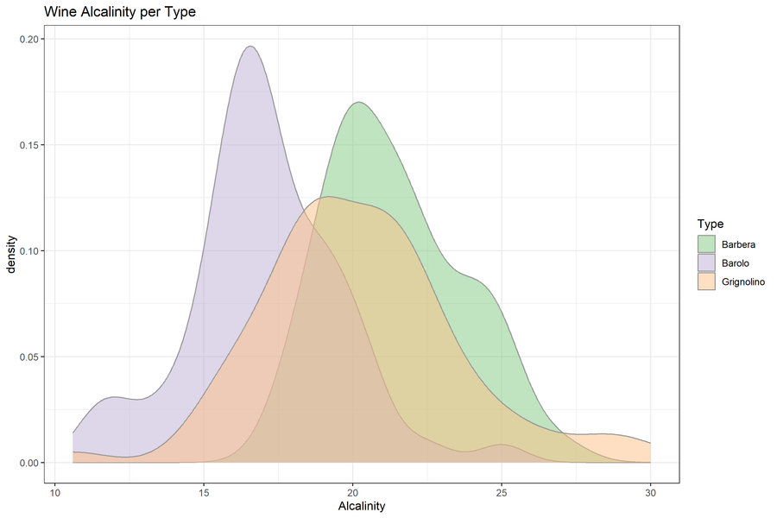
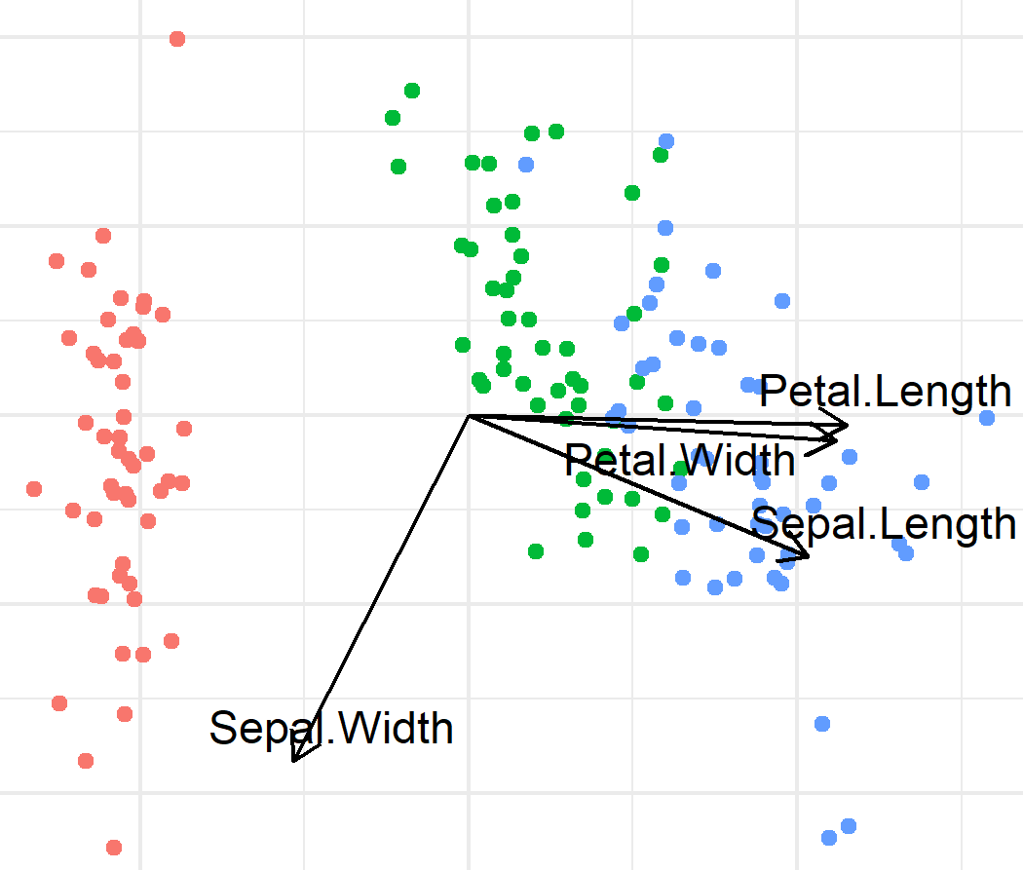
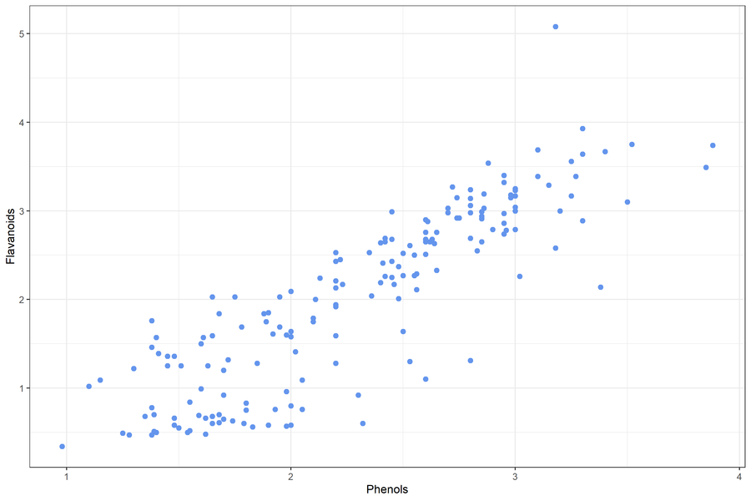
Exploratory Data Analysis

Slide 2
Exploratory Data Analysis
Identify variable type, ranges and distributions
Identify and remedy quality issues
Investigate relationships between variables
Discover patterns, trends, and structures that inform further analysis or modeling

Slide 3
Exercise 3a

Slide 4
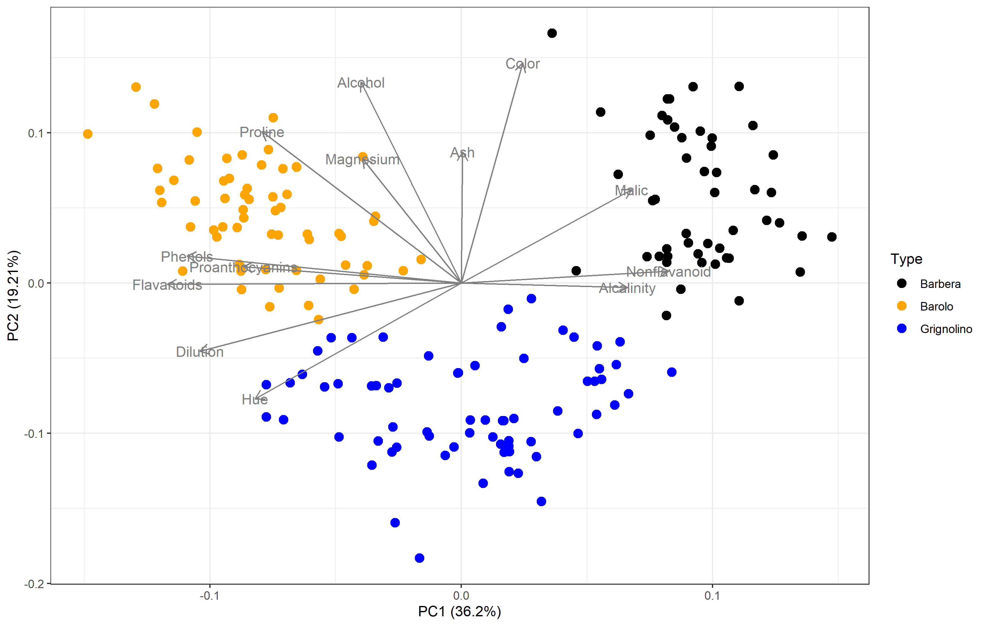
Principal component analysis
Fundamentally a dimensionality reduction technique
Find new dimensions that capture as much variation as possible
Shows structure of the data
178 wines x 2 features
178 wines x 13 features
Wine type | Alc | Alkalinity | Flavonoids | Color | …
Barolo | 1.51 | -1.17 | 1.03 | 0.25 | …
Barolo | 0.25 | -2.48 | 0.73 | -0.29 | …
Grignolino | 1.50 | -0.96 | 0.97 | 0.57 | …
… | … | … | … | … | …

Slide 5
Exercise 3B

Slide 6
Scripting in r
reuseable and functional code

Slide 7
If-else statements
Code
Symbol | Meaning
> , < | Greater, smaller
== | Equal to
! | Not
%in% | Occurs in
is.[type] | Check variable type
& | And
| | Or
Condition
If block
Else block
Code
continues
Conditions can be complex:
if (age > 30 & (!(smoker) | hospital == 'Herlev')

Slide 8
Controlling the flow of code
Code
Code
Code
Function
Definition
Condi-
tion
Call function
Do this for all items in iterable
Code
continues
If block
Else block
Call function
Code
continues
Code
continues
Code
continues
If-Else
Loop
Functions

Slide 9
Exercise 4

Slide 10

Modelling in r
Open-source software for bioinformatics

Slide 11
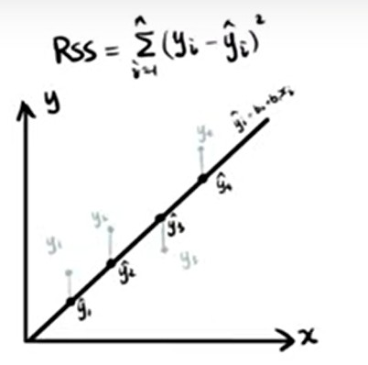
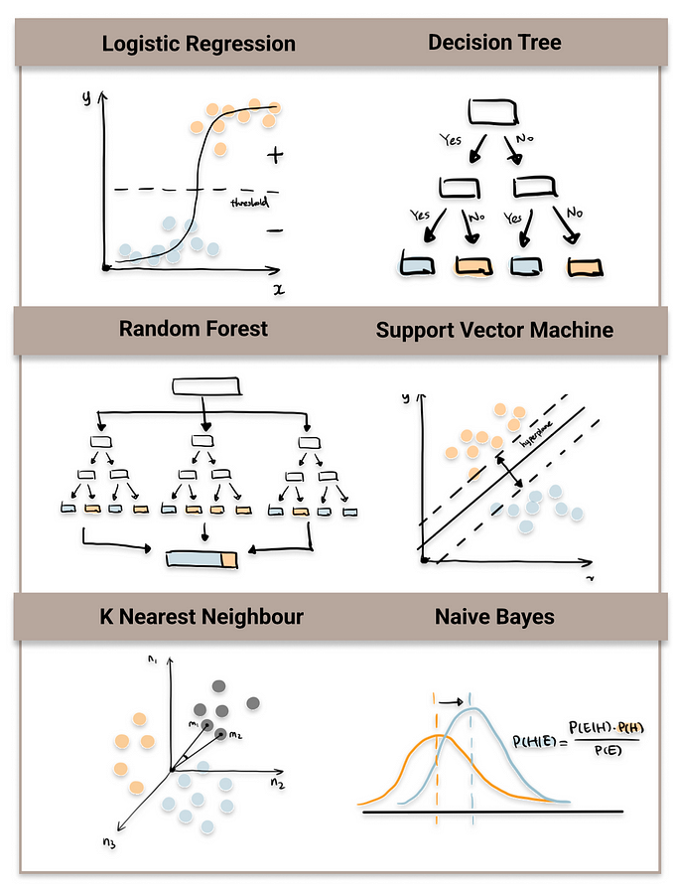
Types of models
Regression
Classification
Clustering

Slide 12
Bioconductor
Open-source software for bioinformatics

Slide 13







Bioconductor
Community-driven, open-source R packges for bioinformatics
Well-documented, many tutorials, support forum
RNAseq (bulk and single cell), Annotation, Epigenetics, Proteomics, ect
BiocManager is the install wrapper for bioductor
Notes:
We always install bioconductor packages with biocmanager
RNAseq (bulk and single cell), Annotation, Epigenetics, Proteomics, ect

