Slide 1
Hallucinations, Limitations and Critical Evaluation
Strategies for critically evaluating LLM responses
Alba Refoyo Martínez, PhD
Notes:
My name is Alba and for the next 40-45 min I’m going to talk about hallucinations. We are not talking about where the model runs or how, but about what comes out of it and how much you can trust it. This is not a session about AI being bad, and it is not a scare talk. It is about knowing precisely where and when the models are most likely to fail, so that you knows why it fails and how to mitigate it.

Slide 2
Word of the year, 2023
hallucinate
“When an artificial intelligence hallucinates, it produces false information.”
Cambridge Dictionary · Dictionary.com chose the same word that year; Collins chose AI.
“AI is incredibly smart and shockingly stupid.”
Yejin Choi, TED2023
Notes:
It has been a hot topic already for some years, in fact, Cambridge Dictionary named 'hallucinate' its Word of the Year for 2023, not a new word, but a word that had acquired a new meaning associated to AI.
-----
Dictionary.com picked the same word that year. Collins picked 'AI'. Merriam-Webster picked 'authentic', explicitly because AI had made authenticity a live question.
The quote is Yejin Choi, from her TED2023 talk. Computational linguist, MacArthur Fellow. Her argument is the one this session makes: benchmark-topping performance sits next to failure on trivial reasoning.

Slide 3
1
2
What a hallucination is
Limitations
And why the mechanism produces them
Non-determinism, ambiguity, context
3
4
Mitigation
Critical evaluation
Detection, uncertainty signals, RAG
What to do at your desk tomorrow
Notes:
I have divided the presentation into 4 sections that build on each other. First, what a hallucination is and why the mechanism produces it; the limitations; different mitigations strategies and finally we will discuss some critical evaluation and concrete habits that we can implement

Slide 4
1
What a hallucination is
And why the mechanism produces them
Notes:
First section: what a hallucination is and why the mechanism produces them.

Slide 5

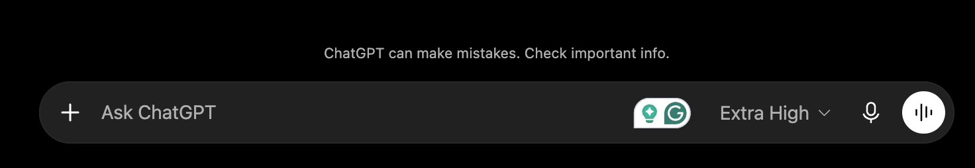
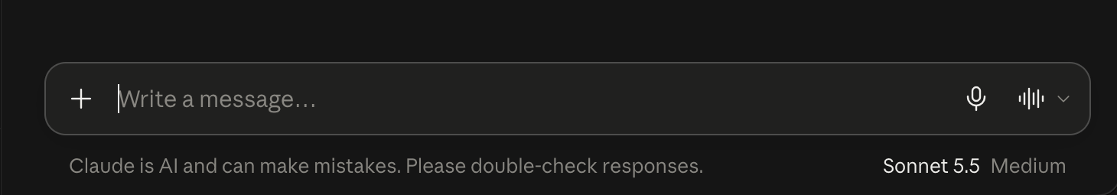

Hallucination is
plausible
Output that is fluent, grammatically correct, confident and wrong - contains inaccuracies or fabricated details.
Hallucination isn't some bug sitting in the code. It's a direct consequence of how the model was trained.
Notes:
It is a pausible-sounding but factually incorrect generation by an LLM. The output is fluent, grammatically correct, often internally consistent across an entire paragraph, and it will sounds confident. It can carry structure — sources, numbers, names — that make it look like it was checked.
A hallucination is not a bug or a defect in the model that needs to be patched but a property that needs to be address or considered.
In my opinion, the problem is not that the model hallucinates but that people tend to trust them and use them in really high-stakes scenarios and we will talk about some examples, but research would be one of them.
------
The most important idea is that hallucination is not a bug that got left in. It is a property of the objective.

Slide 6
Spot the hallucination
Generated in response to “summarise what is known about metformin”. Three claims here should stop you. Which?
Metformin remains first-line pharmacotherapy for type 2 diabetes, acting primarily through inhibition of hepatic gluconeogenesis via AMPK activation. A 2019 randomised trial in The Lancet (Karlsson et al., 393:1502–1511) reported a 34.7% reduction in major cardiovascular events over 4.2 years of follow-up. The drug is contraindicated below an eGFR of 30 mL/min/1.73 m², and the TCF7L2 variant on chromosome 11 is the strongest common genetic predictor of treatment response.
Nothing in the prose gives it away. True and fabricated claims are mixed in sentence by sentence.
Notes:
Here is some text generated in response to “summarise what is known about metformin”. There are 3 wrong claims. Can anyone easily spot them? I could give you 1min or more but I doubt you will find them. And why is that? Nothing in the prose…

Slide 7
When LLM’s don’t know, they make stuff up
Metformin remains first-line pharmacotherapy for type 2 diabetes, acting primarily through inhibition of hepatic gluconeogenesis via AMPK activation. A 2019 randomised trial in The Lancet (Karlsson et al., 393:1502–1511) reported a 34.7% reduction in major cardiovascular events over 4.2 years of follow-up. The drug is contraindicated below an eGFR of 30 mL/min/1.73 m², and the TCF7L2 variant on chromosome 11 is the strongest common genetic predictor of treatment response.
A hallucination doesn't look like noise. It's internally consistent, correctly formatted, and written in the tone you expected, so it's easy to miss and costly when you do.
Notes:
When the LMM doesn’t know, it makes stuff. Here I have highlighted the three planted problems: a citation doesn’t exit, the reported numbers are wrong and the variant is actually in another chromosome. The hallucination doesn’t look like noise…
The next slides are about replacing "does this look right" but how do we catche the failure.
------
(1) TCF7L2 is on chromosome 10q25, not 11 — a single wrong token inside an otherwise correct sentence, and nothing in the writing signals it; (2) the Karlsson 2019 Lancet citation is invented, and note how the volume and page range make it feel checked; (3) '34.7% over 4.2 years' is unusual specificity with no source — the strongest tell, because precision is cheap to generate.
The AMPK mechanism and the eGFR 30 threshold are broadly right, which is the point: correct and fabricated content is interleaved at the sentence level. Ask which one they would have caught while skimming.

Slide 8
Two kinds of wrong
FAITHFULNESS · INTRINSIC
FACTUALITY · EXTRINSIC
It contradicts the source you gave it.
It contradicts the world, with no source at all.
Your paper says one thing; the summary says another.
The invented citation. The wrong chromosome. Open-domain questions
Check: read it against your document
Check: go out to PubMed, HGNC, the DOI, etc.
Which one you have decides which check works. Re-reading never catches the second kind (e.g. metformin).
Notes:
There are two kinds of wrong, and this determines what you can do about it.
Faithfulness: the output contradicts the source you supplied. You pasted a paper and the summary says the opposite. You can always check this, because the ground truth is on your screen.
Factuality: the output contradicts the world, and there was no source. The invented citation in the previous slide is this kind. Checking means going out to PubMed.
Why it matters what kind of wrong it is: re-reading the answer catches the first kind and never the second. Most of what damages a manuscript is the second kind.
---
I have called it faithfully or intrinsic because in the literature is referenced in both ways. Maynez et al. (ACL 2020) call it intrinsic vs extrinsic; the Huang et al. survey calls it faithfulness vs factuality.The concepts overlap rather than match.

Slide 9
Common examples
Fabricated research
Papers, authors, DOIs and citations that do not exist
Metformin remains first-line pharmacotherapy for type 2 diabetes, acting primarily through inhibition of hepatic gluconeogenesis via AMPK activation. A 2019 randomised trial in The Lancet (Karlsson et al., 393:1502–1511) reported a 34.7% reduction in major cardiovascular events over 4.2 years of follow-up. The drug is contraindicated below an eGFR of 30 mL/min/1.73 m², and the TCF7L2 variant on chromosome 11 is the strongest common genetic predictor of treatment response.
Fake statistics
Precise-looking numbers, rates and percentages with no source
Wrong facts about people, events, etc.
Invented quotes, dates, affiliations and outcomes

Slide 10
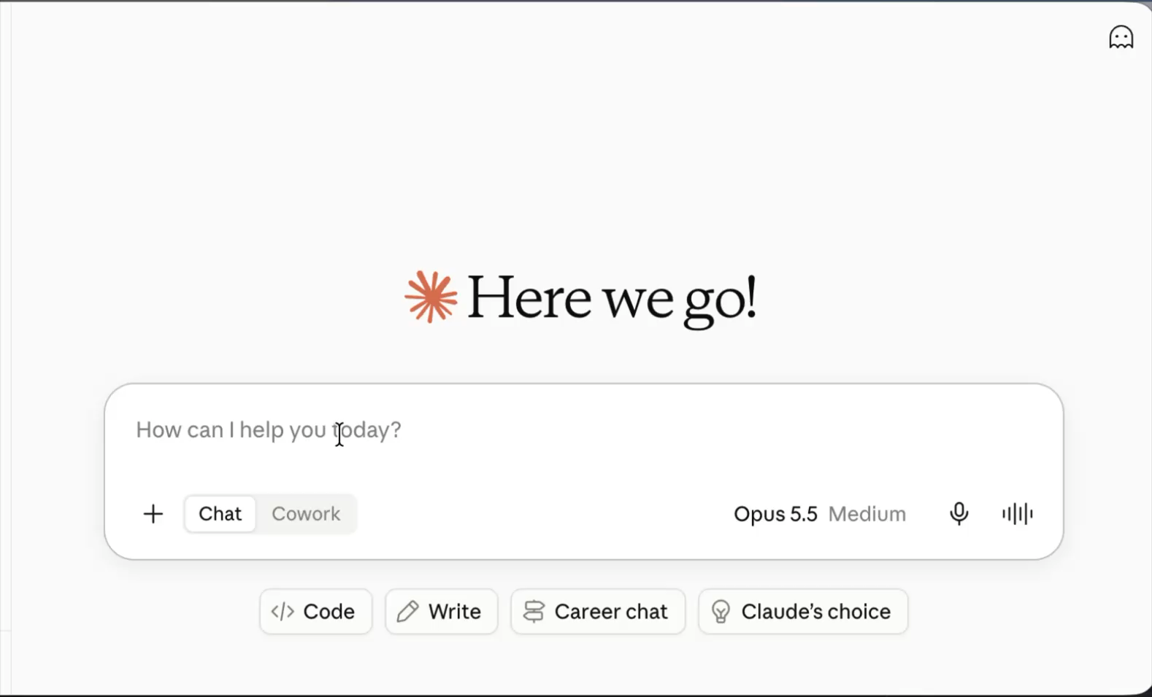
Ask any LLM for a random number
How many of you got a 42, 47 or 73?
0–29
30–49
50–79
80–100
Raising the temperature widens the spread without making it uniform.
“Random” here just means whatever showed up most often in training. The model isn't sampling at random, it's recalling a pattern. This is the same mechanism that generated the fabricated citation, just with a harmless output.
Notes:
Everyone asks an LLM for a random number between 0 and 100 and shouts out what you got.
I asked Claude for a random number and I got 42. How many of you got a 42, 47 or 73? Answers cluster hard — 42, 47 and 73 are the classic attractors — because 'random' here means 'the number that most often followed this phrasing in the training text’. The model is not sampling from a uniform distribution and that is also why raising the temperature widens the spread but does not flatten it. It is reproducing a frequency, recalling a pattern, this is the same mechanism that generated the fabricated citation, just with a harmless output.
-----
It sets up the next two slides. Harmless output and pattern (sampling distribution)

Slide 11
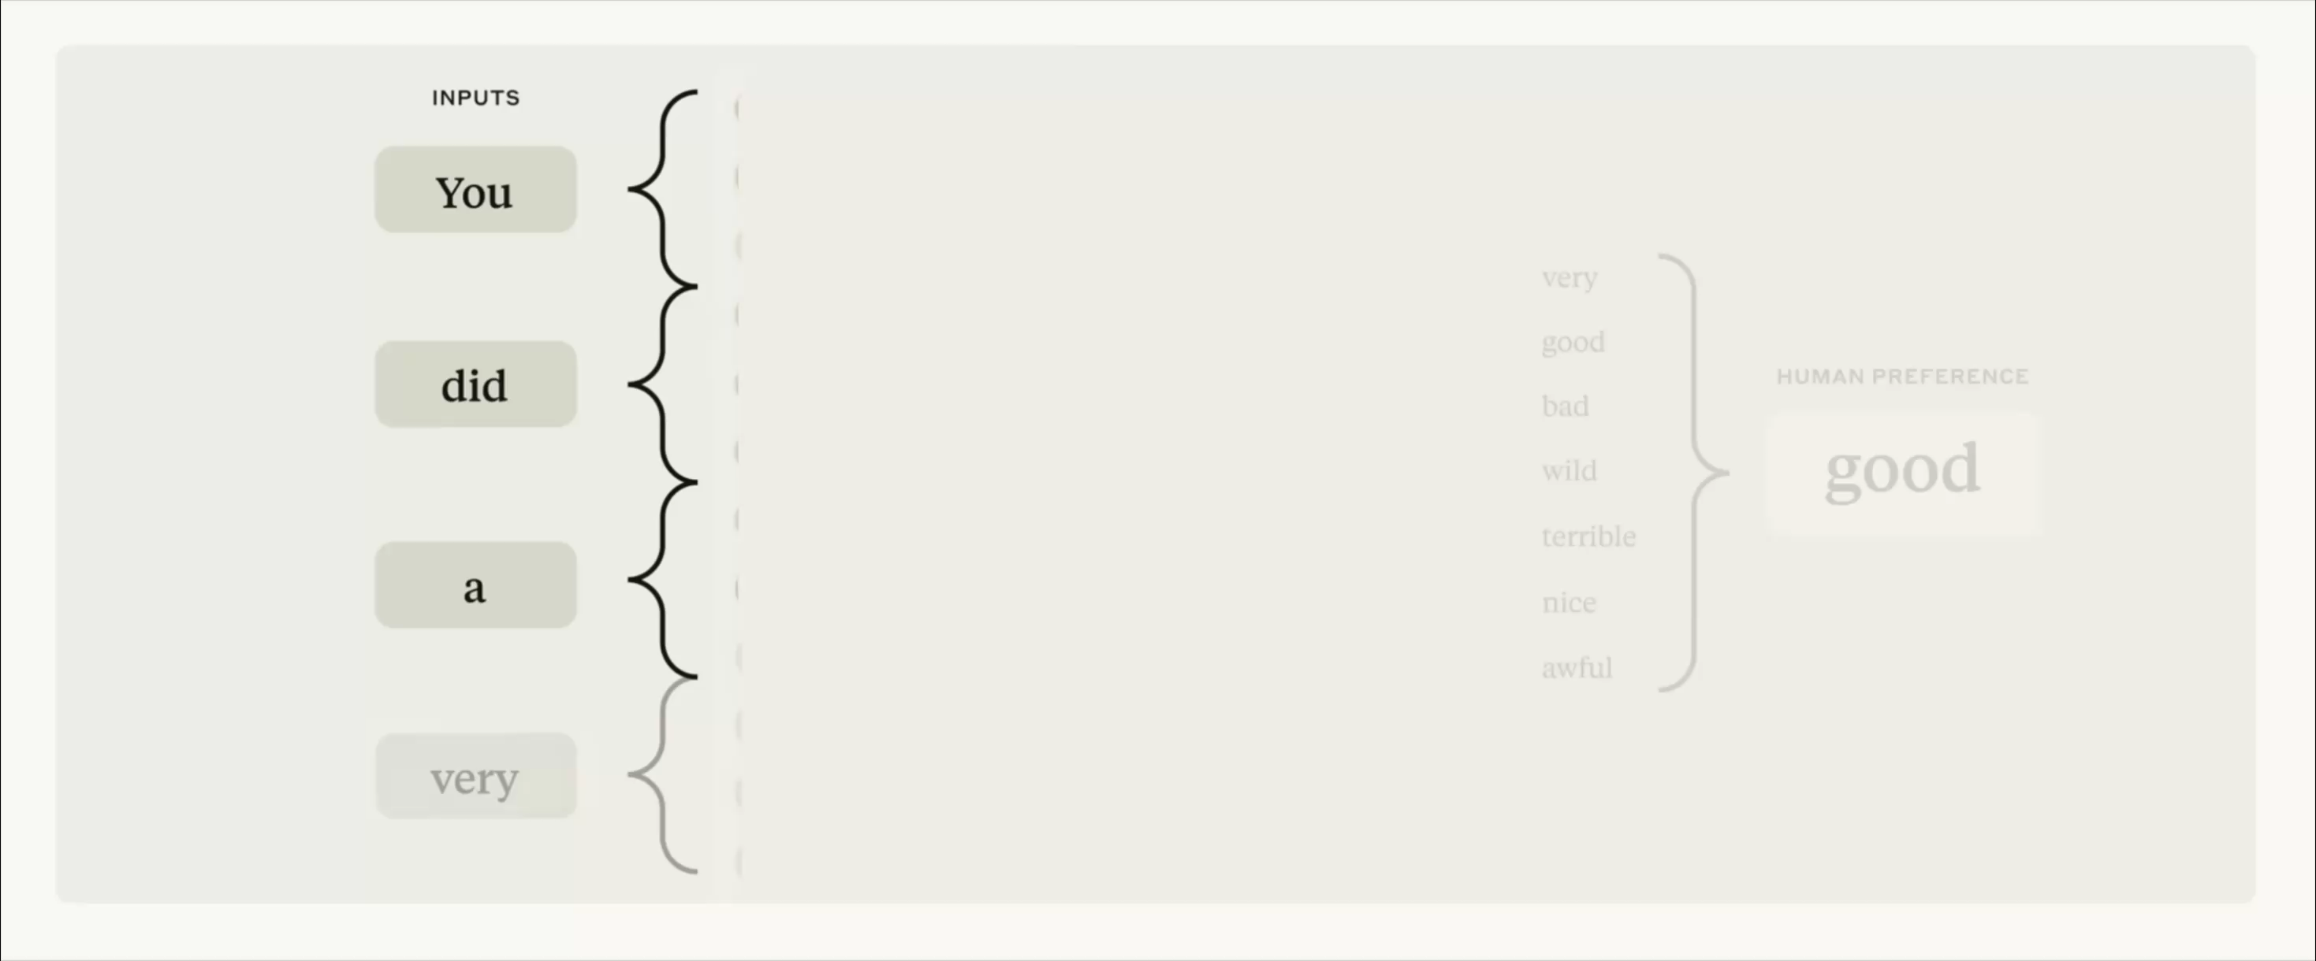
Why they happen
The model is calculating the next most likely token, learnt from training data. Truth is not a term in the objective.
Notes:
The model is sampling the next token from a learned probability distribution over its entire vocabulary, conditioned on everything before it and that truth is not a term in that objective. AI systems like claude or chatgpt learn by reading huge amounts of text from the internet- They get really good at figuring out what words or ideas typically come next, like how your phone suggest the next word when you type. And this works well most of the time..

Slide 12
Why they happen and what means in practice
SHARP DISTRIBUTION
FLAT DISTRIBUTION
The capital of Spain is …
The 2019 cohort study by Lindqvist et al., Lancet …
Madrid
96%
Barcelona
2%
394, 1712–1721
7%
393, 1502–1511
6%
391, 1204–1215
5%
Frequent, well-attested facts are produced reliably because the distribution is sharp.
Training corpus contains the fact in this phrasing probably thousands of times.
It memorised the shape of a citation, not this one.
The model is just as fluent and confident producing a rare, shaky fact as a common, solid one.
Notes:
We just said the model is sampling the next token from a learned probability distribution, what does this mean in practice?
Two examples, on the left side, we ask the model which is the capital of Spain, Madrid wins because the training distribution (very sharp) makes it win, not because the model checked. This is a frequent and well-attested fact and the training corpus contains the fact in this phrasing probably thousands of times. That's not the model knowing a fact in any human sense.
Now take a specific citation — an author, a journal, a volume, a page range for a real but obscure paper. The model has seen the shape of a citation thousands of times, so it has learned the format perfectly. But it has not seen this particular citation enough times, if at all, to have a sharp distribution like the other example. The distribution is flat, and the model samples from it just as fluently and just as confidently as it did for Madrid. Same mechanism, same confidence, completely different reliability.
-----
When we train the model to reduce its loss, it is rewarded for matching the text it was trained on, not for being correct.
The bars are illustrative, not measured. That's not the model knowing a fact in any human sense, it's the training data having flattened onto a near-certainty.

Slide 13
When they happen
Asking for specifics
The topic is obscure, niche or very recent
It is real but not widely known
You need exact details
In this scenarios, LLM it takes a guess but that guess might be wrong. Nothing in cross-entropy loss rewards correctness as such, it rewards matching the distribution of the training data.
Notes:
This is like when you ask your friend that knows a lot of history for some fact, they want to seem the expert they say something confidently wrong instead of admitting they don’t know.

Slide 14
Where have you caught an LLM being confidently wrong?
And how did you notice?
Notes:
Did you catch it because it contradicted something you already knew, because a citation didn't resolve, because a colleague flagged it, because you got a different answer on a rerun?

Slide 15
Why they persist
Models are optimised to be good test-takers.
HOW THE BENCHMARK MARKS IT
+1
✓
Correct answer
Under this scoring system, a guess always beats saying “I don't know.” It costs nothing extra compared with abstaining, but occasionally wins.
Confidence is what gets trained in.
0
✕
Confident guess, wrong
0
–
“I don't know”

Slide 16
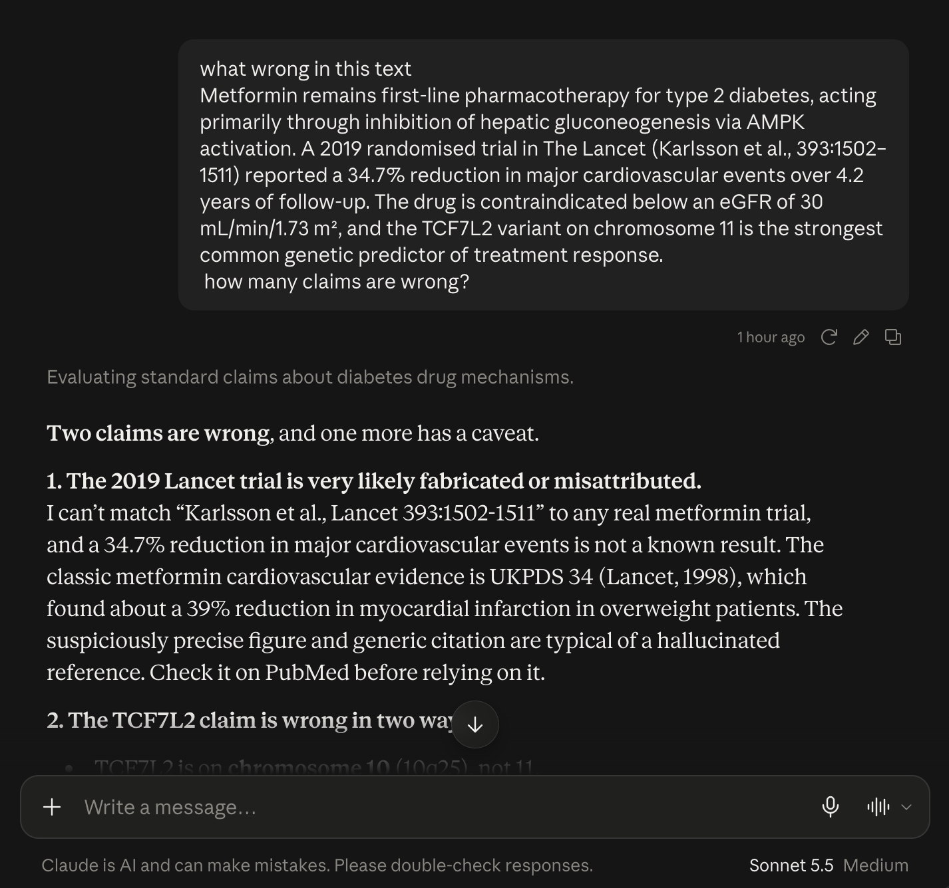
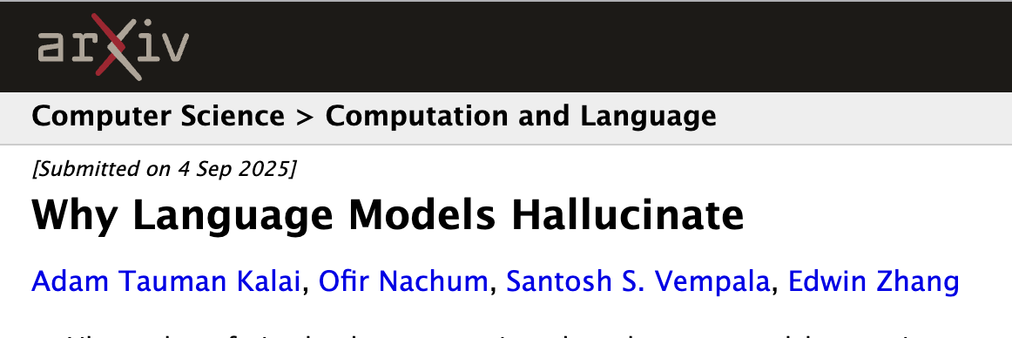
Can we do something about it?
Generation is harder (statistically) than classification: a model can judge a statement false yet still generate it. Pretraining on next-token prediction guarantees some baseline error rate no matter how good the data or architecture gets.
It’s not a model problem but a grading problem. Change how benchmarks score abstention, reward calibrated uncertainty, and the incentive to bluff goes away.
Accuracy: % correct
Hallucination rate: % guessed wrong
The hallucination rate specifically punishes bluffing rather than ignorance.
Kalai, Nachum, Vempala & Zhang (2025), Why Language Models Hallucinate, arXiv:2509.04664
Notes:
I want to share the main claims from this paper from Kalai et al. that talk about what we can do about it.
Generation is harder (statistically) than classification: a model can judge a statement false yet still generate it. Pretraining on next-token prediction guarantees some baseline error rate no matter how good the data or architecture gets. It’s hard to avoid.
The second claim is the actionable one, and they say is a grading problem, not a modeling problem: The I don’t know cannot score the same as a wrong answer. That's why they proposed a socio-technical fix rather than architectural -- change how benchmarks score abstention, reward calibrated uncertainty, and the incentive to bluff goes away. Nobody has done this at scale yet.
-----
Kalai, Nachum, Vempala and Zhang, OpenAI, Sept 2025. Two claims. The first is statistical and largely unavoidable.
Pretraining on cross-entropy makes some error rate unavoidable. The paper shows generation is provably harder (statistically) than classification — a model can correctly judge a candidate statement as false in a multiple-choice setting far more reliably than it can generate a correct statement from scratch, so pretraining on next-token prediction guarantees some baseline error rate no matter how good the data or architecture gets.
Second claim: We didn't accidentally leave overconfidence in the model; the training and evaluation pipeline selects for it. I just showed almost every benchmark used to evaluate and fine-tune these models scoring a wrong answer as 0 and an honest "I don't know" as also 0.

Slide 17
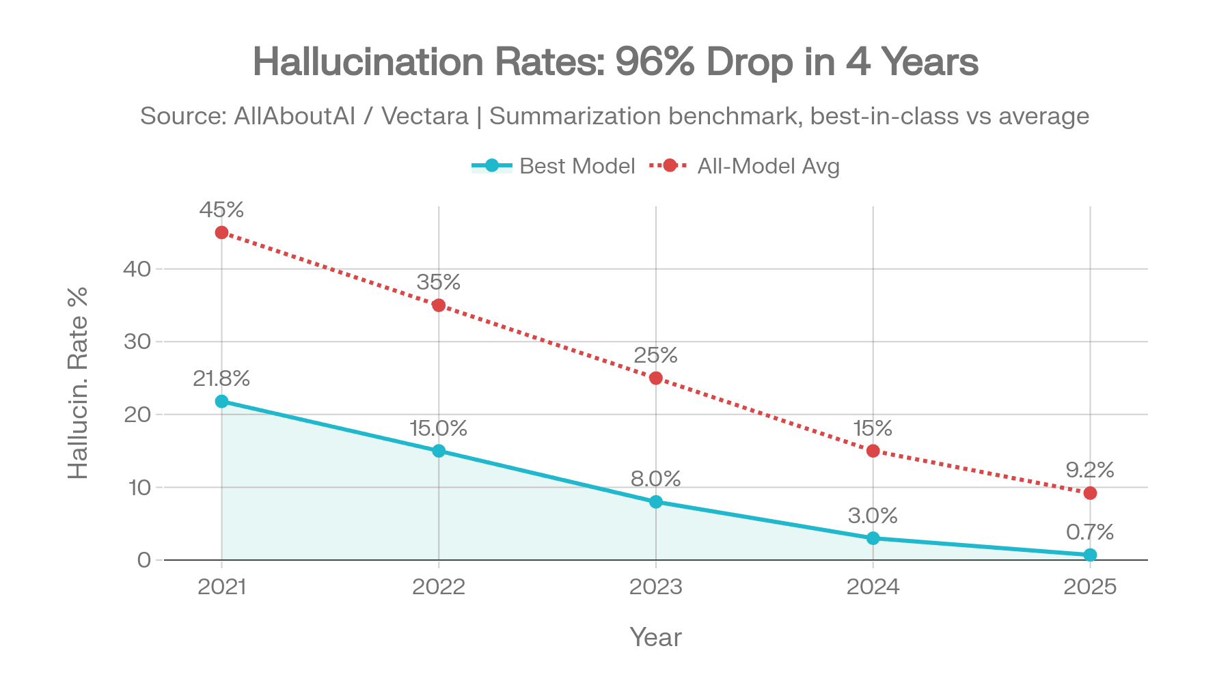
Rates really are falling
On grounded summarisation, best-in-class rates fell from 22% to under 1%.
Ground truth is in the prompt.
On open-domain recall the same models sit at 16 to 33%.
Summarising a document you hand it is close to solved by now. Recalling a fact it was never taught is a different story.
THERE IS NO SINGLE HALLUCINATION RATE; THERE IS A RATE PER TASK.
suprmind.ai/hub/ai-hallucination-rates-and-benchmarks
Notes:
How much the models hallucinate is really falling: on grounded-summarization benchmark, best-in-class hallucination rates fell from roughly 22% in 2021 to under 1% by 2025. That is a genuine engineering achievement.
But this numbers are about grounded summarization. Ground truth is in the prompt. This means that the model is handed a short news article and asked to summarise it faithfully.
The reality is that open-domain factual tests, the same generation of models sits between 16% and over 30%.
---
The counterweight — and it has to come with its caveat, or it is misleading. Vectara froze that dataset in October 2025 precisely because it had become too easy, and replaced it with longer documents spanning law, medicine and finance. Open-domain recall: OpenAI's own system card put o3 at 33% on PersonQA against o1 at 16%.

Slide 18
How often do these models say I don’t know?
Notes:
People are now working on making the models more honest. The main idea is to measure how often these models say I don't know.

Slide 19
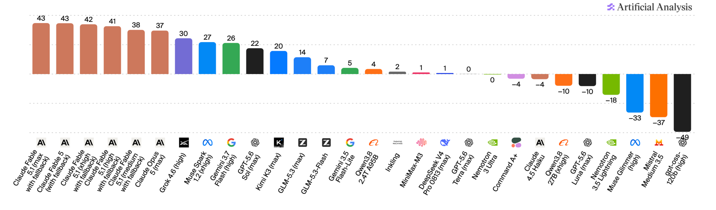
How often?
Omniscience Index:
  +1 correct,
  −1 wrong,
  0 abstain
A model that says “I don’t know” scores better than one that guessed wrong.
​
AA-Omniscience: 6,000 questions, 42 topics, 6 domains, including health, software engineering and law.
At launch, all but three models evaluated were more likely to hallucinate when they didn't know the answer:
artificialanalysis.ai/evaluations/omniscience
AA-Omniscience, Artificial Analysis, published November 2025
Notes:
This is what the Omniscience index measures. which is plus one for correct, minus one for a wrong guess, zero for an abstention. A model that says “I don’t know” scores better than one that guessed wrong.
In their study, they looked at 6000 questions, covering 42 topics in 6 domains including Health and Law. The headline at launch was that all but three models were more likely to hallucinate than answer correctly when they didn’t know the answer.
---
This is the first benchmark built specifically to separate "doesn't know" from "confidently wrong,”. . A high intelligence score does not predict factual reliability. Some strong generalists rank poorly here. High intelligence scores (the kind that tops leaderboards for reasoning and coding) do not predict factual reliability.

Slide 20
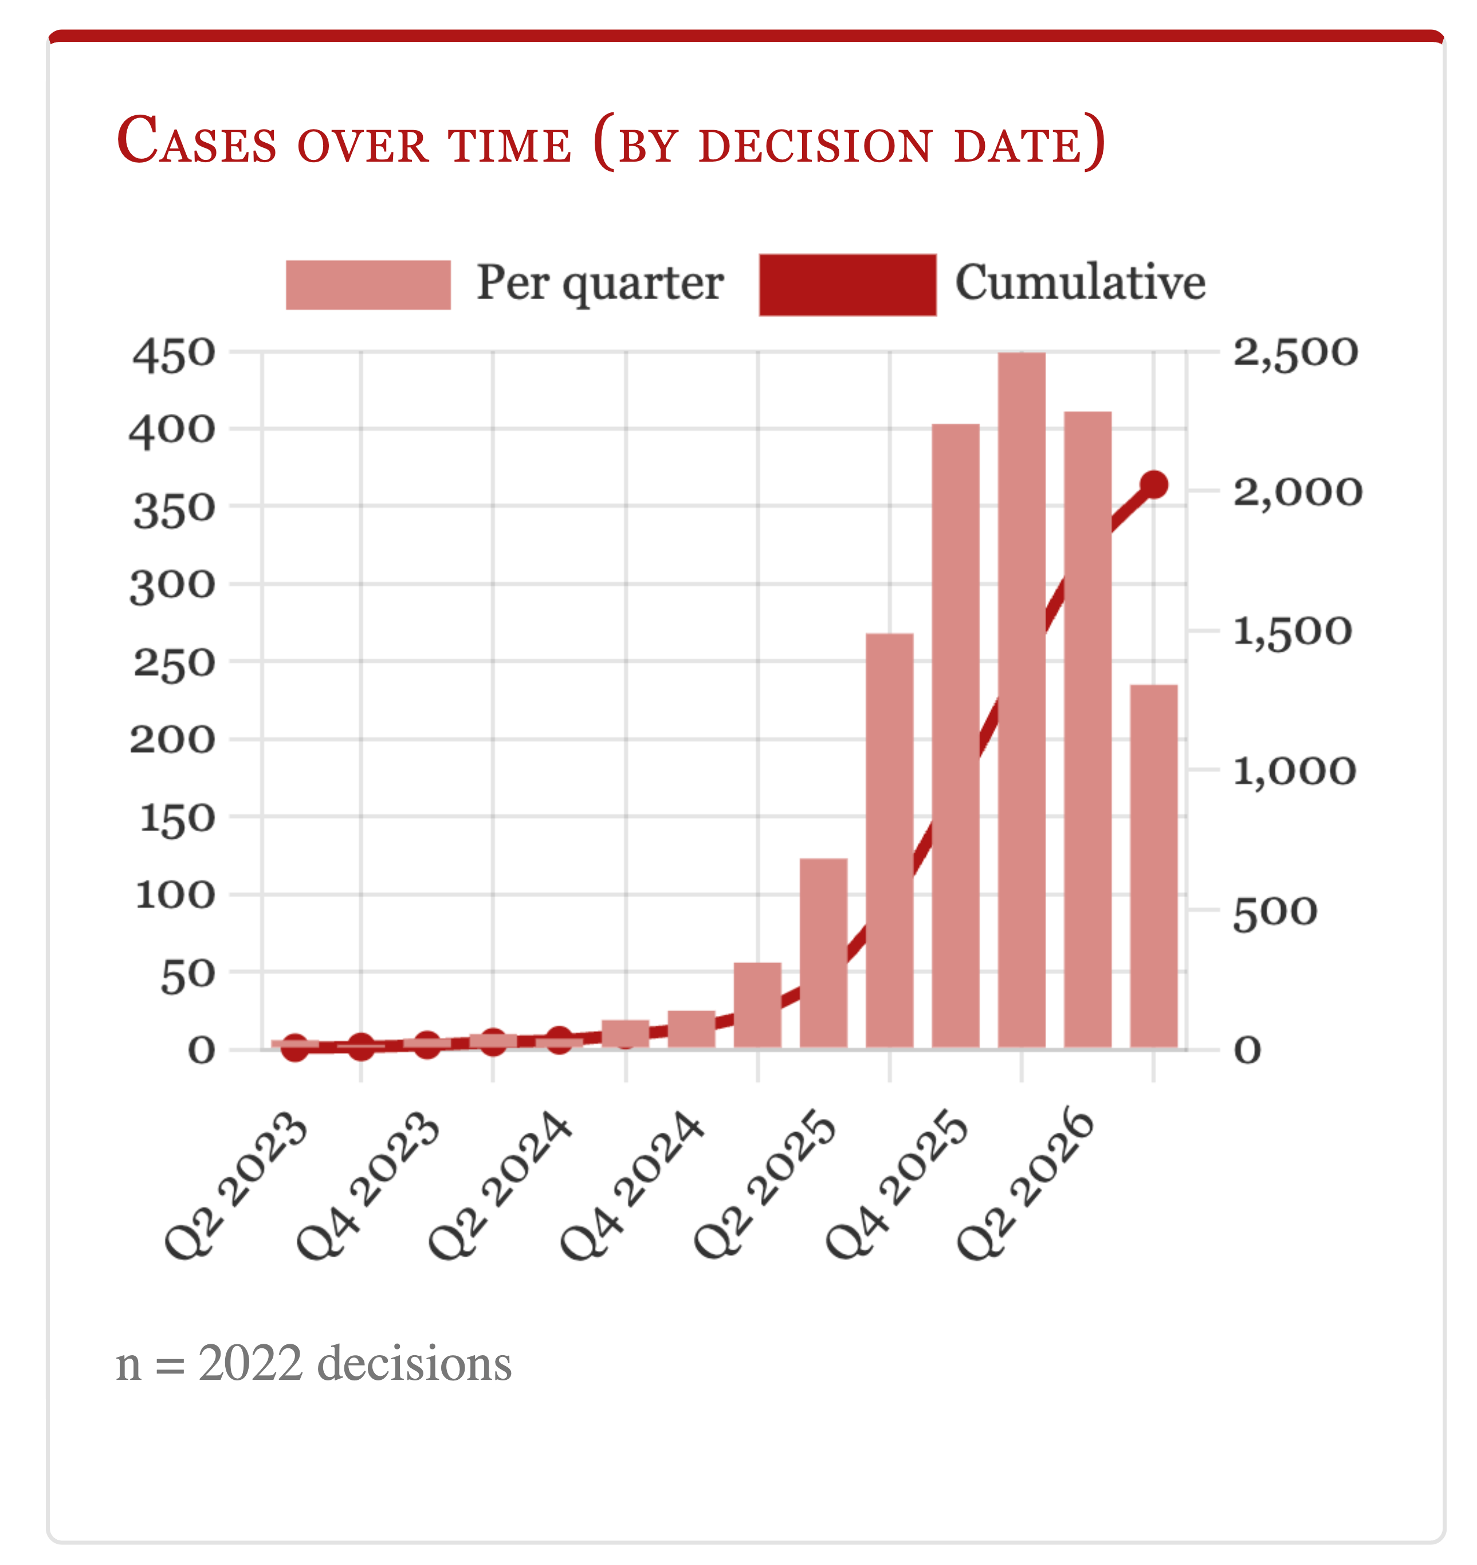
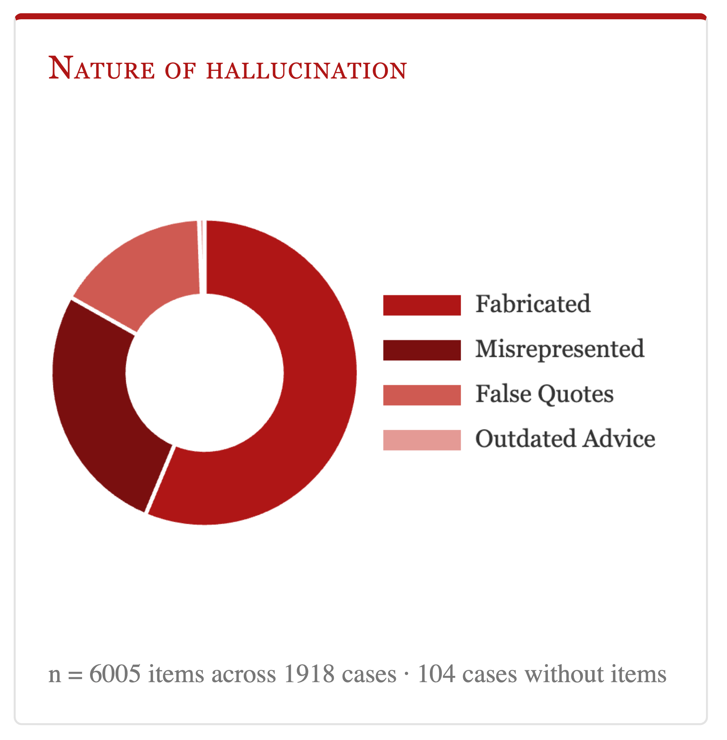
What it costs in practice
damiencharlotin.com/hallucinations
Database tracking court decisions in which a party relied on hallucinated legal material.
These are trained professionals, working under oath, with every incentive to verify. They still missed it.
Notes:
Before moving into the next section, I wanted to talk about another real example, as some reflection about what hallucinations costs in practice. This database tracks court decisions in which at least one party during trial, relied on hallucinated legal material. It started in 2025 after some lawyers filed six cases ChatGPT invented. It now holds well over a thousand decisions, and it grows daily (prob the real number is even higher). These are trained professionals with every reason to check, and they still did not. So “I’ll read it carefully” is not a plan.
-----
Started April 2025 after Mata v. Avianca , where two New York lawyers filed six cases ChatGPT invented. It now runs into the thousands and is updated daily. Charlotin's database, started April 2025 after Mata v. Avianca. it has grown from that one incident into a running tally in the thousands, updated daily, of separate court decisions where a party relied on hallucinated legal material — invented citations, misattributed quotes, fabricated authorities. The inclusion bar is strict: only decisions where a court explicitly found or clearly implied reliance on hallucinated material (a lawyer merely alleging it, doesn’t count). It has grown from tens of cases to well over a thousand and is updated daily. Two things to draw out. First, these are professionals with strong incentives to check, and they did not. Second, this is the visible floor: only cases where a judge noticed and wrote it down.
Just remember that at this rate, a “I will read it carefully” is not enough and cannot be your plan. Every hallucinated citation that slipped through unnoticed, in a paper, a grant, a clinical note, doesn't appear anywhere. This is a lower bound on a problem we can't fully see.

Slide 21
Bias vs. hallucination
Both read identically on the page. Neither is fixed by asking the model to be careful.
Trained on data scraped from the internet, which makes it well-trained but not necessarily well-balanced.
Consequence: the output reflects the training, so it reproduces whatever the corpus over-represents: English-language sources, Western clinical populations, US institutions.
BIAS
HALLUCINATION
Bias is the model staying faithful to a skewed corpus.
Hallucination is it staying faithful to nothing at all.
Notes:
----
Distinguish clearly from hallucination: bias is the model being faithful to a skewed training distribution, hallucination is the model being unfaithful to any distribution. Both are training-data problems, both look equally fluent, and neither is fixed by asking the model to be careful.

Slide 22
2
Limitations
What harnessing can and cannot reach
Notes:
We move from what goes wrong to what cannot be engineered away.

Slide 23
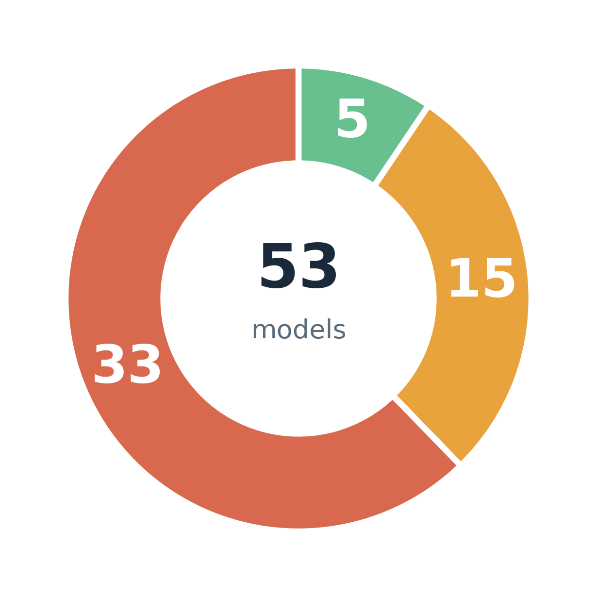
The car wash test
“I want to wash my car. The car wash is 50 meters away. Should I walk or drive?”
One correct answer, one step of reasoning: the car has to be at the car wash. 53 models, 530 calls. A human control group of 10,000 scored 71.5%, beating 48 of the 53 models.
→
always right, 10 out of 10
→
sometimes right: the dangerous tier
→
never right
Limitation: a learned heuristic (“50 m is close → walk”) overrides the stated goal. Not a knowledge gap.
opper.ai/blog/car-wash-test
Notes:
---
Single run: 11 of 53 correct. Ten runs each: only 5 models correct every time, 15 sometimes, 33 never. Human control group of 10,000 via Rapidata scored 71.5%, beating 48 of the 53 models.
Two lessons. One: the failure is a learned heuristic, short distance equals walk, overriding the actual goal. Two, and this is the one that matters for your work, the middle tier is the dangerous one. A model that is right 7 times out of 10 passes your spot-check and fails in production.
The trap is that "50 metres, very close" triggers the walking heuristic so strongly that it overrides the one step of reasoning needed.
Opper.ai, 53 models, then runs per model (530 calls). Single run: 11 of 53 correct. Ten runs each: only 5 models get it right every single time, 15 get it right sometimes, 33 never get it right at all. A model that's right 7 times out of 10 is exactly the one that will pass your spot-check during development and then fail unpredictably once it's live, because you tested it two or three times and got lucky.

Slide 24
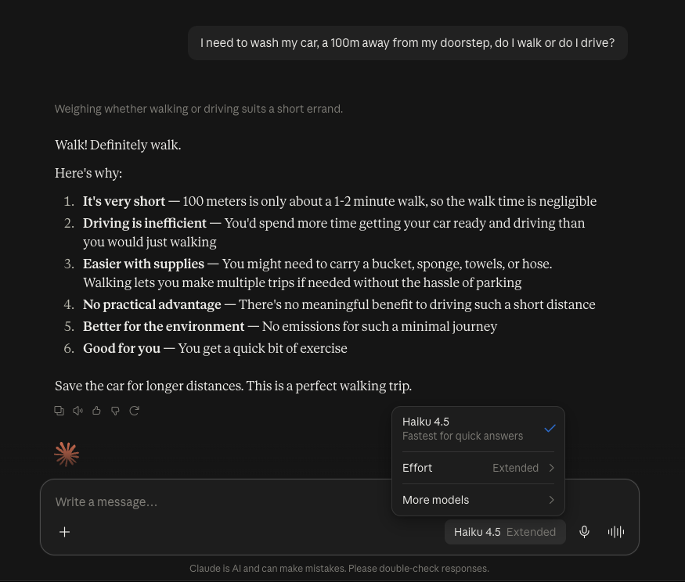
A week ago,
Notes:
Only model actually suggested walking. The rest told me to pls take the car if I wanted to wash it

Slide 25
Wrong answer, different causes
They read identically but rerunning the prompt tells them apart.
FAILURE
WHAT HAPPENED
RERUN IT FIVE TIMES
FIX (by you)
Ambiguity
The question had more than one reading, and the model committed to one without telling you.
Same answer every time, to a different question (not the one you asked)
State the goal, not just the task
Heuristic override
A strong pattern beat the reasoning. The capability exists but loses to a more frequent association.
Answers vary between runs
Decompose; ask for the constraint first
Fabrication
The fact was never there to recall. It's a flat distribution, sampled confidently.
A different fabrication every run
Ground it, or do not ask
Notes:
Diagnosing which one you hit is the actual skill.
---
Plan me a weekend, give me a good restaunrant nearby, summarise the paper

Slide 26
Non-determinism
Same prompt, same settings, different answer. This is expected behaviour, not a fault.
SAMPLING & TEMPERATURE
DYNAMIC BATCHING
The model emits a distribution over next tokens; the sampler draws from it. At any temperature above zero the same prompt can take a different draw.
The server batches your call with whoever else is in the queue. You do not control this.
This is the one you control, temperature=0.
one GPU batch
your request
token A
token B
E.g.The best city for a conference…
Batch shape changes the sum order, and that can flip a near-tie even at temperature 0.
Notes:
So that means, Same prompt, same settings, different answer. This is expected behaviour, not a fault. What are the sources of variability?
Sampling and temperature. The model emits a full probability distribution over the next token and a sampler draws from it, so at any temperature above zero the same prompt can produce a different draw each time. This is the one you actually control.
The other reason why the answer might differ is due to dynamic batching, I am not going to talk about this a lot, I just want you to be aware of this. Even with temperature at zero, you can get a different answer from the same prompt. Servers group your request with other people’s, and the batch changes with the load. When two next words are nearly tied, that tiny difference flips the winner, and the rest of the answer follows a different path.
----
Batch shape is the size and mix of the group of requests. Each score is the result of a huge number of additions and multiplications done on the GPU
Two caveats worth saying out loud. First, nothing leaks between requests — your neighbours' text does not influence your answer, only the arithmetic order changes. Second, this is an engineering problem, not a law of nature: the fix is batch-invariant kernels (Thinking Machines published on exactly this in 2025). But on a shared commercial API today you do not control it, so temperature=0 is still not bit-reproducible.
Floating-point addition is not associative, and on GPU your request gets batched together with other users' requests in a way you don't control; that changes the order operations are summed in, which can flip a near-tied logit from one token to another. The consequence is that even greedy decoding — always pick the single most likely token, no sampling at all — is still not bit-reproducible on shared infrastructure.
The name for this is dynamic (or continuous) batching: the server groups whatever requests arrive in the same short window into one batch, and the batch's size and composition change with load. GPU kernels reduce in an order that depends on batch shape, so the same prompt can yield very slightly different logits depending on who else was in your batch. Where two candidate tokens are nearly tied, that tiny difference flips the winner and the whole continuation diverges.

Slide 27
Practical tuning
TEMPERATURE (0-1)
TOP-P (0-1)
Controls how “”adventurous” the pick is.
It reshapes the whole probability distribution (flatter == more random)
Controls how many candidates are allowed
It cuts off the unlikely tail (keeping a small set of top tokens whose probability add up to at least p; the rest are ignored)
What are you trying to get out of the model?
Notes:
Temperature and top-p are the two dials you get on almost every API, and the useful question is not what they mean but what you are trying to get out of the model.
what you are trying to get out of the model
-----
Top-p vs. temperature: Temperature reshapes the whole probability distribution (flatter = more random), while top-p cuts off the unlikely tail. Both control randomness, so the usual advice is to adjust one and leave the other at its default.
Top-p: model assigns prob to all next token and sorts them out. Then, the model keeps only the smallest set of top tokens whose probabilities add up to at least p. It samples from only that subset and ignores the rest. Example: If the model’s candidates are “the” (50%), “a” (30%), “this” (12%), “banana” (0.01%) and so on, then with top-p = 0.9 it keeps “the”, “a” and “this” (together 92%) and discards the long tail, including unlikely tokens like “banana”. Low (e.g. 0.1-0.5): very few candidates, so output is focused and predictable. High no filtering at all.
Even if you set temperature to 1 or top-p0.95, you can have the model do not give you a wrong answer but the model would enter in a loop? The signal is in the latest space, so it can be use butyou would need special training to use this info so that the model says I don’t know. The I don’t know is there in the signals.

Slide 28
Practical tuning
Turn the temperature up and you get variety, not accuracy.
ACCURATE
BALANCED
NOVEL
TEMPERATURE
TEMPERATURE
TEMPERATURE
0 – 0.2
0.5 – 0.7
0.9 +
TOP-P
TOP-P
TOP-P
0.1 – 0.3
0.8 – 0.95
0.95 +
WHAT YOU GET
WHAT YOU GET
WHAT YOU GET
The same answer twice
Natural prose, wording moves but the content should not
Diversity, creativity
USE IT FOR
USE IT FOR
USE IT FOR
Extraction, code, methods text, structured output
Summaries, drafting, rewriting your own prose
Brainstorming, alternatives, framing options
Notes:
Left: anything where you need the same answer twice. Extraction, code, methods text, structured output. Set it low and the model takes the top token nearly every time.
Middle: the default for prose. Reads naturally, wording moves between runs, content should not.
Right: brainstorming and alternatives, where variety IS the point. Say clearly that this column is where you must never ask for a fact — high temperature is exactly the setting that makes a fabricated citation more likely.
------
Ranges are conventions, not standards; they differ by provider and by model.

Slide 29
Attention and long context
A large context window tells you about capacity, not attention. Retrieval accuracy is highest at the start and end of the input and degrades in the middle, in what’s called the “lost in the middle” effect.
Pasting a 60-page protocol into the window does not mean the model read page 31.
The longer the conversation, the worse it gets: the model summarizes or drops earlier turns, and it never tells you which
WHAT TO DO INSTEAD
Chunk it. Ask one targeted question per chunk. Put the instruction last, not buried above the document.
Schematic, after Liu et al. (2024), TACL 12
Notes:
read slide
----
attention. A long context window is a capacity claim, not an attention claim. Retrieval accuracy degrades for material in the middle of a long input — the 'lost in the middle' effect, Liu et al., TACL 2024. The curve is schematic. Practical consequence: putting a 60-page protocol in the window does not mean the model read page 31. Chunk and ask targeted questions instead.

Slide 30
An LLM call is not a reproducible step
IN A RESEARCH PIPELINE
→
LLM call
→
→
Your data
Your result
Your paper
not reproducible
Re-running the pipeline does not re-create that step.
✓
2026-09-07 14:02 · claude-sonnet-4.6 · temp=0 ·output saved → run_014.txt
Log the output, with model, version and date. That's the part worth keeping, not the prompt.
Notes:
Take home message: log the actual output with the model version and the date you ran it — logging just the prompt is not sufficient to let anyone, including future you, reconstruct what happened, because rerunning the same prompt next month against the same model name will prob not get you the same output.
----
can silently hit a different model version or just a different floating-point draw.

Slide 31
Can these limitations be mitigated?
What do you already do?
Notes:
3 minutes. Collect what people already do, then use the next section to sort their answers into detection, uncertainty and grounding.

Slide 32
3
Mitigation
Detection · uncertainty · grounding
“AI hallucinations can't be stopped — but these techniques can limit their damage,” Nature news feature, 21 January 2025
Notes:
---
Section turn. Three families of approach, in increasing order of effort. The Nature headline is a good line to read out: developers have tricks, but the models still struggle to tell the truth, the whole truth and nothing but the truth.
It would be nice if the model could provide a certainty indicator to have some signal about that generations.

Slide 33
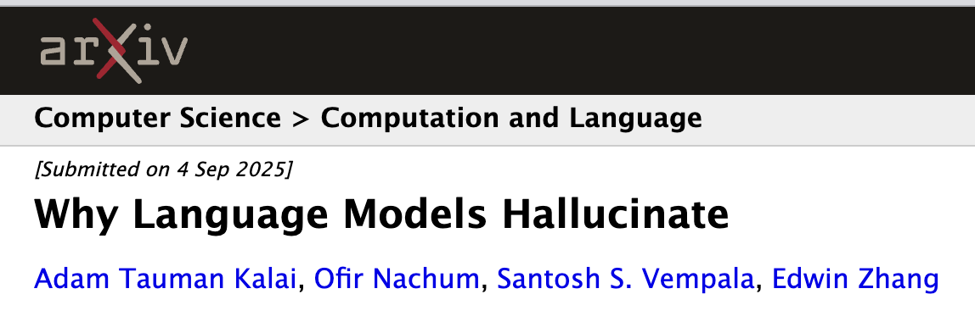
Harnessing
RAG, agents, tool use, verification loops: all of it lowers the rate.
But it works downstream of the objective. The model is still a next-token predictor with no notion of truth.
So a fluent, confident, wrong answer stays possible no matter how much you stack on top. That's Kalai et al.'s error floor.
bare model
+ grounding in your source
+ retrieval, tools, checks
The floor does not reach zero
The bars move with every model release.
Notes:
What I mean by harnessing is anything and everything you build around a model to make it useful and reliable.
-----
Harnessing moves the rate, it does not remove the category. Harnessing (RAG, agent, tool use, verification loops) will measurably lower how often a model hallucinates but it operates downstream of the objectives that produces the behavior of hallucinating in the first place. It does not change what a language model fundamentally is, a next-token predictor with no built-in notion of truth. So the category of failure — a fluent, confident, wrong answer — remains possible no matter how much harnessing you stack on top, even as the rate drops.
Harnessing changes how often you hit the failure. It doesn't change whether the failure is still there to hit. Irreducible error / error floor (Kalai et al.'s framing — some hallucination rate is statistically unavoidable given the pretraining objective)

Slide 34
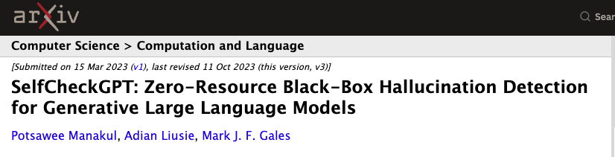
Detection by consistency
SelfCheckGPT: sample the same prompt several times and measure whether the answers agree.
RUN 1
Lancet 394, 1712–1721
RUN 2
NEJM 381, 2103–2114
Cost: n× inference, useful for black-box models
RUN 3
Diabetes Care 42, 731–740
Scored by
BERTScore
QA
n-gram overlap
NL inference
prompting the model itself.
DO IT BY HAND
Ask it in three fresh chats and compare by eye. No scoring needed. When it knows the answer, the repeats agree; when it's making something up, they usually don't.
Manakul, Liusie & Gales (2023), EMNLP, arXiv:2303.08896
Notes:
BERTScore for semantic similarity between samples, a question-answering-based comparison, simple n-gram overlap, natural language inference to check for contradiction, or just prompting the model itself to judge whether two answers agree.
You don’t know Models weights or the sores for each possible next word.
------
SelfCheckGPT, Manakul, Liusie and Gales, EMNLP 2023. The premise is simple and it is the one thing here you can do by hand today: if the model knows a fact, independently sampled responses agree; if it fabricated, they diverge. Scoring can be BERTScore, QA, n-gram, or NLI-based. Cost is the catch: n times inference. But the manual version, rerun three times in separate chats and look for divergence, costs you two minutes.
Bert models are use to predict entitlement, that two generations of sentence predictions means the same or not (one sentence needs to entails the other one and viceversa, so bidirectional).
---
SelfCheckGPT, Manakul, Liusie and Gales, EMNLP 2023. Zero tooling. The premise is simple and it is the one thing here you can do by hand today: sample the model on the same prompt multiple times, independently, do the responses agree with each other,? with no external knowledge base or fact-checker required at all. if the model actually knows a fact — the distribution is sharp — independent samples will converge on essentially the same answer every time, if it fabricated, sampling from a flat distribution, the responses will diverge (inconsistent fabrications). Scoring can be BERTScore for semantic similarity between samples, a question-answering-based comparison, simple n-gram overlap, natural language inference to check for contradiction, or just prompting the model itself to judge whether two answers agree.. Cost is the catch: n times inference. But the manual version, rerun five times in separate chats and look for divergence, If they diverge, you've just caught a fabrication for free, in less time than it takes to make coffee.

Slide 35
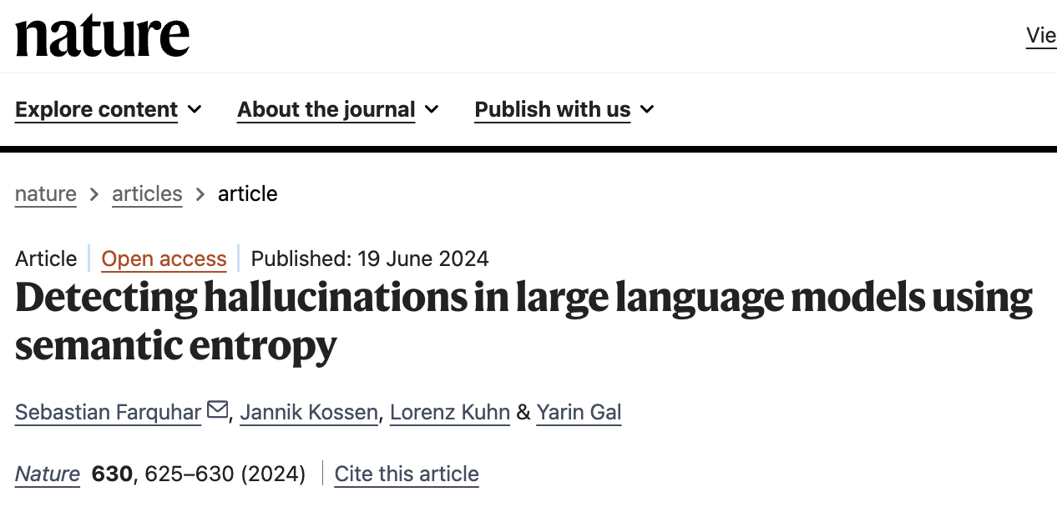
Uncertainty signals
Where the API exposes them:
log probabilities
hidden-state and attention scores
embedding similarity between the answer and its source
Token probability tells you how confident the model is in its wording, not in whether the fact is true.
Lindqvist et al. (2019), Lancet 394, 1712–1721
0.94
Token-level confidence
Looks fine. The citation does not exist. High confidence
Correct format, highly predictable.
Semantic entropy clusters repeated samples by meaning rather than wording, and flags the ones that scatter.
Consistency check: same question, sampled 4 times
A
Lindqvist et al. (2019), Lancet 394
B
Karlsson et al. (2018), BMJ 362
C
Andersson et al. (2020), JAMA 323
D
Nilsson et al. (2017), NEJM 377
4 samples, 4 different meanings: high entropy.
https://www.youtube.com/watch?v=eiL6egIX4ms
Farquhar, Kossen, Kuhn & Gal (2024), Nature 630, 625–630
Notes:
Two concepts, the idea of attention scores is find which parts the model is looking at while producing the word or is there any patters that tend to appear when the model is making something up?
Semantic entropy, Farquhar et al., Nature 2024, addresses this by clustering samples by meaning rather than by surface form, and it is the strongest of these signals. But if you use a chat interface you see none of it, which is exactly why the consistency check on the previous slide matters
---
The important caveat: token probability is confidence in the wording, not in the fact. A model can be highly confident about a fabricated citation because the citation format is highly predictable.
The important caveat: token probability is confidence in the wording, not in the fact. A model can be highly confident about a fabricated citation because the citation format is highly predictable.
API exposes them: means that not every provider lets you see them, many only return the final text
Hidden state: spot patterns that tend to appear when the model is making something up.
Attention scores: show which parts of the input the model “looked at” while producing each word
Where an API actually exposes internals, there are real signals available: log probabilities on the tokens generated, hidden-state and attention-pattern features some research systems extract, and embedding similarity between a generated claim and whatever source material is available to check it against.
The most sophisticated of these, semantic entropy from Farquhar, Kossen, Kuhn and Gal, published in Nature in 2024, improves on raw consistency checking by clustering repeated samples by their meaning rather than their exact wording — two answers that say the same thing in different words should count as agreement, not disagreement, and semantic entropy is what makes that distinction, flagging the samples whose meaning scatters rather than just their surface phrasing. But a very important take-away: token-level probability is confidence in the wording, not confidence in the underlying fact. A fabricated citation can score very high token probability precisely because the format of a citation — author, year, journal, volume, page range — is extremely predictable and well-rehearsed, even when the specific content inside that format is entirely invented. , But if you use a chat interface you see none of it, which is exactly why the consistency check on the previous slide matters.
The important caveat: token probability is confidence in the wording, not in the fact. A model can be highly confident about a fabricated citation because the citation format is highly predictable. Semantic entropy
-—
High confidence and correctness are not the same axis

Slide 36
Semantic entropy
Ask the same question many times, then count the meanings, not the wordings.
HOW IT WORKS
WHAT THE PAPER FOUND
Sample. Ten answers at high temperature, plus one at low temperature to be judged.
Group by meaning. A second model checks whether two answers entail each other.
Measure the spread. One group means it agrees with itself. Many groups means it is guessing.
Semantic entropy
0.79
P(True)
0.70
Naive entropy
0.69
Embedding regression
0.69
AUROC for flagging wrong answers (0.5 is chance), averaged over 30 task and model combinations.
“Paris”, “It’s Paris”, “The capital is Paris”: one meaning, low entropy.
“Paris”, “Lyon”, “Nice”: three meanings, high entropy.
Works on a paragraph too: split it into claims, then score each claim.
Later work (Kossen et al., 2024) predicts it from the hidden states of one answer, with no resampling.
Cost: about ten extra generations per question.
Farquhar, Kossen, Kuhn & Gal (2024), Nature 630, 625–630. Kossen et al. (2024), arXiv:2406.15927.
It catches a model that is making things up. It cannot catch one that is consistently wrong.
Notes:
Source: Farquhar et al., Nature 2024 (the talk by the first author). Sampling: temperature 1 for the sampled answers, one temperature-0.1 answer judged for correctness. Grouping: bidirectional entailment (GPT-3.5 or DeBERTa-large-MNLI). Token-probability and discrete versions both work. Long text: decompose into claims, six questions per claim, three fresh answers each, average the entropy. From the talk (not checked against the paper): the group is working on fine-tuning models to abstain when semantic entropy is high; kernel language entropy is a related method.
https://www.youtube.com/watch?v=eiL6egIX4ms
Semantic uncertainty: sequence samples at high temperature and one generation at low temperature to calcualte accuracy.
Usings token prob of llm
You have a parapgrahs, divide into facts, For each fact we ask a model to generate multiple questions to see if the models answer with the same info as the fact. So if the fact is X is the CEO of Y, you ask questions to make sure we always get that X is the CEO of Y
We cannot diff betweeen a model that has many duffrernts thungs to say and one thst has many ways to say the same thing
Min 9
Semantic entropy probes, cheap approximation (without accuracy labels)

Slide 37
Grounding helps
RAG grounds the answer in retrieved passages. It moves the failure surface: “does the model know this?” becomes “was the right passage retrieved, and did the model use it?” Zhang & Zhang (2025), Mathematics 13(5), 856
​
your question
retriever
passages
model
answer
RETRIEVAL FAILURE · 4 CAUSES
GENERATION DEFICIENCY · 5 CAUSES
The passage never reached the model.
It was there and the model ignored it.
Data sources · queries · retrievers · retrieval strategy
Context noise · context conflict · middle curse · alignment · capability boundary
Feeding the model your data doesn't erase what it already believes. It just puts the two in competition.
FINE-TUNING ON NEW FACTS
RETRIEVAL IT DOESN'T READ
Teaching it new knowledge raises the rate.
It prefers its memory over your evidence.
New-knowledge examples are learnt slowly, and hallucination rises as they are. Gekhman et al. (2024)
RAG models favour faulty passages supplied over internal memory. Tug-of-War (2024)
Notes:
Top half: where a RAG system still hallucinates. Zhang & Zhang's review splits it in two. Retrieval failure means the right passage never reached the model — four causes: data sources, queries, retrievers, retrieval strategy. Generation deficiency means the passage was there and the model overrode or ignored it — five causes: context noise, context conflict, the middle curse, alignment, capability boundary.
Bottom half: the two documented ways the popular fixes make things worse. Gekhman et al. show that fine-tuning examples carrying facts the model never knew are learnt slowly, and as they are learnt hallucination rises roughly linearly. The Tug-of-War paper shows RAG models favouring faulty internal memory even when correct evidence is in front of them.
The line that ties them together: adding your data does not overwrite what the model believes. It puts the two in competition — which is why you read the retrieved chunk.

Slide 38
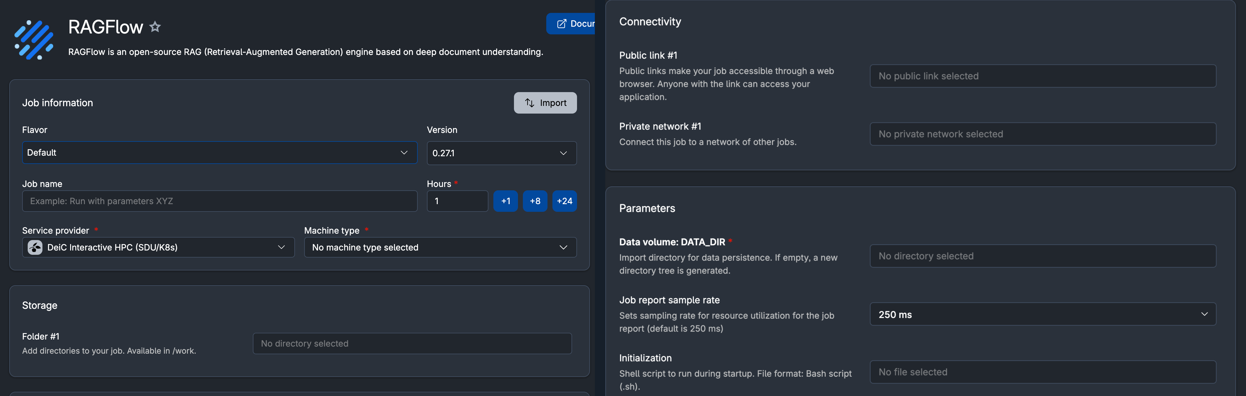
RagFlow on UCloud
Corpus is yours: your protocols, your papers, your SOPs, not the open internet. Data stays inside UCloud.
Every answer comes back with the chunks it was built from, shown by default. If there's no chunk behind a claim, the model wrote it.
ragflow.io
cloud.sdu.dk
Notes:
Practical: RagFlow on UCloud lets you keep the corpus on-prem, which for sensitive health data is the difference between allowed and not. The habit to teach: always read the retrieved chunk, not just the answer. If a claim has no chunk behind it, the model wrote it.
---
You heard this morning about keeping sensitive data inside UCloud rather than sending it to an external API — RagFlow is what that looks like in practice for retrieval. RagFlow on UCloud lets you keep the corpus on-prem, which for sensitive health data is the difference between allowed and not. The core idea: instead of relying on whatever the model happened to memorise from the open internet, you build the corpus yourself, out of your own protocols, your own papers, your own SOPs, so the system is grounded in material you actually trust and control. Because it runs inside UCloud, you can use it given the data protection agreements. The habit to teach: for every answer always read the retrieved chunk of source material it was built from, not just the generated text. If a claim in the answer has no chunk behind it at all, the model wrote that part itself, ungrounded, inside what otherwise looks like a grounded, sourced response. Citations are the entire point of RAG, and a RAG system you use without ever opening the underlying sources is just a slower, more expensive chatbot.

Slide 39
In summary
1
Source constrains and quote extraction: ask AI to find sources and anchor statements to direct quotation
2
Uncertainty permission: tell the AI it’s okay if it doesn’t know
3
Start a new chat and ask AI to find errors
4
Cross-reference with verified sources and be sceptical
5
Double-check facts and ask follow-up questions
6
COT Reasoning: step-by-step reasoning so uncertainty becomes visible
Notes:
ask AI to find sources to back up those claims, and if it already provide sources, ask to check if those sources actually support what its saying
2. Upfront, and if you are unsure about the answer, ask AI how confident it is and wether anything could be wrong. Often AI knows is wrong but they wanted to sound confident
3. If you are still unsure, open a new chat and ask AI to find errors in the answer and to confirm that the sources support the statements
4. for critical work, you should cross.... with trusted sources, be sceptical and double check specific dates, number, citations...
5.
6. Change of thought
reducing hallucitaions is improtant goal to make it more trusthworhty and useful to everyone

Slide 40
4
Critical evaluation
What to do at your desk tomorrow
Notes:
Section turn. Everything so far was diagnosis. This is the part they take back to their desk.

Slide 41
A working checklist
1
Ask what you could verify. Never ask for a fact you have no way to check.
2
Scale scrutiny to consequence. A brainstorm and a methods section are not the same risk.
3
Check every citation at source. DOI or it didn't happen, including the ones that look right.
4
Rerun in a fresh chat. Divergence between runs marks the fabricated part.
5
Give it the source. Grounded in your document beats recalled from training.
6
Log model, version and date. The same prompt will not reproduce next month.
Specificity with no source behind it is the giveaway: exact page numbers, precise percentages, named authors you cannot find.
Notes:
Six habits. If they remember one, make it number two: verifiability scales with the cost of being wrong. Number four is the cheap version of SelfCheckGPT and the single highest-value habit on the slide.

Slide 42
Use an LLM to work on what you give it, not as a source of facts.
1
Every model hallucinates. The rate differs; the category does not.
2
Confidence is trained, not earned. Fluency says nothing about correctness.
3
Harnessing moves the failure somewhere you can inspect. That is the win.
4
The verification burden stays with whoever signs the paper.
Notes:
“Every model makes things up sometimes. Some do it less, but none of them stop.”
“Sounding sure doesn’t mean it’s right. Models are trained to sound confident.”
“Giving the model your own sources doesn’t stop the mistakes, but it makes them much easier to catch.”
“If you sign the paper, you’re the one who has to check it.”

Slide 44
Resources
AA-Omniscience: knowledge & hallucination leaderboard
AI Hallucination Cases Database, D. Charlotin
artificialanalysis.ai/evaluations/omniscience
damiencharlotin.com/hallucinations
Hallucination Mitigation for Retrieval-Augmented LLMs: A Review, Zhang & Zhang 2025, Mathematics 13(5), 856
The Car Wash Test: 53 models, Opper.ai
opper.ai/blog/car-wash-test
doi.org/10.3390/math13050856
Why Language Models Hallucinate, Kalai et al. 2025
SelfCheckGPT, Manakul et al. 2023, EMNLP
arxiv.org/abs/2509.04664
arxiv.org/abs/2303.08896
Semantic entropy, Farquhar et al. 2024, Nature 630, 625–630
Fabricated references in medical content, Bhattacharyya et al. 2023, Cureus 15(5):e39238
doi.org/10.1038/s41586-024-07421-0
doi.org/10.7759/cureus.39238
Does fine-tuning encourage hallucination? Gekhman et al. 2024, EMNLP
Survey on Hallucination in LLMs, Huang et al.
arxiv.org/abs/2311.05232
arxiv.org/abs/2405.05904
Lost in the Middle, Liu et al. 2024, TACL 12, 157–173
AI hallucinations can't be stopped, Nature news feature, Jan 2025
arxiv.org/abs/2307.03172
nature.com/articles/d41586-025-00068-5
Notes:
Leave this up during questions. All links live; the two databases update continuously, so re-check the numbers before you reuse the slides.

