Slide 1
Brandt Redd
CIO/CTO Smarter Balanced Assessment Consortium

Slide 2


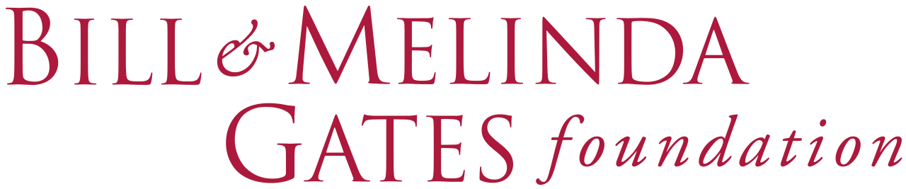

Folio Corporation

Slide 3
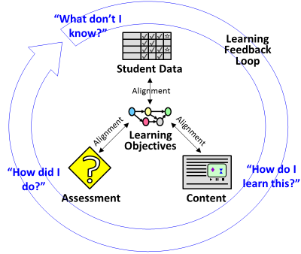
Personalized Learning Model

Slide 4
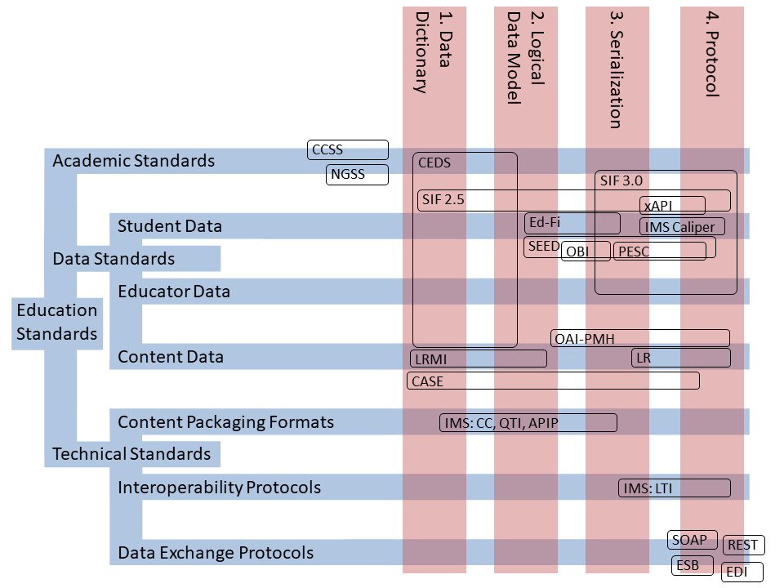
Education Standards Matrix

Slide 5
Abundant Assessment
A Game (Jane McGonigal)
A Goal, Rules, Feedback, Voluntary Participation
Select Observations of School as a Game
Scarce assessment is an impediment to adaptive and personalized learning
The structure of schooling is strongly influenced by a scarcity mentality related to assessment.
Proposition
Abundant assessment would have a transformative impact on the structure of education.

Slide 6
Open
Open Systems
Open Source
Open Content
Open Education Resources
Open Assessment

Slide 7
Open CAT Assessment Framework
Number of Items On Assessment (50)
× Open CAT Ratio (200)
× Cost per Item ($1000)
------------------------------
Cost of an Open Assessment $10,000,000

