Slide 1






Slide 2
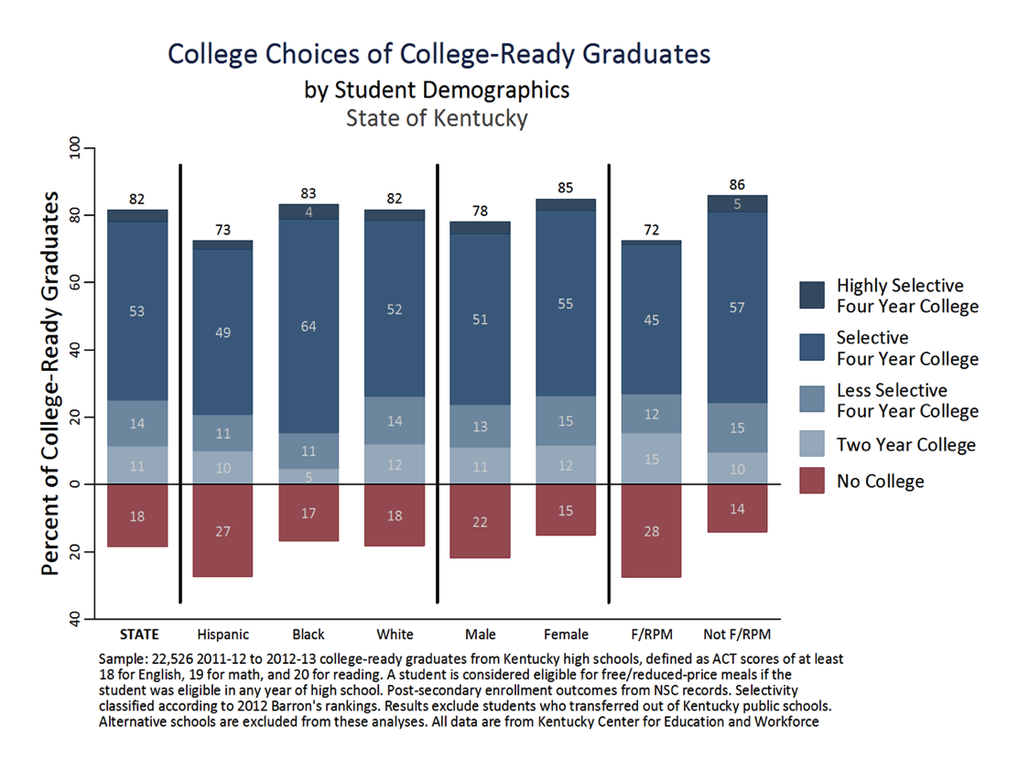
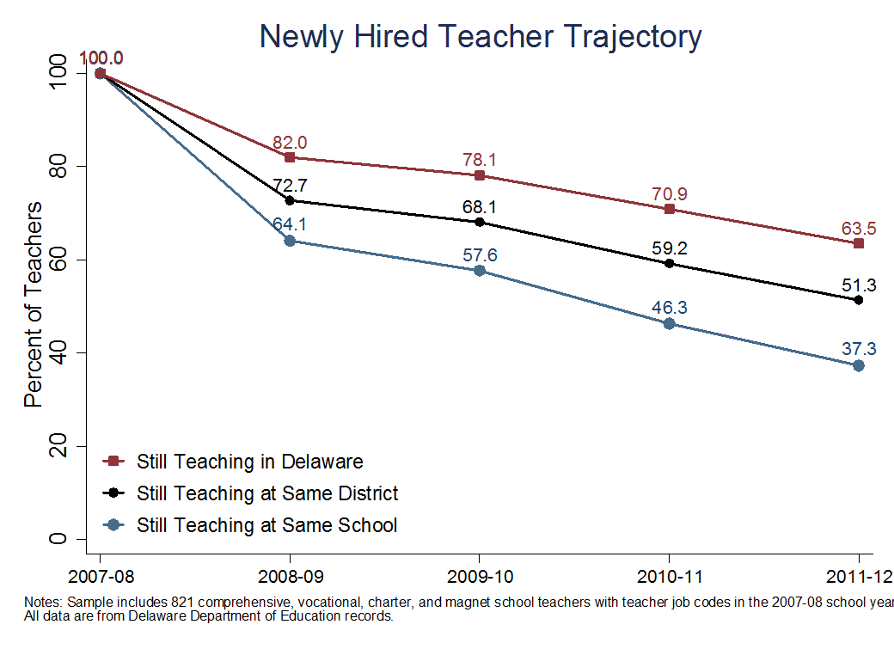

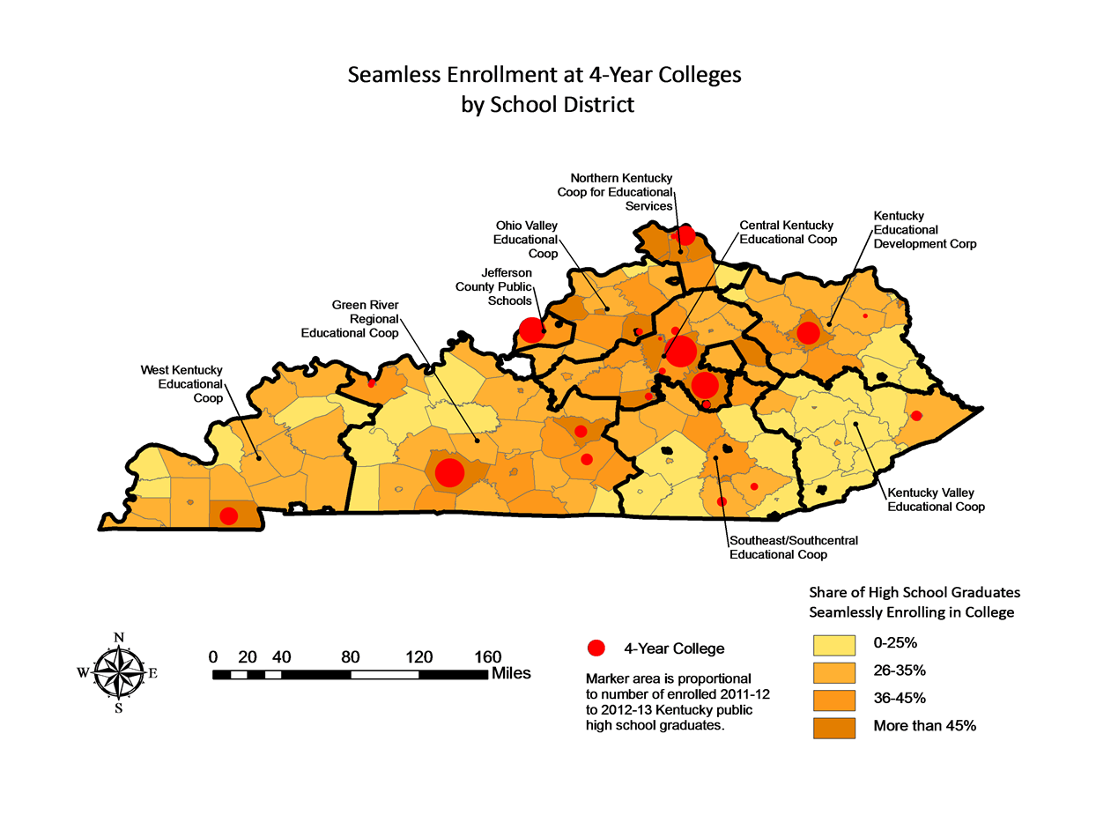
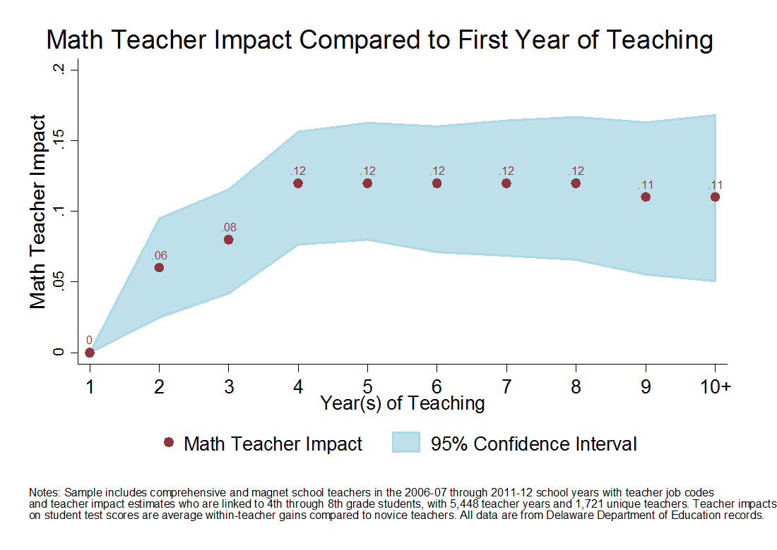

Slide 3
Right People
Right Decisions
Right Data
Right Analysis
SDP Mission:
Transform the use of data in education
to improve student achievement.

Slide 4
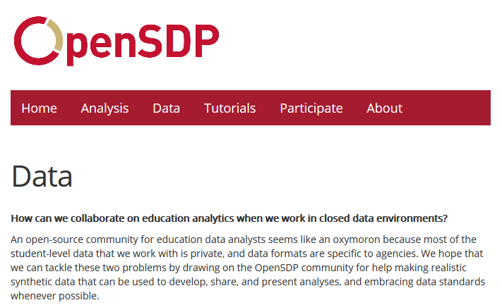

Slide 5
