Slide 1
Applying a Conceptual Framework for Assessment Literacy
NCME Training Session
San Antonio, Texas
April 27, 2017

Slide 2
Current State of Assessment Literacy
The recent emphasis on data-driven decision making and assessment-based accountability has led to a renewed interest and increased sense of urgency surrounding assessment literacy.
A wide variety of topics, many of them technical, are placed under the heading of assessment literacy
One aspect of assessment literacy on which there is little dispute is the lack of it among educators

Slide 3
What is assessment?

Slide 4
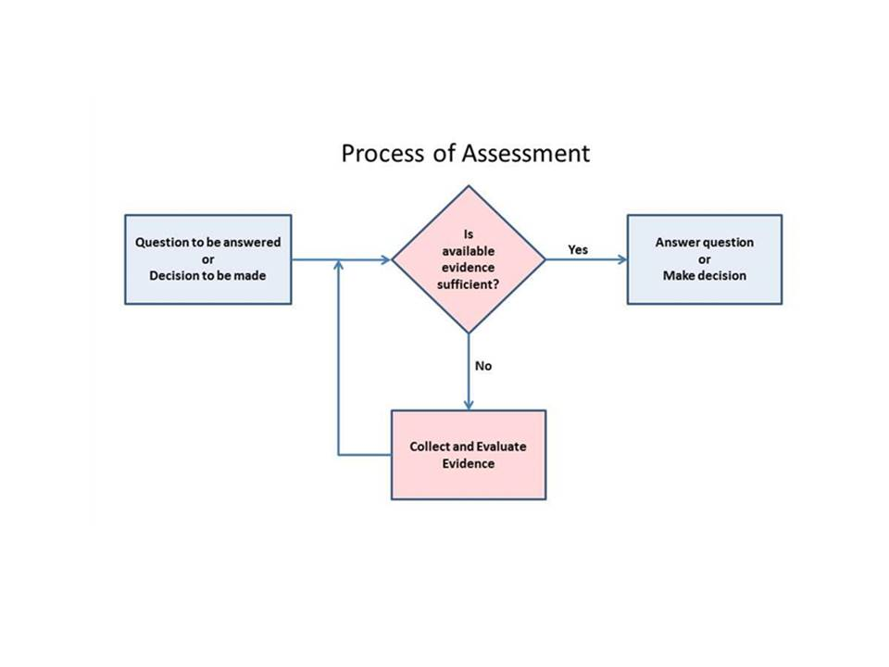
Assessment is a Process
Assessment is a process that involves the collection and evaluation of evidence to answer a specific question.
A critical point in the assessment process is determining whether there is sufficient evidence available to answer that question.
If there is sufficient evidence, the question can be answered.
If not, additional evidence must be collected and evaluated.

Slide 5
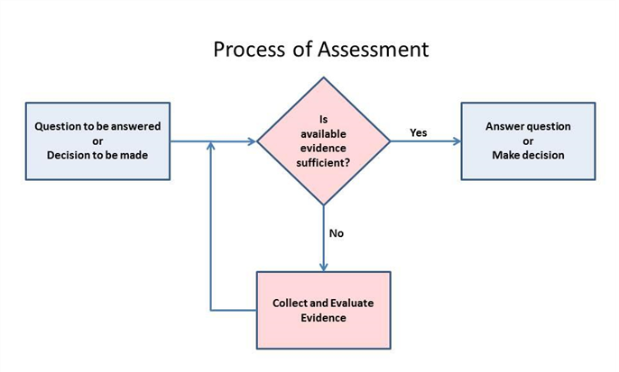
Assessment process in its basic form

Slide 6
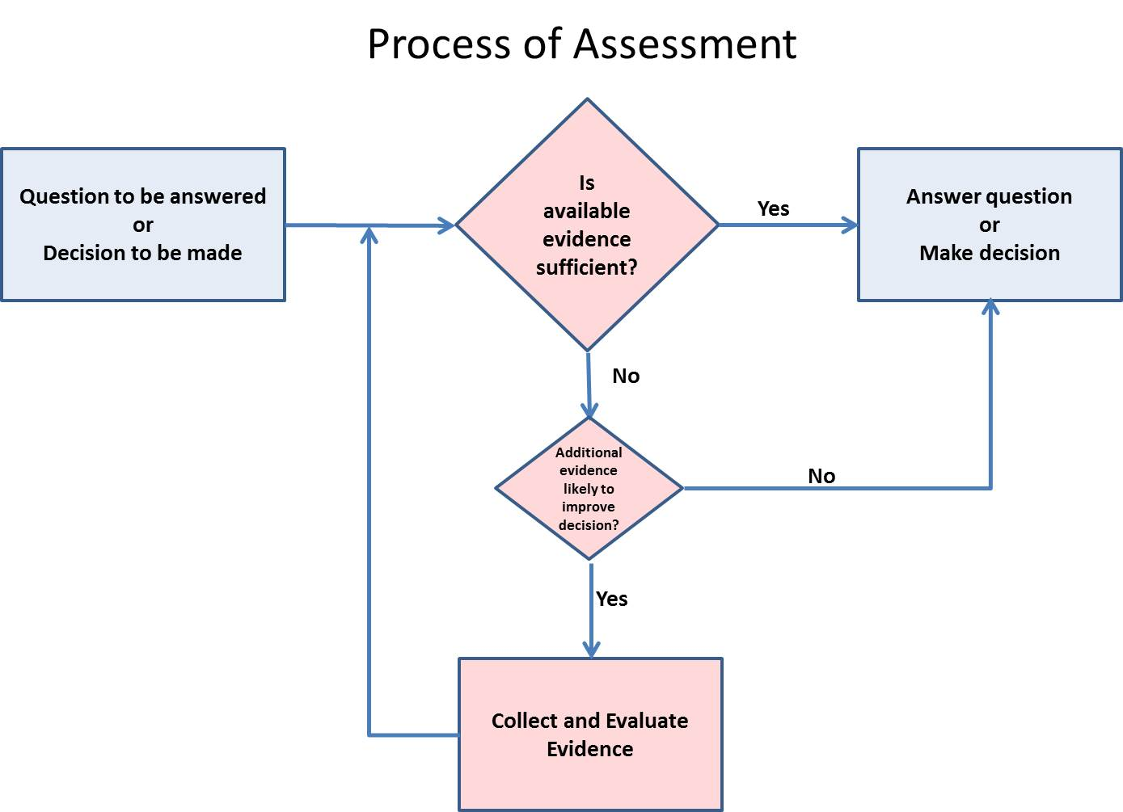
Assessment process – adding complexity

Slide 7

Assessment process – adding complexity

Slide 8
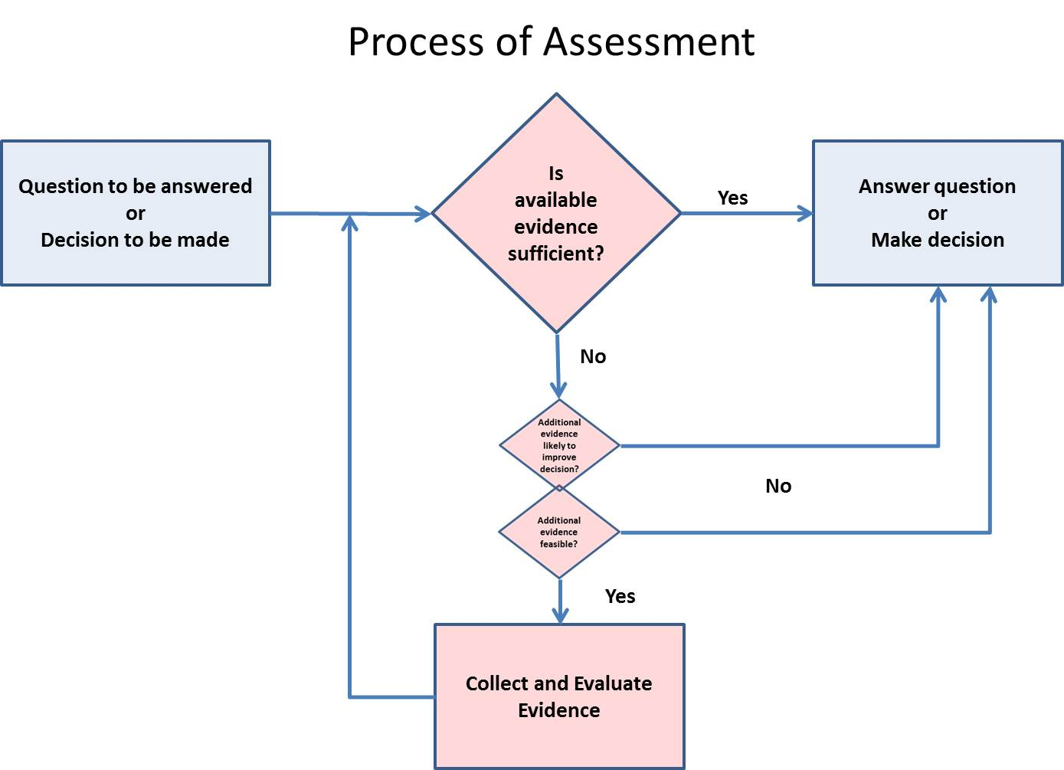
Assessment process – tradeoffs

Slide 9
Questions and Decisions
What is a common question that educators want to answer? Or
What is an important decision that educators need to make?
Consider your own perspective or the perspective of a key stakeholder
Teachers
Building Administrators
Policymakers
Parents, students, general public

Slide 10
Evidence
What evidence is needed to answer the question?
Two critical questions
What is acceptable evidence?
Defining the evidence
Collecting the evidence
How much evidence do I need?

Slide 11
What is acceptable evidence?
Defining the evidence
What is it? and
What makes it acceptable?
Why?
Collecting the evidence
When
How
from Whom

Slide 12
Working through examples

Slide 13
How much evidence do I need?
What are the consequences of a bad decision or incorrect answer?
What are the stakes associated with the decision?
What types of error are most serious?
How fine a distinction is needed?
What level of precision and/or accuracy is required?
Where along the ‘performance continuum’ and distribution of people is the decision point?

Slide 14
How much evidence do I need?
To determine whether
A student performing here
Meets a standard located here

Slide 15
How much evidence do I need?
To determine whether
A student performing here
Meets a standard located here

Slide 16
How much evidence do I need?
To determine whether
A student performing here
Meets a standard located here

Slide 17
How much evidence do I need?
To determine whether more than 50% of students are Proficient
Not Proficient
Proficient

Slide 18
How much evidence do I need?
To determine whether more than 50% of students are Proficient
Not Proficient
Proficient

Slide 19
How much evidence do I need?
To determine whether 54% of students are Proficient
Not Proficient
Proficient

Slide 20
Is available evidence sufficient?
Consider the knowledge and skills needed to answer that question?
It first requires an understanding of what evidence is appropriate, necessary
This often comes from a deep knowledge of the topic area
It also requires an understanding of the context
How much precision and accuracy is needed?
What are the consequences of various types of error?

Slide 21
Is available evidence sufficient?
We can couch the previous questions in measurement terms as validity and reliability…
In reality, however, they require a pre-existing knowledge base that is external to the assessment process.
All assessment is situated within a broader context.
An understanding of that context, therefore, is a necessary condition for assessment literacy

Slide 22
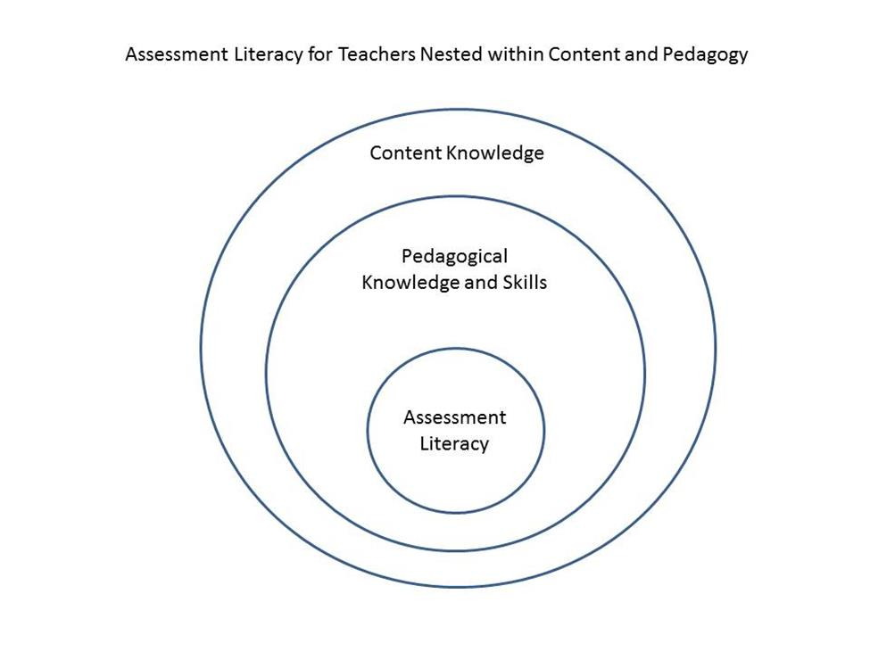
Assessment Literacy is always nested

Slide 23
Context varies across stakeholders
The questions asked and evidence needed to answer those questions will vary across stakeholders.
Teachers, administrators, policymakers, parents, students, and the public at large
Therefore, the required prior knowledge base will also vary across stakeholders
Communication and interactions among stakeholder groups, however, requires some shared understanding; for example
Administrators Teachers
Policymakers Administrators
Teachers Parents
Policymakers Public

Slide 24
Context across stakeholders
What would the nesting picture look like for various stakeholders?
School administrators
State Policymakers
Parents
What knowledge and skills do they need to answer questions and make decisions?
What knowledge and skills do they need to make judgments about evidence?

Slide 25
Work through Examples

Slide 26
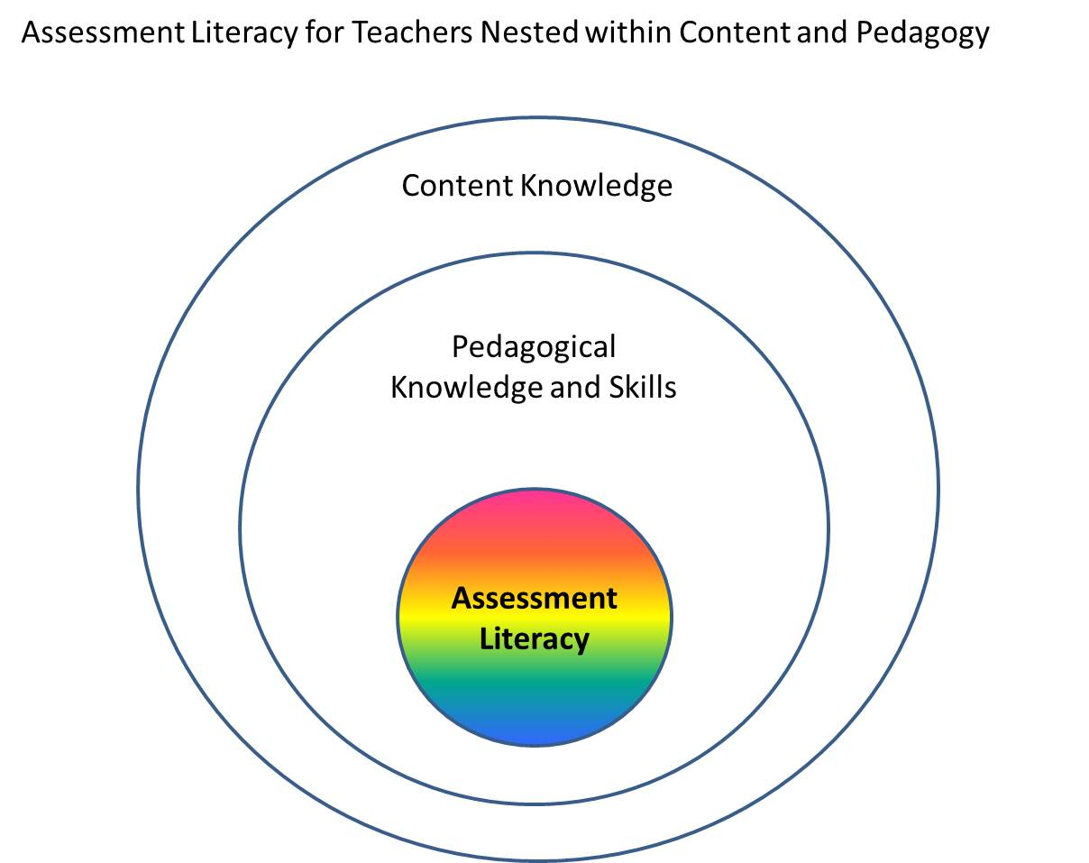
Assessment Literacy
Accepting that assessment literacy is nested within a broader context
What are the knowledge and skills that are needed to be an assessment literate teacher, administrator, policymaker, …?

Slide 27
Assessment Literacy
Assessment Literacy comprises three types of literacy
Testing Literacy – the understanding of the fundamental principles of test design, development, and use.
Measurement Literacy – the understanding of fundamental measurement principles, particularly those related to validity and the uncertainty of measurement
Data Literacy – the possession of the basic skills needed to organize and manipulate data so that it can be analyzed, interpreted, and used appropriately
They are applied together, but each is a distinct body of knowledge and skills.
The particular skills needed within each of the three types of literacy are context dependent

Slide 28
Testing Literacy (sample knowledge and skills)
Properties of various item types
Principles for item development
Development and use of scoring rubrics
Methods for aggregating items scores to generate test scores
Time needed to respond to items
Issues related to bias and sensitivity

Slide 29
Measurement Literacy (sample knowledge and skills)
Understanding Uncertainty due to
Students, Items, Testing conditions, etc.
Balancing standardization and flexibility
Interpreting Norm- and criterion-referenced scores
Comparing scores across
Students
Classes or schools
Different tests
Time
Interpreting individual student and group scores

Slide 30
Data Literacy (sample knowledge and skills)
Sorting Items or Students
Selecting or filtering groups of students
Examining relationships between variables
Generating and interpreting basic charts and graphs
Generating and interpreting two-way tables
Generating and interpreting summaries of group performance
Combining information from multiple sources

Slide 31
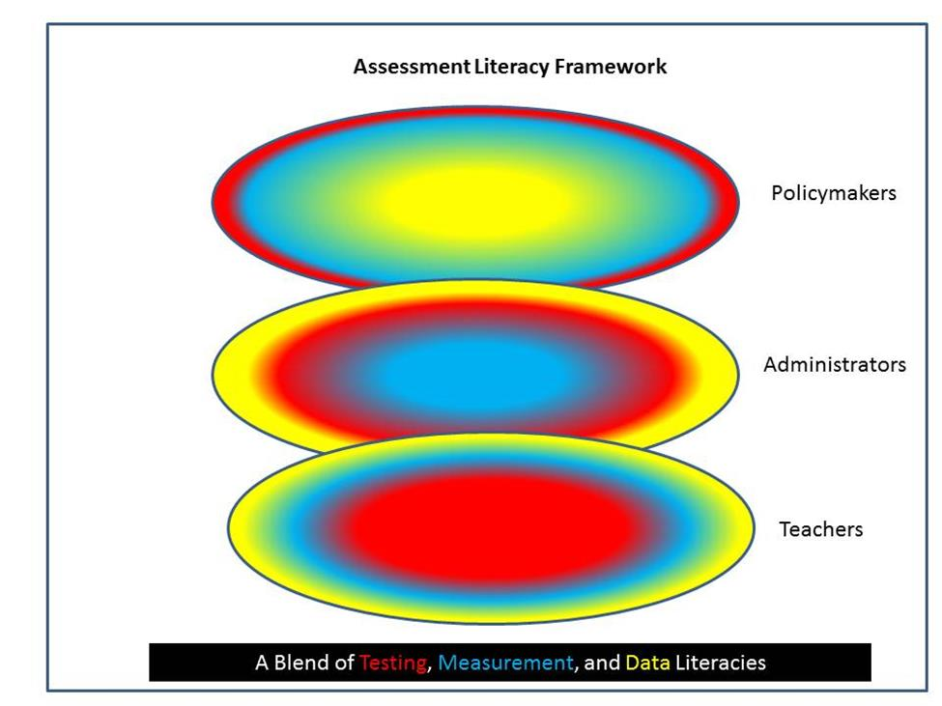
A conceptual framework

Slide 32
Applying the conceptual framework
In developing the Assessment Literacy Framework, our focus was the efforts needed to develop, support, and sustain assessment literacy.
Through the proposed assessment literacy framework, we hope to provide a comprehensive picture of assessment literacy
a view of assessment literacy that is multidimensional, grounded in practice, and nested within the role-specific knowledge and skills of teachers, administrators, and policymakers.
The framework should serve as a useful tool for states, local education agencies, educator preparation programs, and others developing programs and materials to increase assessment literacy and improve the instruction and learning of all students.

Slide 33
For more information

