Slide 1

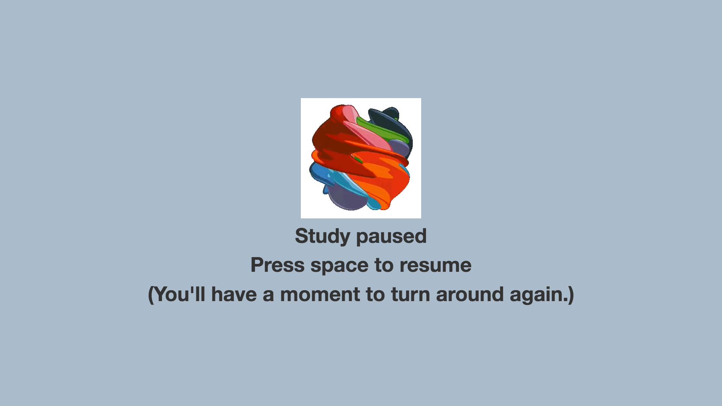
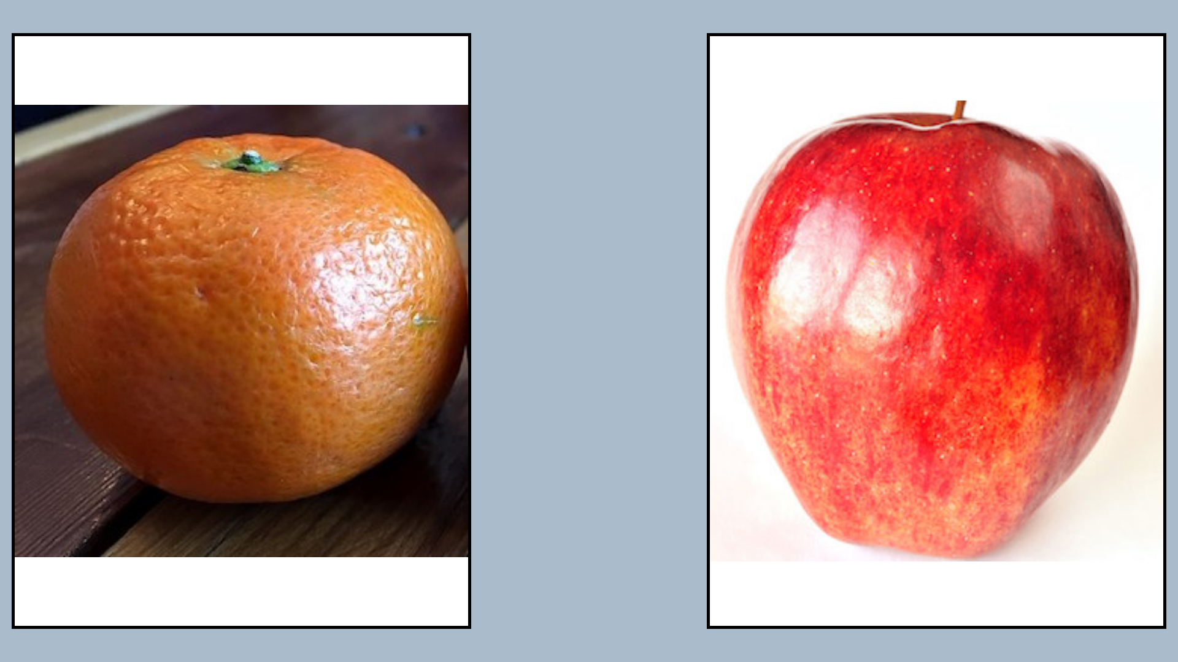

♫ audioSources
♫ pauseAudio
Announcement phase (optional)
Duration: maximum of
attnLength, audio duration
containerColor
backgroundColor
x N (determined
by trial length)
Duration: trialLength seconds
displayMs
♫ musicSources
Alternates between leftImagesA and leftImagesB
blankMs
Alternates between rightImagesA and rightImagesB
♫ endAudioSources
Wrap-up audio (optional) – useful if this is last trial

Slide 2
