Slide 1



AFTER DETERRENCE: EXPLAINING CONFLICT SHORT OF WAR
J Andres Gannon*, Erik Gartzke*, and Jon Lindsay†
American Political Science Association (APSA) Conference, Boston, MA
^{October 2019}
* † Center for Peace and Security Studies (cPASS)
*Political Science Dept, University of California, San Diego
†Munk School of Global Affairs, University of Toronto

Slide 2
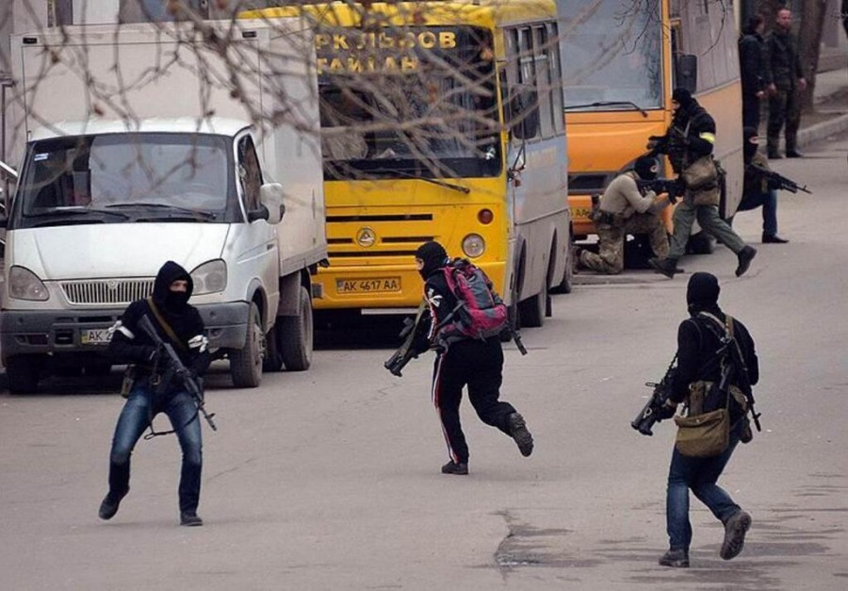
Motivation

Slide 3
Puzzle
What is gray zone conflict?
Why is it pursued?
How should the US respond?

Slide 4
Point
Gray zone conflict occurs when militarily capable conflict initiators intentionally limit the intensity and capacity with which they conduct military or intelligence operations and the target either does not or cannot escalate the contest
Happens under two conditions:
Deterrence
- Disincentivizing causes de-escalation to ordinary competition
2. Efficiency
- Disincentivizing causes escalation to traditional conflict

Slide 5
Goal is to convince you that:
Although conflict between peace and war isn’t new
Motivations are
Theories about changes in how states fight
Requires understanding why
Russian cyber operations are illustrative of motivations for gray zone conflict

Slide 6
Conventional Understanding
Low intensity conflict is “waged by a combination of means, including the use of political, economic, informational, and military instruments...major causes of low intensity conflicts are instability, and lack of political and economic development in the Third World.”
President Reagan National Security Strategy (1987)
Wars are limited by:
Ends (Brodie 1957, Kissinger 1957, Osgood 1969)
Risk (Hart 1954, Snyder 1965, George and Smoke 1989, Powell 2015)
Means (Kornbluh and Hackel 1986, Schultz 1986, Nagl 2005)

Slide 7
Conventional Understanding
“a conceptual space between peace and war,
occurring when actors purposefully use single or multiple elements of power to achieve political-security objectives
with activities that are typically ambiguous or cloud attribution
and exceed the threshold of ordinary competition, yet intentionally fall below the level of large-scale direct military conflict,
and threaten US and allied interests by challenging, undermining, or violating international customs, norms, or laws.”
- General Votel (January 2017)

Slide 8
New Understanding
Gray zone conflict occurs when militarily capable conflict initiators intentionally limit the intensity and capacity with which they conduct military or intelligence operations and the target either does not or cannot escalate the contest

Slide 9
New Understanding
Gray zone conflict occurs when militarily capable conflict initiators intentionally limit the intensity and capacity with which they conduct military or intelligence operations and the target either does not or cannot escalate the contest
1. Capable initiators – distinguishes gray zone from other forms of low-intensity conflict

Slide 10
New Understanding
Gray zone conflict occurs when militarily capable conflict initiators intentionally limit the intensity and capacity with which they conduct military or intelligence operations and the target either does not or cannot escalate the contest
2. Limitation by choice – motivated by agency, not necessity

Slide 11
New Understanding
Gray zone conflict occurs when militarily capable conflict initiators intentionally limit the intensity and capacity with which they conduct military or intelligence operations and the target either does not or cannot escalate the contest
3. Mutually-preferred – tacit collusion between adversaries

Slide 12
1. Capable Initiators
 |  | Ends
 |  | Concessions | Conquest
Available Means | Smaller, less diverse | Small wars | Revolutionary wars
 | Larger, more diverse | Gray zone conflicts | Major combat operations

Slide 13
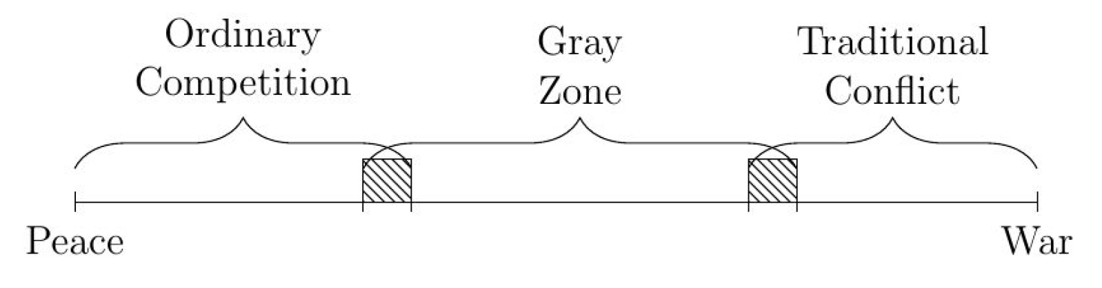
2. Choice
“[a] main consequence of limited war, and potentially a main purpose for engaging in it, is to raise the risk of larger war”
- Schelling, Arms and Influence
Powerful actors choose limited war to lower the risk of larger war
Deterrence: Limited conflict ≿ Ordinary competition ≿ High intensity warfare
Efficiency: Limited conflict ≿ High intensity warfare ≿ Ordinary competition

Slide 14
2. Choice
Deterrence success – avoids triggering escalation
The initiator’s strategy is a compromise between what they do best and what would avoid a retaliate response
Efficient choice –initiator’s preferred option
The initiator perceives that it is likely to succeed in the gray zone without unnecessary costs in resource expenditure or losing the benefits of ordinary peacetime competition

Slide 15
3. Mutually Preferred
Nash equilibrium: no incentive to deviate from limited gray zone contest
Initiator perspective
- Avoids retaliation or unnecessary costs
Target perspective
- Avoids having to retaliate and risk open escalation

Slide 16
Responding to Gray Zone
Ask ‘why was a gray zone strategy chosen?’
Raising the cost of gray zone changes initiator’s options. What initiator chooses depends on the causal model
Deterrence: Gray zone ≿ Ordinary competition ≿ High intensity conflict
Efficiency: Gray zone ≿ High intensity conflict ≿ Ordinary competition

Slide 17
Responding to Gray Zone
Ask ‘why was a gray zone strategy chosen?’
Deterrence model
Raising the cost of gray zone conflict decreases the risk of escalation
Efficiency model
Raising the cost of gray zone conflict increases the risk of escalation
Deterrence: Gray zone ≿ Ordinary competition ≿ High intensity conflict
Efficiency: Gray zone ≿ High intensity conflict ≿ Ordinary competition

Slide 18
Empirical Examples
Goal:
Investigate military means chosen by capable actor “pulling punches”
Motivated by deterrence or efficiency
What is effect of target response
Case studies:
Russian cyber campaigns

Slide 19
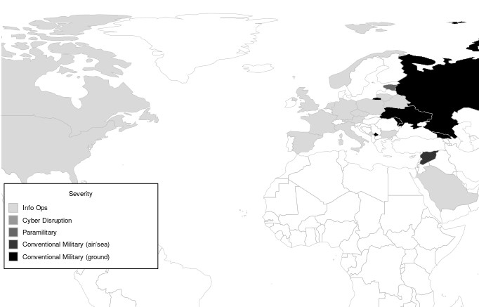
Intensity of Russian Activity (1994-2017)

Slide 20
Case comparison of Russian gray zone conflicts
Russian Response | United States (2016) | Estonia (2007) | Ukraine (2014) | Georgia (2008)
Conventional Forces |  |  |  | X
Special Operations |  |  | X | X
Disruptive Cyber |  | X | X | X
Information Operations | X | X | X | X

Slide 21
Contrasting Cases
Georgia (2008)
Estonia (2007)
Low deterrent gradient
Full spectrum Russian gray zone operations
Western reaction prompted escalation by Russia
High deterrent gradient
Muted Russian gray zone operations
Western reaction prompted cyber-defense and Russia “designing around” deterrence

Slide 22
Takeaway
“Conflict short of war” is an old concept, but “gray zone conflict” requires a new understanding of the type of actor, motivation, and mutual preference
Gray zone challenges are an inevitable consequence of causes of peace in the 21st century
Deterrence (high cost to war): adversaries are “designing around” successful general deterrence
Efficiency (high benefits to peace): adversaries can be revisionist and hassle without triggering a loss of cooperation
Reaction to disincentivizing gray zone conflict is a function of these factors

