Slide 1



AFTER DETERRENCE: EXPLAINING CONFLICT SHORT OF WAR
J Andres Gannon*, Erik Gartzke*, and Jon Lindsay†
American Political Science Association (APSA) Conference, Boston, MA
^{October 2019}
* † Center for Peace and Security Studies (cPASS)
*Political Science Dept, University of California, San Diego
†Munk School of Global Affairs, University of Toronto

Slide 2
New theory of gray zone conflict
Gray zone conflict occurs when militarily capable conflict initiators intentionally limit the intensity and capacity with which they conduct military or intelligence operations and the target either does not or cannot escalate the contest
Happens under two conditions:
Deterrence
- Disincentivizing causes de-escalation to ordinary competition
2. Efficiency
- Disincentivizing causes escalation to traditional conflict

Slide 3
1. The who of gray zone
 |  | Ends
 |  | Concessions | Conquest
Available Means | Smaller, less diverse | Small wars | Revolutionary wars
 | Larger, more diverse | Gray zone conflicts | Major combat operations

Slide 4
2. The why of gray zone
Deterrence success – avoids triggering escalation
The initiator’s strategy is a compromise between what they do best and what would avoid a retaliate response
Efficient choice –initiator’s preferred option
The initiator perceives that it is likely to succeed in the gray zone without unnecessary costs in resource expenditure or losing the benefits of ordinary peacetime competition

Slide 5
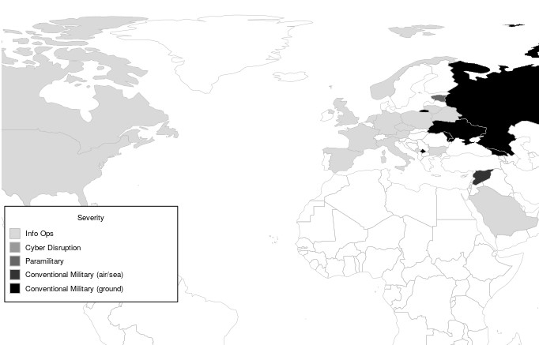
Empirical test: Intensity of Russian Activity (1994-2017)

Slide 6
Empirical test: Intensity of Russian Activity (1994-2017)
Russian Response | United States (2016) | Estonia (2007) | Ukraine (2014) | Georgia (2008)
Conventional Forces |  |  |  | X
Special Operations |  |  | X | X
Disruptive Cyber |  | X | X | X
Information Operations | X | X | X | X

