Slide 1



AFTER DETERRENCE: EXPLAINING CONFLICT SHORT OF WAR
Erik Gartzke*, J Andres Gannon*, and Jon Lindsay†
* † Center for Peace and Security Studies (cPASS)
*Political Science Dept, University of California, San Diego
†Munk School of Global Affairs, University of Toronto

Slide 2
Goals of Paper
Re-define gray zone
Explaining its causes
Implications that has for responses

Slide 3
Structure of the paper
Introduction
Policymaking understanding of gray zone
Academic understanding of gray zone
New definition of gray zone
Implications for understanding security
Implications for constructing policy
Conclusion

Slide 4
Point
Gray zone conflict is a policy choice by powerful actors who both prefer low-intensity to full-scale war
Happens under two conditions:
The target has raised the cost of full-scale war to an unacceptable level for the initiator (initiator is deterred from fighting full-scale)
The initiator believes it can achieve its objectives at a lower intensity and cost than full-scale war (gray zone appears efficient)

Slide 5
Re-defining gray zone
Gray zone conflict is conflict involving actors who intentionally limit the intensity and capacity that they dedicate to fighting. In other words, gray zone conflict defines political conflict between peace and war where neither side is willing to escalate to full-scale war

Slide 6
Explaining its causes
Deterrence success - they wish to avoid triggering escalation
The initiator’s strategy is a compromise between what it does best militarily and what it fears will happen if it adopts its optimal battlefield strategy and tactics
Implication – raising the cost of gray zone can cause initiator to stop without risk of escalation
Limited war as a choice - it’s the initiator’s preferred option
The initiator perceives that it is likely to succeed in the gray zone without unnecessary costs
Implication – raising the cost of gray zone conflict risks encouraging the initiator to escalate

Slide 7
Implications for responses
“[a] main consequence of limited war, and potentially a main purpose for engaging in it, is to raise the risk of larger war”
- Schelling, Arms and Influence
Powerful actors choose limited war to lower the risk of larger war
Ask ‘why was a gray zone strategy chosen?’
Raising the cost of gray zone changes initiator’s options. What initiator chooses depends on the causal model: 1) cost-aversion vs 2) preferred limited war

Slide 8
Updated SMA Definition (Jan 2017)
The gray zone is a conceptual space between peace and war, occurring when actors purposefully use single or multiple elements of power to achieve political-security objectives with activities that are typically ambiguous or cloud attribution and exceed the threshold of ordinary competition, yet intentionally fall below the level of large-scale direct military conflict, and threaten US and allied interests by challenging, undermining, or violating international customs, norms, or laws.

Slide 9
Updated SMA Definition (Jan 2017)
Distinction between gray zone and traditional warfare:
Significant, attributable coercive force
Means and goals:
Can involve non-security domains, but for the purpose of a broadly-defined security advantage over the other actor

Slide 10
Updated SMA Definition (Jan 2017)
Relationship to norms:
Challenges norms while stopping short of clear violations of international law (e.g. Chinese “little blue men”)
Violates norms in ways that avoid penalties (e.g. Russia in Crimea)
Extremist organizations and non-state actors integrate elements of power to advance security interests

Slide 11
Identifying Thresholds
The gray zone is a conceptual space between peace and war, occurring when actors purposefully use single or multiple elements of power to achieve political-security objectives with activities that are typically ambiguous or cloud attribution and exceed the threshold of ordinary competition, yet intentionally fall below the level of large-scale direct military conflict, and threaten US and allied interests by challenging, undermining, or violating international customs, norms, or laws.

Slide 12
Identifying Thresholds
Ordinary Competition
Gray Zone
Traditional Conflict
Peace
War
Means: coercive, directed maneuvering
Ends: revisionist, harms another actor, affect relative power
Means: combined arms intensive warfare
Ends: avoid proportional response, maintain mutually agreed upon ceiling of escalation

Slide 13
CDD Angle
Types and levels of conflict are not synonymous
Dimensions over which gray zone conflict varies:
Intensity/level – resource allocation
Cost to adversary
Explains whether shifting from one type of conflict to another necessitates an increase in the level of conflict

Slide 14
Empirics
Russia in Crimea (avoiding response e.g. Malaysian airline)
Russia in Ukraine (cost-minimization)
China in South China Sea (violation of norms)
Pakistan in Kashmir (ambiguity)
North Korea and Sony
Iran and nuclearization threat
US and USSR air defense systems

Slide 15
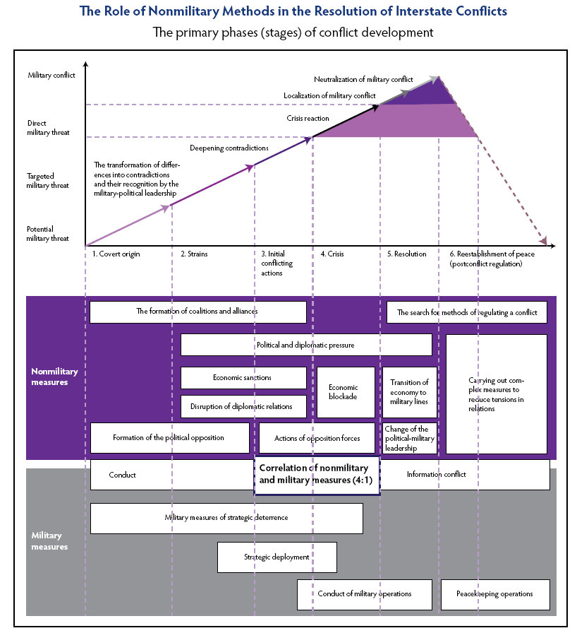
Gerasimov Doctrine
Lines are blurred between war and peace
Non-military means are used to achieve political and strategic goals (Libya no fly zone) and military means are concealed (drones, PGS)
Need to change unified approaches and integration, control information, defend territory from SOCOM
Enemies will always have vulnerabilities
Don’t copy foreign experience, “outstrip them and occupy leading positions ourselves”

Slide 16
Short-term to do list
What to do regarding new SMA definition
Identify the current IR theories we disagree with
Limited war raises the risk of larger war (Schelling 1966)
High risk of large war disincentivizes limited war (Snyder 1967)
Adaptability of deterrence (George and Smoke 1974, 1989)
Theories of LIC sufficiently explain this
Limited nuclear war?

Slide 17
Long-term to do list
Relevance for spiral and deterrence models of conflict
Audiences (allies and proxies) and the telegraphing of intentions
Gray zone and rising powers
Electioneering
Implications for cyber

