Slide 1


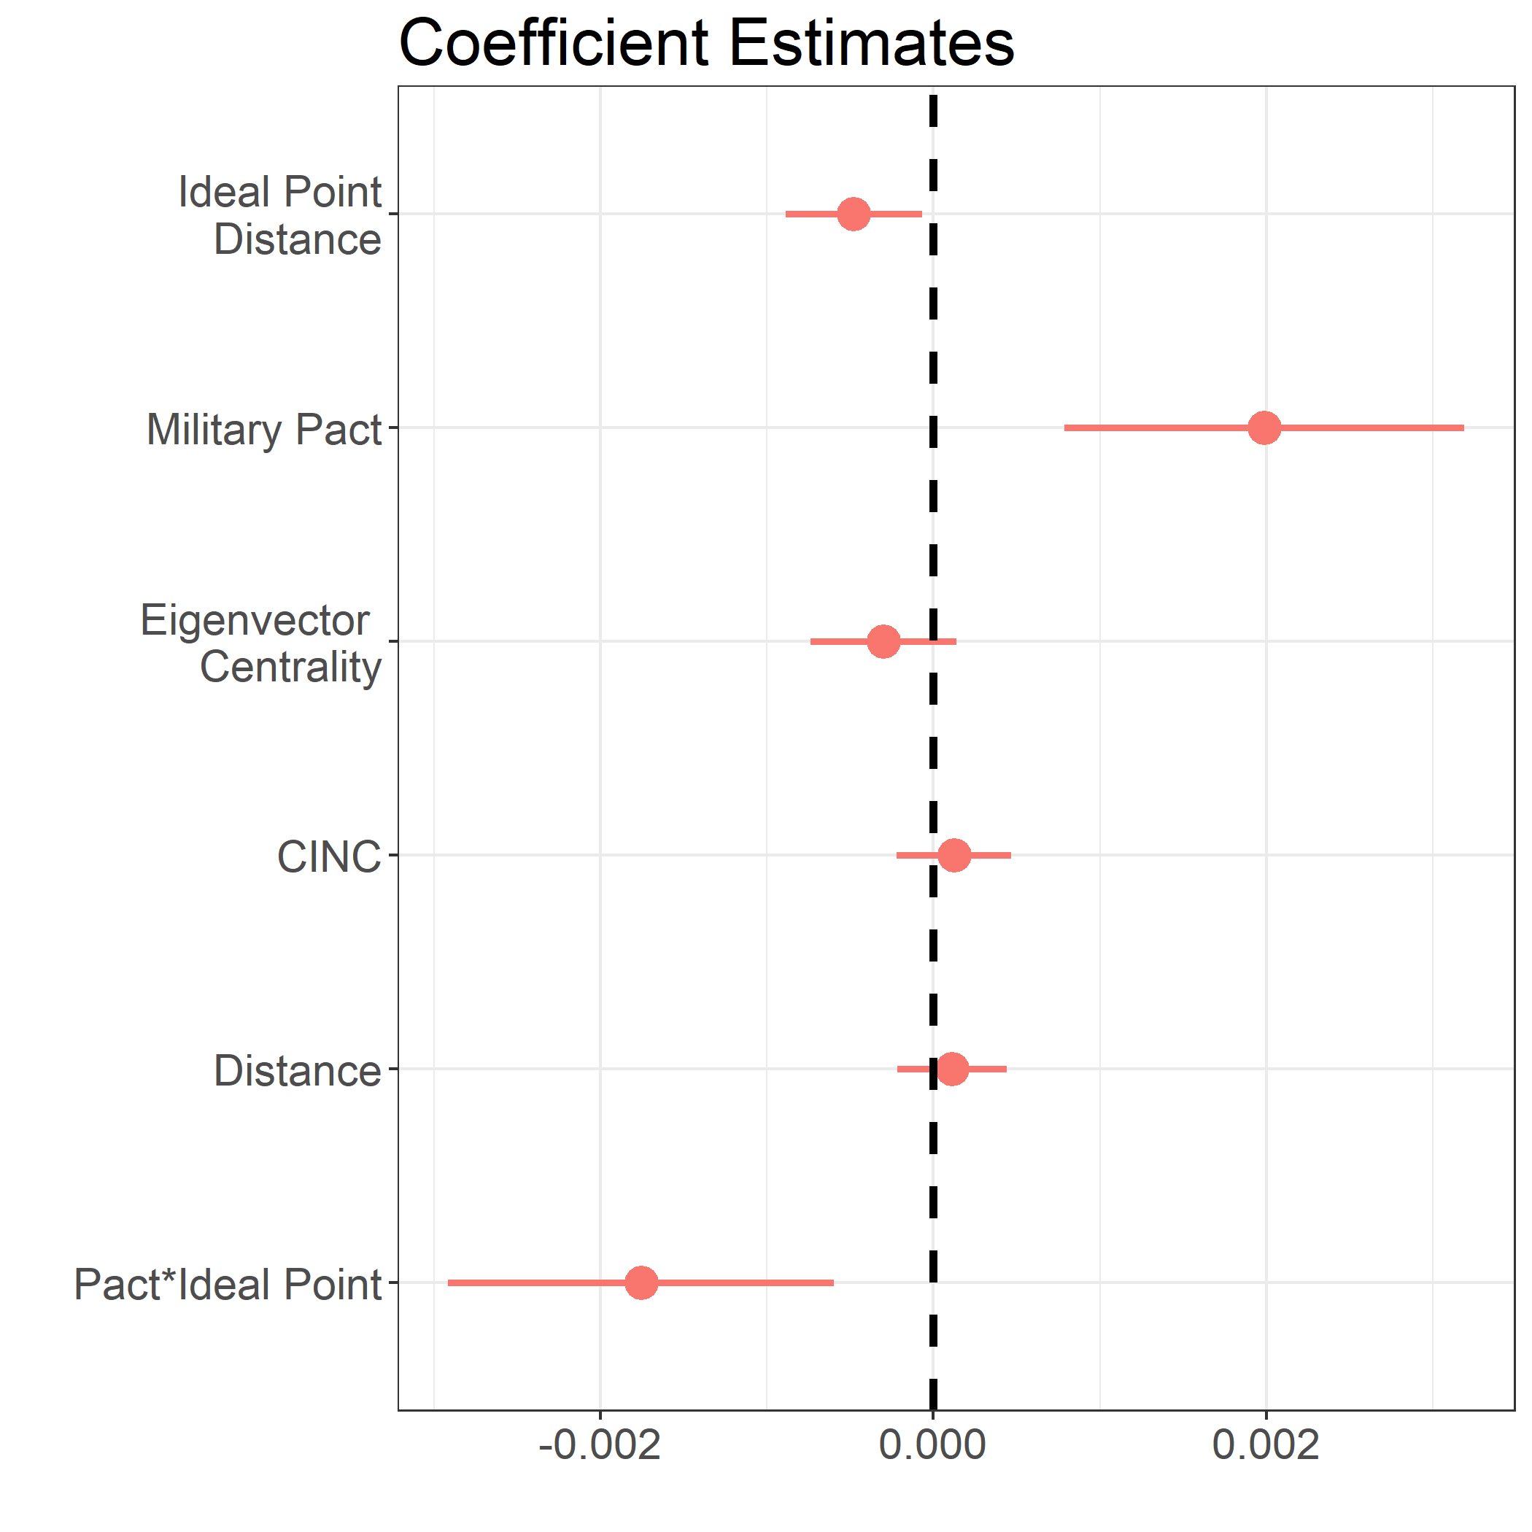
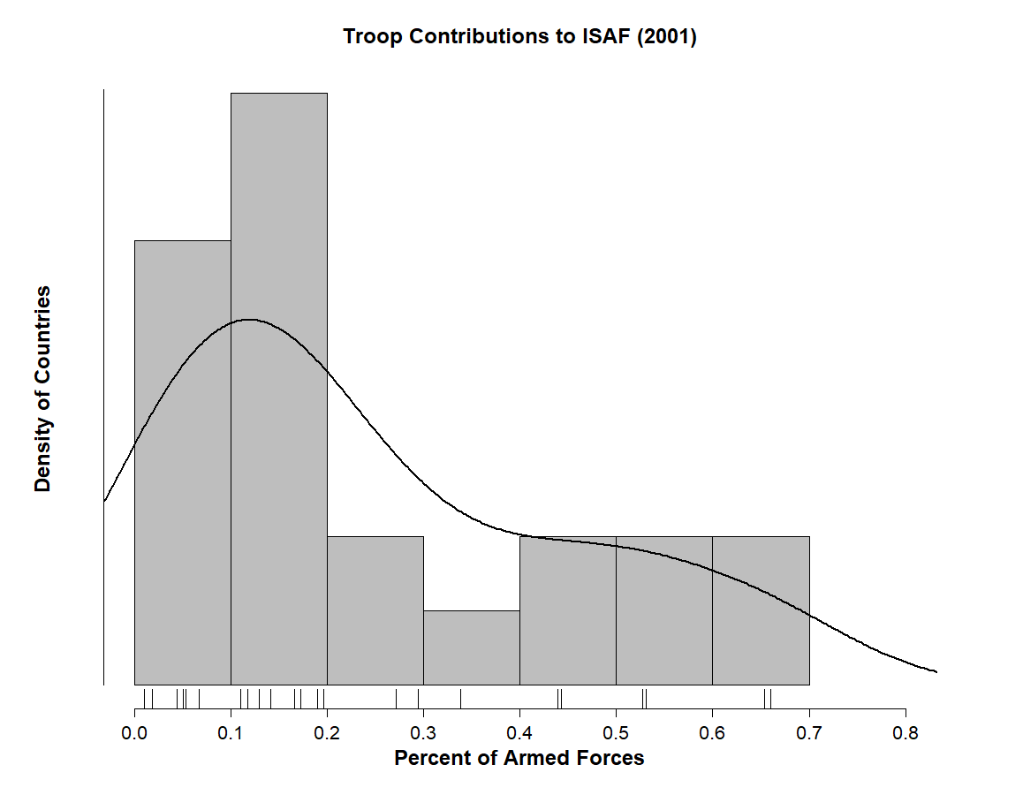
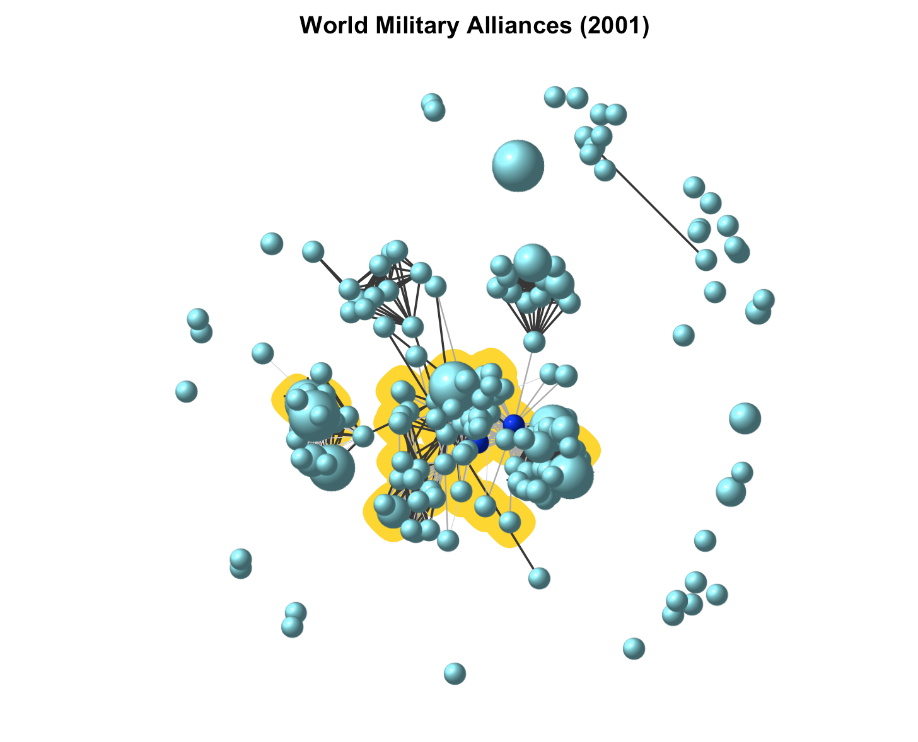
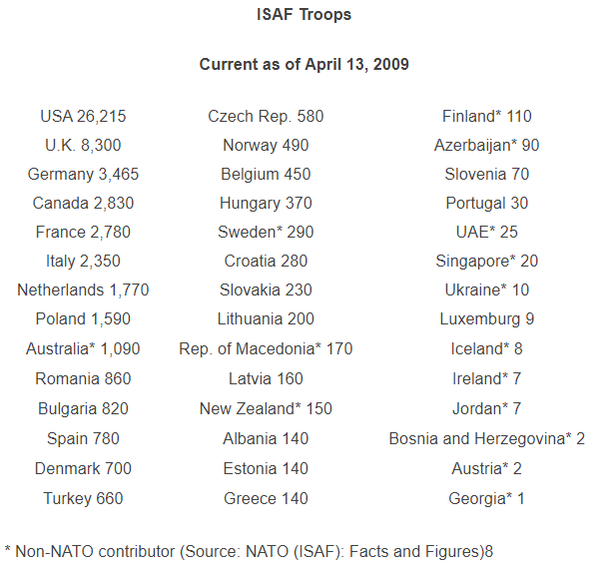
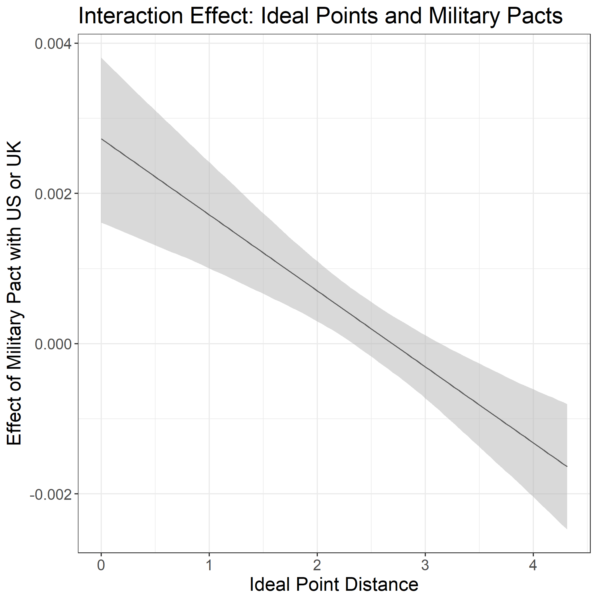
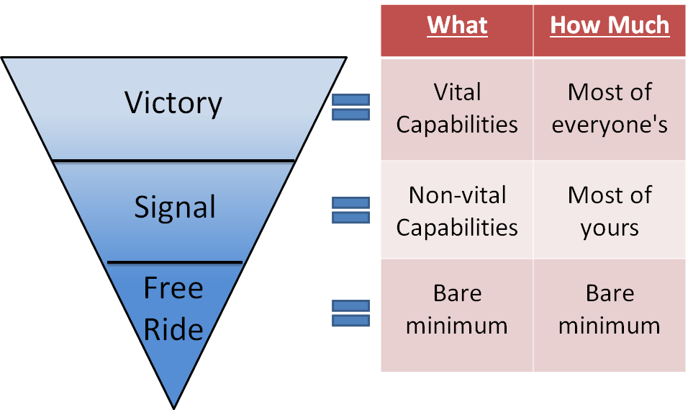
Coordination in Conflict Theaters: Explaining Contributions to Coalition Warfare
J Andres Gannon, UC San Diego (jagannon@ucsd.edu) and Daniel Kent, OSU (kent.249@osu.edu)
Abstract
Why do countries contribute forces to war-time conflicts in which they have seemingly little strategic interest? We construct a novel data set of country-level force structures and each country's specific commitments to the NATO International Security Assistance Force in Afghanistan. After employing measures of foreign policy preferences from UN voting data, we find that closer foreign policy preferences with the US are associated with greater troop contributions. However, countries without a military pact with the US or UK are less sensitive to these preferential differences. These analyses suggest that countries will contribute surprisingly to conflicts if signaling reliability can produce material benefits through subsequent cooperation.
Conflict Theater Network
Research Design
Unit of analysis: State (2001)
DV: Percent of national military personnel fighting in Afghanistan War
EV: Preference Alignment with US/UK + Military pact with US/UK
Controls: Military Pact, Ideal Point Distance from US, Eigenvector Centrality in Preference Network, CINC score, Distance from Afghanistan
Model: pact + ideal point + pact*ideal point + eigen + cinc + log(distance)
Model and Results
Variation in Dependent Variable
Denmark and New Zealand contributed the highest percent of their military to ISAF, over 0.6%
Greece, Poland, Belgium, Bulgaria, Portugal, and the Czech Republic contributed less than 0.1%
Motivation
Alliance Network
The network of bilateral defense pacts. Highlighted countries contributed forces to the war in Afghanistan
Of the countries contributing, those peripheral to the central actors over-contribute relative to their size
Theory
States want to signal good favor to central coalition states when they have similar foreign policy preferences but lack formal military ties That signal manifests itself in relatively costly troop contributions to those conflicts, even when the outcome is irrelevant to the state
Conclusion
Takeaway
Small states fight for future military cooperation
Contribution
New data on relative contributions helps explain free-riding exceptions
Next steps
Examine variation in allocation of military equipment, type of personnel, and geography
Investigate whether this signal pays off
Acknowledgements: This research is supported by the Center for Peace and Security Studies (cPASS) and Office of Naval Research Grant N00014‐16‐1‐3081. Excellent research assistance was provided by Erin Ling, Amanda Madany, Cailen Rodriguez, Yiyi Sun, Erin Werner, and Lisa Yen.

