Slide 1
Friends Without Benefits: Explaining Costly
Contributions to Unnecessary Wartime Coalitions
J Andres Gannon, UC San Diego
Daniel Kent, Ohio State University

Slide 2
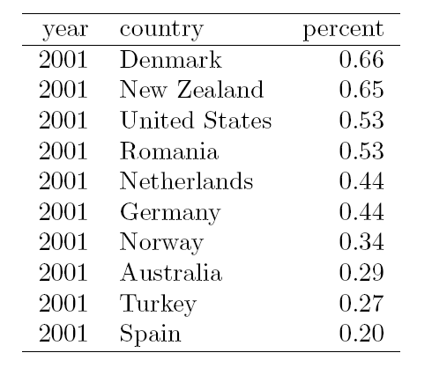
Motivation
Contribution
Best friend
Acquaintance
Obligatory Attendee
Friendship Tie

Slide 3
Puzzle
Why do some countries punch above their weight in contributing to coalition conflicts?

Slide 4
Point
Value of Contribution
Best friend
Cost of Contribution
Acquaintance
Best friend
Acquaintance
Obligatory Attendee
Obligatory Attendee
Friendship Tie
Friendship Tie

Slide 5
Point
Outsized contributions signal a desire for a stronger relationship
Costly transmission of information
Anticipate future payoffs because of reputation and reciprocity

Slide 6
Goal is to convince you that...
Current explanations for alliance contributions incorrectly focus on:
Current alliance tie, not desired
Value of contribution, not cost
Examining cost of contributions to Afghan war (ISAF) and desired ties by contributing states better explains over-contributions to war effort

Slide 7
Problems with conventional explanations
Largest share of forces are contributed by:
Collective action (Olsen and Zeckhauser 1966) - powerful states
Weaker states didn’t free ride
Balance of threat (Walt 1987) - most threatened states
Contributing states had not stake in the outcome
Alliance politics (Snyder 1984) - closest friends
Closest friends did less than acquaintances
Domestic politics (Ashraf 2011) - consistency with political ideology
Explains whether you contribute, not extent

Slide 8
Problems with conventional explanations
Largest share of forces are contributed by:
Collective action (Olsen and Zeckhauser 1966) - powerful states
Expected free riders don’t
Balance of threat (Walt 1987) - most threatened states
Non-threatened states do
Alliance politics (Snyder 1984) - closest friends
Closest friends don’t over-exert
Domestic politics (Ashraf 2011) - consistency with political ideology
Extent of contribution unexplained

Slide 9
New theory needs to look at:
What states carry the highest burden in US-led operations
What states most desire improved ties with the US

Slide 10
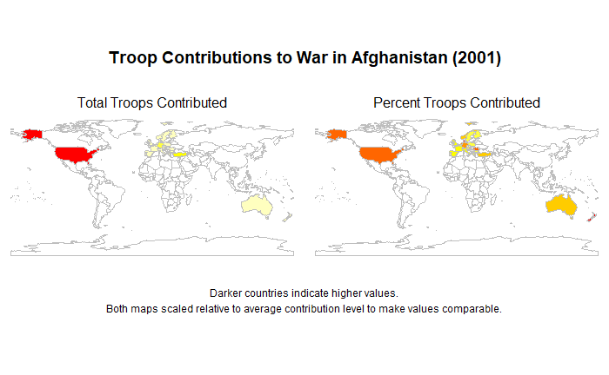

Slide 11
Theory
States wanting a closer relationship with the United States will make higher cost contributions to US-led war efforts
DV: Higher cost contribution - larger strain on armed forces
EV: Desire for closer relationship - “acquaintances” wanting to become “best friends”

Slide 12
Theory
States wanting a closer relationship with the United States will make higher cost contributions to US-led war efforts because:
They are a costly signal of desiring a stronger relationship:
Benefit to US without immediate benefit to over-contributor
Cost to over-contributor (resource strain, risk of casualties/collateral damage)
Which creates:
Reputation of reliability
Expectation of reciprocity

Slide 13
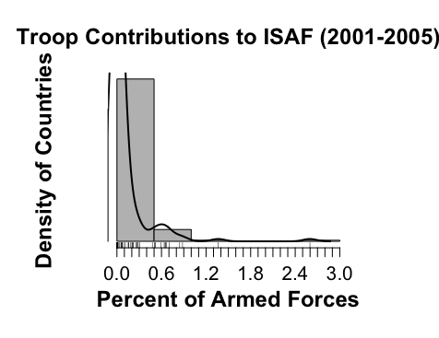
Empirical Data
Unit of Analysis
Country-year (2001-2005)
Troop contributions
Binary
Ratio of available forces

Slide 14
Empirical Data
Country | Percent of Forces
Denmark | 0.66
New Zealand | 0.65
United States | 0.53
Romania | 0.53
Netherlands | 0.44
Germany | 0.44
Norway | 0.34
Australia | 0.29
Turkey | 0.27
Spain | 0.2
Country | Percent of Forces
Finland | 0.14
Austria | 0.13
Sweden | 0.12
Albania | 0.11
Greece | 0.07
Poland | 0.05
Belgium | 0.05
Bulgaria | 0.04
Portugal | 0.02
Czech Republic | 0.01
Top 10 Contributors
Bottom 10 Contributors

Slide 15
Empirical Model
Relationship is non-linear, two separate models capture decision-making process.
1. Who contributes any troops?
2. Among contributors, how many troops does each country provide?

Slide 16
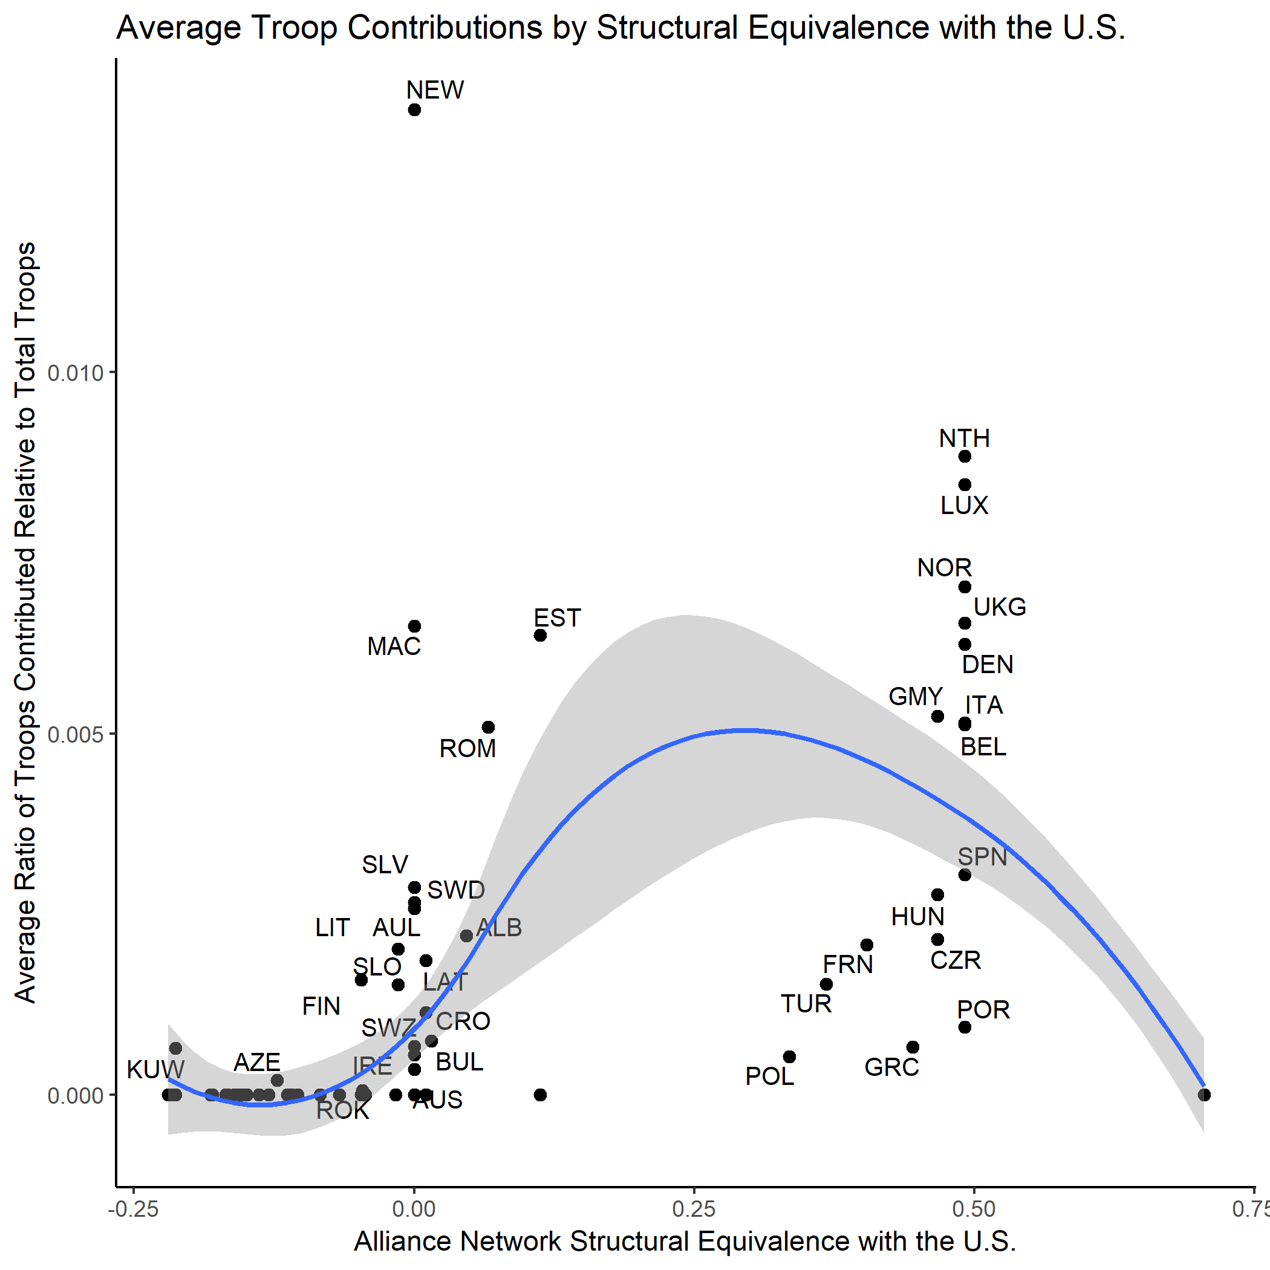

Slide 17
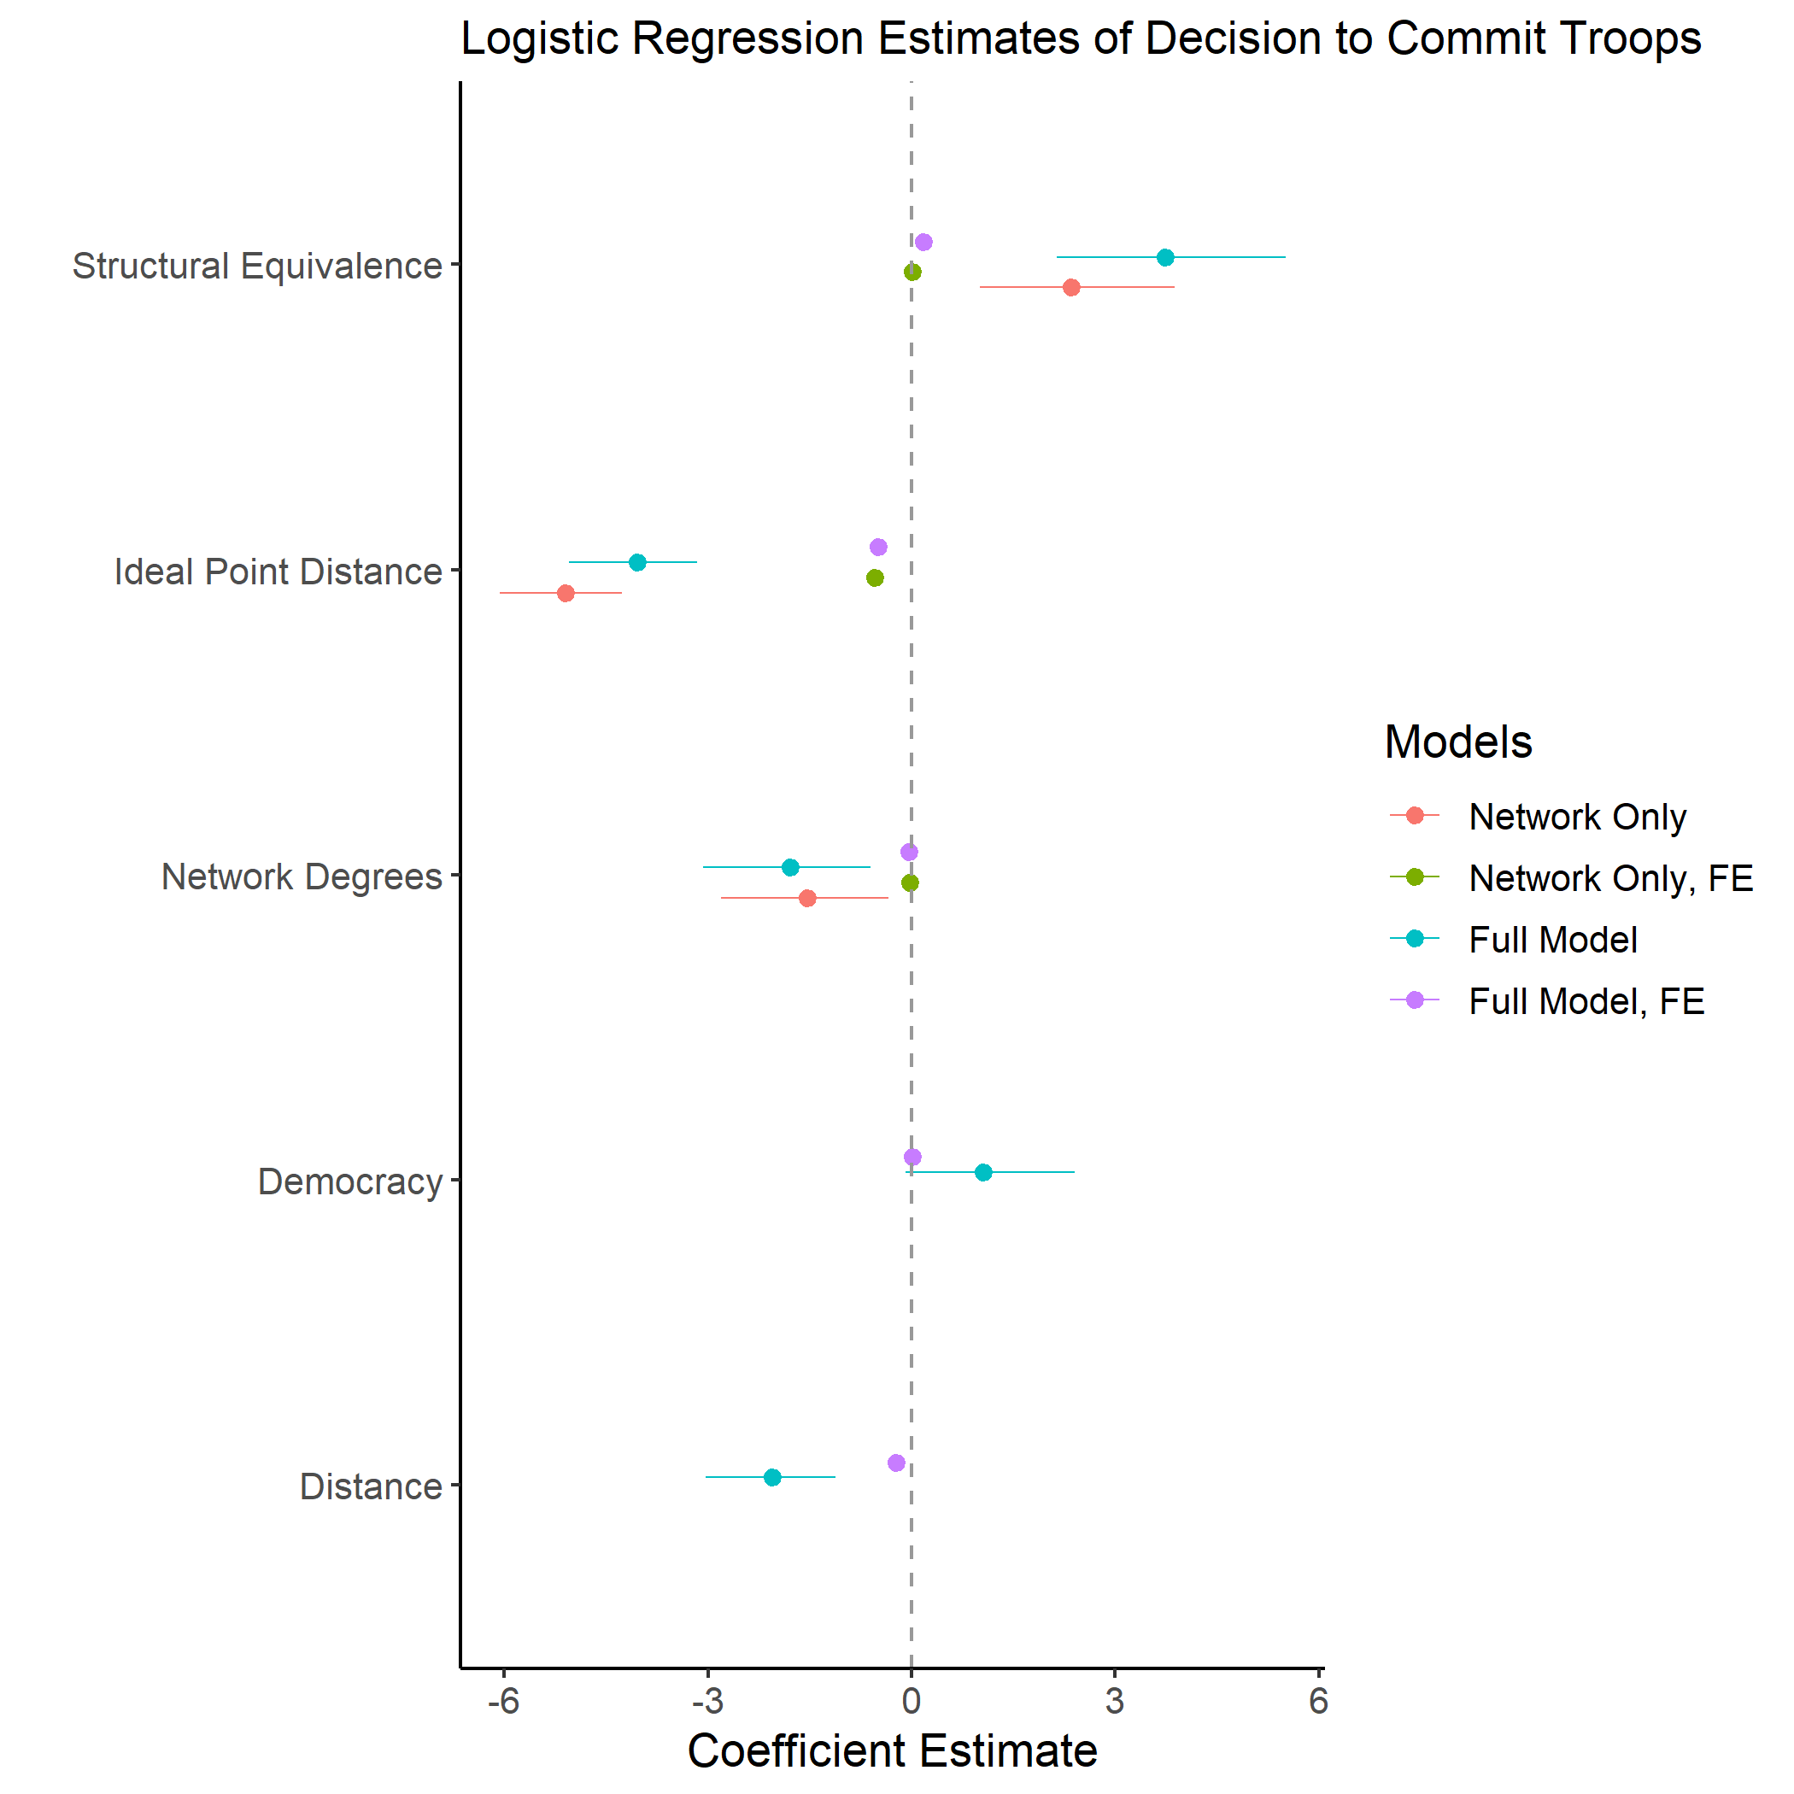

Slide 18
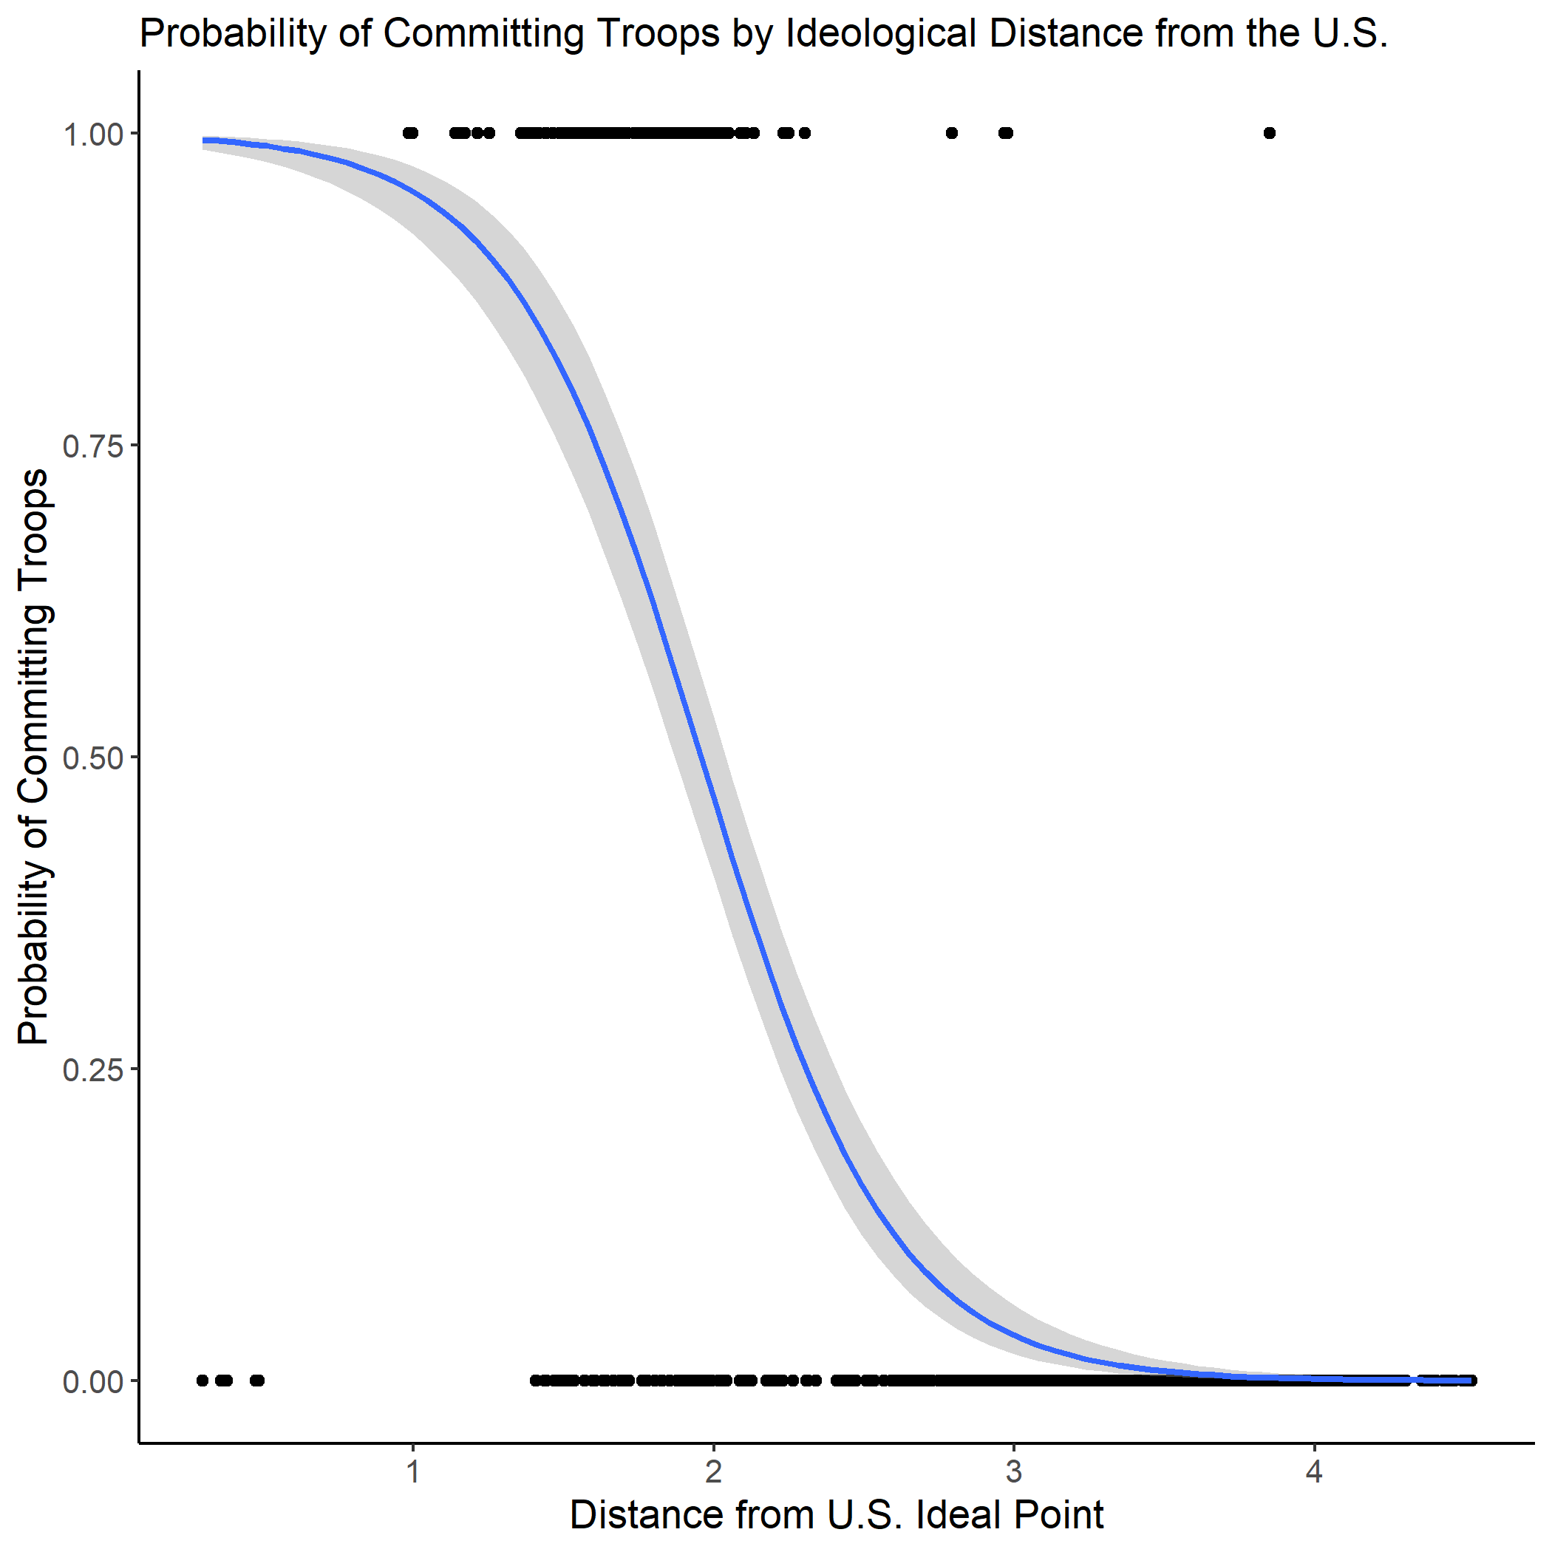

Slide 19
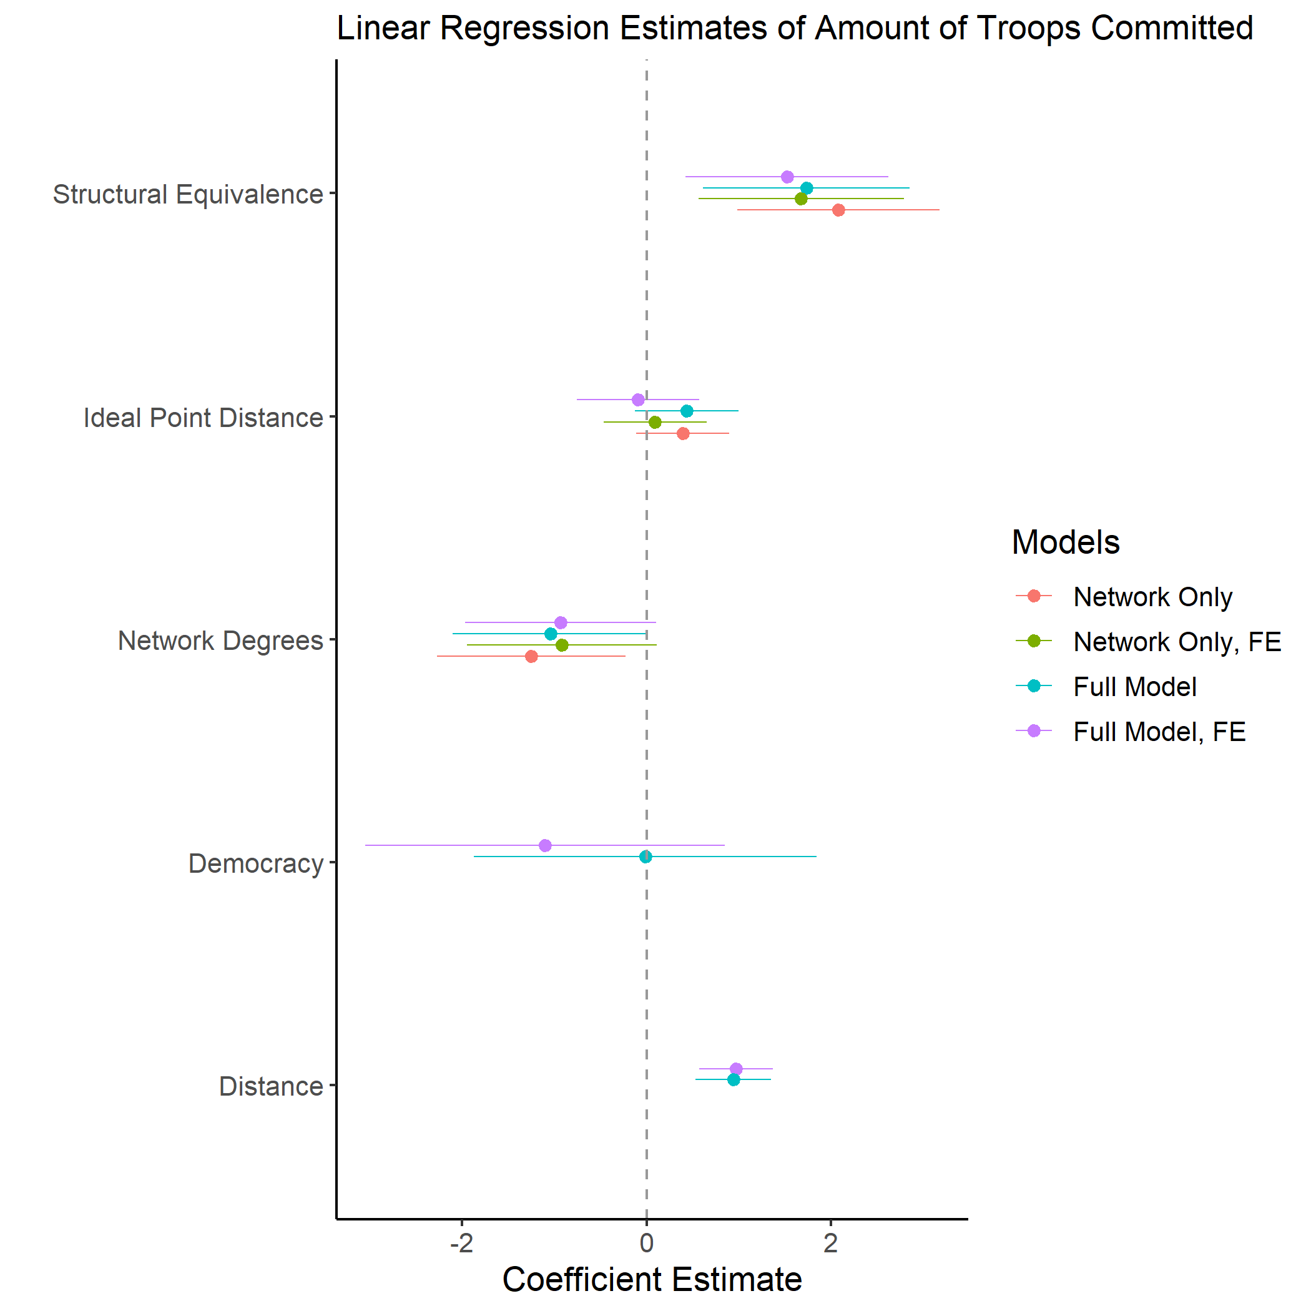

Slide 20
Recognized by over-contributor
“...good opportunity for the New Zealand Defence Force to test its interoperability with contributing NATO nations. This deployment is an example of New Zealand's commitment to playing our part in supporting NATO in areas of common interest." - Jonathan Coleman, New Zealand Defence Minister (2014)

Slide 21
Recognized by the US
“In the Libya operation, Norway and Denmark, have provided 12 percent of allied strike aircraft yet have struck about one third of the targets...These countries have, with their constrained resources, found ways to do the training, buy the equipment, and field the platforms necessary to make a credible military contribution." - US Defence Secretary Robert Gates (2011)

Slide 22
Conclusion and Next Steps
Polynomial model to more explicitly capture curvilinear relationship
Interacting ideal point similarity with measures of alliance network -- create a single measure of ‘relationship status’
What should relationship be (ideal point) divided by what it is (network). Or something similar -- should standardize.
Is structural equivalence the right measure? Netherlands and Luxembourg have the same score as the UK.

