Slide 1
Module: Network Defense
Lesson 2: Firewalls

Slide 2
Network Defense Module
Module Description: ​
The intent of this Knowledge Unit is to provide students with an understanding of network threats and defensive techniques.
Topics:​
Lesson 1: Network Attacks and Threats
Lesson 2: Firewalls
Lesson 3: Netfilter
Lesson 4: Intrusions
Option Lesson: Slammer Worm

Slide 3
Learning Outcomes
Upon completion of this lesson:
Students will be able to list characteristics of a firewall
Students will be able to explain the types of firewalls
Students will be able to describe firewall locations and configurations

Slide 4
Attribution
Slides based on material from :
William Stallings, Cryptography and Network Security: Principles and Practice, 5th Edition, Pearson Publishing

Slide 5
The Need for firewalls
Internet connectivity is no longer optional for organizations
Individual users within the organization want and need Internet access
While Internet access provides benefits to the organization, it enables the outside world to reach and interact with local network assets
This creates a threat to the organization
Equipping each workstation and server with strong security features may not be sufficient and in some cases is not cost-effective

Slide 6
The Need for firewalls
Firewall
An alternative, or at least complement, to host-based security services
Is inserted between the premises network and the Internet to establish a controlled link and to erect an outer security wall or perimeter
The aim of this perimeter is to protect the premises network from Internet-based attacks and to provide a single choke point where security and auditing can be imposed
May be a single computer system or a set of two or more systems that cooperate to perform the firewall function

Slide 7
Firewall characteristics
Design goals for a firewall:
All traffic from inside to outside, and vice versa, must pass through the firewall
Only authorized traffic, as defined by the local security policy, will be allowed to pass
The firewall itself is immune to penetration
Techniques that firewalls use to control access and enforce the site’s security policy:

Slide 8
Firewall Controls
Service Control
Determines the types of Internet services that can be accessed, inbound or outbound
Direction Control
Determines the direction in which particular service requests may be initiated and allowed to flow through the firewall
User Control
Controls access to a service according to which user is attempting to access it
Behaviour Control
Controls how particular services are used

Slide 9
Firewall Expectations
Defines a single choke point that keeps unauthorized users out of the protected network, prohibits potentially vulnerable services from entering or leaving the network, and provides protection from various kinds of IP spoofing and routing attacks
Provides a location for monitoring security-related events
Is a convenient platform for several Internet functions that are not security related
Can serve as the platform for IPsec

Slide 10
Firewall Limitations
Cannot protect against attacks that bypass the firewall.
A laptop, PDA, or portable storage device may be used and infected outside the corporate network, and then attached and used internally.
May not protect fully against internal threats, such as a disgruntled employee or an employee who unwittingly cooperates with an external attacker
Cannot guard against wireless communications between local systems on different sides of the internal firewall

Slide 11
Packet-Filtering Example

Slide 12
Packet Filtering Firewalls
Weaknesses
Do not examine upper-layer data, so cannot prevent application-specific attacks
The logging functionality present in packet filter firewalls is limited, due to limited information
Most packet filter firewalls do not support advanced user authentication schemes
Vulnerable to attacks and exploits that take advantage of problems within the TCP/IP specification and protocol stack
Due to the small number of variables used in access control decisions, packet filter firewalls are susceptible to security breaches caused by improper configurations
Strengths
Its simplicity
Transparent to users and are very fast

Slide 13
Attacks and Counter Measures
IP Address Spoofing
Hacker spoofs packets from the outside with a source IP address field containing an address of an internal host
Countermeasure is to discard packets with an inside source address if it arrives on an external interface
Source Routing Attacks
IP protocol allows source to specify the route that a packet should take as it crosses the internet. Hacker can use this to try to bypass security measures that do not analyze the source routing information
Countermeasure is to discard all packets that use this option

Slide 14
Attacks and Counter Measures (part 2)
Tiny Fragment Attacks
Hacker uses the IP fragmentation option to create extremely small fragments and force the TCP header information into a separate packet fragment, or sends information so slowly that TCP timeout mechanism will send pending data.
Countermeasure is to enforce a rule that the first fragment of a packet must contain a predefined minimum amount of the transport header

Slide 15
Example Stateful Firewall Connection State Table
Source Address | Destination Address | Connection State
192.168.1.10:2221 | 172.217.14.110:80 | ESTABLISHED
192.168.1.10:2212 | 172.217.14.112:80 | ESTABLISHED
192.168.1.11:3214 | 151.101.65.67:80 | ESTABLISHED
127.0.0.1:2222 | 127.0.0.1:55320 | ESTABLISHED
192.168.1.84:40226 | 52.85.85.61:443 | ESTABLISHED
192.168.1.84:22 | 192.168.1.77:53662 | ESTABLISHED
127.0.0.1:35744 | 127.0.0.1:35744 | ESTABLISHED
127.0.0.1:2222 | 127.0.0.1:55320 | ESTABLISHED
127.0.0.1:2222 | 127.0.0.1:35744 | ESTABLISHED
127.0.0.1:55320 | 127.0.0.1:2222 | ESTABLISHED

Slide 16
Application Level Gateway
Also called an application proxy
Acts as a relay of application-level traffic
If the gateway does not implement the proxy code for a specific application, the service is not supported and cannot be forwarded across the firewall
The gateway can be configured to support only specific features of an application that the network administrator considers acceptable while denying all other features
Tend to be more secure than packet filters
Disadvantage:
The additional processing overhead on each connection

Slide 17
Circuit-Level Gateway
Also called circuit-level proxy
Can be a stand-alone system or it can be a specialized function performed by an application-level gateway for certain applications
Does not permit an end-to-end TCP connection
The security function consists of determining which connections will be allowed
Typical use is a situation in which the system administrator trusts the internal users
Can be configured to support application-level or proxy service on inbound connections and circuit-level functions for outbound connections
Example of implementation is the SOCKS package

Slide 18
Bastion Host
A system identified by the firewall administrator as a critical strong point in the network’s security
Typically serves as a platform for an application-level or circuit-level gateway
Common characteristics:
Executes a secure version of its operating system, making it a hardened system
Only the services that the network administrator considers essential are installed
Additional authentication before a user is allowed access to the proxy services
Proxy module is a very small software package specifically designed for network security. Each proxy:
configured to support only a subset of the standard application’s command set
configured to allow access only to specific host systems
maintains detailed audit information by logging all traffic, each connection, and the duration of each connection
is independent of other proxies on the bastion host
generally performs no disk access other than to read its initial configuration file
runs as a nonprivileged user in a private and secured directory on the bastion host

Slide 19
Host-Based Firewall
A software module used to secure an individual host
Is available in many operating systems or can be provided as an add-on package
Filters and restricts the flow of packets
Common location is a server
Advantages:
Filtering rules can be tailored to the host environment
Protection is provided independent of topology
Used in conjunction with stand-alone firewalls, provides an additional layer of protection

Slide 20
Personal Firewall
Controls the traffic between a personal computer or workstation on one side and the Internet or enterprise network on the other side
Can be used in the home environment and on corporate intranets
Typically is a software module on the personal computer
Can also be housed in a router that connects all of the home computers to a DSL, cable modem, or other Internet interface
Primary role is to deny unauthorized remote access to the computer
Can also monitor outgoing activity in an attempt to detect and block worms and other malware

Slide 21
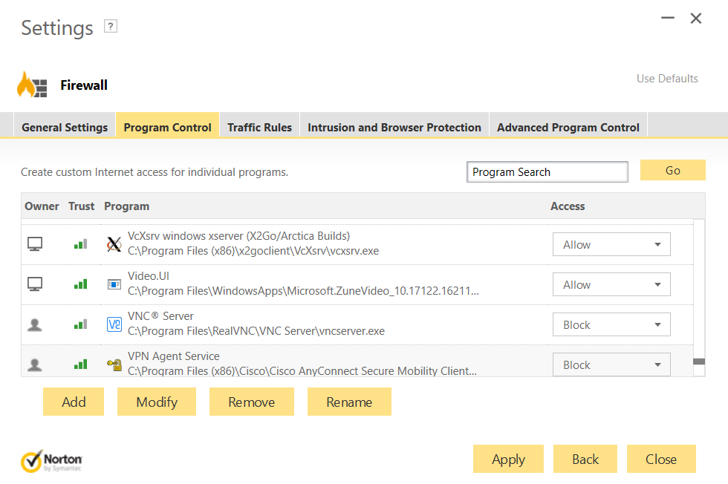
Example Personal Firewall Interface

Slide 22
Summary of Firewall Locations and Topologies
Host-resident firewall
This category includes personal firewall software and firewall software on servers
Can be used alone or as part of an in-depth firewall deployment
Screening router
A single router between internal and external networks with stateless or full packet filtering
This arrangement is typical for small office/home office (SOHO) applications
Single bastion inline
A single firewall device between an internal and external router
This is the typical firewall appliance configuration for small-to-medium sized organizations
Single bastion T
Similar to single bastion inline but has a third network interface on bastion to a DMZ where externally visible servers are placed
Double bastion inline
DMZ is sandwiched between bastion firewalls
Double bastion T
DMZ is on a separate network interface on the bastion firewall
Distributed firewall configuration
Used by some large businesses and government organizations

Slide 23
Summary
The need for firewalls
Firewall characteristics
Types of firewalls
Packet gateway
Filtering firewall
Stateful inspection firewalls
Application level gateway
Circuit level
Firewall location and topologies summary
Notes:
Chapter 12 summary.

Slide 24
Firewall Summary 2
Firewall basing
Bastion host
Host based firewalls
Personal firewall
Firewall locations and configurations
DMZ networks
Virtual private networks
Distributed firewalls

Slide 25
Please attribute Dr. Jim Alves-Foss and Dr. Jia Song, University of Idaho
Except where otherwise noted, this work is licensed under https://creativecommons.org/licenses/by-nc-sa/4.0/ Not withstanding the non-commercial license terms, non-profit educational institutions are granted a non-exclusive license to adapt and use this material, with attribution. Creative Commons and the double C in a circle are registered trademarks of Creative commons in the United States and other countries. Third party marks and brands are the property of their respective holders.
Project sponsored by the National Security Agency under grant Number H98230-17-1-0199. The United States Government is authorized to reproduce and distribute reprints notwithstanding any copyright notation herein.

