Slide 1
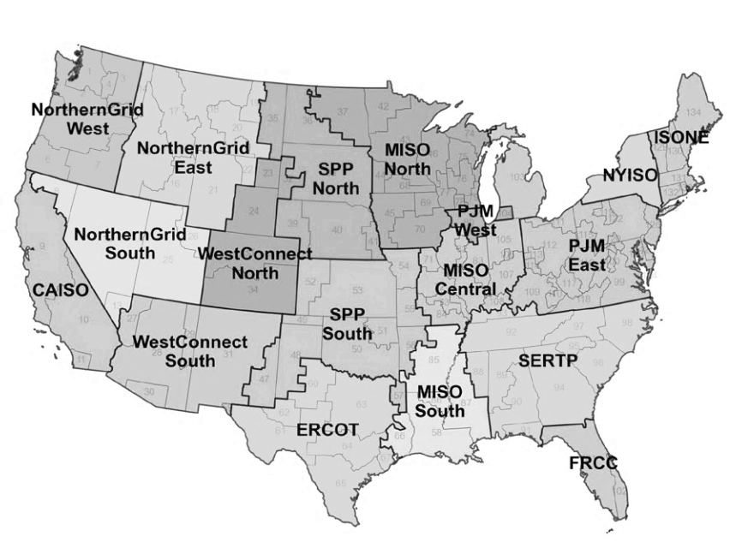


Temporal resolution matters
Grid emission factors
Variable onsite PV generation
Emission accounting accuracy
Annual avg: 1 (year)
Seasonal avg: 4 (season)
Time-of-day avg: 24 (hour)
Season-hour avg: 4 x 24 (season x hour)
Month-hour avg: 12 x 24 (month x hour)
(% annual electricity consumption offset)
0%
25%
100%
Operational & avoided emissions
Error distribution
Not recommended: Annual &
Seasonal &
Time-of-day avg
Recommended: season-hour & month-hour avg
18 grid regions
639 real buildings
Policy implication

Slide 2




Temporal resolution matters
Evaluating Carbon emission factors for Accurate Accounting in Commercial Buildings
Annual avg.
Seasonal avg.
Time-of-day avg.
Season-hour avg.
Month-hour avg.
Operational and avoided emissions
600 real buildings
0% ~ 100% annual electricity consumption offset

Slide 3

1. Building electricity usage (Building Genome 2.0)
3. Accounting error
Metered usage
Onsite solar PV
Generation capacity
Annual operation
Emissions accounting
639 buildings
10 locations
12 building types
Hourly interval
15 ° facing south
Local solar radiation
Outdoor temperature
(% annual load offset)
0%
25%
100%
Net electricity usage
Exported electricity
Operational emissions
Avoided emissions
Error distribution
(w.r.t. hourly avg. reference)
2. Grid emission factors (Cambium 2024)
Grid
Scenarios
Time
Emission factors
CAISO
ERCOT
PJM East
MidCase
LowRECost_HighNGPrice
2025
2050
Annual avg.
Seasonal avg.
Time-of-day avg.
Season-hour avg.
Month-hour avg.
Hourly avg. (reference)
(e.g., error distribution of emissions accounting using annual avg. emission factor)

