Slide 1
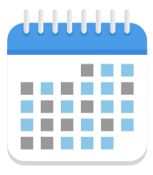

Demonstrating the reliability of randomized measurement and verification method for switchable control retrofits
We obtained faster and more accurate results than conventional measurement and verification (M&V)
Abs. estimation error
Abs. estimation error
20 %
Intervention
15 %
Randomized M&V
Baseline
After satisfying all stopping criteria
10 %
After 24 months of data collection
5 %
1.2 %
0.6 %
0 %
Randomized M&V
(Typically 36 weeks)
Randomized M&V
(2 years)
639 buildings
Intervention
Abs. estimation error
20 %
Intervention
15 %
Conventional M&V
Baseline
TOWT normalized baseline
After 24 months of data collection
10 %
5 %
4.6 %
12-month pre-retrofit
12-month post-retrofit
0 %
Conventional M&V
(2 years)

