Slide 1
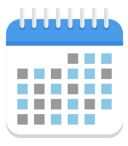

Abs. estimation error
Abs. estimation error
20 %
Intervention
15 %
Randomized M&V
Baseline
After satisfying all stopping criteria
10 %
5 %
0 %
1.2 %
Randomized M&V
(Typically 36 weeks)
Abs. estimation error
20 %
Intervention
Intervention
15 %
Conventional M&V
Baseline
TOWT normalized baseline
After 24 months of data collection
10 %
12-month pre-retrofit
12-month post-retrofit
5 %
4.6 %
0 %
Conventional M&V
(2 years)

