Slide 1
R-higher-ed-training
Center on Budget and Policy Priorities

Slide 2
Plan
Discuss helpful mental models
Learn the basics of R and RStudio
Explore R tools for data analysis

Slide 3
What is R?
R is a programming language for data analysis
RStudio is a software for using R
Both are free

Slide 4
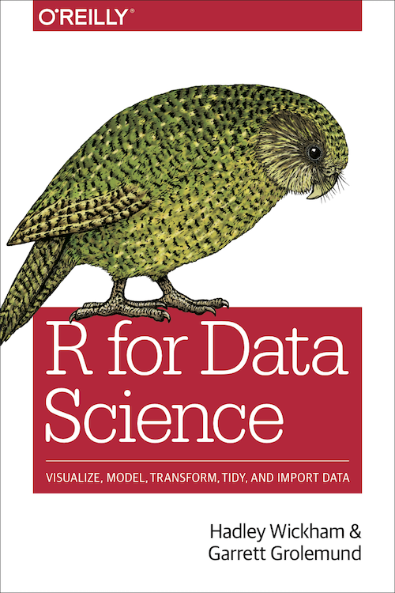
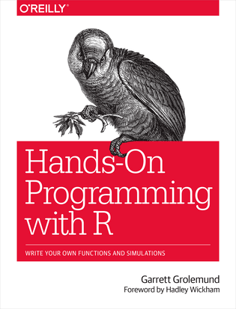
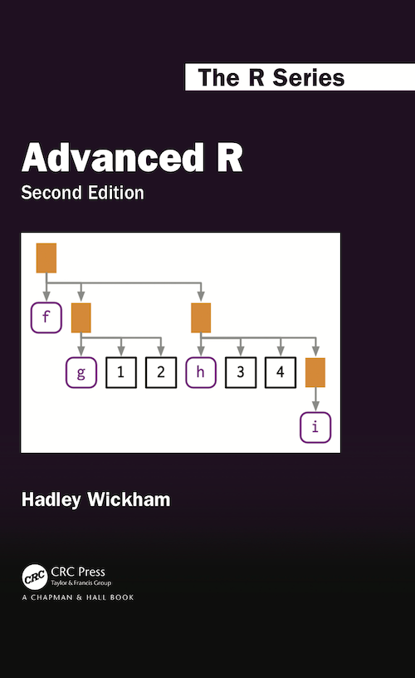
How can I learn R?
All are free

Slide 5
Core Skills for Data-Based Policy Research
Research and Policy Area
Coding and Programming
Statistics and Data Analysis

Slide 6
Workflow of Data Analysis
Retrieve Data
Import Data
Clean Data
Analyze Data
Export Results
Communicate Findings

Slide 7
Code as a Shareable Recipe
0_download_data.R
1_clean_data.R
2_analyze_data.R
3_make_tables.R

Slide 8
Thought experiment
If you wanted to bake a muffin (for the first time), which would you rather have:
An example muffin
A muffin recipe

