Slide 1
r-intro-training
Center on Budget and Policy Priorities

Slide 2
Plan
Explore some helpful mental models
Learn the basics of R and RStudio
Run a real-world analysis using R

Slide 3
What is R?
R is a programming language for data analysis
RStudio is an integrated development environment (IDE) for R
Both are free

Slide 4
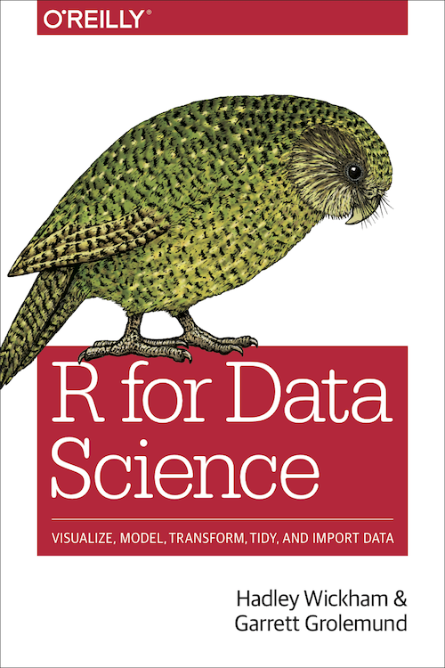
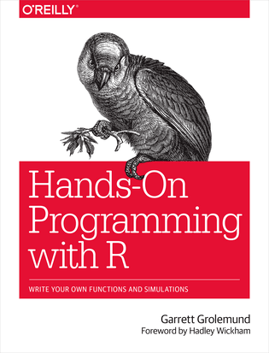
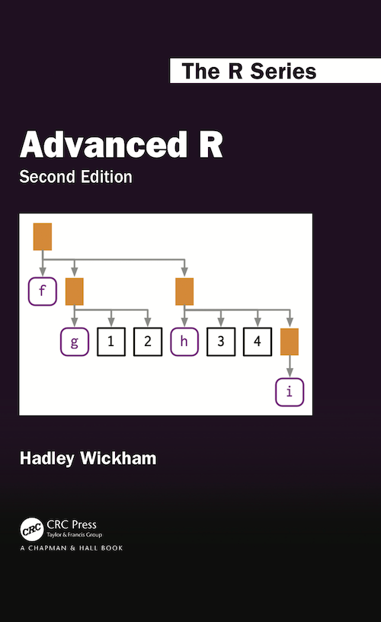
How can I learn R?
All are free

Slide 5
Core skills for data-based policy research
Research and policy area
Coding and programming
Statistics and data analysis

Slide 6
Workflow of data analysis
Import data
Clean data
Analyze data
Export results
Get data
Share findings

Slide 7
Code as a shareable recipe
0_get_data.R
1_clean_data.R
2_analyze_data.R
3_make_tables.R

