Slide 1
DBMS Assignment-12 Implement a back end oriented application
Name: Yash Rajesh Nawale
PRN : 21510074
Batch : S-5

Slide 2
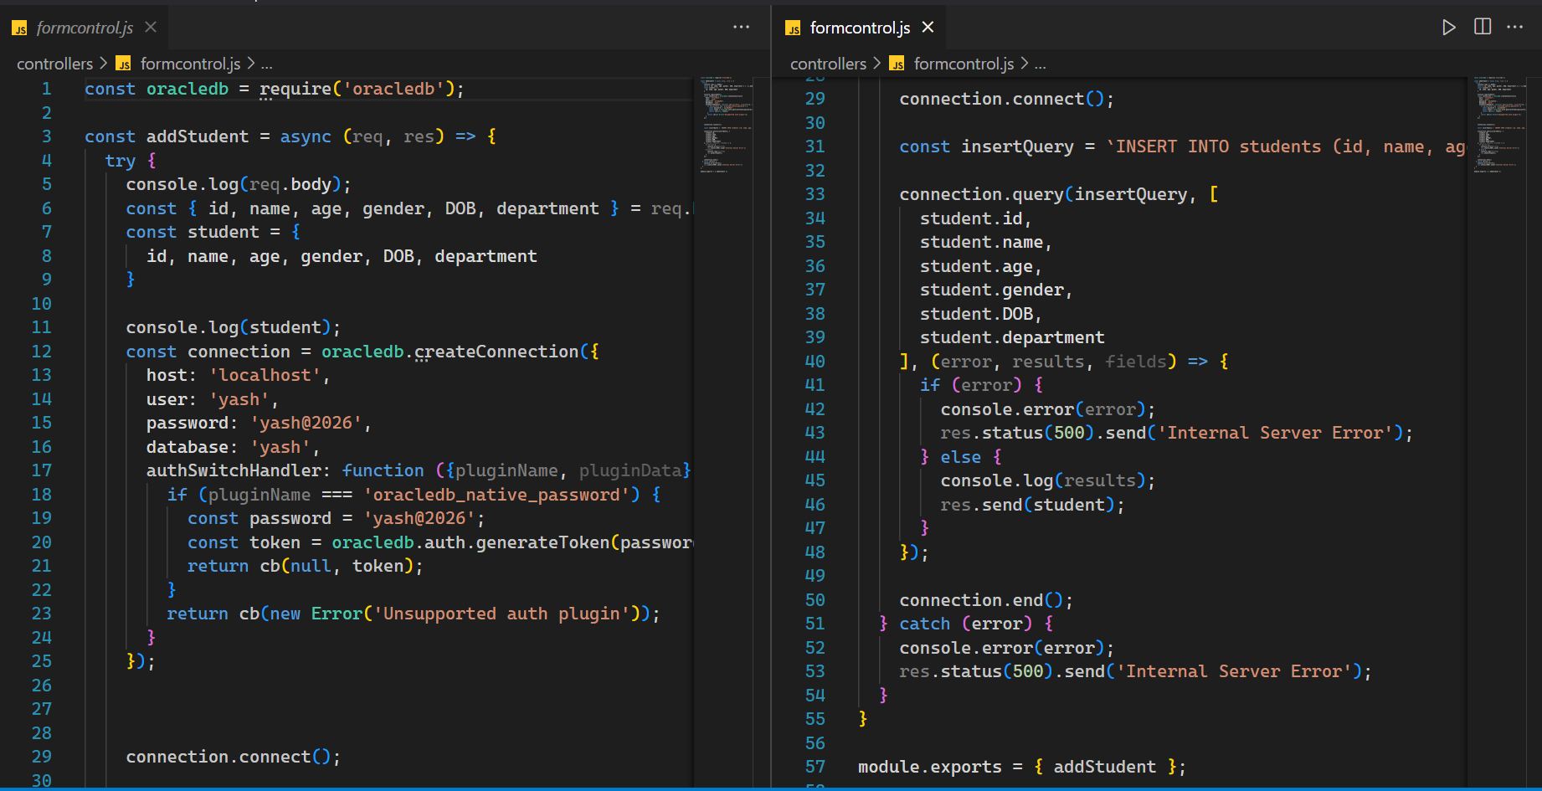

Slide 3
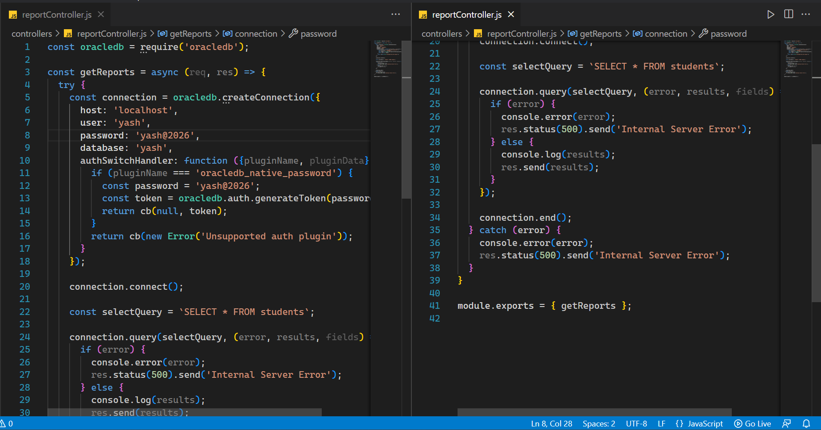

Slide 4
