Slide 1
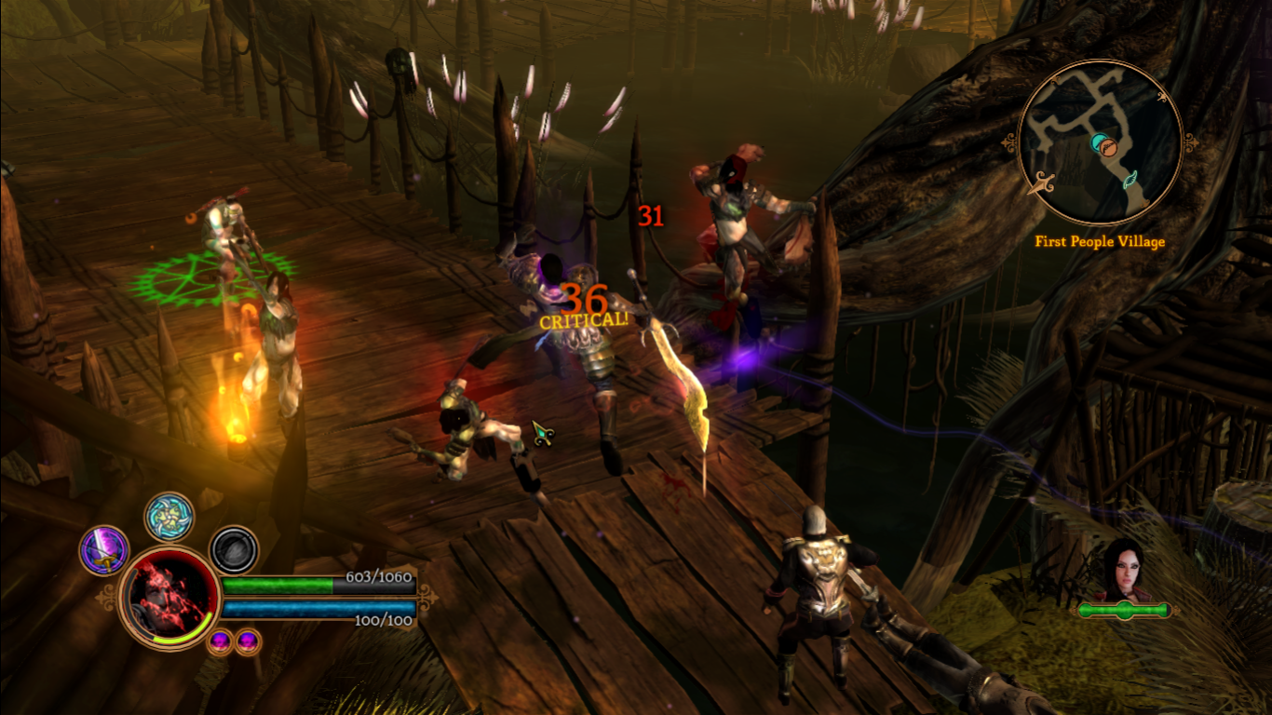
VGP336 - Gameplay Programming
Instructor: Peter Chan

Slide 2
Agenda
Introduction
Course Syllabus
Entity Component System

Slide 3
Entity Component System
"Software architecture pattern that separates the functionality into individual components that are mostly independent of one another"
Scott Bilas from Gas Powered Games gave a talk in GDC 2002 on using this architecture in the development of Dungeon Siege
Used by many game developers (Resident Evil, Prototype, Unity3D)

Slide 4
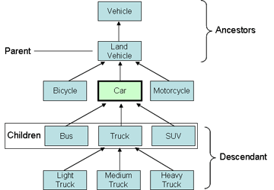
Object-Oriented Approach

Slide 5
Object-Oriented Approach
The traditional way to implement game entities was to use object-oriented design
It's intuitive and allows code reuse and extension of entities through polymorphism
As the number of entity types grew, we are left with large, rigid class hierarchies

Slide 6
Object-Oriented Approach
Became increasingly difficult to add new class types
Functionality is rigid and difficult to satisfy design changes
Heavy use of polymorphism also implies performance hit on modern hardware

Slide 7
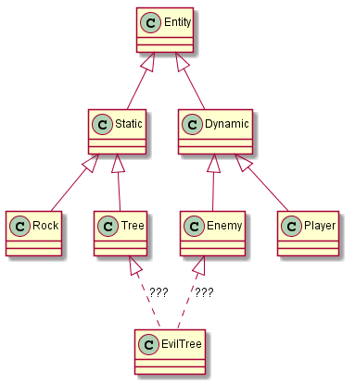
Object-Oriented Approach

Slide 8


Slide 9
Entity Component System
Use composition instead of inheritance to build game objects
Separate complex entities into a collection of data (the components) and subscribe to service logic (the systems)

Slide 10
Components
Essentially a C-style struct
Consists of a minimal set of data needed for a specific purpose
Does not contain any useful methods other than simple accessors/mutators

Slide 11
Component Examples
Position
Velocity
Mesh
Colliders
Animation clips
Health

Slide 12
Entities
Anything that exists in your game world
Usually only consists of an unique ID and a container of components
Advantages of using IDs include increased robustness over pointers (no dangling pointers upon destruction), easy serialization to disk and across networks, fast access of data

Slide 13
Entity Examples
Rock (Position, Mesh)
Crate (Position, Mesh, Health)
Grunt (Position, Velocity, Mesh, Animation, Health, AI)
Player (Position, Velocity, Mesh, Animation, Health, Input)

Slide 14
Systems
Single purpose functions that operate on related groups of components
Minimal dependency between systems promote code modularity
Relatively easy to setup for multithreaded execution

Slide 15
System Examples
Locomotion (Position, Velocity)
Rendering (Position, Mesh, Material)
AI (Position, Velocity, Collider, Memory Records, NavMesh, etc)

Slide 16
Benefits
Easy to add new, complex game objects
Easy for data driven design
Increased efficiency

