Slide 1
COMP 1004 Interim Video
Max Lowther
Notes:
Min 10 sec / slide, max slide count = 24

Slide 2
Project Vision
This web application stores both usernames and passwords for a user, making it easier for them to sign-in to applications and websites.
The application stores these details locally in a secure format, and this may only be accessed by a sign-in, keeping their details from being accessed without permission.

Slide 3
Project Background
There are many similar password managers, some are local applications, such as Nordpass, while others are webapps or built into browsers, such as the Chrome password manager.
This program acts similarly to other such managers, but unlike most stores credentials entirely locally.
Notes:
As credentials are stored locally, they can only be accessed if a malicious user gained access to the computer and could decrypt the values.
This is less likely to happen than if a web-based manager was breached, and affects far fewer users.

Slide 4
Planning and Sprints
At time of writing, two sprints have been completed, one is currently in progress, and a fourth is fully planned.
In Sprint 1 very little code development was performed, with most work being for research and a limited amount of design.
In Sprint 2, initial designs were planned out, alongside the first prototype of the webpage.
In Sprint 3, a significant amount of functionality is expected to be added, at minimum including sign-in and loading/saving. Proper encryption may also be added in this sprint or the next.
In Sprint 4, additional functionality –the ability to show and hide passwords alongside copying them- is expected to be added.

Slide 5
User Stories
As a user, I want to have easy access to my passwords so that I can spend less time signing in and won’t lose them.
As a user, I want my log in information to remain secure, so it is unlikely for my accounts to be breached.
As a user, I want secure information (such as my passwords) to be behind a sign in, so malicious actors cannot access them even if they gain access to my computer.
As a user, I want to be able to reset my login password, so if I forget it, I can still access my other passwords.
As a user, I want the application to be easily accessible, preferably without requiring any prerequisites, so it is easier to install and use.

Slide 6
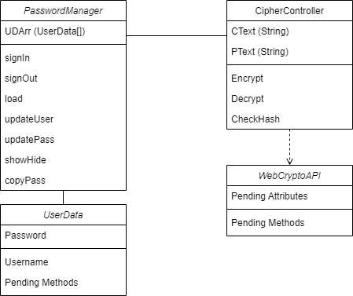
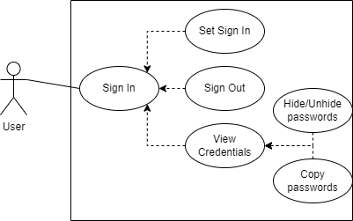
UML Models

Slide 7
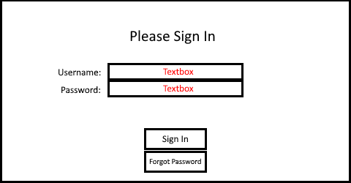
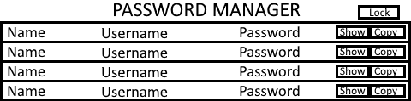
Page Designs
Notes:
These are two basic designs. While the left one is mostly consistent with prototypes, the right one has been altered.
Display prototype after this page.

Slide 8
Issues and Challenges
Due to the restriction of the project to exclusively HTML, CSS and JS, many cryptographic schemes cannot be used.
As this is a local application, and does not plug-in to browsers, it cannot be used to auto-fill usernames and passwords.
As there are no servers, there is no method to reset sign-in details while maintaining security.
Notes:
Point 1: This includes many industry standards.
Point 2: Even if it could auto-fill, this would be incredibly limited due to the development time required.
Point 3: This said, the application can be reset by deleting both the stored sign-in details and credentials.

