Slide 1
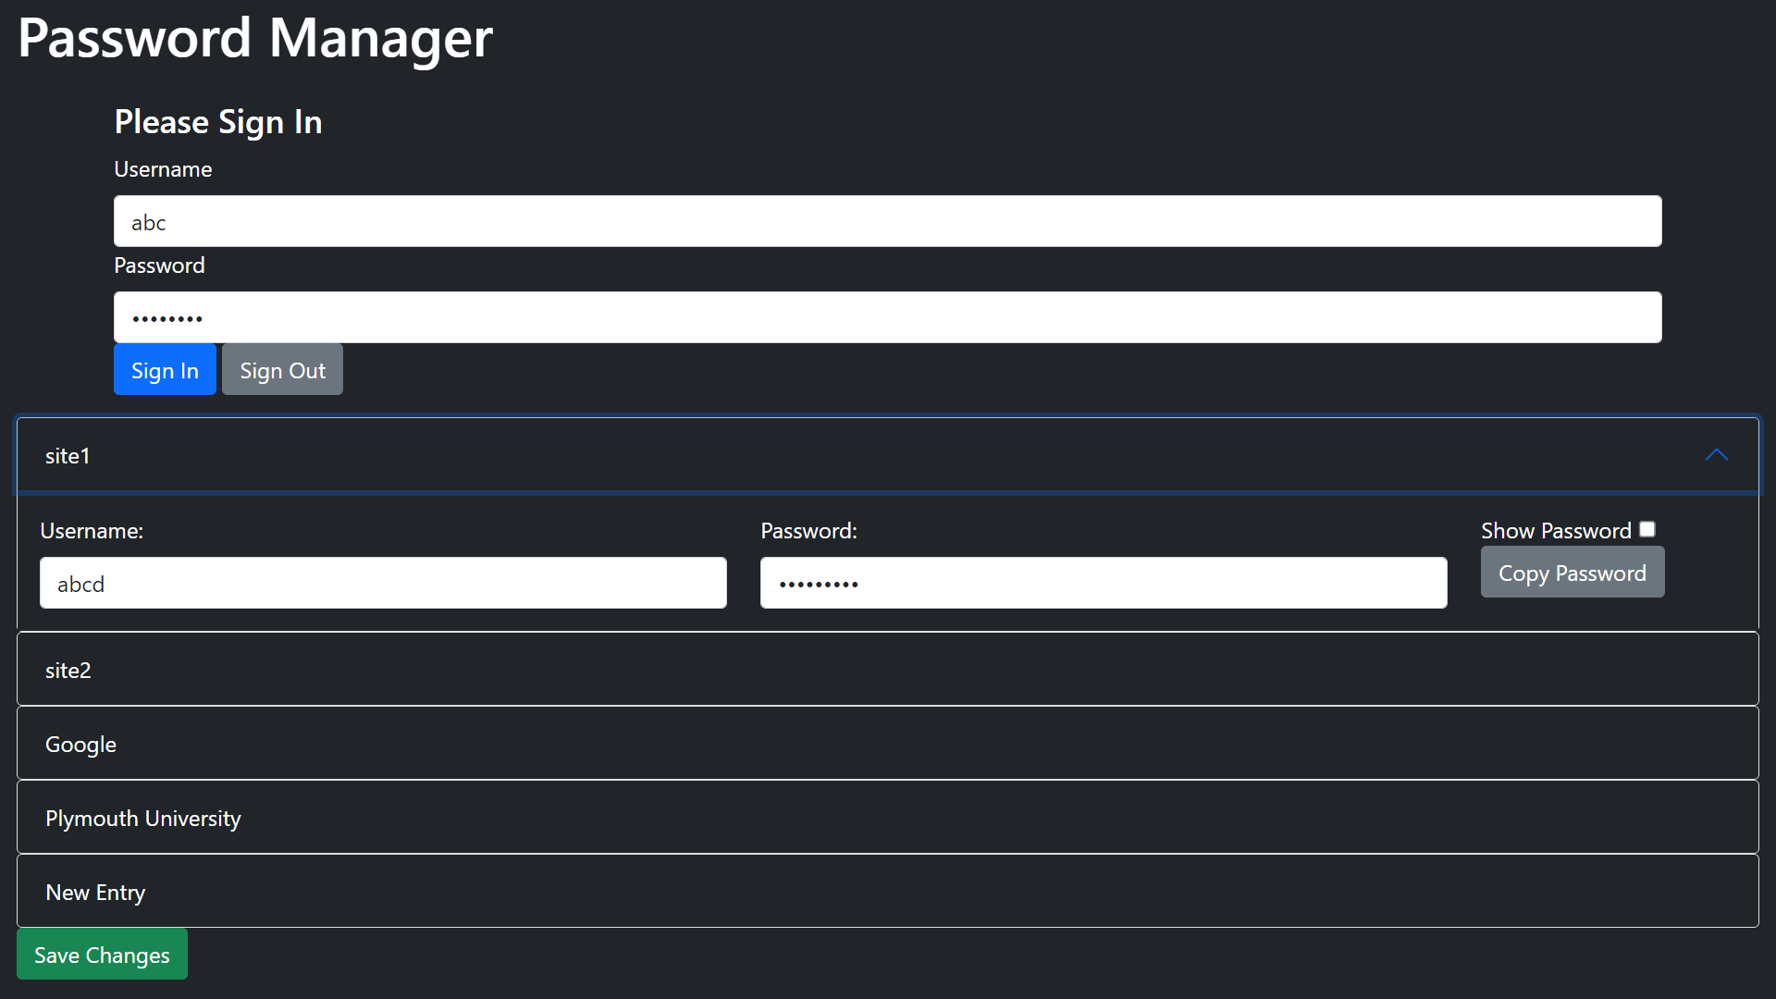
Password Manager
Max Lowther max.lowther@students.plymouth.ac.uk
Introduction
Technology
Project Vision:
This password manager will be for individuals to help store their passwords in a secure way. The application will store passwords in encrypted files, and these will only be decrypted when a successful sign-in occurs, preventing unauthorised access to passwords.
Description:
Many password managers are either reliant on the browser running them, such as the Chrome Password Manager, or store their data in the cloud, such as NordPass (1). This means that there is a lack of fully local password managers which are not constrained to one browser or set of browsers.
This password manager fills the gap by storing user credentials locally with minimal internet use – in fact, it is fully functional without ever connecting to the internet at all.
Features:
Users can sign in securely, with their credentials being hashed
The page will reset, and all credentials will be saved, when the user signs out
Only the necessary credentials can be opened for viewing
Passwords can be copied to clipboard without ever being displayed
Passwords can be made visible, if the user cannot copy them to clipboard
Edits can be saved, in the event of a mistake or accidental shutdown
Technology:
Bootstrap, a HTML toolkit, has been used to create and stylise the password manager, providing the coloured buttons and collapsable credential containers.
To achieve hashing, SubtleCrypto has been used. This cryptographic system is integrated into many web browsers, such as Chrome, Microsoft Edge and Firefox (2), and is far superior to anything which could have been implemented as part of the password manager.
Conclusion
Though an incomplete implementation, missing the ability to encrypt or decrypt the credentials being stored, the password manager could easily be improved to provide this functionality.
Beyond this, future developments could include:
Improvements to the file system, which currently requires the user to select a file, and creates new files rather than updating them when saved.
Using templates to increase the speed at which credentials are displayed, while decreasing the size of the JavaScript file.
The inclusion of a search feature, to allow for users to quickly find the credentials they are searching for when using large sets.
Making the implemented Bootstrap functionality local, so that the Password Manager is no different when being run for the first time online or offline.
References
https://nordpass.com/features/zero-knowledge-architecture/
https://developer.mozilla.org/en-US/docs/Web/API/SubtleCrypto#browser_compatibility

