Slide 1
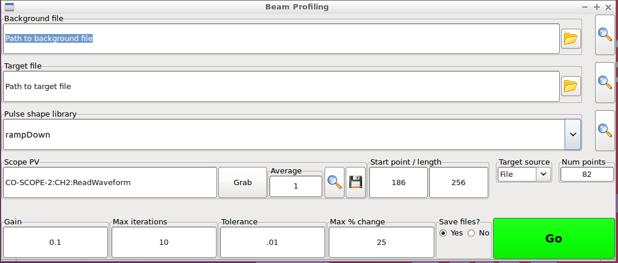
Connect to the Scope PV: enter the name in box. Doesn’t currently register until you press enter in this box. If connected will be green. If not will be red (the colours need improving)
Choose how many scope traces you wish to average for the background. This has no effect for the looping.
Click grad and wait a bit (2.1 seconds for each trace grabbed). I will improve feedback to let you know when grabbing is finished.
Click the magnifying glass to see a preview of the curve. Repeat if necessary. Use this view to set the Start point of the curve and the length.
Save the curve if desired by clicking on the disk icon.

Slide 2
Browse for the background curve (quite possible the one you just saved) or just enter the name if you know it. You can preview it by clicking on the magnifying glass. It will be read when you launch the loop, so you don’t need to preview it if you don’t want to.

Slide 3
Optionally define the file that is going to be used as the target. This is necessary if you don’t want to use a library file. The library file dropdown menu is only re-read when you relaunch the application so if you add new target files but don’t want to restart you need to use this option.

Slide 4
If you wish to use a predefined curve then choose it from here.
NOTE: You need to tell the software the source of the target i.e. File or Library in the target source dropdown

Slide 5
Settings for the loop.
Gain. What you expect
Max iterations: The loop will stop automatically after this many iterations
Tolerance: The loop will stop automatically if the RMS error between current and target is less than this value
Max change is the most any AWG point can change in any iteration
Save files?: If yes, diagnostic files are saved every iteration
Num points. The target, background, and grabbed traces are resamples to this many points to be written to the AWG.
Hit Go when happy. You’re not committed to anything at that point; you’ll have the opportunity to quite before changes are made.

Slide 6
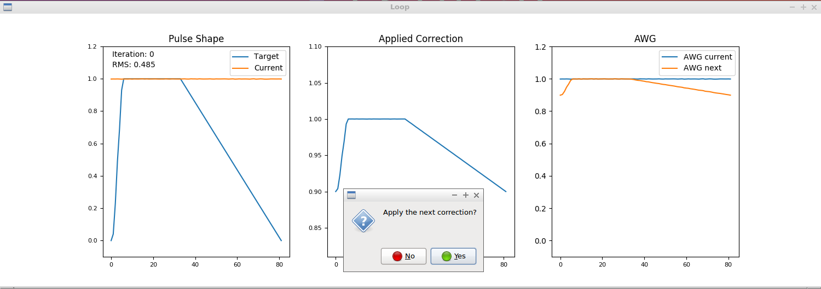
You’ll then see this window.
As it stands, every loop you will be asked if you wish to apply to proposed changes to the AWG (see right panel).
The left panel shows the iteration number and RMS. If the loop stops and you didn’t ask it to, the number of iteration may have reached max, or the RMS may be below threshold.
Click No to abort or Yes to apply. The terminal will provide feedback as to which points are being written to the AWG. Iteration 1 may take a while since we’re now writing all 288 samples not just the first 82. Should be back to normal after that though.
This window needs to be closed before a new loop can be launched (to avoid two competing loops)

Slide 7
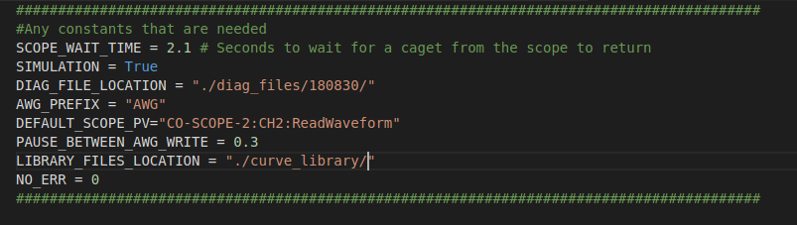
A file called “header.py” defines a few constants that you can change.
SCOPE_WAIT_TIME: how long to wait for the scope to send back data after a request (secs). I wouldn’t change this.
SIMULATION: Running in simulation mode just doesn’t look for any hardware. The loop doesn’t do anything so it’s not much use, but you can have a look around. I can develop it further if necessary. Set to False to run for real
DIAG_FILE_LOCATION: where all the diagnostic files are written
DEFAULT_SCOPE_PV: the string that appears in the UI by default.
PAUSE_BETWEEN_AWG_WRITE: how long to wait between writing points to the AWG (secs). This is the slowest aspect of the loop, so if we are happy running smaller numbers it will be faster. For reference, when writing a waveform we wait 50 ms between each point, so I think there is scope to go faster here.
LIBRARY_FILE_LOCATION: where the UI looks for library files on start up. Put new curves here (with a .curve extension) to have them show up.
NO_ERR: don’t change this
When finished here, you run the software with:
> python main.py

