Slide 1
Data wrangling for IPCC AR7 UKESM 1.3 model evaluation
Blues dream team:
Jasmeen Tatani (Oxford)
Charlie Wartnaby, Saheed Bello (Cambridge)

Slide 2
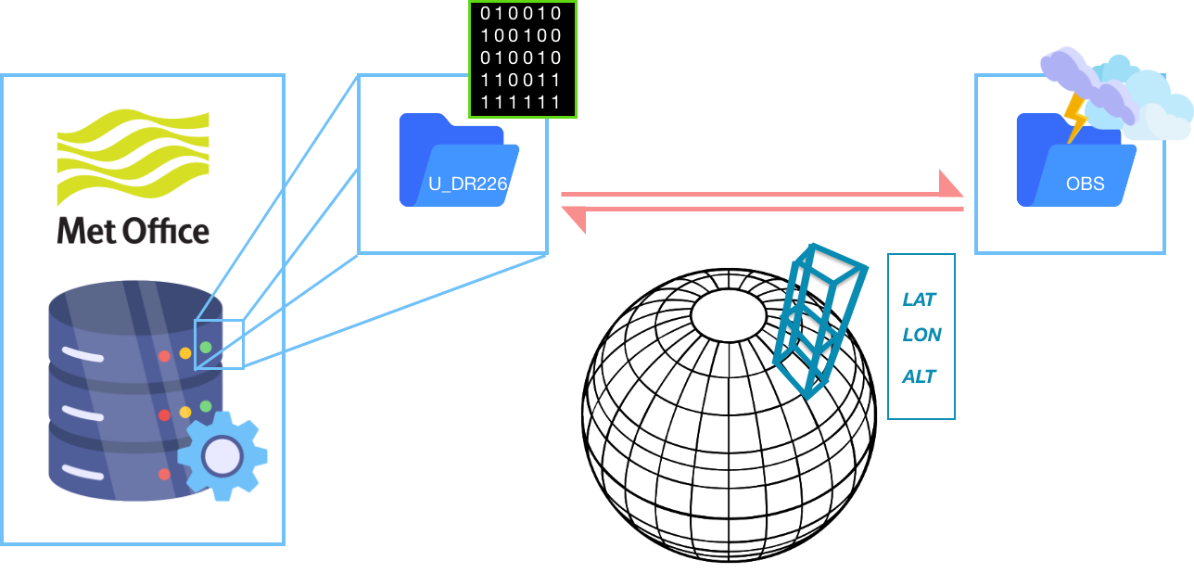
Are these comparable?

Slide 3
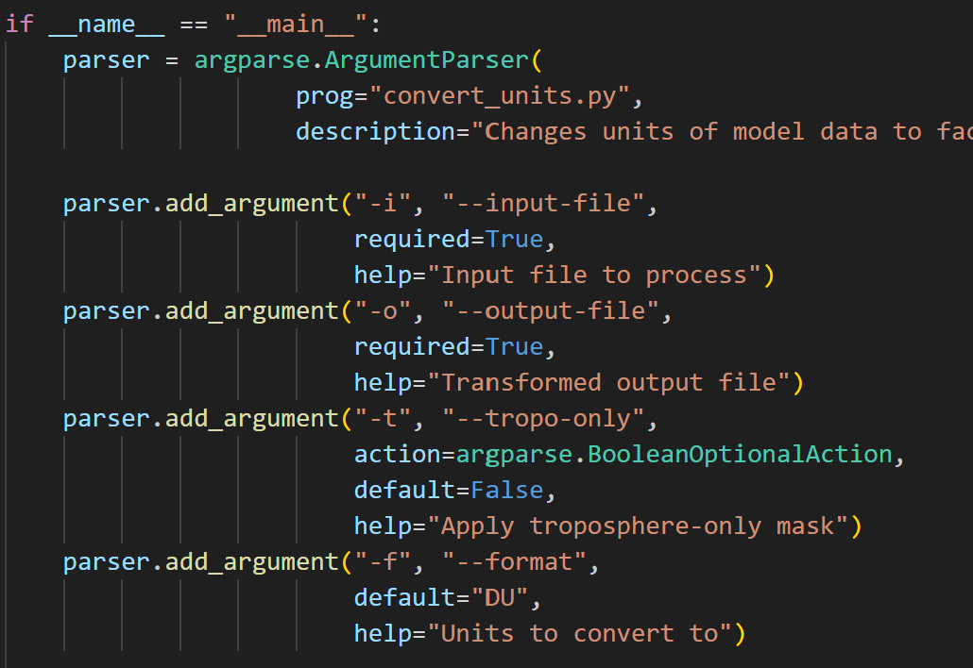
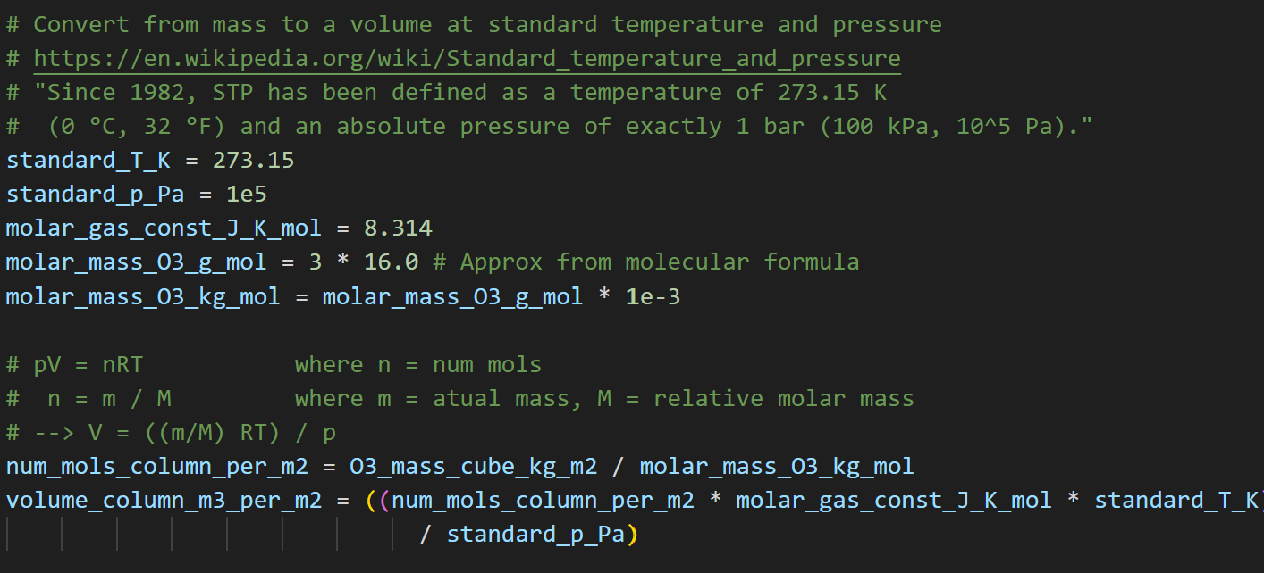
Deliverables
Project repo: https://github.com/Centre-for-Atmospheric-Science-Cam-Chem/2025-iccs-hackathon-ukesm
Project Slack channel: https://app.slack.com/client/T093UL564FM/C094Z9E7PAT
README.md describing problem and dataset descriptions
Pip requirements.txt provided
Main script runs with arguments for files to process and troposphere-only flag

Slide 4
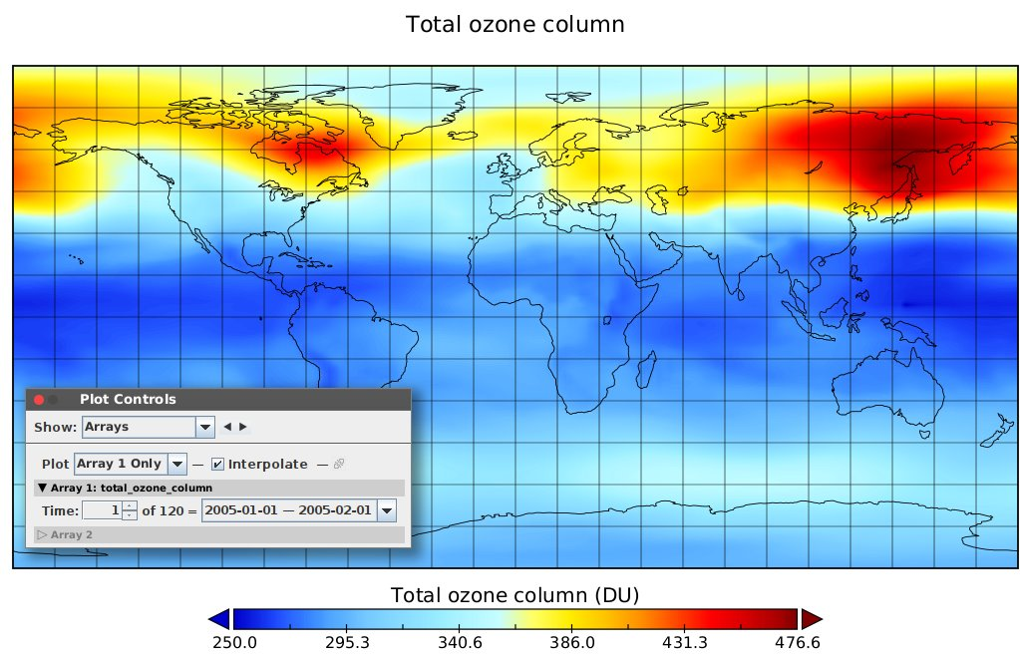
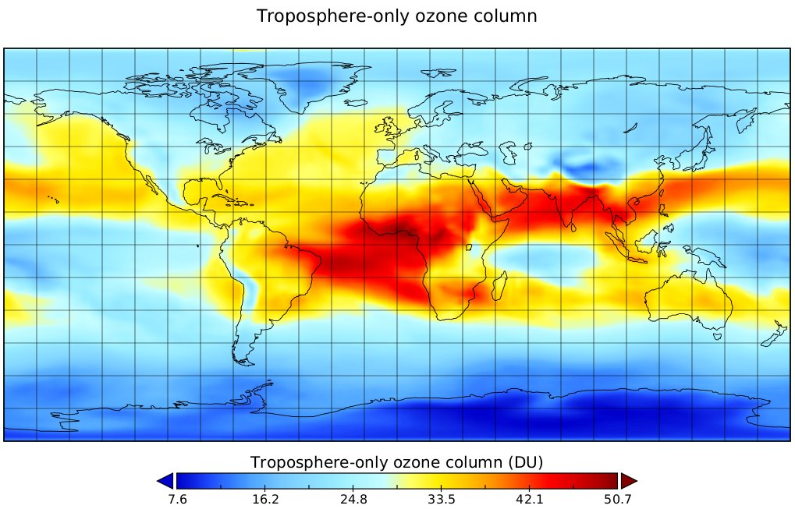
Total and troposhere-only ozone
Load UKESM model output NetCDF using Iris library
Convert from mass mixing ratio to total mass via air statistics and perfect gas formula
Tropospheric mask applied to exclude stratosphere as option
Conversion to Dobson Units (1/100ths mm equivalent at standard conditions)
Now all ready to compare to satellite observations in those units

