Slide 1

Introduction to R
Kevin Shook
Centre for Hydrology
University of Saskatchewan
November 23, 2017

Slide 2
1. Getting Started

Slide 3
What is R?
A command-line program
A GUI-based program
A programming language
A general-purpose scientific program

Slide 4
Why “R”?
S-plus is a proprietary statistics program
  uses the S language
R is an Open Source implementation of the S language

Slide 5
Why use R?
Powerful
Excellent for statistics, advanced data processing and graphing
Free Open Source Software
  Can see, test and trust the code
  Works with standard file formats
  Rapid development
  Huge number of packages available
  Works with other programs

Slide 6
Spreadsheets must die!
Slow
Dangerous
  Unreliable
  No record
  Data silos
Proprietary programs/formats are not trustworthy
  You can’t know what they are doing
  You can’t rely on your data being accessible in the future

Slide 7
What is R for?
Data processing
Publication quality graphing
Statistical analyses
“Big Data” processing
GIS

Slide 8
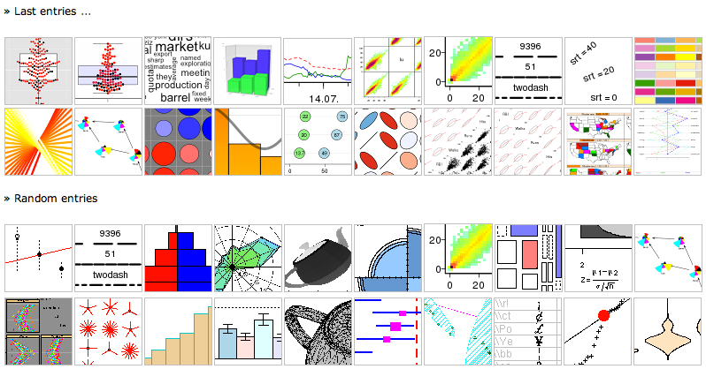
Graphing
R is one of the best scientific/technical graphing programs

Slide 9
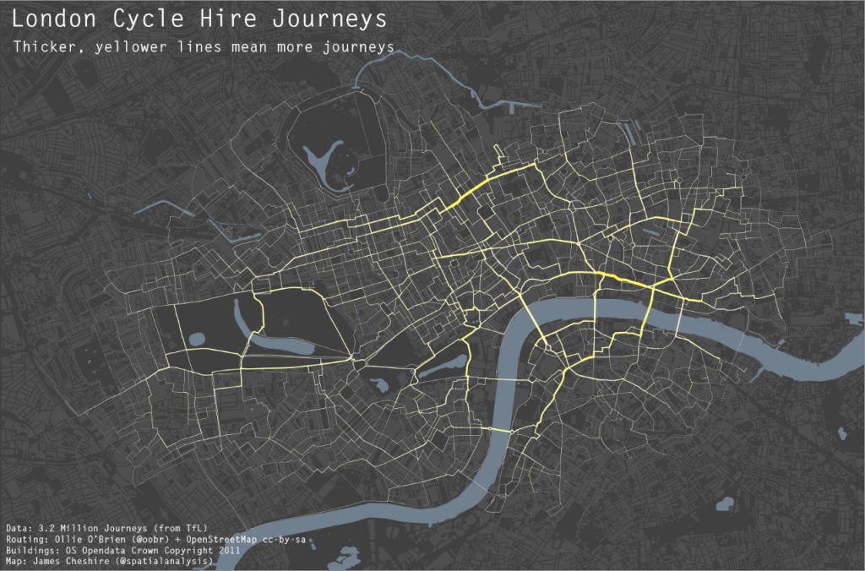
GIS
http://spatial.ly/2012/02/great-maps-ggplot2/

Slide 10
Typical research workflow:
Reading in data (text files, databases, .xls)
Data massaging
Data exploration (trial calculations, plotting)
Final calculations
Saving results
Exporting data for other programs
Creating publication graphs

Slide 11
R's workflow advantages
All tasks can be manual or automated
Logging of calculations/results
All data/results stored in standard files
Data/results easily exported
No vendor lock-in
No data silos

Slide 12
Challenges
Steep learning curve
  Different from other programs
  Need to learn commands
But
  Lots of help available
  GUIs make using it easier
  R reference card contains most of the commands that you will need.
  cran.r-project.org/doc/contrib/Short-refcard.pdf

Slide 13
Getting R
Download R from
https://www.r-project.org/
  Available for all platforms
Then, install Rstudio (GUI)
  Also FOSS
https://www.rstudio.com/

Slide 14
Packages
R has thousands of built-in functions
Thousands more are available in packages
Each package contains:
  Functions
  Sample data sets
  Documentation
  Help file
Downloading done through R

Slide 15
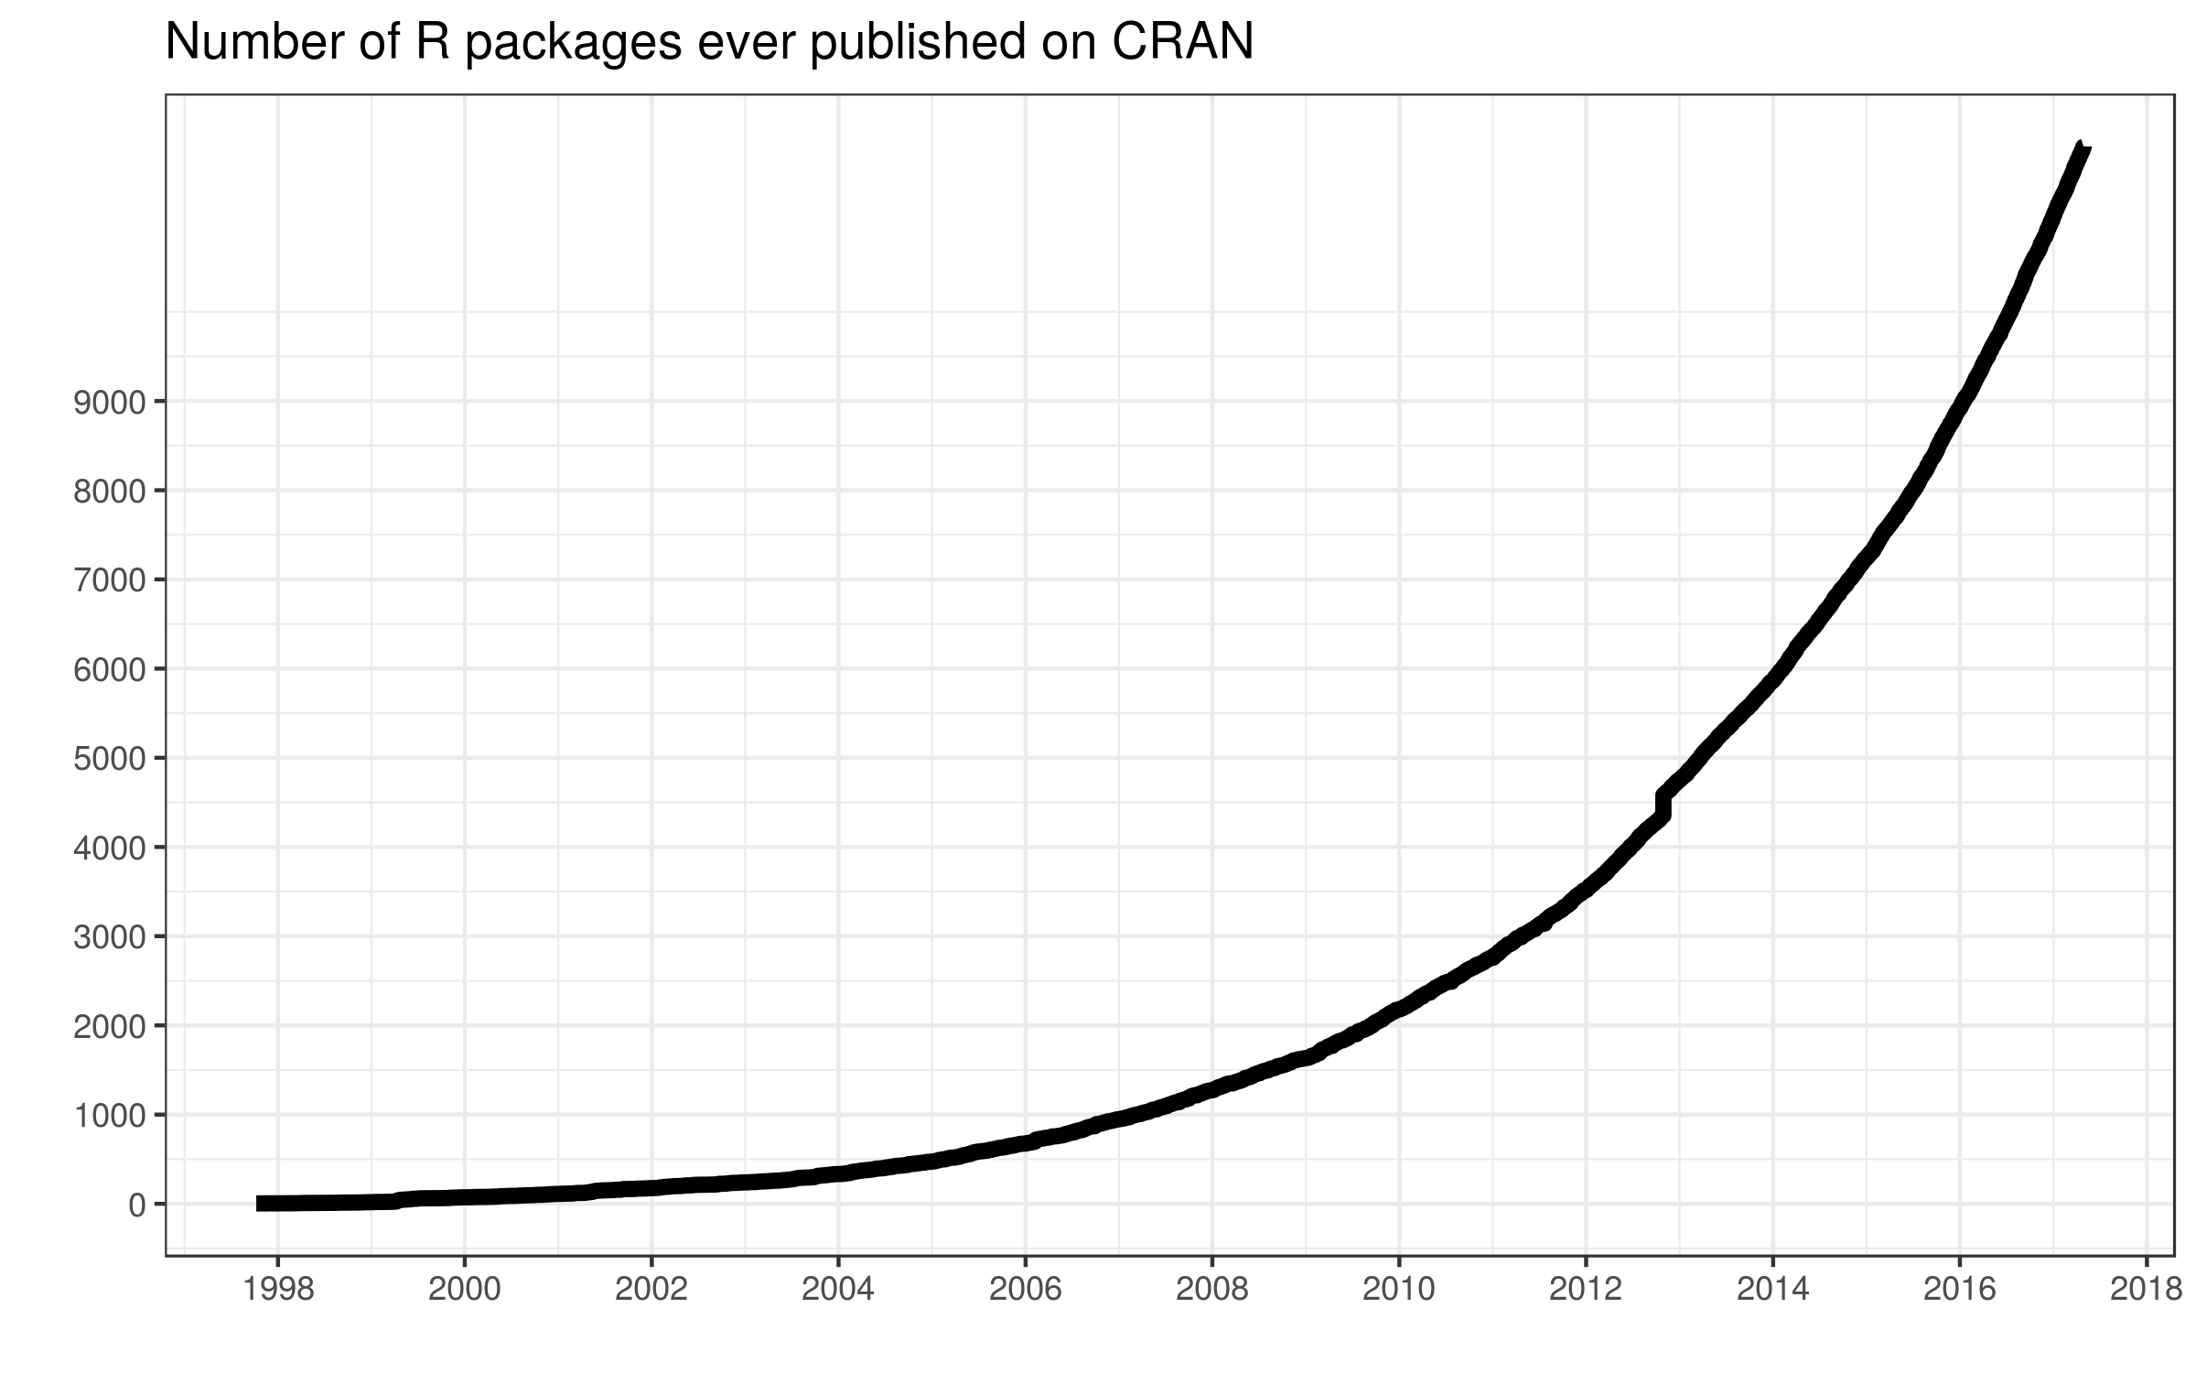
R packages

Slide 16
Installing a package
Rstudio menu:‘Packages’
Install from a local file or from the CRAN repository
  Installing from CRAN also installs all dependencies
  If you are installing from a local file or other repository, you have to install the dependencies manually
Can also install from GitHub repositories using command
  install_github()

Slide 17
2. Demonstration

Slide 18
3. Graphing
Standard (built-in) graphing uses the command plot:
plot(xvals, yvals, options)
Easy to use from the command line
  Good for quick and dirty plots
Can get better results for publication using another package

Slide 19
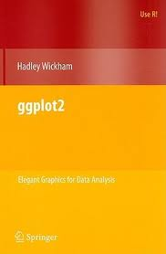
ggplot2
R package
gg = grammar of graphics
by Hadley Wickham
Help available at http://ggplot2.tidyverse.org/reference/
Book: ggplot2: Elegant Graphics for Data Analysis
http://simania.co.il/bookdetails.php?item_id=736973

Slide 20
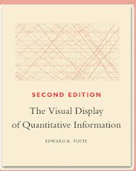
Why ggplot2?
Designed for scientific/technical graphing
Creates amazing publication-quality graphics very easily
Great default settings
  Based on work by Edward Tufte
Uses a grammar for graphs
  Can change graphs interactively
  Extremely good for categorized data
http://ciaranm.wordpress.com/2009/11/29/the-visual-display-of-quantitative-information/

Slide 21
Grammar of graphing
Graphs are made up of:
Component | Short name
Aesthetics | aes
Geometric objects | geom
Statistical transformations | stat
Scales | scale
Faceting | facet
Theme | theme

Slide 22
Creating a ggplot2 graph
Create a ggplot2 object
  var <- ggplot(dataframe)
Add an aesthetic
  var <- var + aes(xvals, yvals)
Add a geometry
  var <- var + geom_name()
Add stats, themes, scales, facets
Display
  print(var)

Slide 23
Data
ggplot2 requires values to be stored in dataframes that are tall, not wide
Opposite of standard R graphs
Takes some getting used to
Worth the effort
Tools provided to convert your data

Slide 24
Wide data
Each series of data in a separate column
Time | Saskatoon Temp | Regina Temp
00:00:00 | -7 | -7
01:00:00 | -5 | -9
02:00:00 | -5 | -9
03:00:00 | -6 | -11
04:00:00 | -6 | -9
05:00:00 | -6 | -11
http://www.climate.weatheroffice.gc.ca/climateData/hourlydata_e.html?StationID=50091&Day=16&Month=4&Year=2013&timeframe=1

Slide 25
Tall data
All data of same type in same column
Other columns) indicate grouping of points
More flexible
Time | Temp | Location
00:00:00 | -7 | Saskatoon
01:00:00 | -5 | Saskatoon
02:00:00 | -5 | Saskatoon
03:00:00 | -6 | Saskatoon
04:00:00 | -6 | Saskatoon
05:00:00 | -6 | Saskatoon
00:00:00 | -7 | Regina
01:00:00 | -9 | Regina
02:00:00 | -9 | Regina
03:00:00 | -11 | Regina
04:00:00 | -9 | Regina
05:00:00 | -11 | Regina

Slide 26
4. Programming

Slide 27
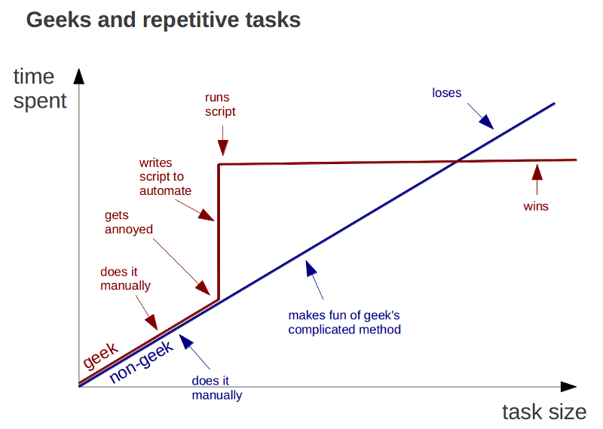
https://plus.google.com/+BrunoOliveira/posts/MGxauXypb1Y

Slide 28
Programming
R is a very powerful programming language
Takes a while to learn, but worthwhile for large tasks
If you do something more than once, you should think of writing a script

Slide 29
Programming
Any sequence of R commands can be a program (a script)
The commands are saved in a plain text file (.r or .R)
Commands can be executed inside R

Slide 30
functions
The best way to organize R commands is in functions
Advantages
  More flexible
  Same code can work on different data
  Code can be easily re-used
  Functions can be assembled into packages

Slide 31
Creating functions
Every function has this structure
my_function <- function(arguments){
# this is a comment
}

Slide 32
Calling functions
To load in a file containing functions:
source(filename)
In Rstudio, you can automatically load the functions every time you save a script file
Once the file is loaded, just call the functions like any other R function

