Slide 1
RESTaurantApp by orbitka ERD – ver 2
tablenames
id
name
capacity (max_no_of_guests)
bills
id
meal
price (value)
table id
waiter id
open/paid (y/n)
tip (y/n)
waiters
id
name
photo
M:N through bills
M:N through bills
orders
id
bill id
meal id
M:N through orders
meals
id
name
price
description

Slide 2
RESTaurantApp by orbitka Views – ver. 1
Welcome
Waiters
Meals
Show all
Show 1 selected
Edit
Delete
Login
Orders
Show 1 order
Edit (add/remove food)
Delete (cancel order)
Close order (print receipt, add tip y/n)
Add new
Show all
Add new
Show 1 selected
Edit
Delete
Add new
Show all
Delete
Edit
Show 1 selected
Show all
Add new
Tables

Slide 3
RESTaurantApp by orbitka Views – ver. 2
Welcome / login
Waiters
Meals
Show all
Show 1 selected
Edit
Delete
Show all
Orders
Show 1 order
Edit (add/remove food)
Delete (cancel order)
Close order (print receipt, add tip y/n)
Add new
Add new
Show 1 selected
Edit
Delete
Add new
Show all
Delete
Edit
Show 1 selected
Show all
Add new
Tables

Slide 4
RESTaurantApp by orbitka Views – ver. 3
Welcome / login
Waiters
Meals
Show all
Show 1 selected
Edit
Delete
Show all
Bills
Show 1 bill
Edit (add/remove food)
Delete (cancel bill)
Close bill (print receipt, add tip y/n)
Add new
Add new
Show 1 selected
Edit
Delete
Add new
Show all
Delete
Edit
Show 1 selected
Show all
Add new
Tablenames

Slide 5
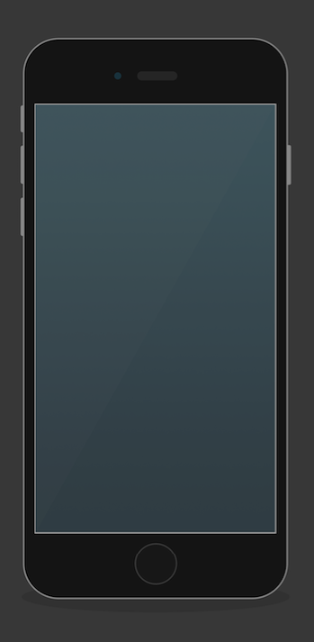
Wireframe 1:
Log In page
Welcome
RESTaurant App
Login
Log in:
user:
password
confirm

Slide 6
Wireframe 2:
Models
Waiters
Bills
Tablenames
Meals
Log in:
user:
password
confirm

Slide 7
Wireframe 3:
Waiters
Waiters
Bills
Tablenames
Meals
WAITERS
Kasia
Daniel
Hania
Zosia
add new

Slide 8
Wireframe 4:
Add new user (waiter)
Add new user:
name:
email
pasword
confirm password
confirm
WAITERS
Kasia
Daniel
Hania
Zosia
add new
After “confirm”
redirect back to welcome screen for login

Slide 9

Wireframe 5:
Waiter profile
KASIA
Score:
100% (10/10)
WAITERS
Kasia
Daniel
Hania
Zosia
add new
OPEN BILLS:
Bill 6/Tablename 3
Bill 5/Tablename 3
Bill 4/Tablename1
CLOSED BILLS:
Bill 3/Tablename 2
Bill 2/Tablename 2
Bill 1/Tablename 2

Slide 10
Wireframe 6:
Bill (show)
KASIA
Score:
100% (10/10)
KASIA
Score:
100% (10/10)
OPEN BILLS:
Bill 6/Tablename 3
Bill 5/Tablename 3
Bill 4/Tablename 1
CLOSED BILLS:
Bill 3/Tablename 2
Bill 2/Tablename 2
Bill 1/Tablename 2
BILL 6 (Tablename 3):
2 pcs Steak 18.00
2 pcs Margarita 20.00
2 pcs Tiramisu 14.00
Current total: 52.00
EDIT (order more)
Pay & Close the bill

Slide 11
Wireframe 7:
Bill (edit)
KASIA
Score:
100% (10/10)
KASIA
Score:
100% (10/10)
BILL 6 (Tablename 3):
2 pcs Steak 18.00
2 pcs Margarita 20.00
2 pcs Tiramisu 14.00
Current total: 52.00
EDIT (order more)
Pay & Close the bill
BILL 6 (Tablename 3):
2 pcs Steak 18.00
2 pcs Margarita 20.00
2 pcs Tiramisu 14.00
ADD from meals:
Quantity
confirm

Slide 12
Map
View: Welcome / login + add new user
Waiters
View: Add new:
fields empty + submit button
-> redirect to show_all after create
View index: Show all:
list of all waiters -> names linked to individual profiles
button “add new”
View: Show 1 selected:
profile info (incl. perfomance (tips yes / all closed bills)
edit button
View: Edit:
fields with info + submit button
delete button
Bills
Tables
Meals

