Slide 1
Vincenzo Mezzio ISI 334 Project 1 COVID-19 in NYC

Slide 2
What is the dataset?
My data set is “COVID-19 Daily Counts of Cases, Hospitalizations, and Deaths” from NYC OpenData. The data provides a count of COVID-19 cases, hospitalizations, deaths, listed daily and per week (average in the current day and previous 6 days), probable count (i.e., probable death includes the cause of death as “COVID-19” yet we currently do not have a laboratory test to prove the deaths were due to COVID-19) as well as overall temporal progression of cases and deaths.
The data also breaks up this information by each of the 5 boroughs in NYC (the data also includes total count in all of NYC). The data starts as early as February 29th, 2020 as well as currently receiving daily updates (in this report, the data was last updated on August 25th).

Slide 3
Who are my customers / stakeholders of my analyses?
The following are my customers of my analyses:
NYC residents; these residents would be able to greatly benefit from understanding the data. For instance, the borough they live in may have a high case count so they should take extra precaution, or a certain month may have a higher case count so the residents should similarly take extra precaution.
Health workers; if a certain borough has more cases, then health workers should protect themselves more carefully. Another possibility is that certain borough should receive extra care from the abundancy of cases.
Businesses; COVID-19 has forced people to stay inside and use remote technology. Companies should be fully aware of COVID-19 data to ensure their employees are safe. Maybe a certain timeframe is coming up and the company should prepare their employees to work in a remote environment to ensure their safety. Companies can also use this data to protect their customers utilizing safety precautions inside the business facilities.
Government officials; the government is able to enforce rules and restrictions to keep citizens safe. If the government understands the information about COVID-19, they would be able to enforce guidelines that help residents in critical times.

Slide 4
Goals
Which borough in NYC has the highest number of cases, deaths, hospitalizations, probable count of cases and probable deaths each year?
Which month was affected by COVID-19 the most in NYC and in both 2020 and 2021?
Which year was affected by COVID-19 the most in NYC?

Slide 5
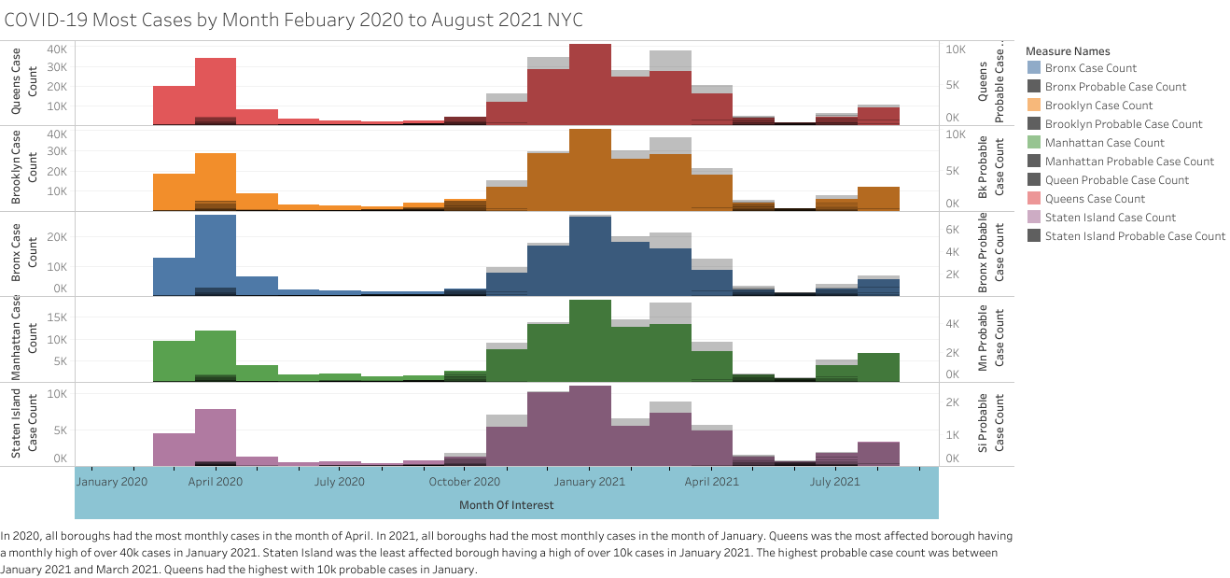
https://public.tableau.com/app/profile/vincenzo.mezzio/viz/COVID-19_Most_Cases_by_Month_Feb_2020_to_Aug_2021_NYC/COVID-19_Most_Cases_by_Month_Feb_2020_to_Aug_2021_NYC

Slide 6
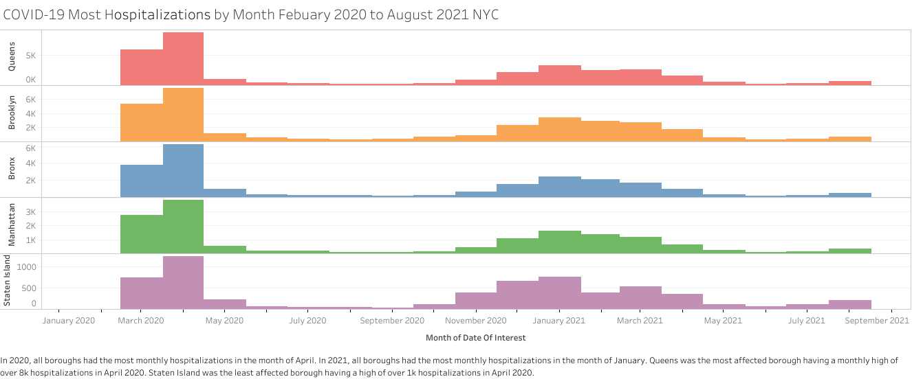
https://public.tableau.com/app/profile/vincenzo.mezzio/viz/COVID-19_Most_Hospitalizations_by_Month_Feb_2020_to_Aug_2021_NYC/COVID-19_Most_Hospitalizations_by_Month_Feb_2020_to_Aug_2021_NYC2?publish=yes

Slide 7
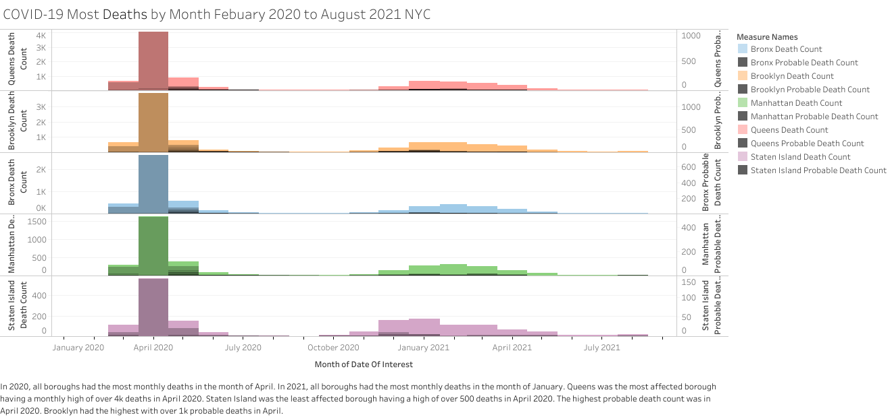
https://public.tableau.com/app/profile/vincenzo.mezzio/viz/COVID-19_Most_Deaths_by_Month_Feb_2020_to_Aug_2021_NYC/COVID-19_Most_Deaths_by_Month_Feb_2020_to_Aug_2021_NYC?publish=yes

Slide 8
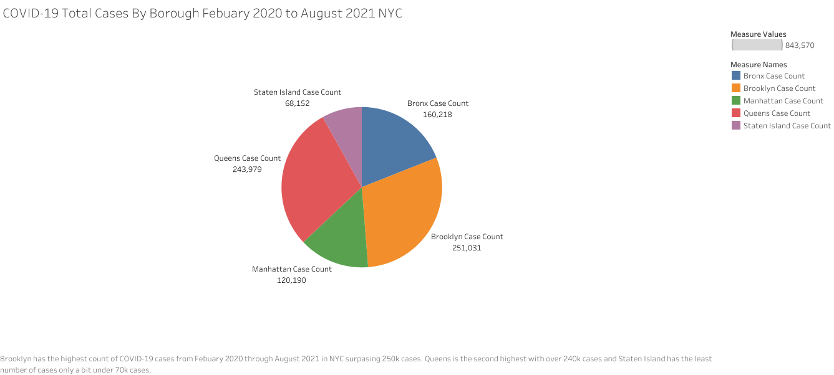
https://public.tableau.com/app/profile/vincenzo.mezzio/viz/COVID-19_Total_Cases_By_Borough_Febuary_2020_to_August_2021_NYC/COVID-19_Total_Cases_By_Borough_Febuary_2020_to_August_2021_NYC?publish=yes

Slide 9
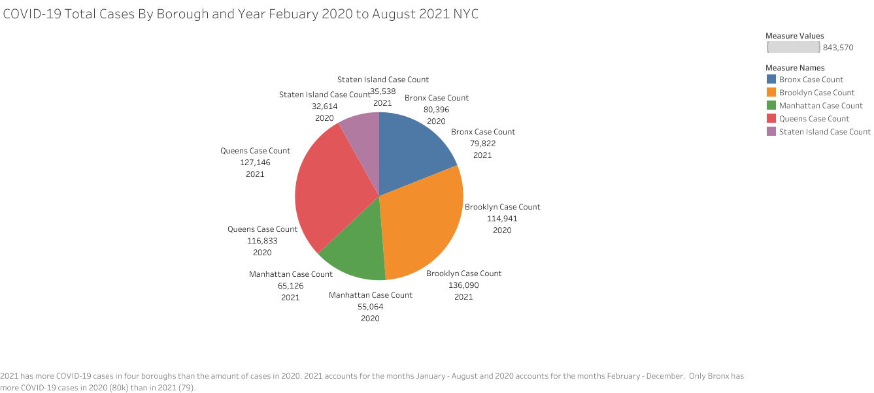
https://public.tableau.com/app/profile/vincenzo.mezzio/viz/COVID-19_Total_Cases_By_Borough_and_Year_Febuary_2020_to_August_2021_NYC3/COVID-19_Total_Cases_By_Borough_and_Year_Febuary_2020_to_August_2021_NYC3?publish=yes

Slide 10
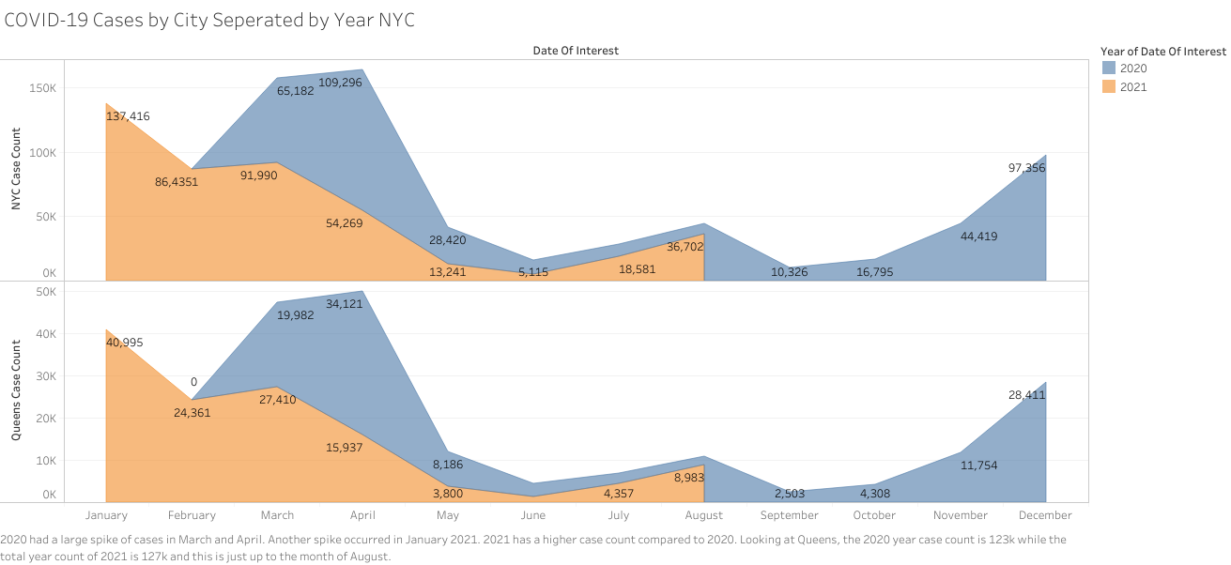
https://public.tableau.com/app/profile/vincenzo.mezzio/viz/COVID-19_Cases_by_City_Seperated_by_Year_NYC/COVID-19_Cases_by_City_Seperated_by_Year_NYC?publish=yes

Slide 11
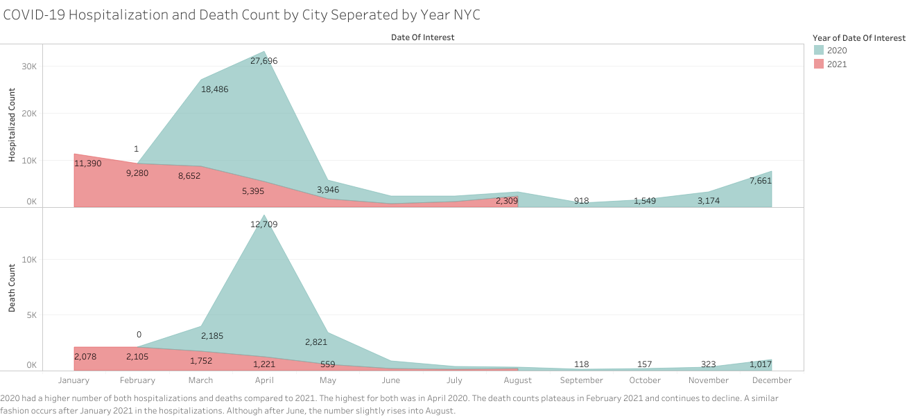
https://public.tableau.com/app/profile/vincenzo.mezzio/viz/COVID-19_Hospitalization_and_Death_Count_by_City_Seperated_by_Year_NYC/COVID-19_Hospitalization_and_Death_Count_by_City_Seperated_by_Year_NYC?publish=yes

Slide 12
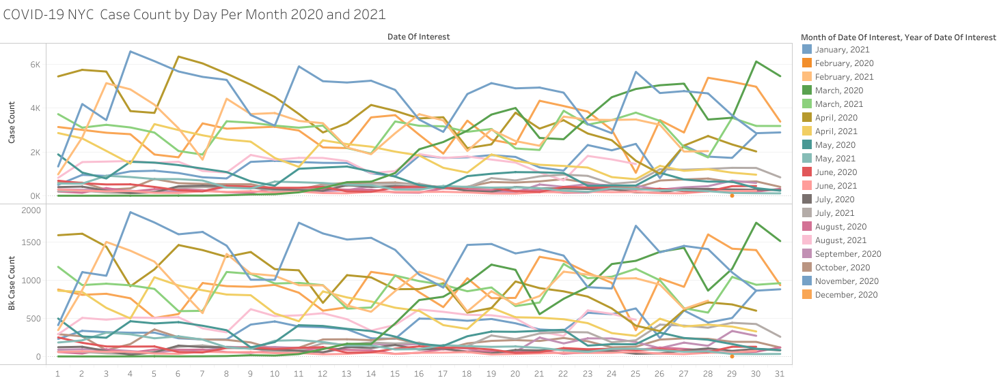
https://public.tableau.com/app/profile/vincenzo.mezzio/viz/COVID-COVID-19_NYC_Case_Count_by_Day_Per_Month_2020_and_2021/COVID-19_NYC_Case_Count_by_Day_Per_Month_2020_and_2021?publish=yes

Slide 13
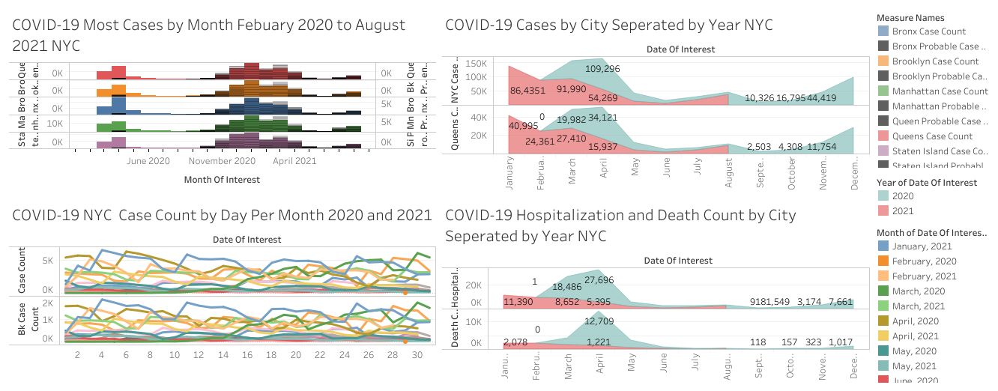
https://public.tableau.com/app/profile/vincenzo.mezzio/viz/COVID-19_Cases_and_Deaths_Dashboard/COVID-19_Cases_and_Deaths_Dashboard?publish=yes

Slide 14
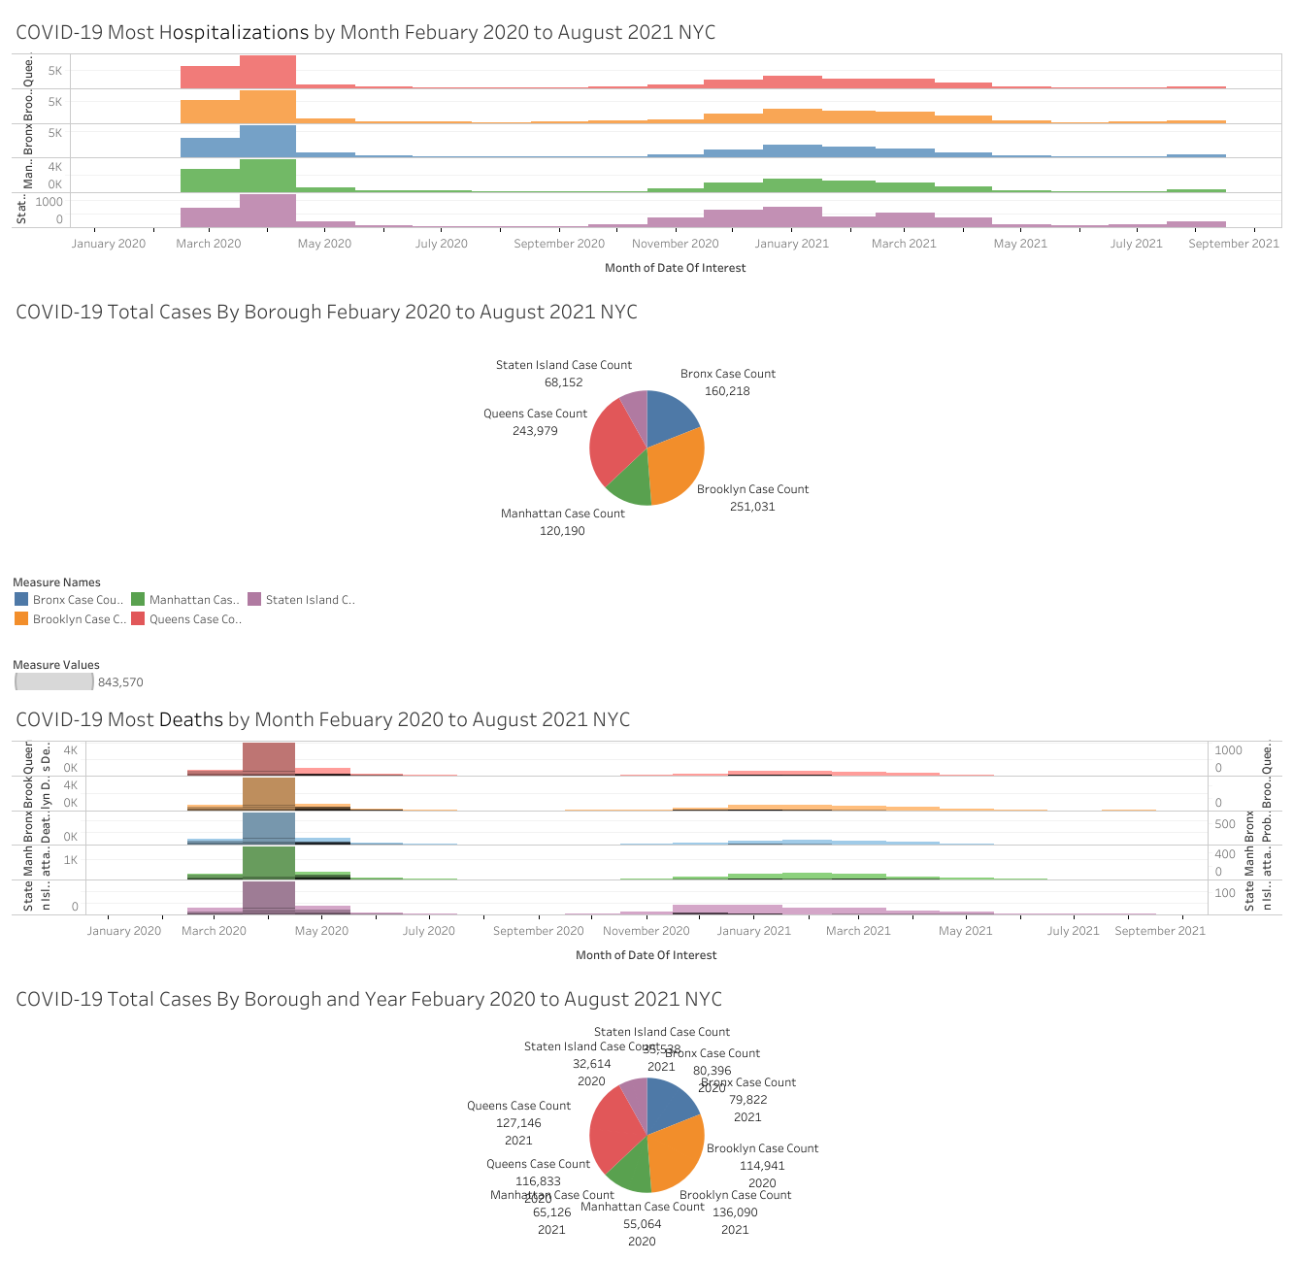
https://public.tableau.com/app/profile/vincenzo.mezzio/viz/COVID-19_Hospitilizations_and_Total_Case_by_Borough_Dashboard/COVID-19_Hospitilizations_and_Total_Case_by_Borough_Dashboard?publish=yes

Slide 15
Findings
April 2020 and January 2021 had the highest number of COVID-19 cases across all 5 boroughs.
January 2021 and December 2020 had the highest number of probable cases in all five boroughs.
The most deaths and hospitalizations occurred in April 2020 and January 2021.
Brooklyn was affected by COVID-19 the most with a total case count of over 250k.
COVID-19 also had a greater impact on NYC in 2021 in terms of number of cases. There were more COVID-19 hospitalizations and deaths in 2020 in NYC.
The count of COVID-19 cases seems to increase in November, peak in January, then have another peak in March / April, then drop down before peaking again in August. Hospitalizations and Deaths have a similar curve except death count plateaus in February 2021
The end of the year months seem to have higher risk of COVID-19 during the ending days of the month while the first few months in the new year have higher risk of COVID-19 in the beginning of the month.

Slide 16
Questions to answer for stakeholders
When is COVID-19 the most and least severe? According to the data, anywhere from November to December is the most severe and the months June and September are the least severe.
Which borough has the highest and lowest risk of COVID-19? Also, according to the data, Queens and Brooklyn have the highest risk while Staten Island has the lowest risk.
Which days in the months have the highest risk of COVID-19? In NYC, January (4th), February (3rd), April (6th), May (4th), June (1st), and October (5th) peak at the beginning of the month (before the 7th). March (30th), July (29th), September (29th), November (30th), and December (28th) peak at the end of the month (after the 19th). August (18th) peaks in the middle of the month.

Slide 17
Links
Dataset: https://data.cityofnewyork.us/Health/COVID-19-Daily-Counts-of-Cases-Hospitalizations-an/rc75-m7u3
Story: https://public.tableau.com/app/profile/vincenzo.mezzio/viz/COVID-19_Story/COVID-19_Story?publish=yes

