Slide 1

Cognitive Services Project
Authors: Andrea Grendene, Davide Colacicco

Slide 2

What is the reason behind Infologo?
The world today is full of logos, which represent companies, projects, associations, etc.
There are a lot of logos that we don’t know, and sometimes we are curious about history, products and economy behind an unkown trademark
Neural networks provide us a powerful instrument which can help us
Infologo comes from this idea
2/16

Slide 3
What is Infologo?
It’s an Android application which can recognize a logo and show some information about it
Uses the default camera app to take a picture of logo
Is based on three Google services: Google Cloud Vision API, Custom Search JSON API and Text-to-speech API
Information comes from English Wikipedia
3/16

Slide 4
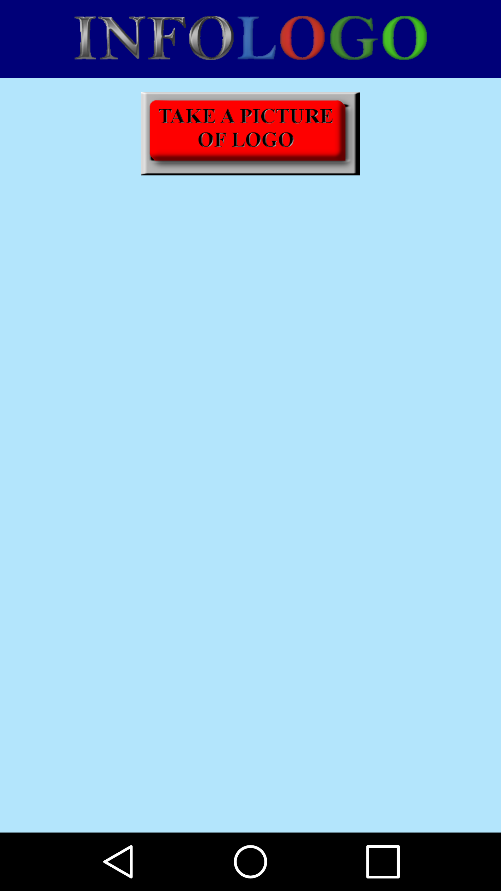
First window
Initially there is only a button, which opens the default camera app
Then the user can take a photo of logo
4/16

Slide 5
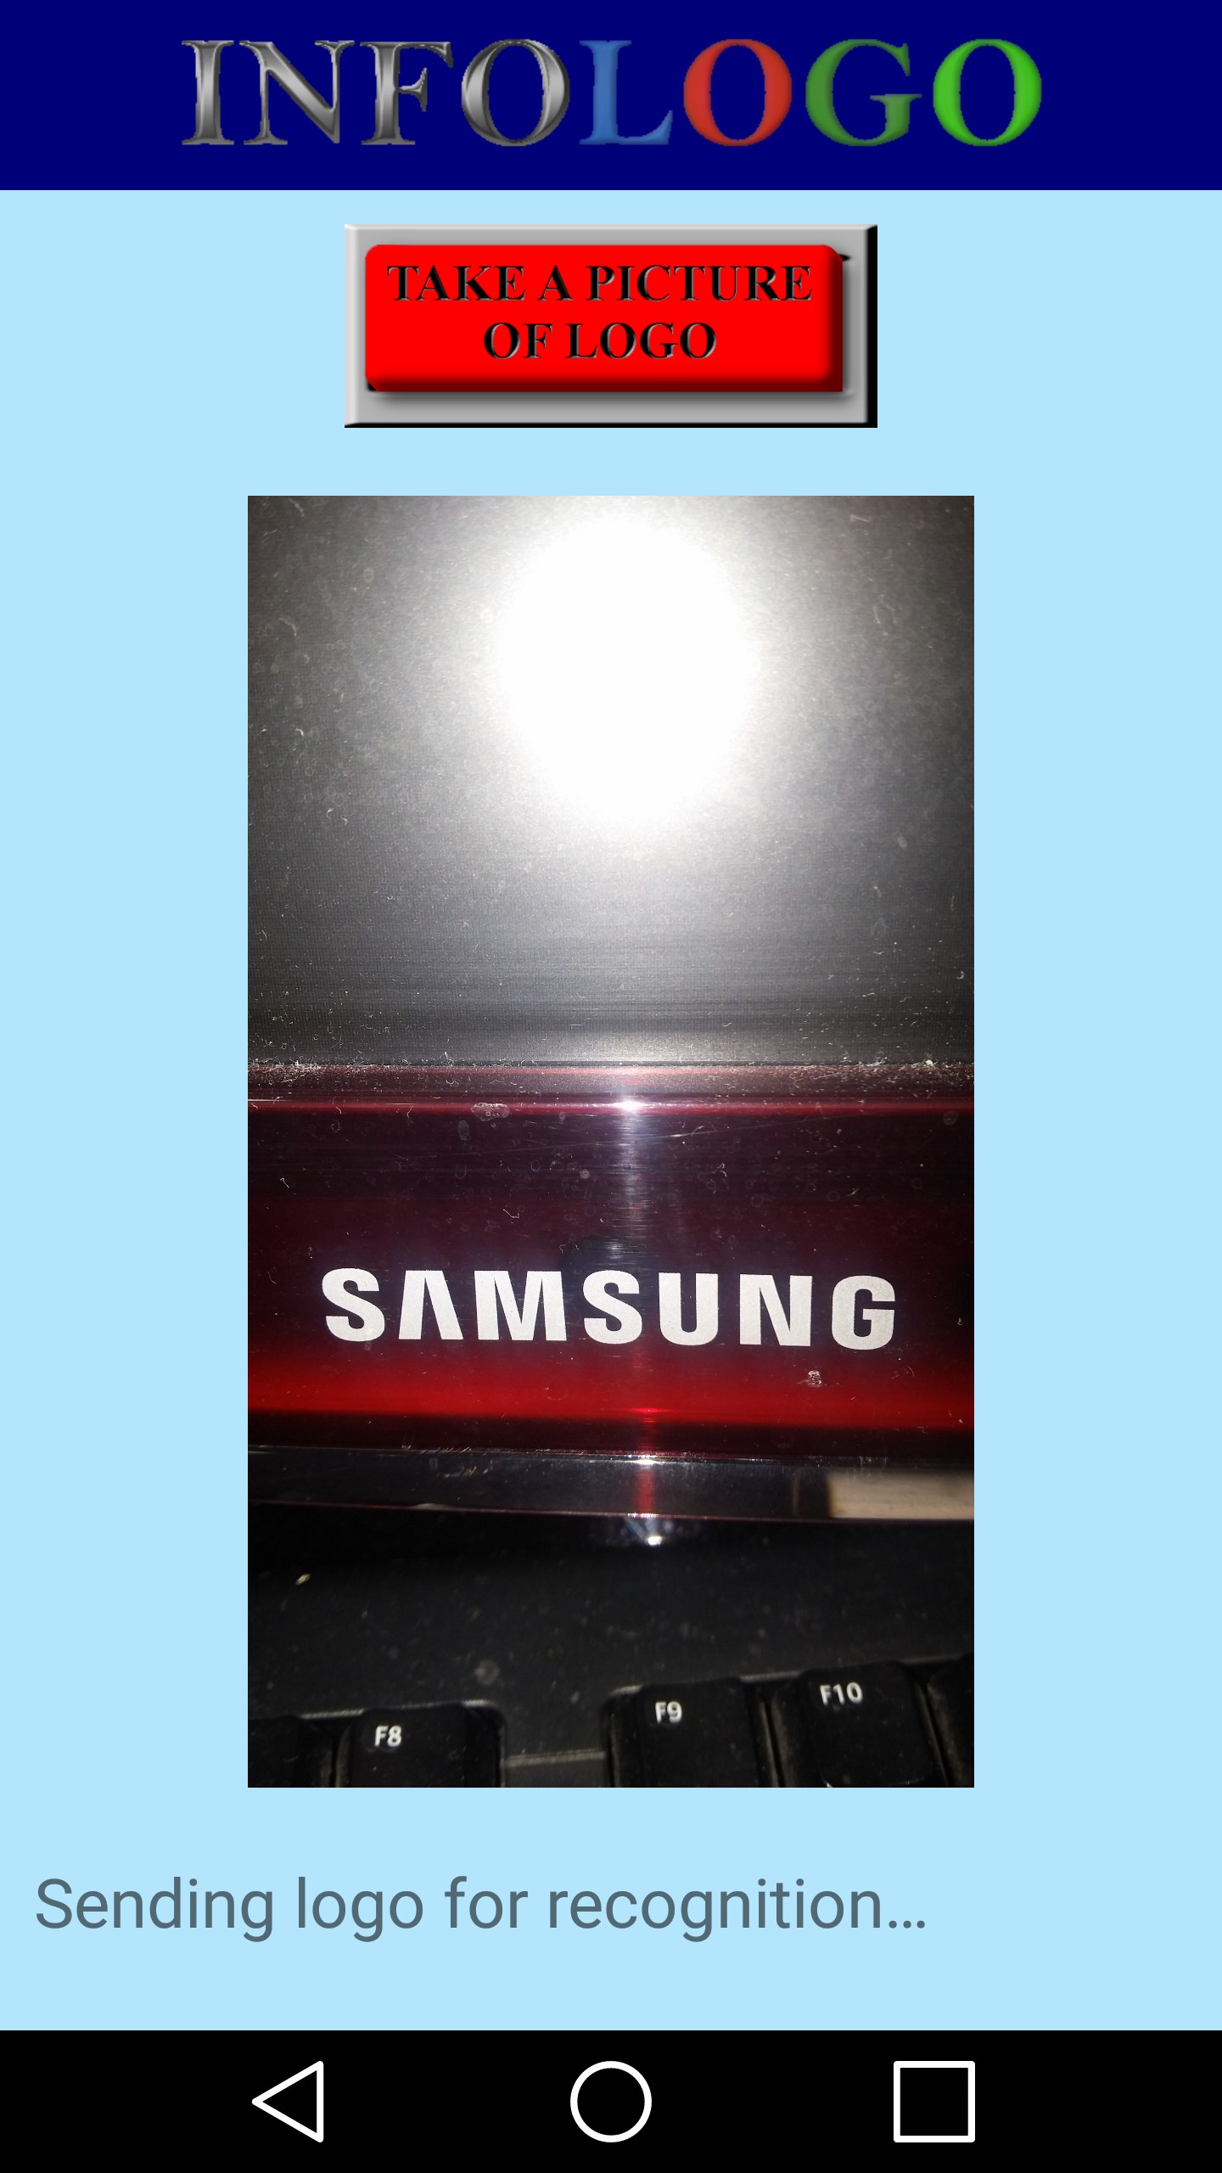
First window
After that the image is shown in the center of the window and recognition begins
In addition every next step is reported in an apposite text view
5/16

Slide 6
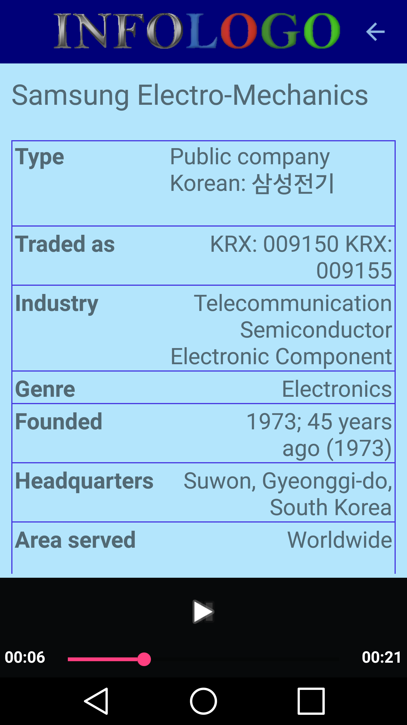
Second window
The final result is shown in a new window
The title is represented by logo name
In the table there are some information, in the form of content-type pairs
In the bottom there is a media player to manage the speech obtained with Text-to-speech service
The user can return to the first window with the arrow on the top right, and come back with a similar arrow which appears when the second window is created
6/16

Slide 7
From first to second window
When the logo picture is loaded 5 steps are performed:
7/16

Slide 8
From first to second window
When the logo picture is loaded 5 steps are performed:
The image is send to Google server and then the application will receive a string, which contains logo name
8/16

Slide 9
From first to second window
When the logo picture is loaded 5 steps are performed:
The image is send to Google server and then the application will receive a string, which contains logo name
With this string the application searches the corresponding Wikipedia page, obtaining as a result an other string with the URL of the page
9/16

Slide 10
From first to second window
When the logo picture is loaded 5 steps are performed:
The image is send to Google server and then the application will receive a string, which contains logo name
With this string the application searches the corresponding Wikipedia page, obtaining as a result an other string with the URL of the page
The page HTML file is downloaded, then Infologo extracts the content-type pairs of the table and cleans the text from undesired contents, such as tables, images, tags, etc.
10/16

Slide 11
From first to second window
When the logo picture is loaded 5 steps are performed:
A part of the remaining text is send to Google server, in order to receive the speech file
11/16

Slide 12
From first to second window
When the logo picture is loaded 5 steps are performed:
A part of the remaining text is send to Google server, in order to receive the speech file
The application creates the second window and plays the speech audio
12/16

Slide 13
What is the reason behind Infologo?
The world today is full of logos, which represent companies, projects, associations, etc.
There are a lot of logos that we don’t know, and sometimes we are curious about history, products and economy behind an unkown trademark
Neural networks provide us a powerful instrument which can help us
Infologo comes from this idea
2/16

