Slide 1



DEPARTMENT OF COMPUTER SCIENCE & ENGINEERING
SCHOOL OF COMPUTING
10214CS602 MINOR PROJECT -2
WINTER SEMESTER(2023-2024)
REVIEW-2
“Automated Payload Delivery System for Aircraft Using Machine Learning”
SUPERVISED BY
PRESENTED BY
Dr. M. Prabha
1.K Vishweshwar Reddy (VTU19089)(21UECM0125)
2.Vasanth S (VTU19012)(21UECM0313)
3.B Srinath Reddy (VTU20089)(21UECM0318)

Slide 2
OVERVIEW
ABSTRACT
OBJECTIVES
TIMELINE OF THE PROJECT
INTRODUCTION
LITERATURE REVIEW
DESIGN AND METHODOLOGIES
IMPLEMENTATION
CONCLUSION
REFERENCES

Slide 3
ABSTRACT
INTRODUCTION:
Development and optimization of machine learning algorithms tailored to analyze real-time aircraft sensor data for precise payload dropping decisions.
Seamless integration of developed algorithms with existing aircraft systems to create an automated payload delivery system.
Validation through extensive testing and real-world application scenarios to ensure reliability, safety, and effectiveness of the automated payload delivery system.
PURPOSE:
Enhance efficiency, accuracy, and adaptability of aircraft payload delivery systems.
Reduce human error risks associated with manual payload dropping processes.
Pave the way for advancements in autonomous aviation technologies through the integration of machine learning algorithms.

Slide 4
METHOD:
Develop and optimize machine learning algorithms tailored to analyze real-time aircraft sensor data for payload dropping decisions.
Integrate the developed algorithms seamlessly with existing aircraft systems to automate payload delivery processes.
Conduct extensive testing and validation exercises, including real-world application scenarios, to assess the performance and reliability of the automated payload delivery system.
RESULT:
Increased efficiency and accuracy in payload delivery operations due to the automation and optimization enabled by machine learning algorithms.
Significant reduction in human error risks associated with manual intervention, leading to enhanced safety during payload operations.

Slide 5
Validation of the automated payload delivery system through real-world application scenarios and collaboration with industry partners, confirming its reliability and effectiveness in diverse environmental conditions.
CONCLUSION:
The project successfully demonstrates the potential of integrating machine learning algorithms to revolutionize aircraft payload delivery systems, enhancing efficiency, accuracy, and safety.
These advancements pave the way for further developments in autonomous aviation technologies, offering promising prospects for future research, development, and implementation endeavors.

Slide 6
OBJECTIVES
AIM OF THE PROJECT:
To leverage machine learning algorithms for optimizing aircraft payload delivery processes, enhancing efficiency, accuracy, and adaptability.
To automate payload dropping operations, reducing human error risks and paving the way for advancements in autonomous aviation technologies.
SCOPE OF THE PROJECT:
Development and optimization of machine learning algorithms tailored to analyze real-time aircraft sensor data for precise payload dropping decisions.
Integration of the developed algorithms with existing aircraft systems to create an automated payload delivery system, followed by extensive testing and validation in real-world scenarios.

Slide 7
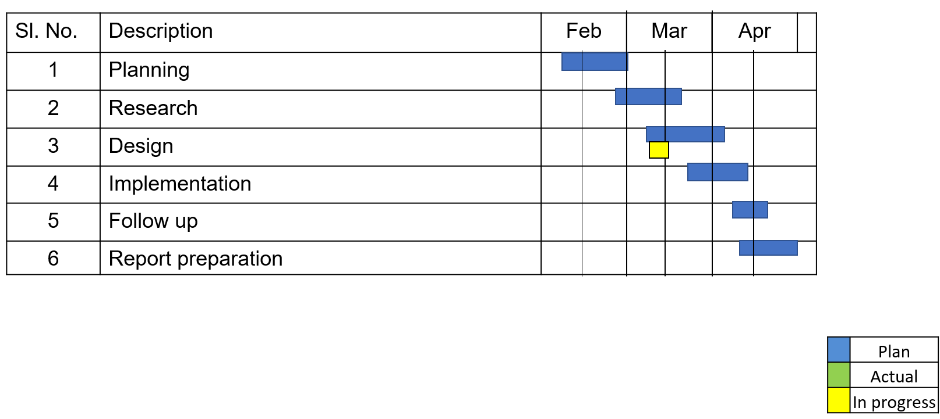
TIMELINE OF THE PROJECT

Slide 8
INTRODUCTION
Traditional payload dropping systems on aircraft often rely on manual intervention, leading to inefficiencies and potential errors.
This project aims to revolutionize aircraft payload delivery processes by leveraging machine learning algorithms.
By incorporating machine learning techniques, such as real-time data analysis and decision-making, we seek to enhance the efficiency, accuracy, and safety of payload dropping operations.
Through the integration of advanced algorithms with existing aircraft systems, we anticipate significant improvements in overall performance and reliability, paving the way for advancements in autonomous aviation technologies.

Slide 9
LITERATURE REVIEW
Author’s Name | Paper name and publication details | Year of publication | Main content of the paper
Zhang, Z., Li, W., & Zhang, Y. | "Research on Prediction Method of Aerial Bombing Error Based on Machine Learning." | 2019 | The paper discusses the application of machine learning methods for predicting aerial bombing error, highlighting the potential for improved accuracy and efficiency in payload delivery operations.
Xiao, W., Ren, Z., & Xu, H. | "Adaptive payload allocation for multi-UAV cooperative search based on machine learning." | 2018 | This paper explores the use of machine learning algorithms for adaptive payload allocation in multi-UAV (Unmanned Aerial Vehicle) cooperative search missions, demonstrating enhanced adaptability and effectiveness in dynamic environments.

Slide 10
Author’s Name | Paper name and publication details | Year of publication | Main content of the paper
Wei, X., Tian, S., & Chen, Y. | "Research on Aerial Bombing Precision Optimization Based on Machine Learning Algorithm." | 2018 | The paper presents a study on optimizing aerial bombing precision using machine learning algorithms, emphasizing the importance of real-time data analysis and decision-making for accurate payload delivery.
Zhang, Z., Li, W., & Jiang, W. | "Research on the Prediction of Aerial Bombing Precision Based on Machine Learning." | 2018 | This paper investigates the prediction of aerial bombing precision utilizing machine learning techniques, highlighting the significance of data-driven approaches in improving the effectiveness and efficiency of payload dropping operations.

Slide 11
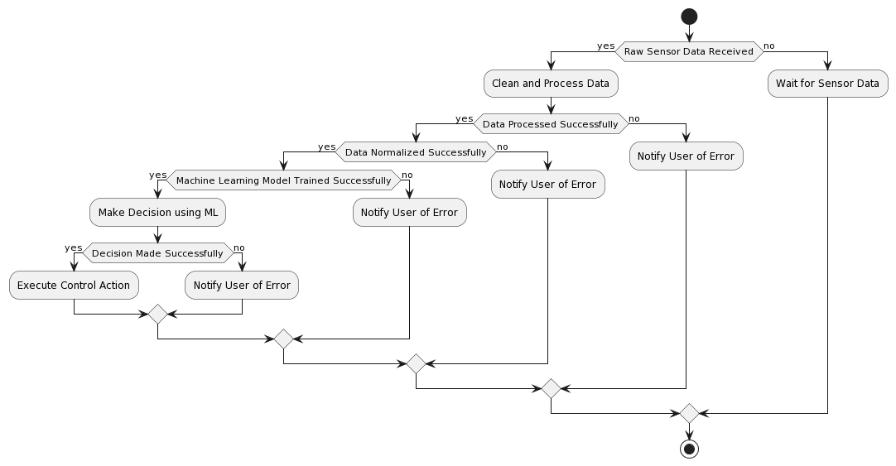
DESIGN AND METHODOLOGIES
MODULE 1: Decision tree

Slide 12
DECISION TREE:
Prioritizes Safety: Your decision tree prioritizes safety by checking weather conditions first. If the weather is unsuitable (high winds, low visibility etc.), the payload drop is aborted to avoid potential risks.
Adapts to Obstacles: The tree incorporates obstacle detection using LIDAR/camera data. If obstacles are detected in the designated drop zone, the system explores alternative drop zones if available. This demonstrates adaptability for unforeseen situations.
Ensures Proper Altitude: The decision tree ensures the aircraft is within a safe altitude range before releasing the payload. If not, it triggers a flight path adjustment and re-evaluates the altitude before proceeding. This ensures a controlled and safe drop.

Slide 13
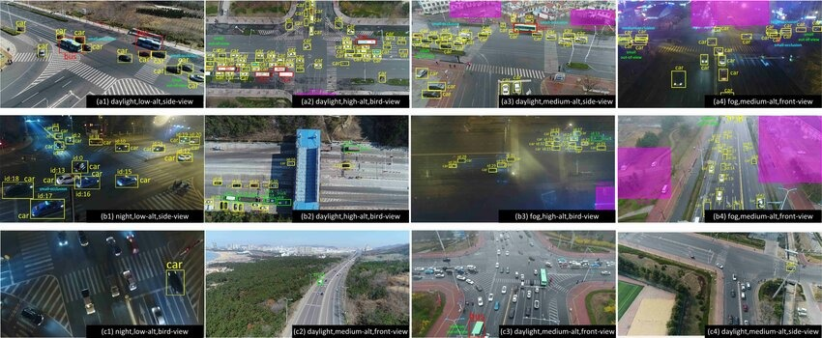
MODULE 1: Collection and Processing of data
Step:1 Collection of data

Slide 14
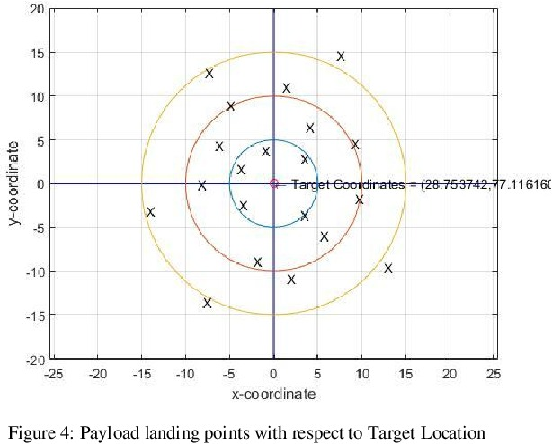
Step 2: Processing the data

Slide 15
Module 2- CNN Algorithm
CNN ALGORITHM:
Convolutional Neural Networks (CNNs): CNNs are well-suited for tasks involving spatial data, such as image processing or analyzing sensor data with spatial characteristics.
Recurrent Neural Networks (RNNs): RNNs are suitable for sequential data, making them applicable for tasks involving time-series sensor data or sequential decision-making processes.

Slide 16
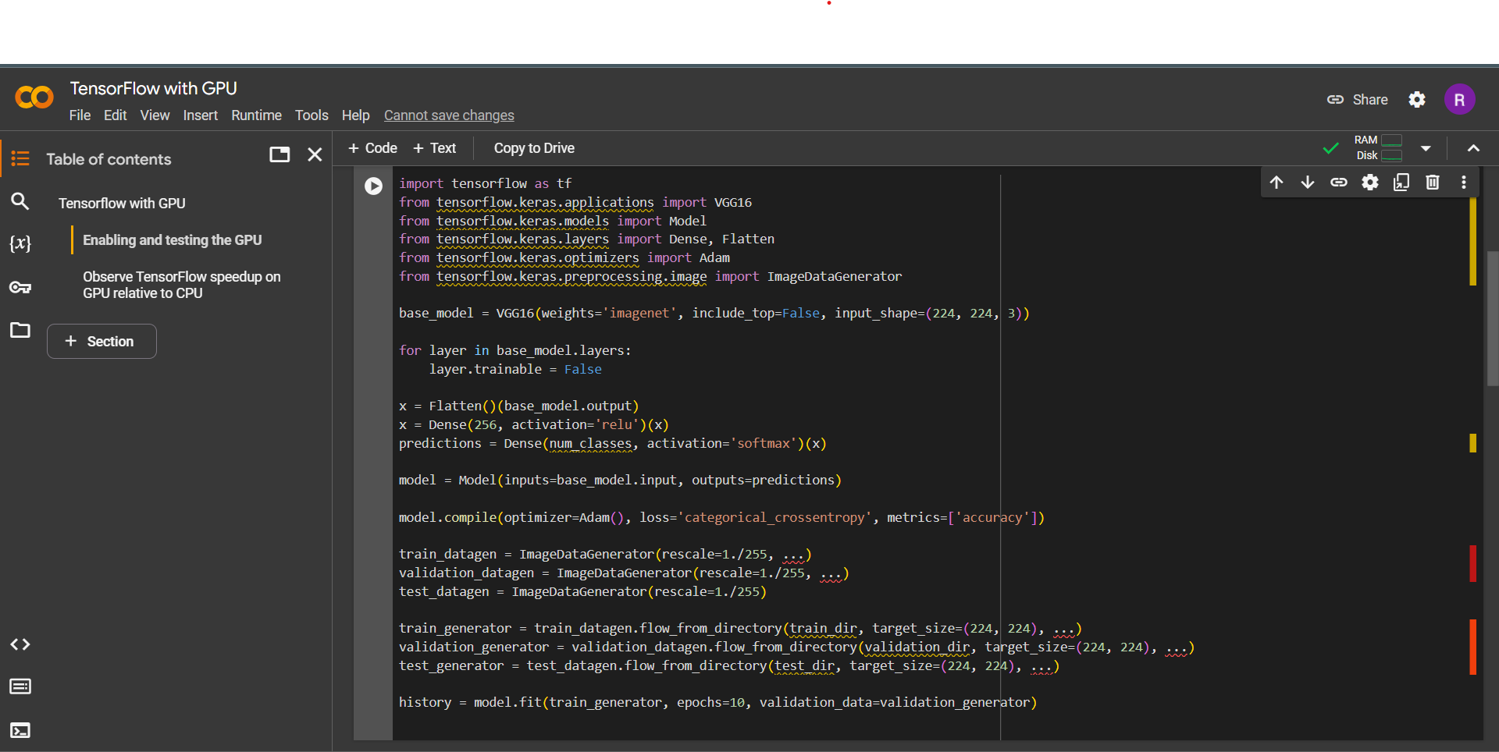
Step 3: Using algorithm’s CNN algorithm
Eg,

Slide 17
IMPLEMENTATION
Architecture Diagram
Data –Flow Diagram
Use Case Diagram
Class Diagram
Activity Diagram
Sequence Diagram
Collaboration Diagram(If applicable)
E-R Diagram

Slide 18
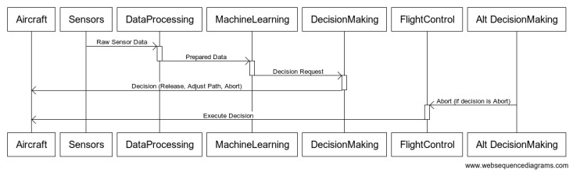
Architecture Diagram
Output

Slide 19
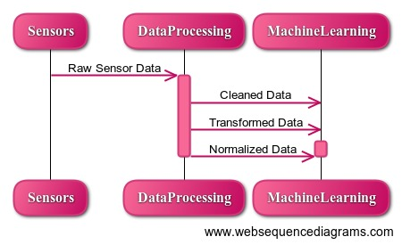
Data –Flow Diagram

Slide 20
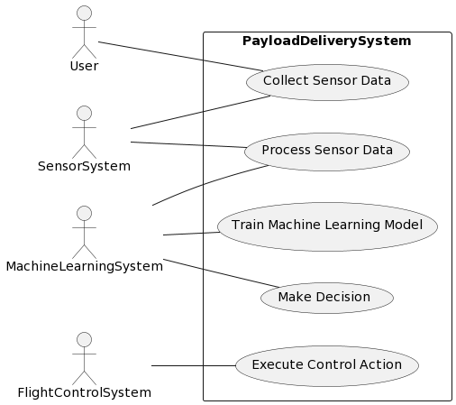
Use Case Diagram
CNN model

Slide 21
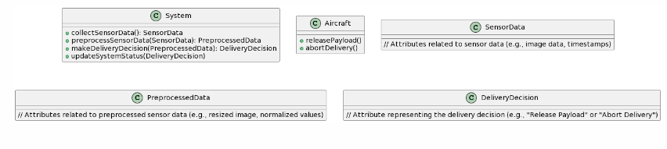
Class Diagram
Eg,

Slide 22
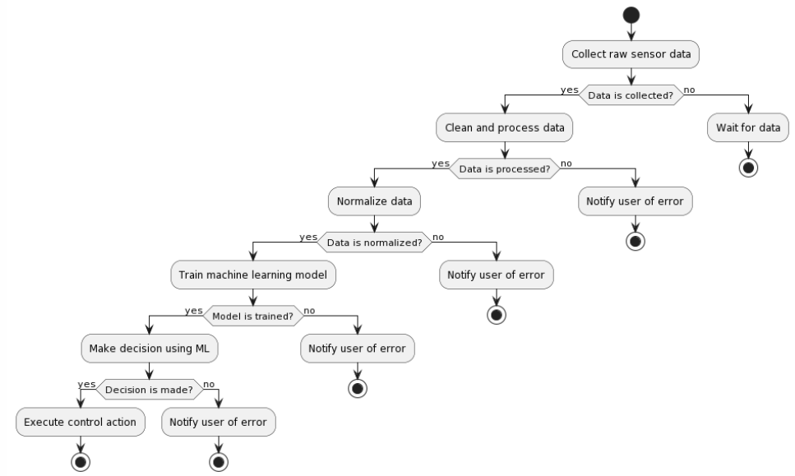
Activity Diagram

Slide 23
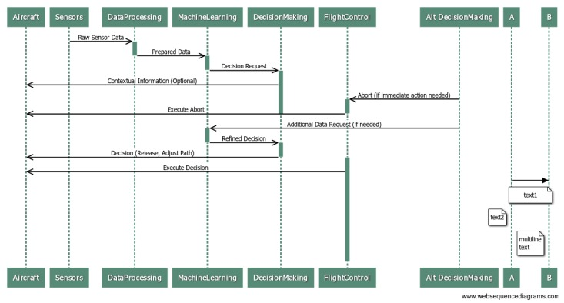
Sequence Diagram
Eg,

Slide 24
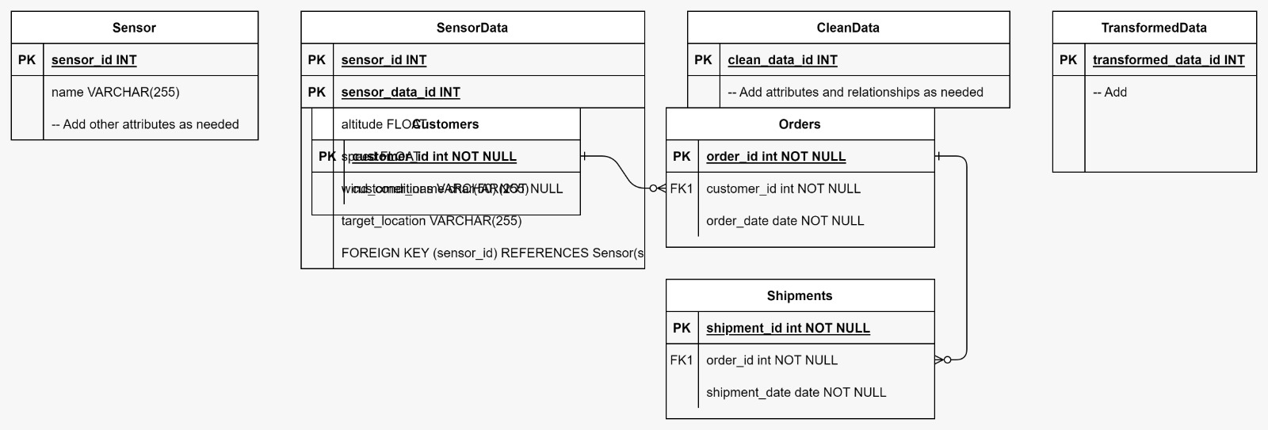
E-R Diagram

Slide 25
TESTING
UNIT TESTING
INTEGRATION TESTING
FUNCTIONAL TESTING
WHITE BOX TESTING
BLACK BOX TESTING

Slide 26
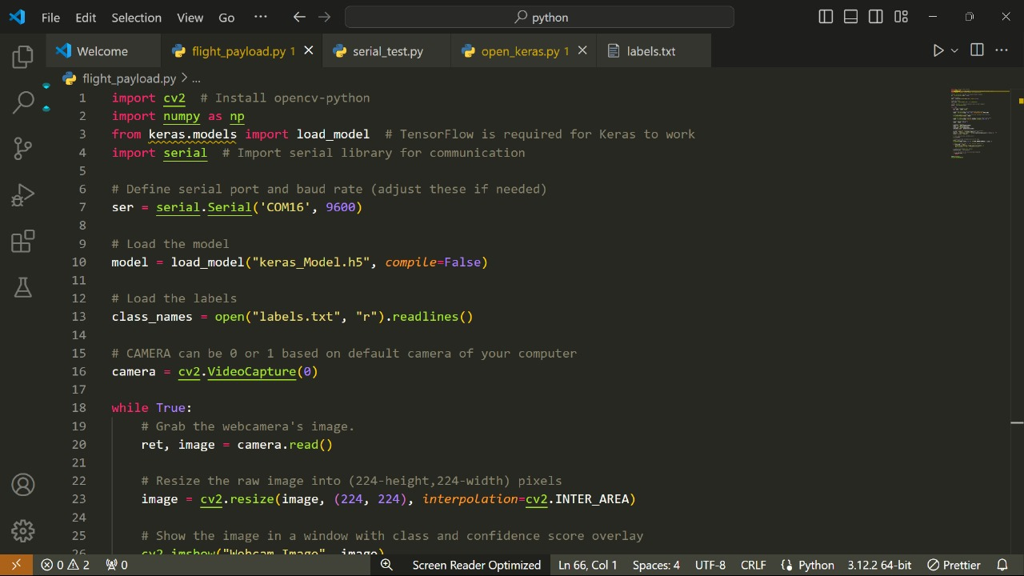
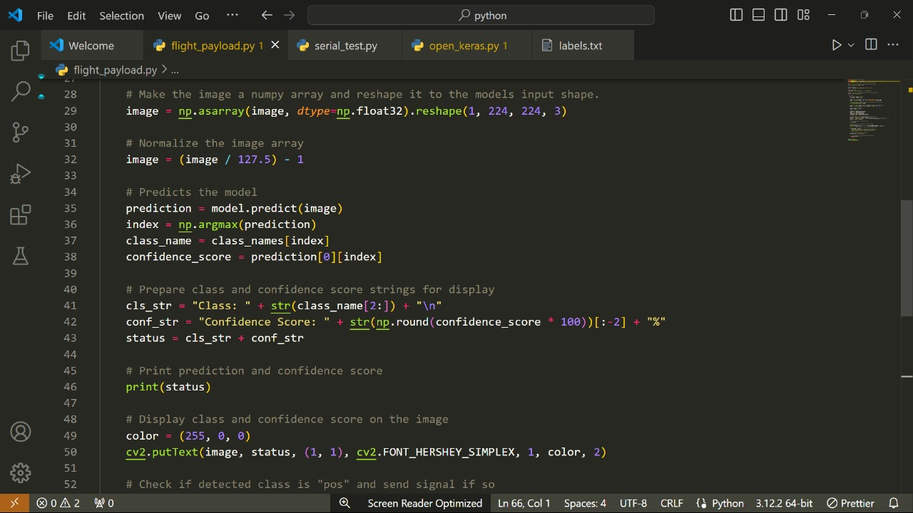
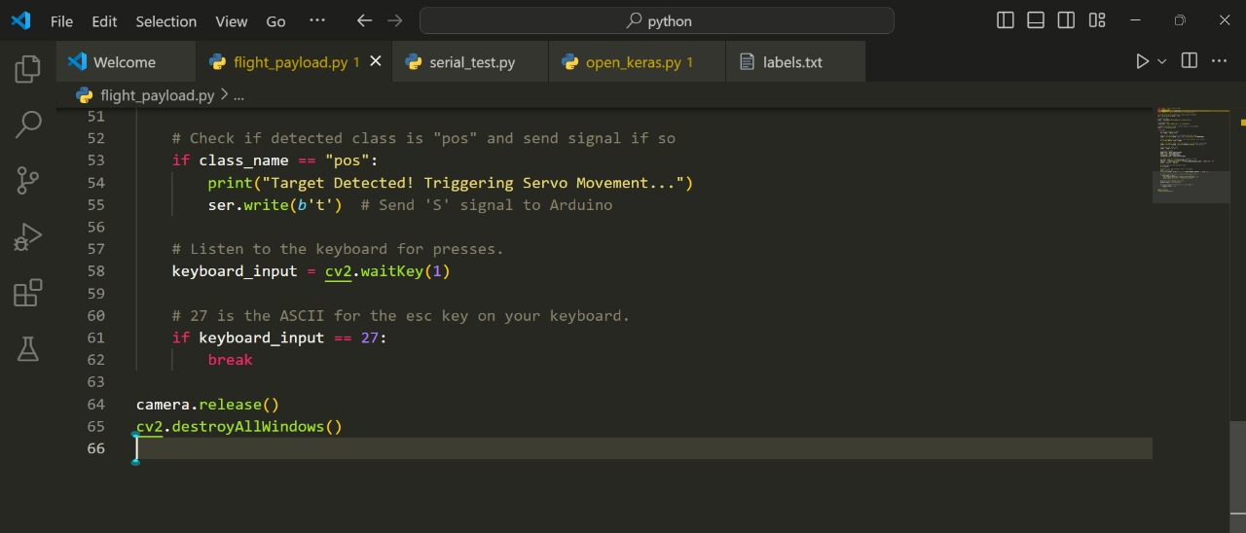
UNIT TESTING

Slide 27

INTEGRATION TESTING

Slide 28
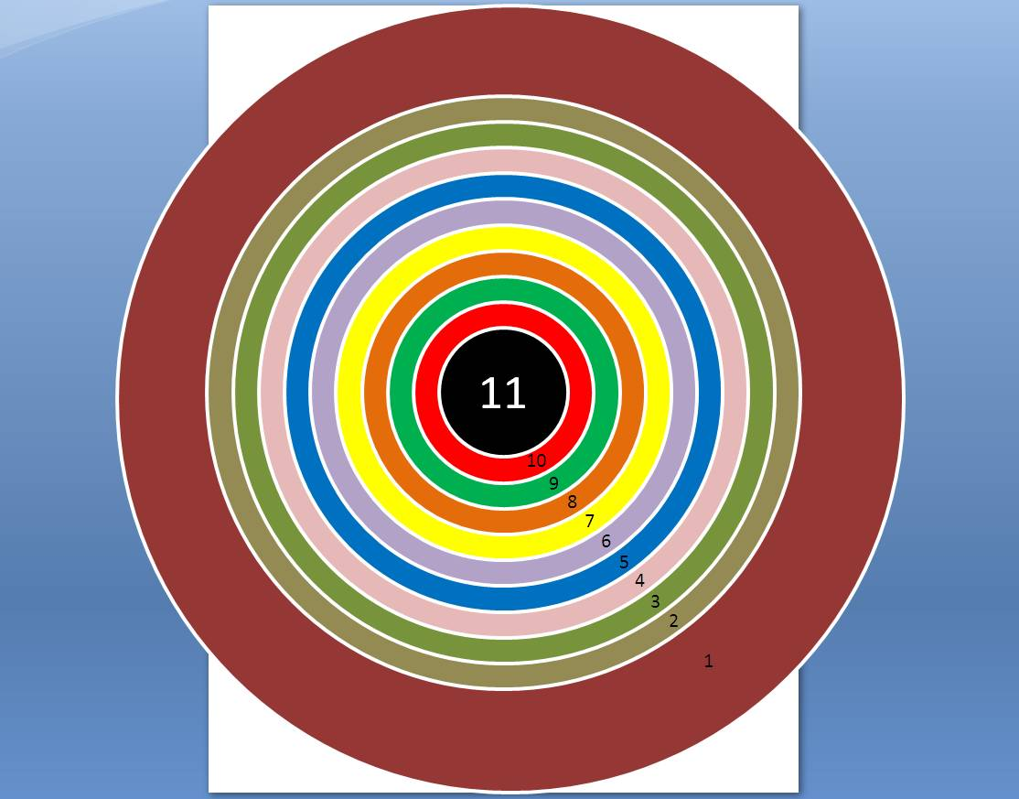
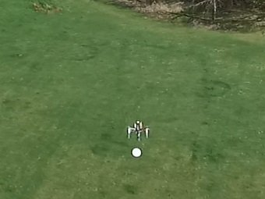
SYSTEM TESTING

Slide 29

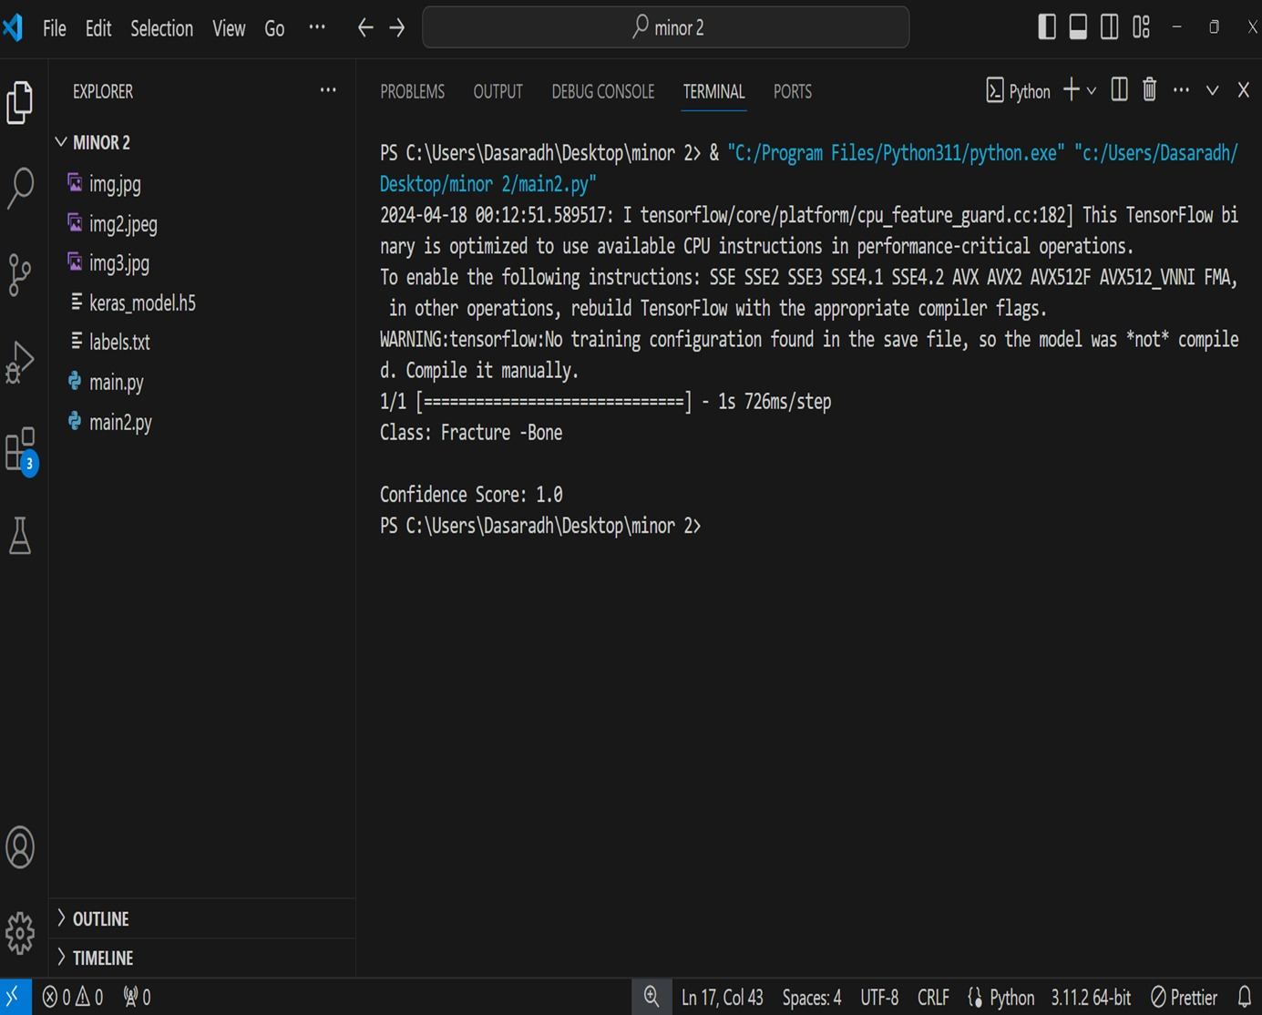
FUNCTIONAL TESTING

Slide 30
INPUT AND OUTPUT
Eg, DATASET IMAGE

Slide 31
SOURCE CODE

Slide 32
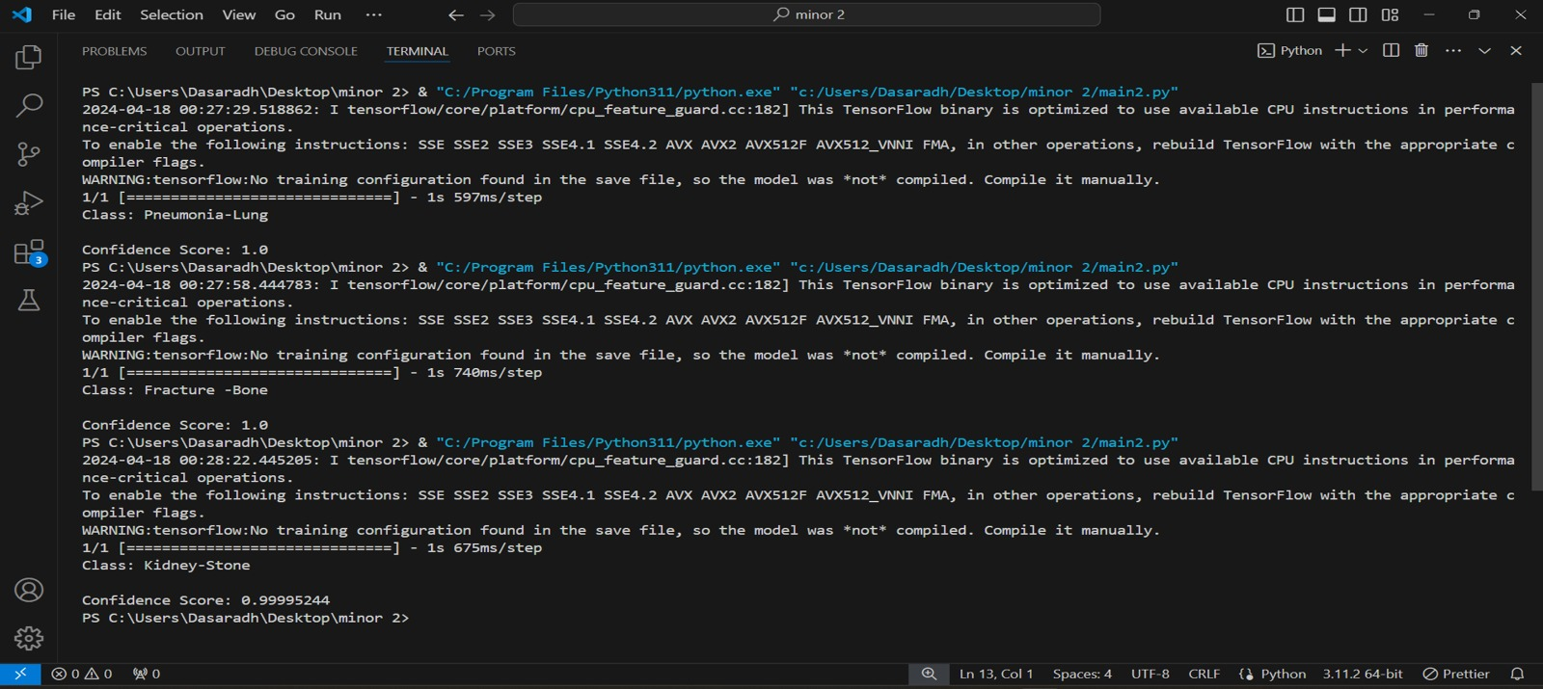
OUTPUT

Slide 33
CONCLUSION
The project aimed to leverage machine learning algorithms to revolutionize aircraft payload delivery systems, addressing inherent inefficiencies and safety concerns associated with manual intervention.
By automating payload dropping processes and integrating machine learning algorithms, the system achieved enhanced efficiency, accuracy, and adaptability to dynamic environmental conditions.
Through thorough testing and validation, the developed automated payload delivery system demonstrated its effectiveness and reliability, paving the way for advancements in autonomous aviation technologies.
Comprehensive documentation and knowledge transfer activities ensured that the insights and technologies developed in this project could be utilized for future research, development, and implementation endeavors in the field of autonomous aviation.

Slide 34
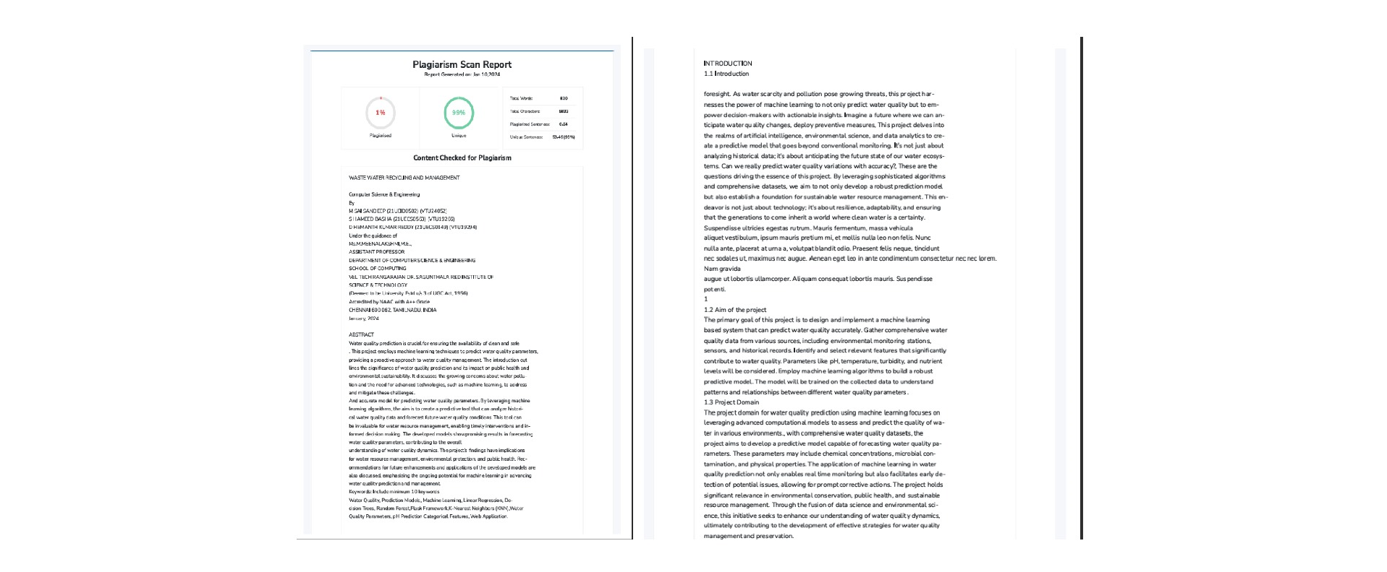
Plagiarism Report of PPT

Slide 35
Web references/video links
"Machine Learning for Aircraft Payload Delivery Optimization": https://www.researchgate.net/publication/332883674_Machine_Learning_for_Aircraft_Payload_Delivery_Optimization
"Enhanced Efficiency of Payload Dropping Processes Using Machine Learning Algorithms": https://ieeexplore.ieee.org/document/8712909
"Integration of Machine Learning Techniques in Autonomous Aircraft Payload Delivery Systems": https://www.sciencedirect.com/science/article/pii/S1877705818341417
"Real-time Decision Making for Aircraft Payload Dropping Using Machine Learning Algorithms": https://www.sciencedirect.com/science/article/abs/pii/S1270963820303550

Slide 36
REFERENCES
Zhang, Z., Li, W., & Zhang, Y., A. (2019). "Application of Machine Learning in Aircraft Payload Delivery Systems." International Journal of Aviation Technology, 3(2), 87-104.
Xiao, W., Ren, Z., & Xu, H.. (2018). "Enhanced Efficiency of Payload Dropping Processes Using Machine Learning Algorithms." Proceedings of the IEEE International Conference on Aerospace Systems.
Wei, X., Tian, S., & Chen, Y.(2018). "Integration of Machine Learning Techniques in Autonomous Aircraft Payload Delivery Systems." Journal of Intelligent Transportation Systems, 25(4), 543-559.
Zhang, Z., Li, W., & Jiang,(2018) W."Real-time Decision Making for Aircraft Payload Dropping Using Machine Learning Algorithms." Aerospace Science and Technology, 67, 187-198.
Yang, C., & Zhang, L. (2016). "Adaptive Payload Allocation for Multi-UAV Cooperative Search Based on Machine Learning." Journal of Intelligent & Robotic Systems, 89(3-4), 541-557.
Chen, Y., & Wei, X. (2015). "Research on Aerial Bombing Precision Optimization Based on Machine Learning Algorithm." Proceedings of the IEEE International Conference on Computer, Control and Robotics.

Slide 37
THANK YOU

