Slide 1
LSGAN
Least Squares Generative Adversarial Networks

Slide 2
I. My Work
Reproduce the model code of LSGAN
Train it with the MNIST data set
Reference:
The idea of realization process refers to the paper
Least Squares Generative Adversarial Networks, 1–15.
[1611.04076] Least Squares Generative Adversarial Networks
Model building process refers to musyoku-LSGAN https://github.com/musyoku/LSGAN

Slide 3
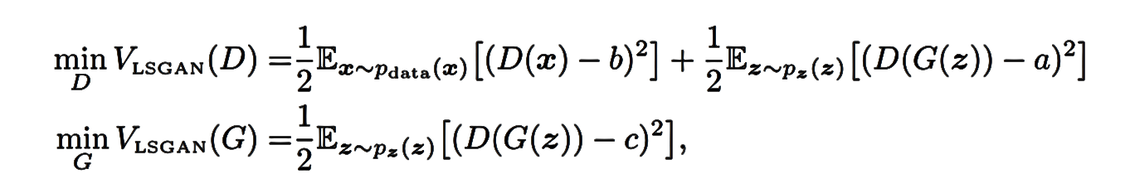
II. Principle
Replace sigmoid cross entropy with least squares.

Slide 4
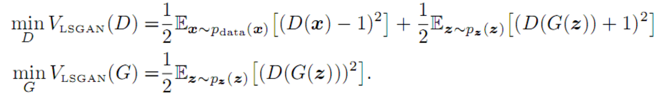
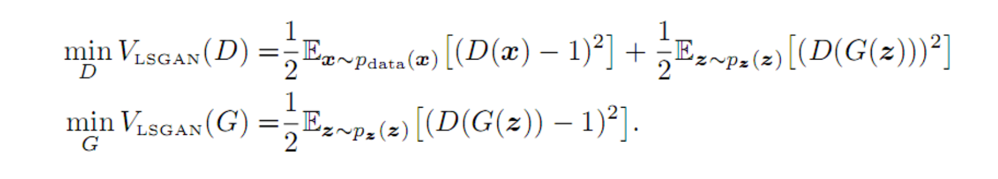

I. Principle
Parameters Selection
Scheme I ($a=−1, b=1, c=0$)
Scheme II $\left(a=0, b=1, c=1\right)$

Slide 5
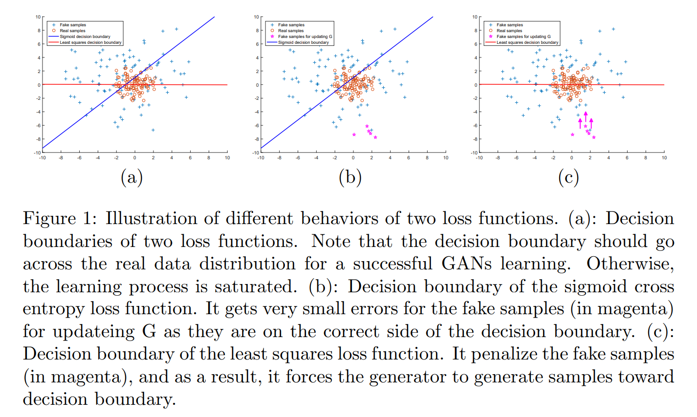
III. Benefit of LSGAN
提高图片质量：
最小二乘损失函数会对处于判别成真的那些远离决策边界的样本进行惩罚，把远离决策边界的假样本拖进决策边界

Slide 6
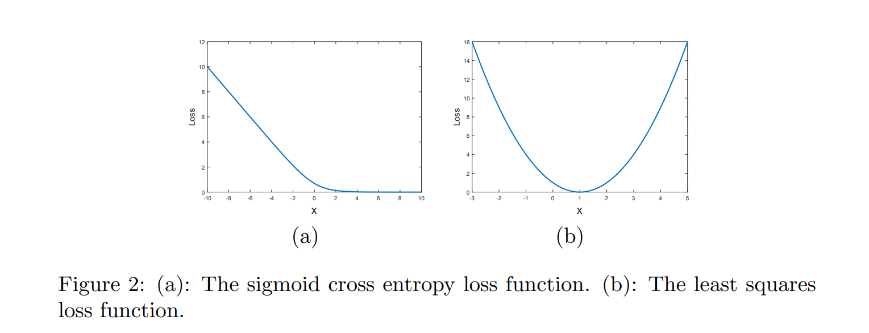
II. Benefit of LSGAN
增强训练稳定性：
传统GAN的训练过程十分不稳定，在最小化目标函数时可能发生梯度弥散，很难更新生成器。
LSGAN 会惩罚那些远离决策边界的样本，这些样本的梯度是梯度下降的决定方向。

Slide 7
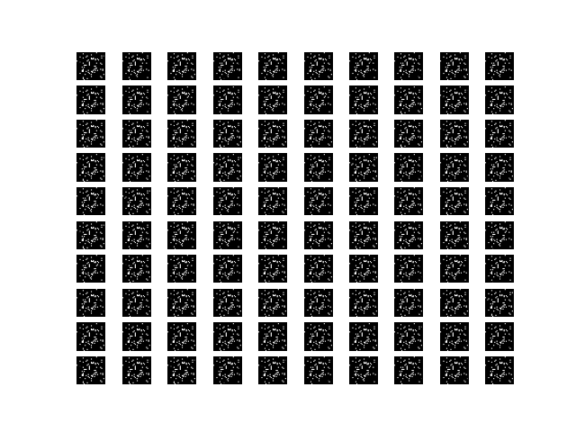
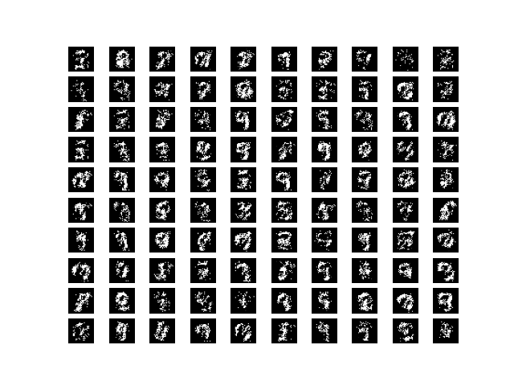
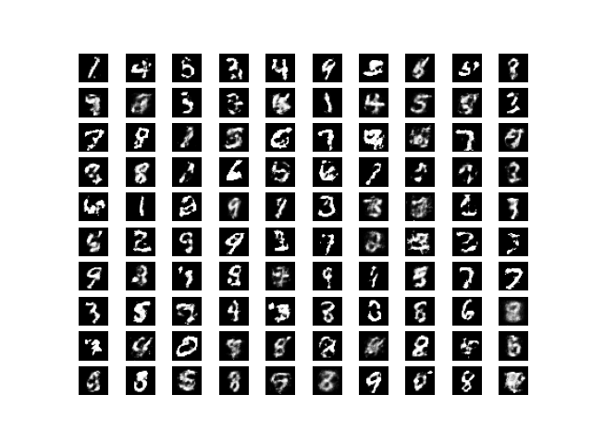
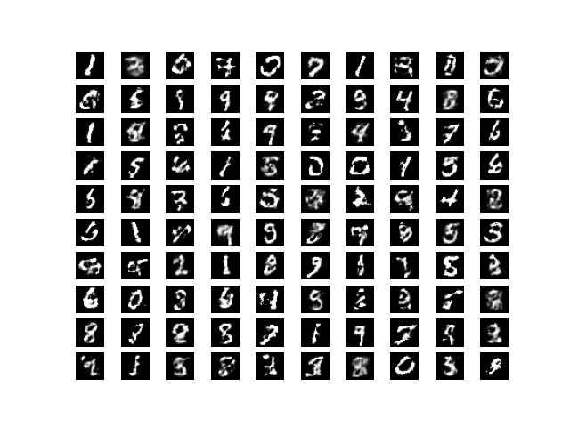
IV. Training Performance On MNIST

