Slide 1
Tatum Bank
From Figma Design to Flutter & Dart — Building a Mobile Banking Application

Slide 2
1. The Problem
Translating a detailed Figma mobile design into production-ready Flutter & Dart code
26 screens across 6 feature modules to implement
Matching pixel-perfect Figma layouts with Flutter widgets
Integrating with a live REST API (Tatum Connect Backend)
Managing authentication state across login, OTP, registration, and biometric flows
Delivering a consistent brand experience: yellow (#FFC727) + navy (#0B192C) design system

Slide 3
2. Figma Mobile App — Full Overview
Module 1 — Authentication & User Access (10 screens)
Landing / Get Started → Sign In → Register → Phone OTP → Email OTP → Biometric Setup → Permissions → Welcome → Security Setup → Account Created
Module 2 — Operations Dashboard (3 screens)
Home Dashboard → Account Detail → Spending Analytics
Module 3 — Transactions / Buy Airtime (4 screens)
Airtime Selection → Confirmation → Payment Method → Success
Module 3a — Transaction History (3 screens)
Full History → Transaction Detail → Filtered View
Module 4 — Customer Service (2 screens)
Support Home → Live Chat
Module 5 — Notifications & Profile (4 screens)
Notifications List → Notification Detail → Profile → Settings
Notes:
Each module is a self-contained flow. The dashboard is the central hub with bottom nav: Home, Activity, Support, Inbox, More.

Slide 4
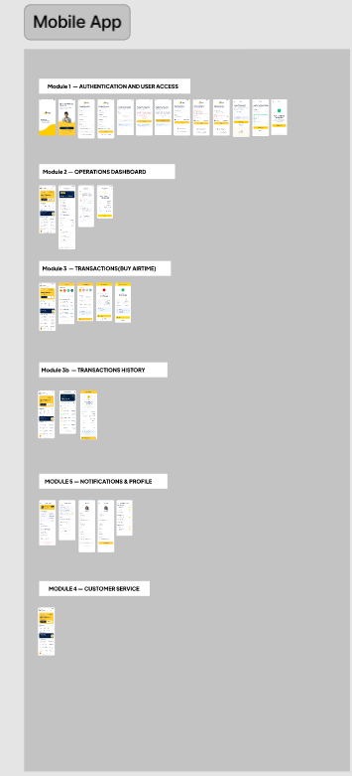
Notes:
This is the Figma overview showing all 6 modules and every screen in the mobile app. Yellow = brand accent, navy = primary text/UI color.

Slide 5
3. Architecture Walkthrough
A. Layout (UI Layer)
Flutter widgets: Scaffold, SafeArea, SingleChildScrollView, Column, Row, Container,GestureDetector
Custom paint: TatumLogoWidget with _TatumIconPainter (4-tile logo)
Reusable tiles: _QuickActionTile, _TransactionTile — stateless widgets
BottomNavigationBar with 5 tabs, custom icon containers with active-state yellow highlight
Responsive Flex layouts: Expanded, Flexible, ConstrainedBox for varied screen sizes
B. API Integration (Data Layer)
HttpAuthRepository implements AuthRepository interface — clean separation of contract vs implementation
APIRoute class: centralized endpoint strings (baseUrl, Auth/*, Notifications/*, Products/*, Transactions/*)
ResponseHandler: maps HTTP responses → domain models, throws typed exceptions
SharedPreferences: persists auth_token locally for session restore
C. State Management (Provider)
AuthProvider extends ChangeNotifier — single source of truth for user session
ViewState enum: idle / loading / success / empty / error — drives UI reaction
MultiProvider at app root wraps MyApp; Consumer<AuthProvider> drives home route
Field-level validation errors mapped from ValidationException into TextField errorText

Slide 6
4. Code Deep-Dive — Layout
DashboardScreen: main hub with balance card, quick actions, recent transactions, bottom nav
_QuickActionTile: stateless widget — icon + label, tap handler
_TransactionTile: InkWell row with icon circle, title, date, amount, status

Slide 7
5. Code Deep-Dive — API Integration
APIRoute: all endpoints in one file — Auth, Notifications, Products, Transactions, Users
HttpAuthRepository: POST/GET with Bearer token, persists token via SharedPreferences
restoreSession(): reads token from prefs, calls /Auth/me, returns User or null

Slide 8
6. Code Deep-Dive — State Management
AuthProvider: ChangeNotifier with _user, loginState, registerState, errorMessage, fieldErrors
login(email, password) → _repo.login() → ViewState.loading → success/error → notifyListeners()
bootstrap(): called at app start — attempts session restore from stored token
logout(): clears _user, resets state, calls _repo.logout(token)

Slide 9
7. Challenges & Fixes — Layout
Challenge 1: Figma auto-layout vs Flutter widgets
Figma uses auto-layout with flexbox-like behavior; Flutter uses Row/Column/Expanded/Flexible
Fix: Replaced Figma spacer frames with SizedBox(height: X) and Spacer() widgets; used Expanded/Flexible for proportional sizing
Challenge 2: Consistent brand colors across 26 screens
Risk of copy-pasting hex values and drifting from the design system
Fix: Centralized in AppColors class (app_colors.dart) — primary=#FFC727, navy=#0B192C; AppTheme provides ThemeData with ColorScheme
Challenge 3: Bottom nav active-state highlight
Default BottomNavigationBar doesn't support container backgrounds per item
Fix: Built custom icon Container with BoxDecoration(color: index==selected ? yellow : transparent) — dashboard_screen.dart lines 620-628

Slide 10
8. Challenges & Fixes — API Integration
Challenge 1: Multiple API response shapes
Backend returns user data nested under body['data'] in some endpoints, flat in others
Fix: User.fromJson() handles both — checks json['user'] nested map, falls back to top-level; tries id/userId, name/(firstName+lastName) combos
Challenge 2: Token persistence & session restore
App needs to remember logged-in state across restarts; token must be refreshed or cleared on failure
Fix: SharedPreferences stores auth_token; restoreSession() in HttpAuthRepository reads it, calls /Auth/me; on AppException clears token and returns null → AuthProvider.bootstrap() sets ViewState.error
Challenge 3: Typed error handling across async calls
Raw HTTP errors don't tell UI what went wrong
Fix: sealed class AppException with NetworkException, UnauthorisedException, ValidationException (with fieldErrors map), TimeoutException, ServerException — each caught in AuthProvider._run() and mapped to ViewState.error + errorMessage

Slide 11
9. Challenges & Fixes — State Management
Challenge 1: Loading state during async auth flows
Login/register/OTP all async — UI needs to show spinner and disable button during call
Fix: ViewState enum drives UI: loginState==ViewState.loading → ElevatedButton shows CircularProgressIndicator, onPressed=null (login_screen.dart:331-339)
Challenge 2: Field-level validation errors from backend
Backend returns per-field errors (email: 'Invalid format', password: 'Too short')
Fix: ValidationException carries Map<String,String> errors; AuthProvider stores in fieldErrors; TextField errorText: auth.fieldError('email') (login_screen.dart:173,208)
Challenge 3: Biometric login without re-entering password
Device biometrics (fingerprint/face) available but app needs a valid token to restore session
Fix: _handleBiometricLogin() checks localAuth.canCheckBiometrics → authenticates → reads stored auth_token from prefs → calls auth.bootstrap() → if isLoggedIn, pushes /home route (login_screen.dart:60-107)

Slide 12
10. Live Demo
What we'll show:
1. App launch → Tatum logo (CustomPaint 4-tile animation) → Landing screen
2. Sign In flow: email + password → loading spinner → dashboard
3. Dashboard: balance card (toggle visibility), quick actions grid, recent transactions, bottom nav switching
4. Buy Airtime flow: select network → confirm → payment method → success
5. Biometric login: fingerprint button → authenticate → bypass password
6. Logout → session cleared → redirected to landing
Notes:
Demo builds: flutter run on Android (debug) or iOS simulator. The app connects to tatumconnect-backend.onrender.com — ensure device has internet. Offline: the app shows NetworkException toast.

Slide 13
Thank You
Tatum Bank — Figma to Flutter conversion complete
26 screens · 6 modules · Clean architecture: UI / Data / Domain layers
Provider + ChangeNotifier for state · Http + SharedPreferences for data
Questions?

