Slide 1
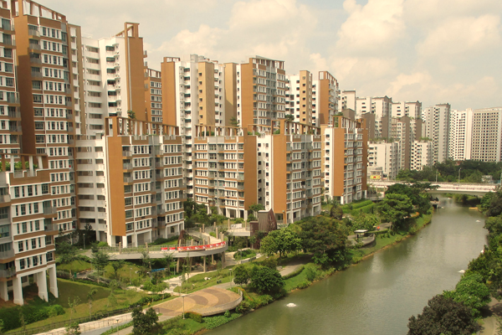
Resale Flat Price Analysis
Prepared by: Cephas Lim

Slide 2
Problem Statement
To provide insights into the drivers of prices of houses in the resale market
To train a working predictive model and provide use case recommendations

Slide 3




Data Analysis Process
Data Wrangling
Modelling
Data Collection
Data Exploration
Insights & Recommendations

Slide 4



Data Collection
Initial Factors:
After data collection:
Month
Town
Flat Type
Storey Range
Floor Area
Flat Model
Remaining Lease
Month
Town
Flat Type
Storey Range
Floor Area
Flat Model
Remaining Lease
Distance to MRT
Distance to CBD
Distance to mall
CPI

Slide 5

Data Wrangling
Before wrangling:
After wrangling:
Month
Town
Flat Type
Storey Range
Floor Area
Flat Model
Remaining Lease
Distance to MRT
Distance to CBD
Distance to mall
CPI
Year
Town premium
Flat Type
Storey Level
Floor Area
Flat Model premium
Remaining Lease
Distance to MRT
Distance to CBD
Distance to mall
CPI
Median price premium

Slide 6
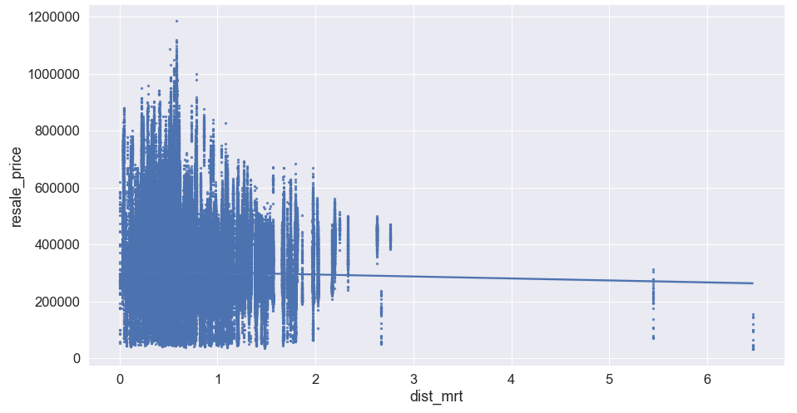
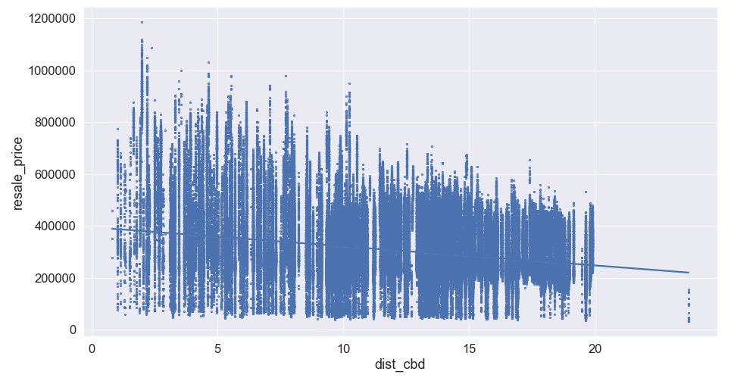
Data Exploration
Selection of 4 Room flat type for a quick overview
Performed preliminary data exploration on bivariate data analysis of resale price against a single feature
Verified visually/ graphically that correlation exists between resale prices and features
Notes:
Decision to remove year from the features set
Also decided to leave flat type to be categorical data → could potentially consider using flat_type premium as well

Slide 7
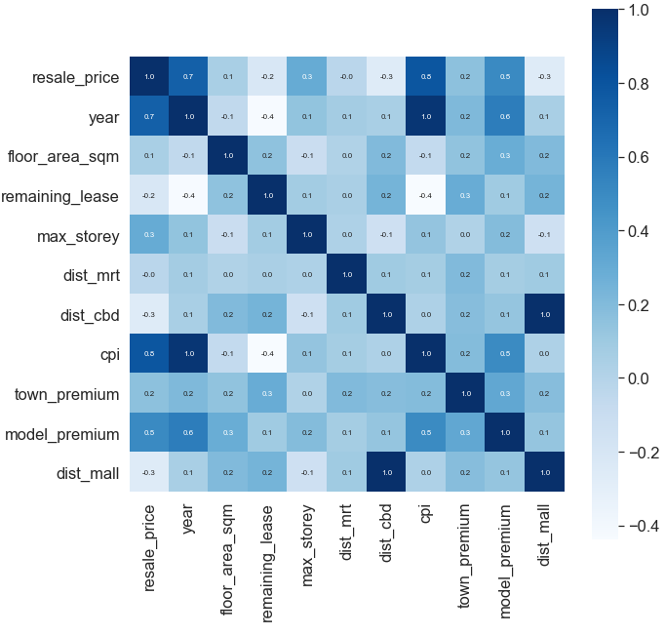
Data Exploration
Correlation and feature importance can be checked using corr() method
From either the first column or first row, it can be seen that all of the features have slight to high correlation with the resale price
One exception is the distance from MRT which though is small is a non-zero value
Notes:
Decision to remove year from the features set
Also decided to leave flat type to be categorical data → could potentially consider using flat_type premium as well

Slide 8
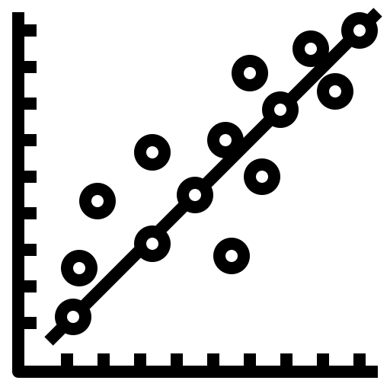




Modelling
Features (4 Room):
Year
Town premium
Storey Level
Floor Area
Flat Model premium
Remaining Lease
Distance to MRT
Distance to CBD
Distance to mall
CPI
Predicted Resale Price
Linear Regression
Grad-Boosting
Random Forest
Neural Network
Actual Resale Price
R-squared Value
Feature Importance
Mean Squared Error

Slide 9
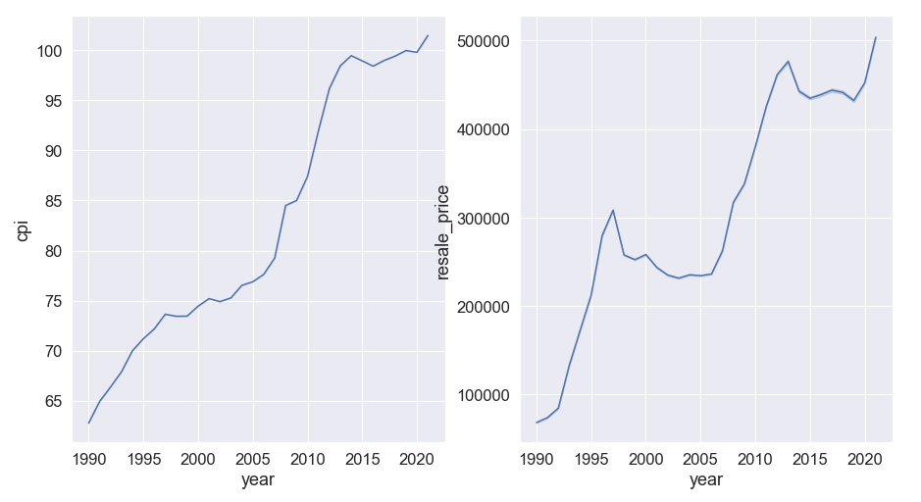
Insights
Comparison and predictors for different time periods
Price predictors (time periods):
Each time period data sets was taken to be trained and tested within the same data set
2014-20
4
3
Time Periods | Score & Top 5 Features
1 | R-squared: 91.64% CPI: 81.98%, Model Premium: 4.34%, Town Premium: 3.32%, Dist from mall: 2.61%, Dist from CBD: 2.42%
2 | R-squared: 86.30% Floor area: 18.94%, Remaining Lease: 16.85%, Dist from CBD: 14.33%, Dist from mall: 14.07%, Town Premium: 12.73%
3 | R-squared: 94.53% CPI: 52.56%, Remaining Lease: 10.73%, Dist from CBD: 10.63%, Dist from mall: 10.52%, Model Premium: 3.77%
4 | R-squared: 95.16% Remaining Lease: 25.15%, Dist from CBD: 22.94%, Dist from mall: 22.19%, Town Premium: 8.59%, Dist from MRT: 5.07%
1998-06
2007-13
2
1
1990-97

Slide 10



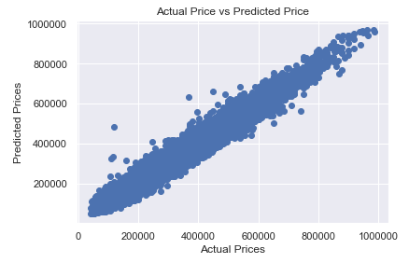

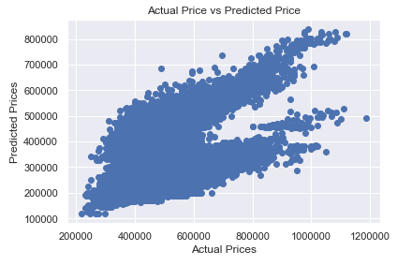
Insights
Comparison between best performing models
Random Forest Regressor
Neural Network (Sequential)
Use Case | Score & Top Features
Predicting Resale Prices within same time period | R-squared: 96.83% CPI: 69.72%, Lease: 7.16%, Distance from CBD: 6.45%
Future Price Prediction | Test R-squared: 96.30% Predict R-squared: 83.54% CPI: 71.76%, Dist from CBD: 6.22%, Dist from mall: 6.14%
Use Case | Score & Top Features
Predicting Resale Prices within same time period | R-squared: 96.66% CPI: 53.32%, Lease: 13.53%, Distance from CBD: 11.08%
Future Price Prediction | Test R-squared: 96.41% Predict R-squared: -114.81% CPI: 49.72%, Dist from mall: 10.73%, Dist from CBD: 9.26%
Overfitting

Slide 11

Use Case Recommendations
Future price prediction:
Training Set: 1990 to 2018 4-Room Flats
Future Set: 2019 to 2021 4-Room Flats
R-squared value: 83.54%
Features | Weightage
Floor Area | 3.16%
Remaining Lease | 5.84%
Storey Level | 1.52%
Distance from nearest MRT | 1.53%
Distance from CBD | 6.22%
Distance from nearest mall | 6.14%
CPI | 71.76%
Town Premium | 2.48%
Model Premium | 1.36%

Slide 12
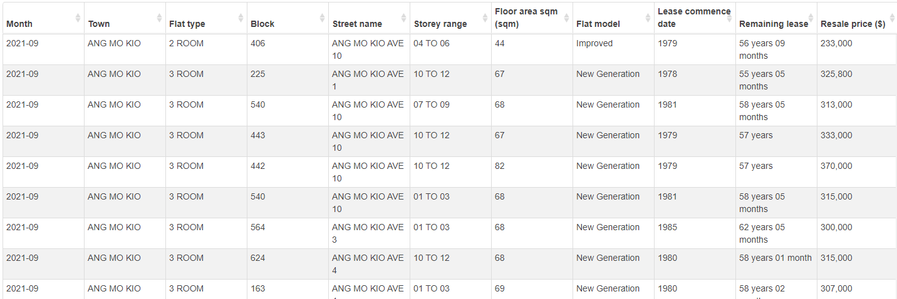
Appendix: Raw Data

Slide 13



Appendix: Location & Distance Calculation
Calculation of distance between amenities and flat addresses
Latitude and longitude of downtown core
Latitude and longitude of all MRT stations
Latitude and longitude of all malls
Group by and aggregate to find minimum distance between flat and amenities

Slide 14
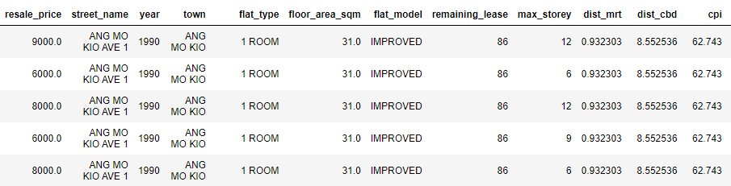
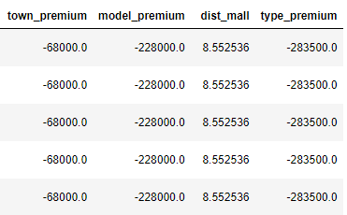
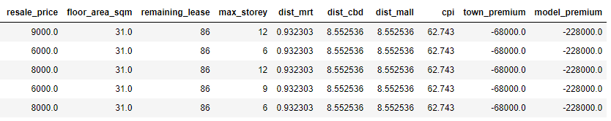
Appendix: Final Data Set
Overall data:
Features list:

Slide 15
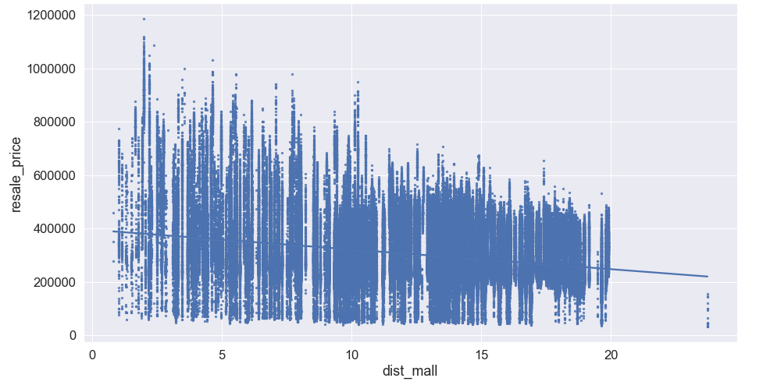
Appendix: Further Data Exploration
Resale price against distance from mall:
Cpi against year & resale price against year:

Slide 16
Appendix: Sequential Model Procedure
Normalization of features
Hyperparameter Tuning
Base model build and tuner build
Building and training the model
Prediction and feature importance

Slide 17
Appendix: Additional ML Techniques & Data Sets Considered
ML Techniques
Principle Component Analysis
Neural Networks – KerasRegressor
Data Sets
Flat Type Premium used in modelling

Slide 18
Appendix: Data Sources
Mall coordinates data: https://github.com/ValaryLim/Mall-Coordinates-Web-Scraper
MRT coordinates data: https://towardsdatascience.com/data-driven-approach-to-understanding-hdb-resale-prices-in-singapore-31c3beecfd97

Slide 19
Appendix: Model, Scores and Feature Importance
Model | Python Library/Module | Training Set | Test/Prediction Set | Feature Importance | R^2 Score | MSE Score
Models Summary

