Slide 1
– Slides adapted from – Introduction to Computer Networks
Aditya Akella
Lecture 5 - Encoding and Data Link Basics

Slide 2
Signals, Data and Packets
Analog Signal
“Digital” Signal
Bit Stream
0 0 1 0 1 1 1 0 0 0 1
Packets
0100010101011100101010101011101110000001111010101110101010101101011010111001
Header/Body
Header/Body
Header/Body
Packet
Transmission
Sender
Receiver

Slide 3
Binary data to Signals
Modulation: changing attributes of signal to effect information transmissions
Encoding
How to convert bits to “digital” signals
Very complex, actually
Error recovery, clock recovery,…

Slide 4
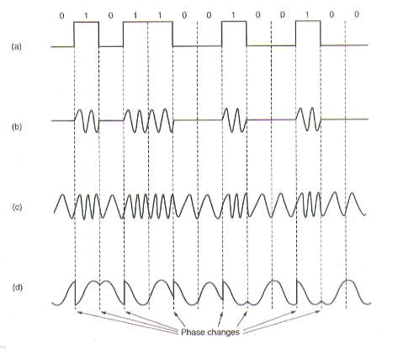
Modulation Schemes
Data
Amplitude Modulation
Frequency Modulation
Phase Modulation

Slide 5
Why Do We Need Encoding?
Meet certain electrical constraints.
Receiver needs enough “transitions” to keep track of the transmit clock
Avoid receiver saturation
Create control symbols, besides regular data symbols.
E.g. start or end of frame, escape, ...
Important in packet switching
Error detection or error corrections.
Some codes are illegal so receiver can detect certain classes of errors
Minor errors can be corrected by having multiple adjacent signals mapped to the same data symbol

Slide 6
Encoding
Use two signals, high and low, to encode 0 and 1.
Transmission is synchronous, i.e., a clock is used to sample the signal.
In general, the duration of one bit is equal to one or two clock ticks
Receiver’s clock must be synchronized with the sender’s clock
Encoding can be done one bit at a time or in blocks of, e.g., 4 or 8 bits.

Slide 7
Non-Return to Zero (NRZ)
0
1
0
0
0
1
1
0
1
.85
V
0
-.85
1 -> high signal; 0 -> low signal
Long sequences of 1’s or 0’s can cause problems:
Hard to recover clock
Difficult to interpret 0’s and 1’s

Slide 8
Non-Return to Zero Inverted (NRZI)
0
1
0
0
0
1
1
0
1
.85
V
0
-.85
1 -> make transition; 0 -> signal stays the same
Solves the problem for long sequences of 1’s, but not for 0’s.

Slide 9
Ethernet Manchester Encoding
0
1
1
0
.85
V
0
-.85
.1μs
Positive transition for 0, negative for 1
XOR of NRZ with clock
Transition every cycle communicates clock (but need 2 transition times per bit)
Problem: doubles the rate at which signal transitions are made
Less efficient
Receiver has half the time to detect the pulse

Slide 10
4B/5B Encoding
Data coded as symbols of 5 line bits => 4 data bits, so 100 Mbps uses 125 MHz.
Uses less frequency space than Manchester encoding
Each valid symbol has no more than one leading zero and no more than two trailing zeros
At least two 1s ➔ Get dense transitions
Uses NRZI to encode the 5 code bits
What happens if there are consecutive 1s?

Slide 11
4B/5B Encoding
16 data symbols, 8 control symbols
Control symbols: idle, begin frame, etc.
Remaining 8 are invalid
Data
Code
Data
Code
0000
0001
0010
0011
0100
0101
0110
0111
11110
01001
10100
10101
01010
01011
01110
01111
1000
1001
1010
1011
1100
1101
1110
1111
10010
10011
10110
10111
11010
11011
11100
11101

Slide 12
Other Encodings
8B/10B: Fiber Channel and Gigabit Ethernet
DC balance
64B/66B: 10 Gbit Ethernet
B8ZS: T1 signaling (bit stuffing)

Slide 13
Datalink Protocol Functions
Framing: encapsulating a network layer
Add header, mark and detect frame boundaries, …
Error control: error detection and correction to deal with bit errors.
May also include other reliability support, e.g. retransmission
Error correction: Correct bit errors if possible
Flow control: avoid sender outrunning the receiver.
Media access: controlling which frame should be sent over the link next
Easy for point-to-point links
Half versus full duplex
Harder for multi-access links
Who gets to send?
Switching: How to send frames to the eventual destination?

Slide 14
Framing
Preamble Postamble
Body
A link layer function, defining which bits have which function
Minimal functionality: mark the beginning and end of packets (or frames).
Some techniques:
frame delimiter characters with character stuffing
frame delimiter codes with bit stuffing
synchronous transmission (e.g. SONET) out of band delimiters

Slide 15
Byte Stuffing
Body
SYN
SOH
Header
STX
SYN
ETX
CRC
Mark end of frame with special character
BISYNC uses “ETX”
What happens when the user sends this character?
Use escape character when controls appear in data
Very common on serial lines; old technique
View frame as a collection of bytes

Slide 16
Byte Counting
Header
Body
SYN
Class
Count
SYN
CRC
An alternative is to include a count of number of bytes
Next to the start of frame
E.g. DDCMP
Corruptions of count field may cause receiver to receive incorrectly
Include an error-check to help receiver realize this

Slide 17
Bit Stuffing
Body
Beginning
Sequence
Ending
Sequence
Header
CRC
Treat frames as a sequence of bits
Mark frames with special bit sequence
Example, HDLC: 01111110 is a special sequence or “flag”
Used at the beginning and end of frame
But, must ensure data containing this sequence can be transmitted
Flag can cross byte boundaries
transmitter inserts a 0 when this is likely to appear in the data:
111111 -> 1111101
must stuff a zero any time five 1s appear:
receiver unstuffs.
Problem with stuffing techniques: frame size depends on data
Frames can be of different size
Could lead to some inefficiencies

