Slide 1
Chapter 2
Instructions: Language of the Computer

Slide 2
Instruction Set
§2.1 Introduction
The repertoire of instructions of a computer
Different computers have different instruction sets
But with many aspects in common
Early computers had very simple instruction sets
Simplified implementation
Many modern computers also have simple instruction sets

Slide 3
The ARMv8 Instruction Set
A subset, called LEGv8, used as the example throughout the book
Commercialized by ARM Holdings (www.arm.com)
Large share of embedded core market
Applications in consumer electronics, network/storage equipment, cameras, printers, …
Typical of many modern ISAs
See ARM Reference Data tear-out card

Slide 4
Arithmetic Operations
Add and subtract, three operands
Two sources and one destination
ADD a, b, c // a gets b + c
All arithmetic operations have this form
Design Principle 1: Simplicity favours regularity
Regularity makes implementation simpler
Simplicity enables higher performance at lower cost
§2.2 Operations of the Computer Hardware

Slide 5
Arithmetic Example
C code:
f = (g + h) - (i + j);
Compiled LEGv8 code:
ADD t0, g, h // temp t0 = g + h ADD t1, i, j // temp t1 = i + j ADD f, t0, t1 // f = t0 - t1

Slide 6
Register Operands
Arithmetic instructions use register operands
LEGv8 has a 32 × 64-bit register file
Use for frequently accessed data
64-bit data is called a “doubleword”
31 x 64-bit general purpose registers X0 to X30
32-bit data called a “word”
31 x 32-bit general purpose sub-registers W0 to W30
Design Principle 2: Smaller is faster
c.f. main memory: millions of locations
§2.3 Operands of the Computer Hardware

Slide 7
LEGv8 Registers
X0 – X7: procedure arguments/results
X8: indirect result location register
X9 – X15: temporaries
X16 – X17 (IP0 – IP1): may be used by linker as a scratch register, other times as temporary register
X18: platform register for platform independent code; otherwise a temporary register
X19 – X27: saved
X28 (SP): stack pointer
X29 (FP): frame pointer
X30 (LR): link register (return address)
XZR (register 31): the constant value 0

Slide 8
Register Operand Example
C code:
f = (g + h) - (i + j);
f, …, j in X19, X20, …, X23
Compiled LEGv8 code:
ADD X9, X20, X21 ADD X10, X22, X23 SUB X19, X9, X10

Slide 9
Memory Operands
Main memory used for composite data
Arrays, structures, dynamic data
To apply arithmetic operations
Load values from memory into registers
Store result from register to memory
Memory is byte addressed
Each address identifies an 8-bit byte
LEGv8 does not require words to be aligned in memory, except for instructions and the stack

Slide 10
Memory Operand Example
C code:
A[12] = h + A[8];
h in X21, base address of A in X22
Compiled LEGv8 code:
Index 8 requires offset of 64
LDUR X9,[X22,#64] // U for “unscaled”
ADD X9,X21,X9
STUR X9,[X22,#96]

Slide 11
Registers vs. Memory
Registers are faster to access than memory
Operating on memory data requires loads and stores
More instructions to be executed
Compiler must use registers for variables as much as possible
Only spill to memory for less frequently used variables
Register optimization is important!

Slide 12
Immediate Operands
Constant data specified in an instruction
ADDI X22, X22, #4
Design Principle 3: Make the common case fast
Small constants are common
Immediate operand avoids a load instruction

Slide 13
Unsigned Binary Integers
Given an n-bit number
§2.4 Signed and Unsigned Numbers
Range: 0 to +2^{n} – 1
Example
0000 0000 0000 0000 0000 0000 0000 1011₂ = 0 + … + 1×2³ + 0×2² +1×2¹ +1×2⁰ = 0 + … + 8 + 0 + 2 + 1 = 11₁₀
Using 32 bits
0 to +4,294,967,295

Slide 14
2s-Complement Signed Integers
Given an n-bit number
Range: –2^{n – 1} to +2^{n – 1} – 1
Example
1111 1111 1111 1111 1111 1111 1111 1100₂ = –1×2³¹ + 1×2³⁰ + … + 1×2² +0×2¹ +0×2⁰ = –2,147,483,648 + 2,147,483,644 = –4₁₀
Using 32 bits
–2,147,483,648 to +2,147,483,647

Slide 15
2s-Complement Signed Integers
Bit 31 is sign bit
1 for negative numbers
0 for non-negative numbers
–(–2^{n – 1}) can’t be represented
Non-negative numbers have the same unsigned and 2s-complement representation
Some specific numbers
0: 0000 0000 … 0000
–1: 1111 1111 … 1111
Most-negative: 1000 0000 … 0000
Most-positive: 0111 1111 … 1111

Slide 16
Signed Negation
Complement and add 1
Complement means 1 → 0, 0 → 1
Example: negate +2
+2 = 0000 0000 … 0010_{two}
–2 = 1111 1111 … 1101_{two} + 1 = 1111 1111 … 1110_{two}

Slide 17
Sign Extension
Representing a number using more bits
Preserve the numeric value
Replicate the sign bit to the left
c.f. unsigned values: extend with 0s
Examples: 8-bit to 16-bit
+2: 0000 0010 => 0000 0000 0000 0010
–2: 1111 1110 => 1111 1111 1111 1110
In LEGv8 instruction set
LDURSB: sign-extend loaded byte
LDURB: zero-extend loaded byte

Slide 18
Representing Instructions
Instructions are encoded in binary
Called machine code
LEGv8 instructions
Encoded as 32-bit instruction words
Small number of formats encoding operation code (opcode), register numbers, …
Regularity!
§2.5 Representing Instructions in the Computer

Slide 19
Hexadecimal
Base 16
Compact representation of bit strings
4 bits per hex digit
0 | 0000 | 4 | 0100 | 8 | 1000 | c | 1100
1 | 0001 | 5 | 0101 | 9 | 1001 | d | 1101
2 | 0010 | 6 | 0110 | a | 1010 | e | 1110
3 | 0011 | 7 | 0111 | b | 1011 | f | 1111
Example: eca8 6420
1110 1100 1010 1000 0110 0100 0010 0000

Slide 20
LEGv8 R-format Instructions
opcode
Rm
shamt
Rn
Rd
11 bits
5 bits
6 bits
5 bits
5 bits
Instruction fields
opcode: operation code
Rm: the second register source operand
shamt: shift amount (00000 for now)
Rn: the first register source operand
Rd: the register destination

Slide 21
R-format Example
opcode
Rm
shamt
Rn
Rd
11 bits
5 bits
6 bits
5 bits
5 bits
ADD X9,X20,X21
1112_{ten}
21_{ten}
0_{ten}
20_{ten}
9_{ten}
10001011000_{two}
10101_{two}
000000_{two}
10100_{two}
01001_{two}
1000 1011 0001 0101 0000 0010 1000 1001_{two} =
8B150289₁₆

Slide 22
LEGv8 D-format Instructions
opcode
address
op2
Rn
Rt
11 bits
9 bits
2 bits
5 bits
5 bits
Load/store instructions
Rn: base register
address: constant offset from contents of base register (+/- 32 doublewords)
Rt: destination (load) or source (store) register number
Design Principle 3: Good design demands good compromises
Different formats complicate decoding, but allow 32-bit instructions uniformly
Keep formats as similar as possible

Slide 23
LEGv8 I-format Instructions
opcode
immediate
Rn
Rd
10 bits
12 bits
5 bits
5 bits
Immediate instructions
Rn: source register
Rd: destination register
Immediate field is zero-extended

Slide 24
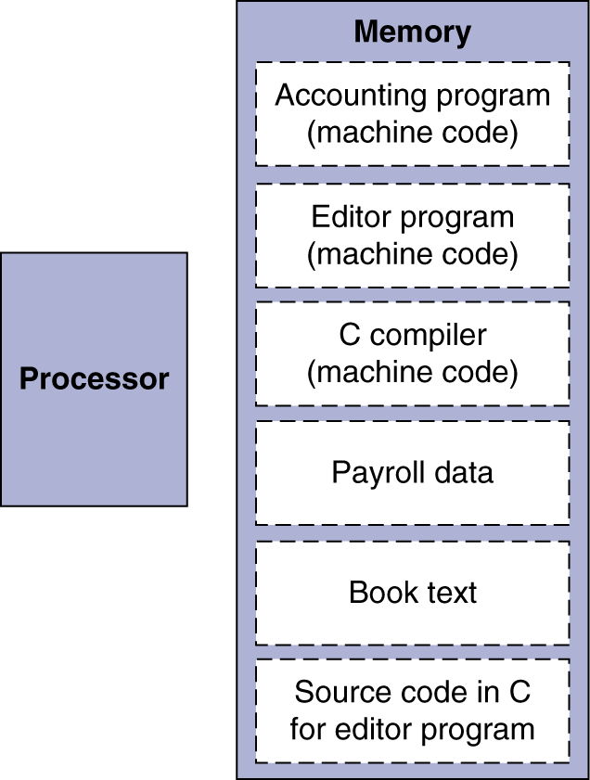
Stored Program Computers
The BIG Picture
Instructions represented in binary, just like data
Instructions and data stored in memory
Programs can operate on programs
e.g., compilers, linkers, …
Binary compatibility allows compiled programs to work on different computers
Standardized ISAs

Slide 25
Logical Operations
Instructions for bitwise manipulation
§2.6 Logical Operations
Operation | C | Java | LEGv8
Shift left | << | << | LSL
Shift right | >> | >>> | LSR
Bit-by-bit AND | & | & | AND, ANDI
Bit-by-bit OR | | | | | OR, ORI
Bit-by-bit NOT | ~ | ~ | EOR, EORI
Useful for extracting and inserting groups of bits in a word

Slide 26
Shift Operations
opcode
Rm
shamt
Rn
Rd
11 bits
5 bits
6 bits
5 bits
5 bits
shamt: how many positions to shift
Shift left logical
Shift left and fill with 0 bits
LSL by i bits multiplies by 2^{i}
Shift right logical
Shift right and fill with 0 bits
LSR by i bits divides by 2^{i} (unsigned only)

Slide 27
AND Operations
Useful to mask bits in a word
Select some bits, clear others to 0
AND X9,X10,X11
X10
00000000 00000000 00000000 00000000 00000000 00000000 00001101 11000000
X11
00000000 00000000 00000000 00000000 00000000 00000000 00111100 00000000
X9
00000000 00000000 00000000 00000000 00000000 00000000 00001100 00000000

Slide 28
OR Operations
Useful to include bits in a word
Set some bits to 1, leave others unchanged
OR X9,X10,X11
X10
00000000 00000000 00000000 00000000 00000000 00000000 00001101 11000000
X11
00000000 00000000 00000000 00000000 00000000 00000000 00111100 00000000
X9
00000000 00000000 00000000 00000000 00000000 00000000 00111101 11000000

Slide 29
EOR Operations
Differencing operation
Set some bits to 1, leave others unchanged
EOR X9,X10,X12 // NOT operation
X10
00000000 00000000 00000000 00000000 00000000 00000000 00001101 11000000
X12
11111111 11111111 11111111 11111111 11111111 11111111 11111111 11111111
X9
11111111 11111111 11111111 11111111 11111111 11111111 11110010 00111111

Slide 30
Conditional Operations
Branch to a labeled instruction if a condition is true
Otherwise, continue sequentially
CBZ register, L1
if (register == 0) branch to instruction labeled L1;
CBNZ register, L1
if (register != 0) branch to instruction labeled L1;
B L1
branch unconditionally to instruction labeled L1;
§2.7 Instructions for Making Decisions

Slide 31
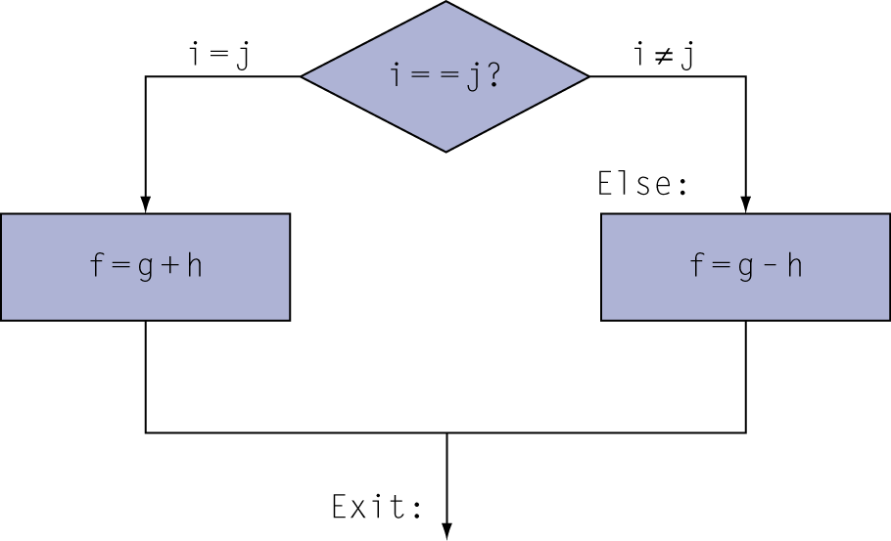
Compiling If Statements
C code:
if (i==j) f = g+h; else f = g-h;
f, g, … in X22, X23, …
Compiled LEGv8 code:
SUB X9,X22,X23
CBNZ X9,Else
ADD X19,X20,X21
B Exit Else: SUB X9,X22,x23 Exit: …
Assembler calculates addresses

Slide 32
Compiling Loop Statements
C code:
while (save[i] == k) i += 1;
i in x22, k in x24, address of save in x25
Compiled LEGv8 code:
Loop: LSL X10,X22,#3 ADD X10,X10,X25 LDUR X9,[X10,#0] SUB X11,X9,X24 CBNZ X11,Exit
ADDI X22,X22,#1 B Loop Exit: …

Slide 33
Basic Blocks
A basic block is a sequence of instructions with
No embedded branches (except at end)
No branch targets (except at beginning)
A compiler identifies basic blocks for optimization
An advanced processor can accelerate execution of basic blocks

Slide 34
More Conditional Operations
Condition codes, set from arithmetic instruction with S-suffix (ADDS, ADDIS, ANDS, ANDIS, SUBS, SUBIS)
negative (N): result had 1 in MSB
zero (Z): result was 0
overlow (V): result overflowed
carry (C): result had carryout from MSB
Use subtract to set flags, then conditionally branch:
B.EQ
B.NE
B.LT (less than, signed), B.LO (less than, unsigned)
B.LE (less than or equal, signed), B.LS (less than or equal, unsigned)
B.GT (greater than, signed), B.HI (greater than, unsigned)
B.GE (greater than or equal, signed),
B.HS (greater than or equal, unsigned)

Slide 35
Conditional Example
if (a > b) a += 1;
a in X22, b in X23
SUBS X9,X22,X23 // use subtract to make comparison
B.LTE Exit // conditional branch
ADDI X22,X22,#1
Exit:

Slide 36
Signed vs. Unsigned
Signed comparison
Unsigned comparison
Example
X22 = 1111 1111 1111 1111 1111 1111 1111 1111
X23 = 0000 0000 0000 0000 0000 0000 0000 0001
X22 < X23 # signed
–1 < +1
X22 > X23 # unsigned
+4,294,967,295 > +1

Slide 37
Procedure Calling
Steps required
Place parameters in registers X0 to X7
Transfer control to procedure
Acquire storage for procedure
Perform procedure’s operations
Place result in register for caller
Return to place of call (address in X30)
§2.8 Supporting Procedures in Computer Hardware

Slide 38
Procedure Call Instructions
Procedure call: jump and link
BL ProcedureLabel
Address of following instruction put in X30
Jumps to target address
Procedure return: jump register
BR LR
Copies LR to program counter
Can also be used for computed jumps
e.g., for case/switch statements

Slide 39
Leaf Procedure Example
C code:
long long int leaf_example (long long int g, long long int h, long long int i, long long int j) { long long int f; f = (g + h) - (i + j); return f; }
Arguments g, …, j in X0, …, X3
f in X19 (hence, need to save $s0 on stack)

Slide 40
Leaf Procedure Example
LEGv8 code:
leaf_example:
SUBI SP,SP,#24
STUR X10,[SP,#16]
STUR X9,[SP,#8]
STUR X19,[SP,#0]
ADD X9,X0,X1
ADD X10,X2,X3
SUB X19,X9,X10
ADD X0,X19,XZR
LDUR X10,[SP,#16]
LDUR X9,[SP,#8]
LDUR X19,[SP,#0]
ADDI SP,SP,#24
BR LR
Save X10, X9, X19 on stack
X9 = g + h
X10 = i + j
f = X9 – X10
copy f to return register
Resore X10, X9, X19 from stack
Return to caller

Slide 41
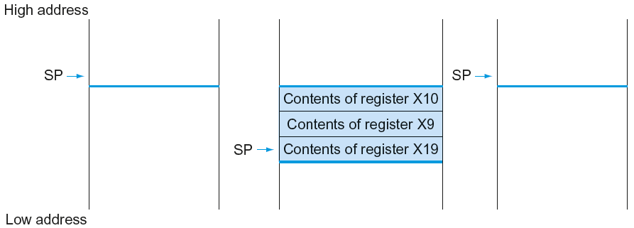
Local Data on the Stack

Slide 42
Register Usage
X9 to X17: temporary registers
Not preserved by the callee
X19 to X28: saved registers
If used, the callee saves and restores them

Slide 43
Non-Leaf Procedures
Procedures that call other procedures
For nested call, caller needs to save on the stack:
Its return address
Any arguments and temporaries needed after the call
Restore from the stack after the call

Slide 44
Non-Leaf Procedure Example
C code:
int fact (int n) { if (n < 1) return f; else return n * fact(n - 1); }
Argument n in X0
Result in X1

Slide 45
Leaf Procedure Example
LEGv8 code:
fact:
SUBI SP,SP,#16
STUR LR,[SP,#8]
STUR X0,[SP,#0]
SUBIS XZR,X0,#1
B.GE L1
ADDI X1,XZR,#1
ADDI SP,SP,#16
BR LR
L1: SUBI X0,X0,#1
BL fact
LDUR X0,[SP,#0]
LDUR LR,[SP,#8]
ADDI SP,SP,#16
MUL X1,X0,X1
BR LR
Save return address and n on stack
compare n and 1
if n >= 1, go to L1
Else, set return value to 1
Pop stack, don’t bother restoring values
Return
n = n - 1
call fact(n-1)
Restore caller’s n
Restore caller’s return address
Pop stack
return n * fact(n-1)
return

Slide 46
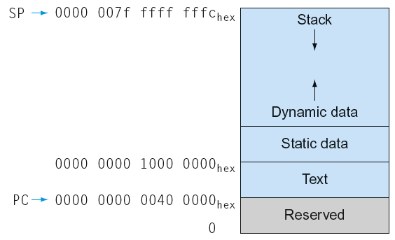
Memory Layout
Text: program code
Static data: global variables
e.g., static variables in C, constant arrays and strings
Dynamic data: heap
E.g., malloc in C, new in Java
Stack: automatic storage

Slide 47
Character Data
Byte-encoded character sets
ASCII: 128 characters
95 graphic, 33 control
Latin-1: 256 characters
ASCII, +96 more graphic characters
Unicode: 32-bit character set
Used in Java, C++ wide characters, …
Most of the world’s alphabets, plus symbols
UTF-8, UTF-16: variable-length encodings
§2.9 Communicating with People

Slide 48
Byte/Halfword Operations
LEGv8 byte/halfword load/store
Load byte:
LDURB Rt, [Rn, offset]
Sign extend to 32 bits in rt
Store byte:
STURB Rt, [Rn, offset]
Store just rightmost byte
Load halfword:
LDURH Rt, [Rn, offset]
Sign extend to 32 bits in rt
Store halfword:
STURH Rt, [Rn, offset]
Store just rightmost halfword

Slide 49
String Copy Example
C code:
Null-terminated string
void strcpy (char x[], char y[]) { size_t i; i = 0; while ((x[i]=y[i])!='\0') i += 1; }

Slide 50
String Copy Example
LEGv8 code:
strcpy: SUBI SP,SP,8 // push X19
STUR X19,[SP,#0] ADD X19,XZR,XZR // i=0 L1: ADD X10,X19,X1 // X10 = addr of y[i] LDURB X11,[X10,#0] // X11 = y[i] ADD X12,X19,X0 // X12 = addr of x[i] STURB X11,[X12,#0] // x[i] = y[i] CBZ X11,L2 // if y[i] == 0 then exit ADDI X19,X19,#1 // i = i + 1 B L1 // next iteration of loop L2: LDUR X19,[SP,#0] // restore saved $s0 ADDI SP,SP,8 // pop 1 item from stack BR LR // and return

Slide 51
32-bit Constants
Most constants are small
12-bit immediate is sufficient
For the occasional 32-bit constant
MOVZ: move wide with zeros
MOVK: move with with keep
Use with flexible second operand (shift)
§2.10 LEGv8 Addressing for 32-Bit Immediates and Addresses
MOVZ X9,255,LSL 16
0000 0000 0000 0000
0000 0000 0000 0000
0000 0000 1111 1111
0000 0000 0000 0000
MOVK X9,255,LSL 0
0000 0000 0000 0000
0000 0000 0000 0000
0000 0000 1111 1111
0000 0000 1111 1111

Slide 52
Branch Addressing
B-type
B 1000 // go to location 10000_{ten}
CB-type
CBNZ X19, Exit // go to Exit if X19 != 0
Both addresses are PC-relative
Address = PC + offset (from instruction)
5
10000_{ten}
6 bits
26 bits
181
Exit
19
8 bits
19 bits
5 bits

Slide 53
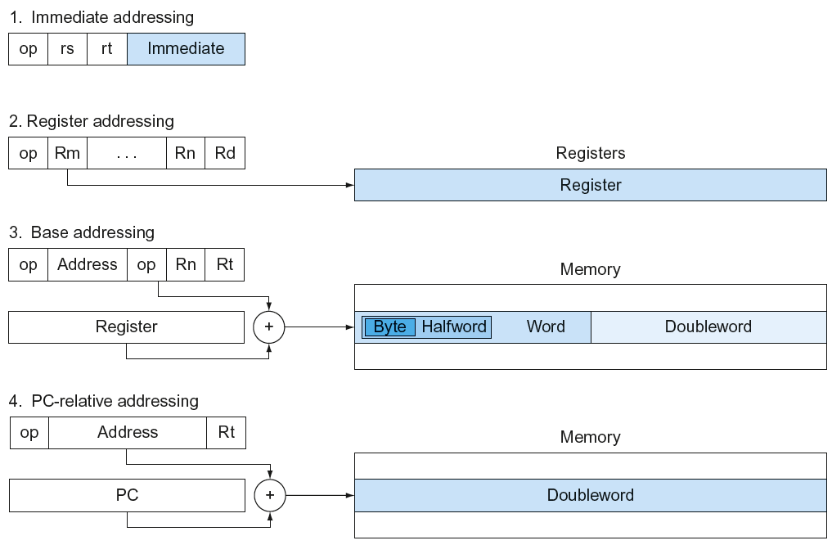
LEGv8 Addressing Summary

Slide 54
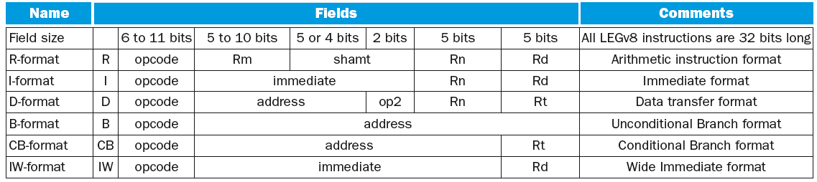
LEGv8 Encoding Summary

Slide 55
Synchronization
Two processors sharing an area of memory
P1 writes, then P2 reads
Data race if P1 and P2 don’t synchronize
Result depends of order of accesses
Hardware support required
Atomic read/write memory operation
No other access to the location allowed between the read and write
Could be a single instruction
E.g., atomic swap of register ↔ memory
Or an atomic pair of instructions
§2.11 Parallelism and Instructions: Synchronization

Slide 56
Synchronization in LEGv8
Load exclusive register: LDXR
Store exclusive register: STXR
To use:
Execute LDXR then STXR with same address
If there is an intervening change to the address, store fails (communicated with additional output register)
Only use register instruction in between

Slide 57
Synchronization in LEGv8
Example 1: atomic swap (to test/set lock variable)
again: LDXR X10,[X20,#0]
STXR X23,X9,[X20] // X9 = status
CBNZ X9, again
ADD X23,XZR,X10 // X23 = loaded value
Example 2: lock
ADDI X11,XZR,#1 // copy locked value
again: LDXR X10,[X20,#0] // read lock
CBNZ X10, again // check if it is 0 yet
STXR X11, X9, [X20] // attempt to store
BNEZ X9,again // branch if fails
Unlock:
STUR XZR, [X20,#0] // free lock

Slide 58
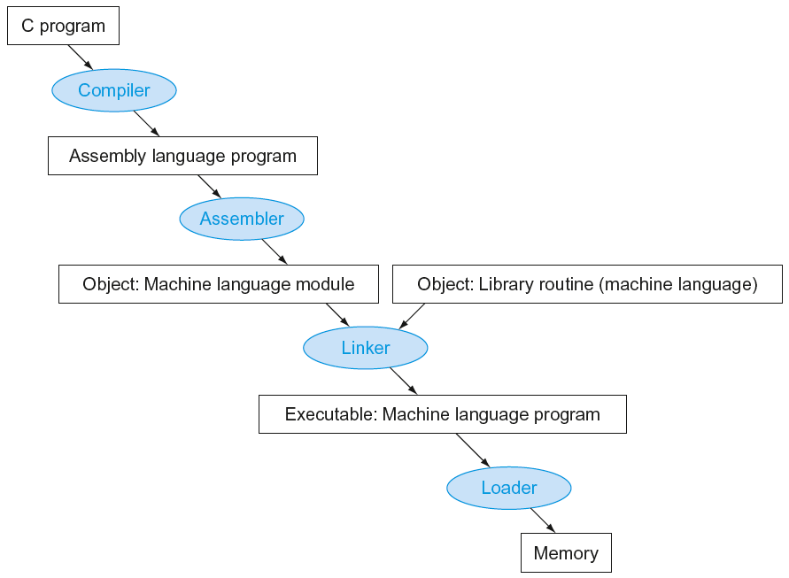
Translation and Startup
Many compilers produce object modules directly
§2.12 Translating and Starting a Program
Static linking

Slide 59
Producing an Object Module
Assembler (or compiler) translates program into machine instructions
Provides information for building a complete program from the pieces
Header: described contents of object module
Text segment: translated instructions
Static data segment: data allocated for the life of the program
Relocation info: for contents that depend on absolute location of loaded program
Symbol table: global definitions and external refs
Debug info: for associating with source code

Slide 60
Linking Object Modules
Produces an executable image
1. Merges segments
2. Resolve labels (determine their addresses)
3. Patch location-dependent and external refs
Could leave location dependencies for fixing by a relocating loader
But with virtual memory, no need to do this
Program can be loaded into absolute location in virtual memory space

Slide 61
Loading a Program
Load from image file on disk into memory
1. Read header to determine segment sizes
2. Create virtual address space
3. Copy text and initialized data into memory
Or set page table entries so they can be faulted in
4. Set up arguments on stack
5. Initialize registers (including SP, FP)
6. Jump to startup routine
Copies arguments to X0, … and calls main
When main returns, do exit syscall

Slide 62
Dynamic Linking
Only link/load library procedure when it is called
Requires procedure code to be relocatable
Avoids image bloat caused by static linking of all (transitively) referenced libraries
Automatically picks up new library versions

Slide 63
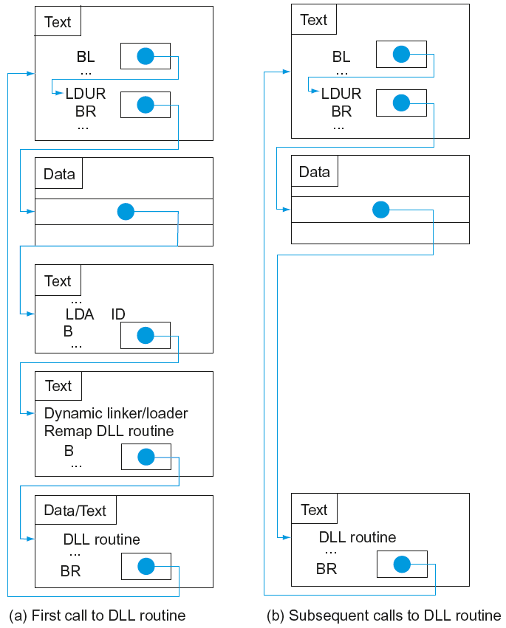
Lazy Linkage
Indirection table
Stub: Loads routine ID, Jump to linker/loader
Linker/loader code
Dynamically mapped code

Slide 64
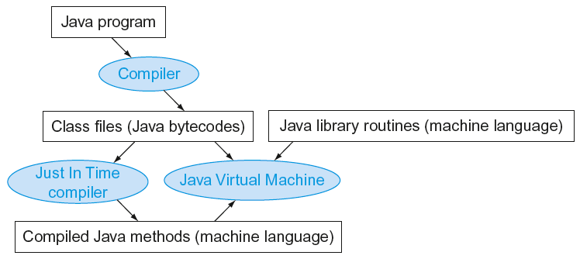
Starting Java Applications
Simple portable instruction set for the JVM
Compiles bytecodes of “hot” methods into native code for host machine
Interprets bytecodes

Slide 65
C Sort Example
Illustrates use of assembly instructions for a C bubble sort function
Swap procedure (leaf)
void swap(long long int v[], long long int k) { long long int temp; temp = v[k]; v[k] = v[k+1]; v[k+1] = temp; }
v in X0, k in X1, temp in X9
§2.13 A C Sort Example to Put It All Together

Slide 66
The Procedure Swap
swap: LSL X10,X1,#3 // X10 = k * 8
ADD X10,X0,X10 // X10 = address of v[k]
LDUR X9,[X10,#0] // X9 = v[k]
LDUR X11,[X10,#8] // X11 = v[k+1]
STUR X11,[X10,#0] // v[k] = X11 (v[k+1])
STUR X9,[X10,#8] // v[k+1] = X9 (v[k])
BR LR // return to calling routine

Slide 67
The Sort Procedure in C
Non-leaf (calls swap)
void sort (long long int v[], size_t n)
{
size_t i, j;
for (i = 0; i < n; i += 1) {
for (j = i – 1;
j >= 0 && v[j] > v[j + 1];
j -= 1) {
swap(v,j);
}
}
}
v in X0, n in X1, i in X19, j in X20

Slide 68
The Outer Loop
Skeleton of outer loop:
for (i = 0; i <n; i += 1) {
MOV X19,XZR // i = 0
for1tst:
CMP X19, X1 // compare X19 to X1 (i to n)
B.GE exit1 // go to exit1 if X19 ≥ X1 (i≥n)
(body of outer for-loop)
ADDI X19,X19,#1 // i += 1
B for1tst // branch to test of outer loop
exit1:

Slide 69
The Inner Loop
Skeleton of inner loop:
for (j = i − 1; j >= 0 && v[j] > v[j + 1]; j − = 1) {
SUBI X20, X19, #1 // j = i - 1
for2tst: CMP X20,XZR // compare X20 to 0 (j to 0)
B.LT exit2 // go to exit2 if X20 < 0 (j < 0)
LSL X10, X20, #3 // reg X10 = j * 8
ADD X11, X0, X10 // reg X11 = v + (j * 8)
LDUR X12, [X11,#0] // reg X12 = v[j]
LDUR X13, [X11,#8] // reg X13 = v[j + 1]
CMP X12, X13 // compare X12 to X13
B.LE exit2 // go to exit2 if X12 ≤ X13
MOV X0, X21 // first swap parameter is v
MOV X1, X20 // second swap parameter is j
BL swap // call swap
SUBI X20, X20, #1 // j –= 1
B for2tst // branch to test of inner loop
exit2:

Slide 70
Preserving Registers
Preserve saved registers:
SUBI SP,SP,#40 // make room on stack for 5 regs
STUR LR,[SP,#32] // save LR on stack
STUR X22,[SP,#24] // save X22 on stack
STUR X21,[SP,#16] // save X21 on stack
STUR X20,[SP,#8] // save X20 on stack
STUR X19,[SP,#0] // save X19 on stack
MOV X21, X0 // copy parameter X0 into X21
MOV X22, X1 // copy parameter X1 into X22
Restore saved registers:
exit1: LDUR X19, [SP,#0] // restore X19 from stack
LDUR X20, [SP,#8] // restore X20 from stack
LDUR X21,[SP,#16] // restore X21 from stack
LDUR X22,[SP,#24] // restore X22 from stack
LDUR X30,[SP,#32] // restore LR from stack
SUBI SP,SP,#40 // restore stack pointer

Slide 71
Effect of Compiler Optimization
Compiled with gcc for Pentium 4 under Linux

Slide 72
Effect of Language and Algorithm

Slide 73
Lessons Learnt
Instruction count and CPI are not good performance indicators in isolation
Compiler optimizations are sensitive to the algorithm
Java/JIT compiled code is significantly faster than JVM interpreted
Comparable to optimized C in some cases
Nothing can fix a dumb algorithm!

Slide 74
Arrays vs. Pointers
Array indexing involves
Multiplying index by element size
Adding to array base address
Pointers correspond directly to memory addresses
Can avoid indexing complexity
§2.14 Arrays versus Pointers

Slide 75
Example: Clearing an Array
clear1(int array[], int size) { int i; for (i = 0; i < size; i += 1) array[i] = 0; } | clear2(int *array, int size) { int *p; for (p = &array[0]; p < &array[size]; p = p + 1) *p = 0; }
MOV X9,XZR // i = 0 loop1: LSL X10,X9,#3 // X10 = i * 8 ADD X11,X0,X10 // X11 = address // of array[i] STUR XZR,[X11,#0] // array[i] = 0 ADDI X9,X9,#1 // i = i + 1 CMP X9,X1 // compare i to // size B.LT loop1 // if (i < size) // go to loop1 | MOV X9,X0 // p = address of // array[0] LSL X10,X1,#3 // X10 = size * 8 ADD X11,X0,X10 // X11 = address // of array[size] loop2: STUR XZR,0[X9,#0] // Memory[p] = 0 ADDI X9,X9,#8 // p = p + 8 CMP X9,X11 // compare p to < // &array[size] B.LT loop2 // if (p < // &array[size]) // go to loop2

Slide 76
Comparison of Array vs. Ptr
Multiply “strength reduced” to shift
Array version requires shift to be inside loop
Part of index calculation for incremented i
c.f. incrementing pointer
Compiler can achieve same effect as manual use of pointers
Induction variable elimination
Better to make program clearer and safer

Slide 77
ARM & MIPS Similarities
ARM: the most popular embedded core
Similar basic set of instructions to MIPS
§2.16 Real Stuff: ARM Instructions
 | ARM | MIPS
Date announced | 1985 | 1985
Instruction size | 32 bits | 32 bits
Address space | 32-bit flat | 32-bit flat
Data alignment | Aligned | Aligned
Data addressing modes | 9 | 3
Registers | 15 × 32-bit | 31 × 32-bit
Input/output | Memory mapped | Memory mapped

Slide 78
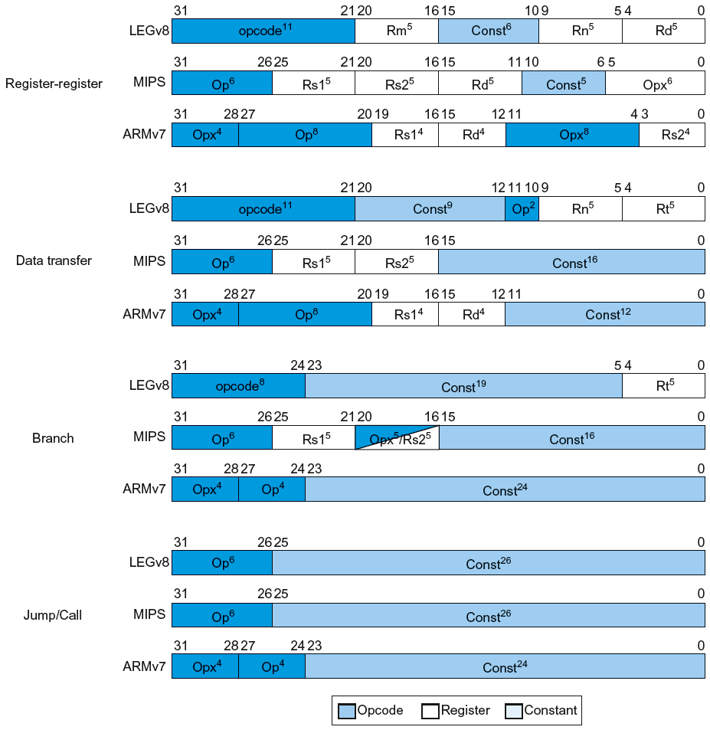
Instruction Encoding

Slide 79
The Intel x86 ISA
Evolution with backward compatibility
8080 (1974): 8-bit microprocessor
Accumulator, plus 3 index-register pairs
8086 (1978): 16-bit extension to 8080
Complex instruction set (CISC)
8087 (1980): floating-point coprocessor
Adds FP instructions and register stack
80286 (1982): 24-bit addresses, MMU
Segmented memory mapping and protection
80386 (1985): 32-bit extension (now IA-32)
Additional addressing modes and operations
Paged memory mapping as well as segments
§2.17 Real Stuff: x86 Instructions

Slide 80
The Intel x86 ISA
Further evolution…
i486 (1989): pipelined, on-chip caches and FPU
Compatible competitors: AMD, Cyrix, …
Pentium (1993): superscalar, 64-bit datapath
Later versions added MMX (Multi-Media eXtension) instructions
The infamous FDIV bug
Pentium Pro (1995), Pentium II (1997)
New microarchitecture (see Colwell, The Pentium Chronicles)
Pentium III (1999)
Added SSE (Streaming SIMD Extensions) and associated registers
Pentium 4 (2001)
New microarchitecture
Added SSE2 instructions

Slide 81
The Intel x86 ISA
And further…
AMD64 (2003): extended architecture to 64 bits
EM64T – Extended Memory 64 Technology (2004)
AMD64 adopted by Intel (with refinements)
Added SSE3 instructions
Intel Core (2006)
Added SSE4 instructions, virtual machine support
AMD64 (announced 2007): SSE5 instructions
Intel declined to follow, instead…
Advanced Vector Extension (announced 2008)
Longer SSE registers, more instructions
If Intel didn’t extend with compatibility, its competitors would!
Technical elegance ≠ market success

Slide 82
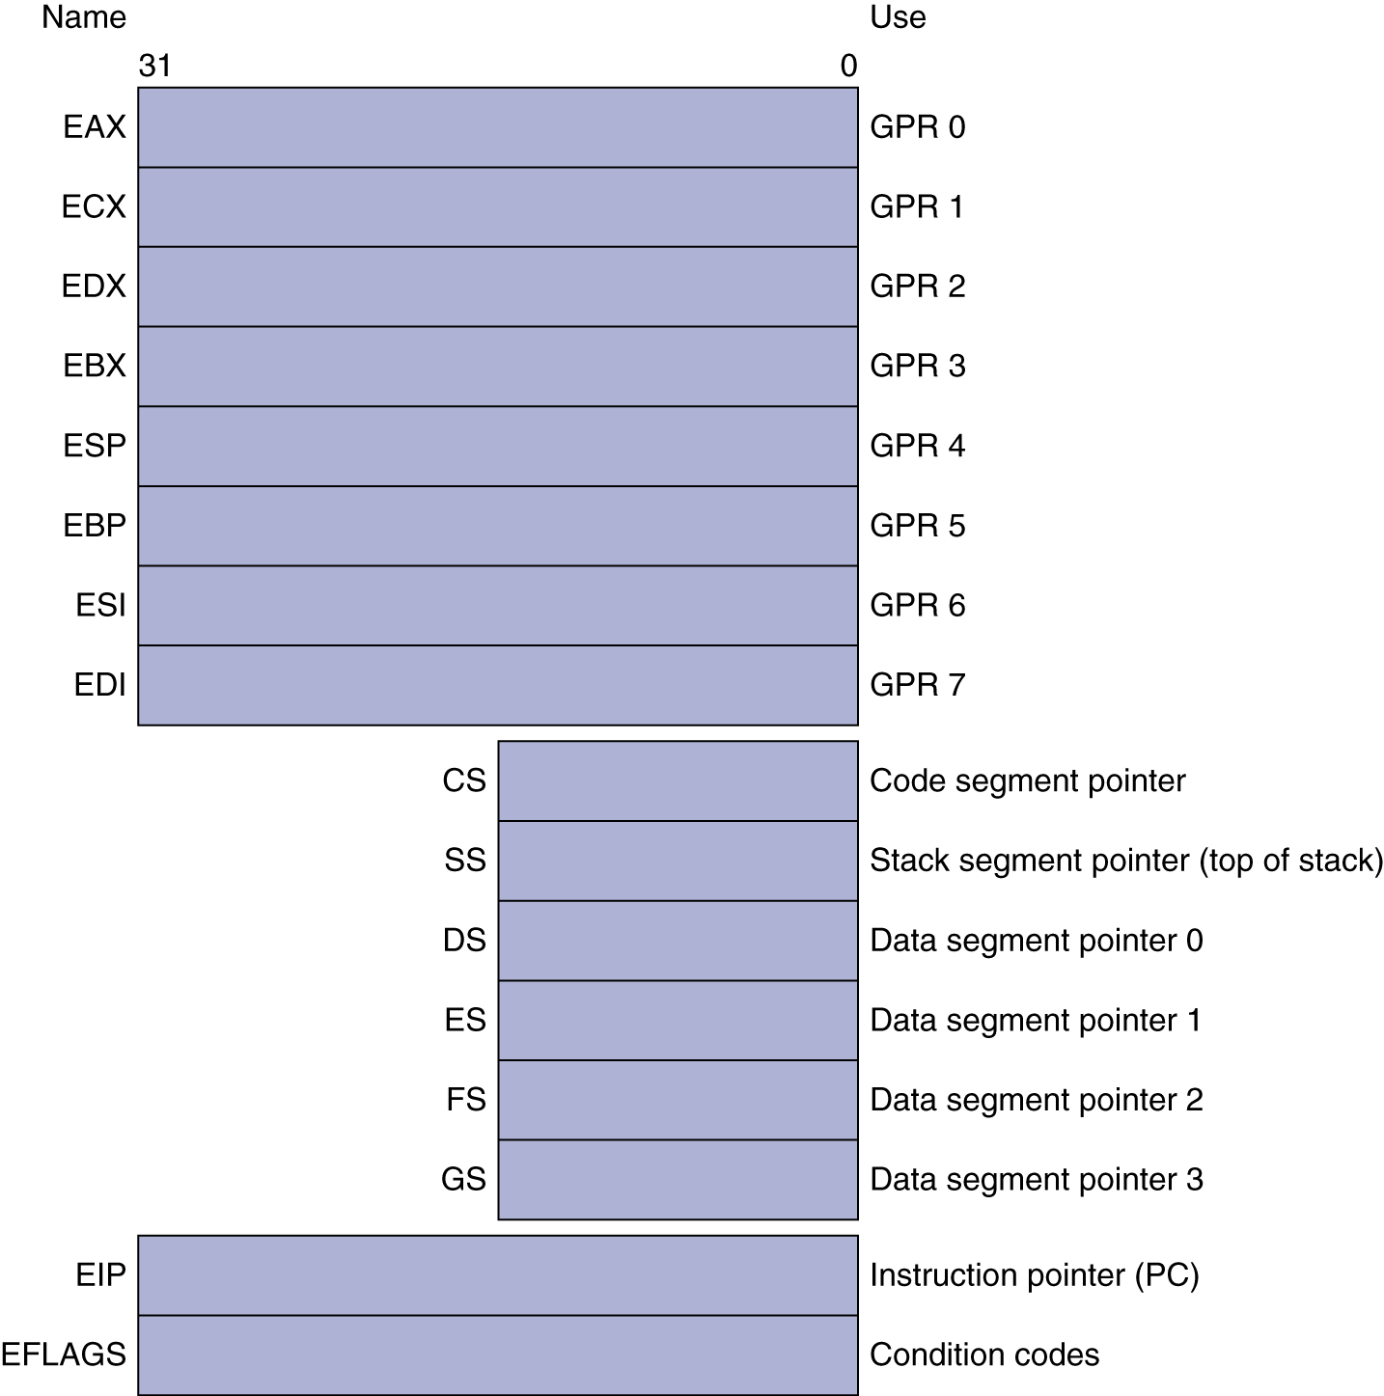
Basic x86 Registers

Slide 83
Basic x86 Addressing Modes
Two operands per instruction
Source/dest operand | Second source operand
Register | Register
Register | Immediate
Register | Memory
Memory | Register
Memory | Immediate
Memory addressing modes
Address in register
Address = R_{base} + displacement
Address = R_{base} + 2^{scale} × R_{index} (scale = 0, 1, 2, or 3)
Address = R_{base} + 2^{scale} × R_{index} + displacement

Slide 84
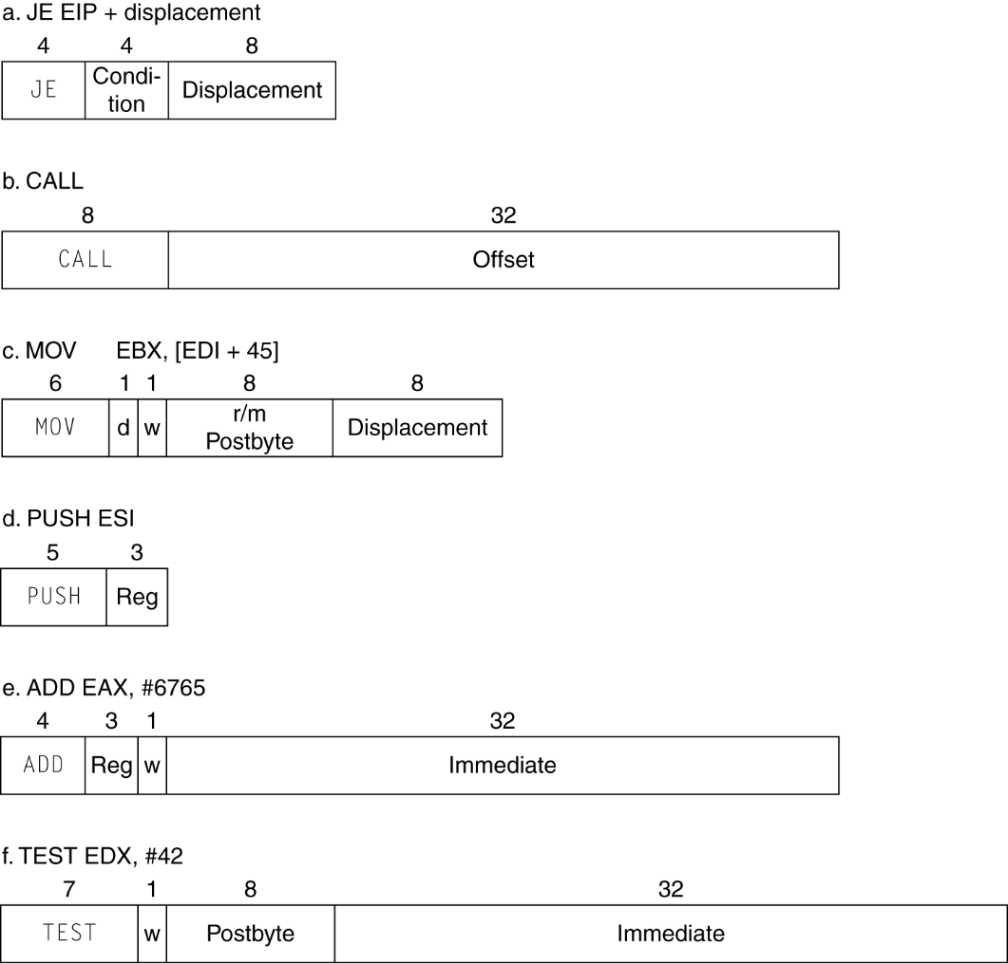
x86 Instruction Encoding
Variable length encoding
Postfix bytes specify addressing mode
Prefix bytes modify operation
Operand length, repetition, locking, …

Slide 85
Implementing IA-32
Complex instruction set makes implementation difficult
Hardware translates instructions to simpler microoperations
Simple instructions: 1–1
Complex instructions: 1–many
Microengine similar to RISC
Market share makes this economically viable
Comparable performance to RISC
Compilers avoid complex instructions

Slide 86
Fallacies
Powerful instruction ⇒ higher performance
Fewer instructions required
But complex instructions are hard to implement
May slow down all instructions, including simple ones
Compilers are good at making fast code from simple instructions
Use assembly code for high performance
But modern compilers are better at dealing with modern processors
More lines of code ⇒ more errors and less productivity
§2.19 Fallacies and Pitfalls

Slide 87
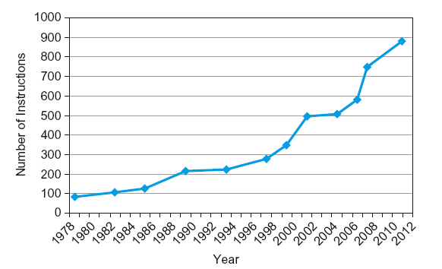
Fallacies
Backward compatibility ⇒ instruction set doesn’t change
But they do accrete more instructions
x86 instruction set

Slide 88
Pitfalls
Sequential words are not at sequential addresses
Increment by 4, not by 1!
Keeping a pointer to an automatic variable after procedure returns
e.g., passing pointer back via an argument
Pointer becomes invalid when stack popped

Slide 89
Concluding Remarks
Design principles
1. Simplicity favors regularity
2. Smaller is faster
3. Make the common case fast
4. Good design demands good compromises
Layers of software/hardware
Compiler, assembler, hardware
LEGv8: typical of RISC ISAs
c.f. x86
§2.20 Concluding Remarks

Slide 90
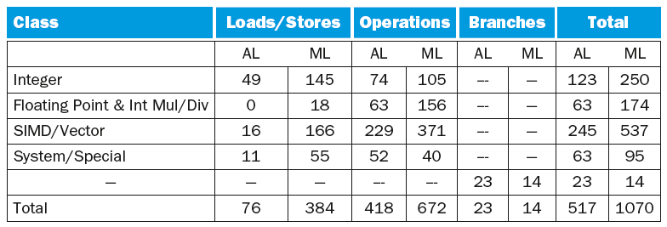
Concluding Remarks
Additional ARMv8 features:
Flexible second operand
Additional addressing modes
Conditional instructions (e.g. CSET, CINC)

