Slide 1







Technology Trends Analysis 2024
Christopher Davis
August, 2024

Slide 2



OUTLINE
Executive Summary
Introduction
Methodology
Results
Visualization – Charts
Dashboard
Discussion
Findings & Implications
Conclusion
Appendix

Slide 3

EXECUTIVE SUMMARY
This presentation provides a comprehensive analysis of current and projected trends in programming languages and databases based on our latest data survey from a diverse respondent base across various industries. The analysis reveals significant insights into technology adoption and preference shifts that are vital for strategic planning and development.

Slide 4

INTRODUCTION
Objective: To provide a data-driven analysis of current and projected technology trends, focusing on programming languages and databases.
Scope: Analysis covers data collected from over [X number] of industry professionals worldwide.
Relevance: The findings aim to assist stakeholders in making informed decisions regarding technology adoption and talent development.

Slide 5

METHODOLOGY
Data Collection: Data was sourced from online surveys and various technology platforms, ensuring a comprehensive coverage of the tech industry.
Data Analysis: Utilized advanced analytics techniques to identify trends and patterns.
Tools Used: Data analysis performed using tools Python, Excel, and Cognos

Slide 6
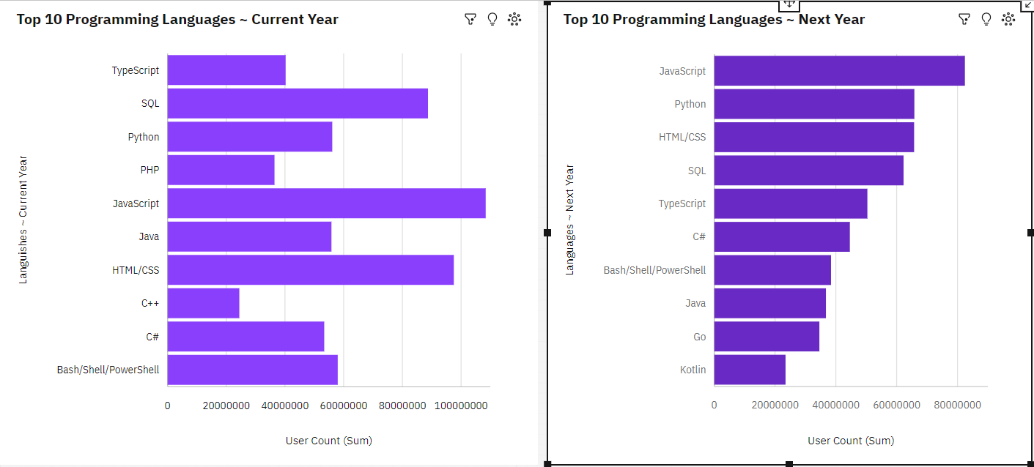
PROGRAMMING LANGUAGE TRENDS
Current Year
Next Year

Slide 7
PROGRAMMING LANGUAGE TRENDS - FINDINGS & IMPLICATIONS
JavaScript Dominance Continues: JavaScript remains the most widely used programming language both in the current year and in the forecast for the next year, suggesting its enduring popularity and necessity in the tech industry.
Python's Growing Popularity: Python is consistently strong, ranking third in the current year but is expected to surpass SQL and HTML/CSS to become the second most popular language next year. This reflects its versatility and wide application across various domains like web development, data science, and automation.
PHP and C++ Decline: PHP and C++ have lower user counts in the current year and do not appear in the forecasted top 10 languages for the next year, indicating a decline in their popularity or usage.
Emergence of New Languages: The forecast for the next year introduces Kotlin and Go into the top 10, which are not present in the current year's top 10. This suggests a growing interest in these languages, possibly due to their relevance in mobile development (Kotlin) and backend/server-side applications (Go).
Skill Development Focus: Developers and tech professionals may need to prioritize learning or enhancing their skills in JavaScript and Python, as these languages are expected to remain critical in the near future.
Strategic Technology Planning: Companies planning their technology stack should consider focusing on JavaScript and Python for both frontend and backend development due to their sustained popularity and wide application.
Shifting Job Market Demands: The declining popularity of PHP and C++ could imply fewer job opportunities in these languages, while the increasing demand for Kotlin and Go might open up new job prospects, particularly in mobile development and cloud computing.
Tooling and Ecosystem Evolution: As Python and JavaScript continue to dominate, the ecosystem of tools, libraries, and frameworks around these languages is likely to grow and improve, reinforcing their dominance and making them more attractive to new developers and businesses alike.

Slide 8
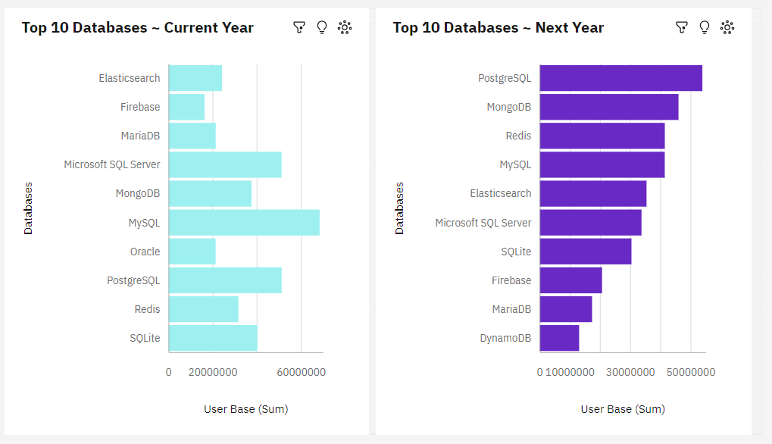
DATABASE TRENDS
Current Year
Next Year

Slide 9
DATABASE TRENDS - FINDINGS & IMPLICATIONS
Findings
Finding 1: The continuous popularity of Python signals its robustness for future projects.
.Finding 2: The shift towards NoSQL databases like MongoDB suggests a need for more flexible data solutions
Implications
Implication 1: Organizations should focus on building Python skills within their teams.
Implication 2: Companies may need to invest in training their workforce on NoSQL technologies.

Slide 10

DASHBOARD
<The GitHub link of the Cognos/Looker Studio dashboard goes here.>

Slide 11
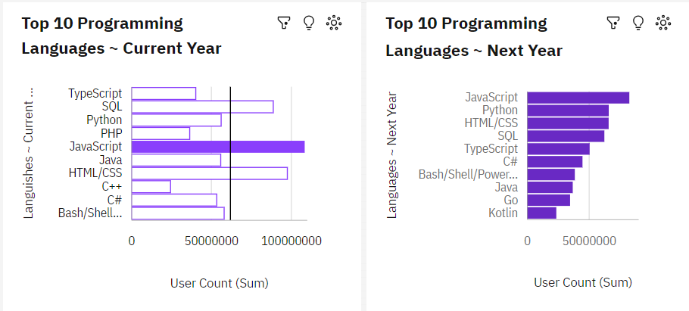
DASHBOARD TAB 1

Slide 12
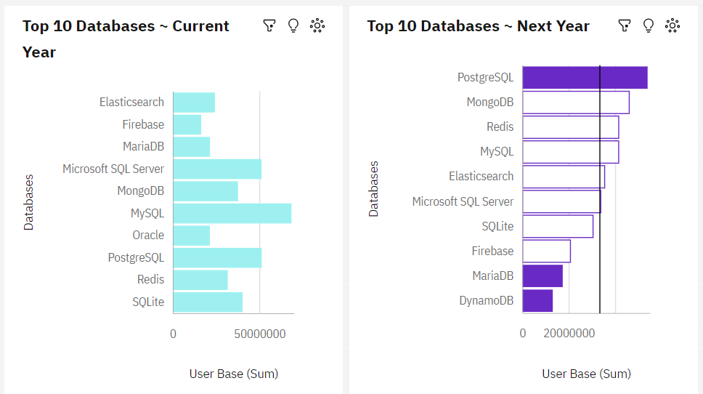
DASHBOARD TAB 2
Screenshot of dashboard tab 2 goes here

Slide 13
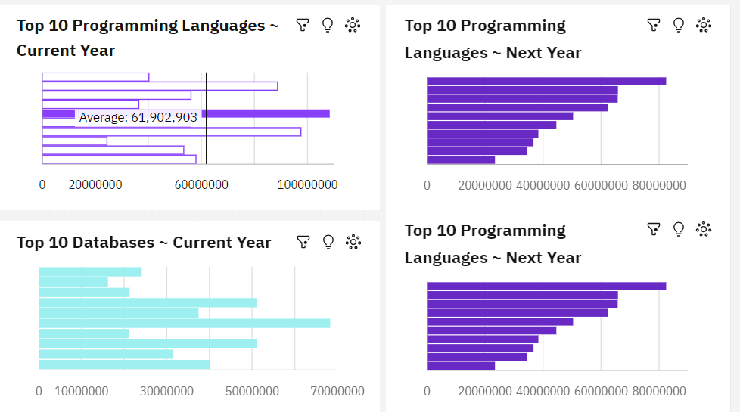
DASHBOARD TAB 3
Screenshot of dashboard tab 3 goes here

Slide 14
DISCUSSION
Further Analysis: While the provided charts offer valuable insights into the current and future trends of programming languages and databases, further analysis is warranted to explore the underlying factors driving these shifts. For example, examining the adoption of new languages like Kotlin and Go might reveal specific industry needs or technological advancements influencing these trends. Additionally, analyzing regional or sector-specific data could provide more targeted insights, helping organizations tailor their technology strategies to their specific market or operational needs.

Slide 15

CONCLUSION
Summary of Insights: The analysis reveals several key trends in the programming languages and database technologies landscape. JavaScript and Python continue to dominate, reflecting their versatility and broad application across various domains. The rise of languages like Kotlin and Go highlights a shift towards modern, efficient tools in areas like mobile development and cloud computing. In the database space, PostgreSQL, MongoDB, and Redis are emerging as preferred choices for next year, suggesting a growing emphasis on scalability, flexibility, and performance. These trends indicate a shift towards more dynamic, developer-friendly, and performance-oriented tools, which can significantly influence technology strategy. Call to Action: Stakeholders should take these trends into account when planning their technology strategies and workforce development. As demand for modern programming languages and databases grows, organizations must ensure their teams are equipped with the necessary skills to leverage these tools effectively. Strategic investment in training and development, particularly in languages like Python, JavaScript, and emerging databases like PostgreSQL and MongoDB, can position companies to stay competitive in the rapidly evolving tech landscape. By aligning their strategies with these trends, organizations can better navigate the challenges and opportunities that lie ahead.

Slide 16

APPENDIX
No Other Charts Provided for this project

Slide 17
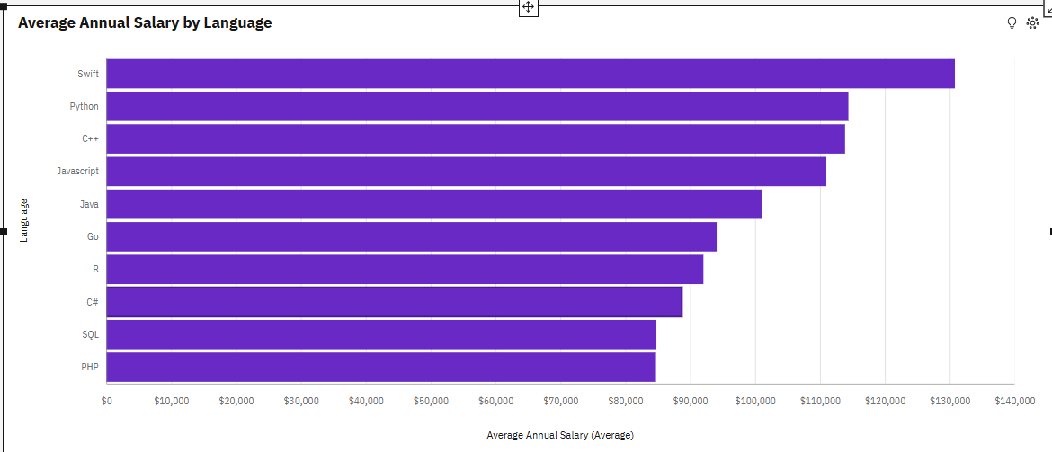
POPULAR LANGUAGES

