Slide 1
Decentralized File Storage using Blockchain: Implementation and Proof-of-Work Analysis
Guided By
Dr.S.Pavithra
Yogesh P 22BPS1044
Vishwa D 22BPS1222
M Dinesh Kumar 22BRS1369

Slide 2
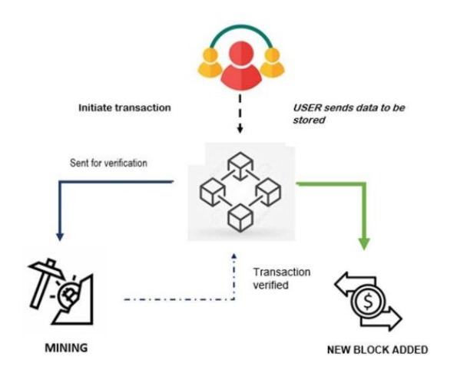
ABSTRACT
This project delves into the development and
implementation of a web-based
decentralized file storage application
leveraging blockchain technology for storing
Medical Records.
The project's primary goal was to design a robust
system enabling users to upload multiple files,
each securely stored in a block within the blockchain,
guaranteeing data integrity and immutability. This holds
particular significance in the healthcare sector, as the
system ensures safe and tamper-proof storage for
sensitive medical records. Leveraging blockchain's cryptographic algorithms, the solution provides an added layer of security, making it resistant to unauthorized access or tampering.

Slide 3
ABSTRACT
The implementation revolves around utilizing a proof-of-work concept with a focus on achieving the desired difficulty level using a randomly generated nonce. The presentation will spotlight the significance of the proof-of-work algorithm as the consensus mechanism, requiring miners to solve cryptographic puzzles before appending blocks to the chain. A critical analysis of two proof-of-work algorithms, focusing on nonce generation methodologies.
Throughout the presentation, the focus remains on the implemented on-chain blockchain storing comprehensive file data within blocks. Insights from the proof-of-work algorithm analysis contribute to understanding the intricate balance between randomness, security, and computational efficiency in decentralized file storage systems.

Slide 4
INTRODUCTION
In today's digital landscape, data security and integrity stand as paramount concerns, particularly in sectors handling sensitive information like healthcare. The advent of blockchain technology has sparked innovative solutions to address these challenges, offering immutable and secure data storage systems.
This presentation delves into the realm of decentralized file storage leveraging blockchain, focusing on its implementation and the critical analysis of proof-of-work methodologies. Through this exploration, we aim to elucidate the intricacies of a web-based application designed to facilitate secure file storage within a blockchain network.
The fundamental premise lies in ensuring robust data integrity, particularly in contexts such as healthcare, where sensitive medical records demand the highest standards of confidentiality and tamper resistance. By harnessing the cryptographic capabilities of blockchain, our solution endeavors to provide an impregnable fortress for the safekeeping of vital patient information.
Throughout this presentation, we'll navigate the core principles, implementation intricacies, and comparative analysis of proof-of-work algorithms, shedding light on their impact on system functionality, security, and efficiency. Join us on this journey as we explore the convergence of blockchain technology and decentralized file storage, unraveling the potential it holds in ensuring secure data ecosystems.

Slide 5

EXISTING SYSTEMS
This already exists as paper work and
the implementing the localised shared
storage for storing medical record
is to be done in this project

Slide 6
PROBLEMS DEFINED
The problem addressed in this project centres on the creation of a web-based application designed for decentralized file storage using blockchain technology. The application allows users to upload files of any type and size, one at a time. All users, including the uploader and other peers in the network, can download and access these files. To ensure security and immutability, the system employs a blockchain structure. When a user uploads a file, its details, including username, filesize, and file data, are stored in a block. These blocks are then appended to the existing blockchain, making it virtually impossible to edit or delete the files or blocks. The implementation incorporates a proof of work concept with randomly generated nonces to achieve a specified difficulty level, enhancing the security of the file storage process. The underlying motivation for using blockchain is to leverage its ability to safeguard files against unauthorized modification or deletion. For a detailed explanation and demonstration, the project provides a demo link for users to explore further.

Slide 7
PROPOSED SYSTEM
In The proposed system, we have used SHA256 cryptographic algorithm to secure the block. As a consensus algorithm, proof of work is implemented, which requires miners to solve any cryptographic puzzle before they get to announce new block on chain. In our application, we require to find a hash value that starts with three 0's as part of a puzzle.

Slide 8
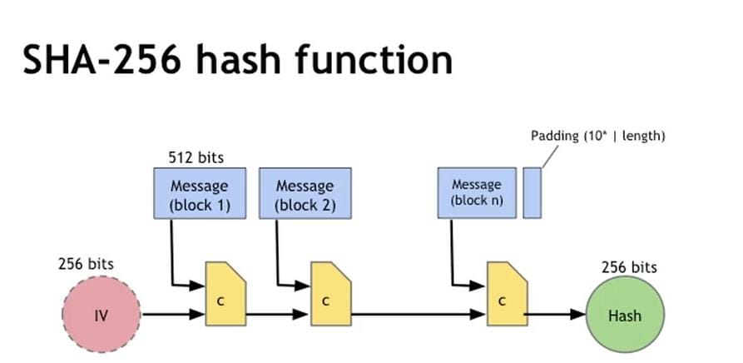
SYSTEM ARCHITECTURE

Slide 9
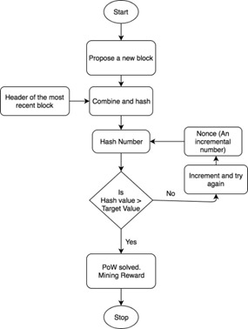

Slide 10
REFERENCES
R. Rajadevi, E. M. R. Devi, R. S. Latha, S. Harshini, K. Ajay and M. Abinash, "Secured Storing and Sharing of Medical Records Based on Blockchain," 2022 International Conference on Computer Communication and Informatics (ICCCI), Coimbatore, India, 2022, pp. 1-5, doi: 10.1109/ICCCI54379.2022.9741070.
Y. Zhang, S. Lin and J. Zhao, "SV-DEMR: An Electronic Medical Record Data Sharing Scheme Based on Searchable and Verifiable Encryption via Consortium Blockchain," 2022 International Conference on Blockchain Technology and Information Security (ICBCTIS), Huaihua City, China, 2022, pp. 123-126, doi: 10.1109/ICBCTIS55569.2022.00038.
B. Bhandari, P. R. Vairagade, H. Trivedi, H. Thakre, G. Indurkar and A. Yadav, "Decentralized Medical Healthcare Record Management System Using Blockchain," 2023 11th International Conference on Emerging Trends in Engineering & Technology - Signal and Information Processing (ICETET - SIP), Nagpur, India, 2023, pp. 1-5, doi: 10.1109/ICETET-SIP58143.2023.10151658.
A. Martínez, C. Molina and D. Subauste, "Electronic Medical Records Management in Health Organizations using a Technology Architecture based on Blockchain," 2020 IEEE ANDESCON, Quito, Ecuador, 2020, pp. 1-6, doi: 10.1109/ANDESCON50619.2020.9271998.
J. Boonkleang, P. Supapong and V. Rujivorakul, "The Borrowing Medical Records System : A Case Study of Medical Information System," 2023 Joint International Conference on Digital Arts, Media and Technology with ECTI Northern Section Conference on Electrical, Electronics, Computer and Telecommunications Engineering (ECTI DAMT & NCON), Phuket, Thailand, 2023, pp. 69-74, doi: 10.1109/ECTIDAMTNCON57770.2023.10139673.

Slide 11
REFERENCES
N. Nautiyal, P. Agarwal and S. Sharma, "Rechain: A Secured Blockchain-Based Digital Medical Health Record Management System," 2023 4th International Conference on Innovative Trends in Information Technology (ICITIIT), Kottayam, India, 2023, pp. 1-6, doi: 10.1109/ICITIIT57246.2023.10068707.
V. B, S. N. Dass, S. R and R. Chinnaiyan, "A Blockchain based Electronic Medical Health Records Framework using Smart Contracts," 2021 International Conference on Computer Communication and Informatics (ICCCI), Coimbatore, India, 2021, pp. 1-4, doi: 10.1109/ICCCI50826.2021.9402689.
R. Widhawati, Royani, A. Khoirunisa, N. P. L. Santoso and D. Apriliasari, "Secure System Medical Record with Blockchain System: Recchain Framework," 2022 International Conference on Science and Technology (ICOSTECH), Batam City, Indonesia, 2022, pp. 1-8, doi: 10.1109/ICOSTECH54296.2022.9828811.
A. S. Koushik, B. Jain, N. Menon, D. Lohia, S. Chaudhari and V. K. B.P, "Performance Analysis of BlockChain-based Medical Records Management System," 2019 4th International Conference on Recent Trends on Electronics, Information, Communication & Technology (RTEICT), Bangalore, India, 2019, pp. 985-989, doi: 10.1109/RTEICT46194.2019.9016812.
A. Alsunbul, W. Elmedany and H. Al-Ammal, "Blockchain Application in Healthcare Industry: Attacks and Countermeasures," 2021 International Conference on Data Analytics for Business and Industry (ICDABI), Sakheer, Bahrain, 2021, pp. 621-629, doi: 10.1109/ICDABI53623.2021.9655852.

Slide 12
REFERENCES
T. Jaya, S. E. Nugraha, G. R. Davinsi, J. V. Moniaga and B. A. Jabar, "Implementation of Blockchain Technology Using Hash Method in Java for Medical Record Application Development," 2022 IEEE 7th International Conference on Information Technology and Digital Applications (ICITDA), Yogyakarta, Indonesia, 2022, pp. 1-6, doi: 10.1109/ICITDA55840.2022.9971286.
M. J. Hossain et al., "A Secured Patient’s Online Data Monitoring through Blockchain: An Intelligent way to Store Lifetime Medical Records," 2021 International Conference on Science & Contemporary Technologies (ICSCT), Dhaka, Bangladesh, 2021, pp. 1-6, doi: 10.1109/ICSCT53883.2021.9642537.
A. Vernekar, A. Sakhare, P. Bhapkar, S. Jadhav and R. B. Adhao, "Blockchain Based Record Management System in Hospitals," 2023 4th International Conference on Innovative Trends in Information Technology (ICITIIT), Kottayam, India, 2023, pp. 1-4, doi: 10.1109/ICITIIT57246.2023.10068685.
M. Mancer et al., "Blockchain Technology for Secure Shared Medical Data," 2022 International Arab Conference on Information Technology (ACIT), Abu Dhabi, United Arab Emirates, 2022, pp. 1-6, doi: 10.1109/ACIT57182.2022.9994101.
R. Panjaitan, D. P. Lazirkha, M. Kamil, R. Supriati and W. N. Wahid, "Design of Know Your Customer (KYC) Using Blockchain Technology," 2022 IEEE Creative Communication and Innovative Technology (ICCIT), Tangerang, Indonesia, 2022, pp. 1-6, doi: 10.1109/ICCIT55355.2022.10119041.

Slide 13
REFERENCES
M. Mancer, L. S. Terrissa, S. Ayad and H. Laouz, "A Blockchain-based approach to securing data in smart agriculture," 2022 International Symposium on iNnovative Informatics of Biskra (ISNIB), Biskra, Algeria, 2022, pp. 1-5, doi: 10.1109/ISNIB57382.2022.10075693.
M. A. Hussen Wadud, A. Rahman, M. J. Islam, T. M. Amir-Ul-Haque Bhuiyan, M. J. Hossain and R. Hossen, "A Decentralized Secure Blockchain-based Privacy-Preserving Healthcare Clouds and Applications," 2023 International Conference on Electrical, Computer and Communication Engineering (ECCE), Chittagong, Bangladesh, 2023, pp. 1-6, doi: 10.1109/ECCE57851.2023.10101540.
S. Ismail and H. Reza, "Security Challenges of Blockchain-Based Supply Chain Systems," 2022 IEEE 13th Annual Ubiquitous Computing, Electronics & Mobile Communication Conference (UEMCON), New York, NY, NY, USA, 2022, pp. 1-6, doi: 10.1109/UEMCON54665.2022.9965682.
S. Bhattacharyya and K. Chandrasekaran, "Towards a Secure Electronic Health Record System Using Blockchain Technology," 2021 12th International Conference on Computing Communication and Networking Technologies (ICCCNT), Kharagpur, India, 2021, pp. 1-8, doi: 10.1109/ICCCNT51525.2021.9579571.
Y. Hu, J. Shen, S. He, G. Xu and H. Yang, "Research on Secure Data Sharing Technology of Block Chain," 2022 6th Asian Conference on Artificial Intelligence Technology (ACAIT), Changzhou, China, 2022, pp. 1-10, doi: 10.1109/ACAIT56212.2022.10137979.

