Slide 1
reachAQ
Automated mouse reach acquisition — what changed, and what it costs in milliseconds

Slide 2
What changed from reach-training
Same experiment. The difference is what the system can do while the reach is still happening.
reach-training
reachAQ
Reach detected by a brightness threshold inside a drawn ROI
Pellet arm driven by an Arduino over USB serial
Timing owned by a Python loop on the host
Signals inspected afterwards, from files
One flat protocol per experiment, delays drawn live
Two closed loops — a fast ROI reflex, and machine vision on the pose stream
Pellet arm on a CAN bus, with firmware capability checks and FSR pressure
Timing owned by hardware-timed NI-DAQ tasks and a real-time stim loop
Signals plotted live during the session, and recorded unfiltered
Experiments composed from reusable trial sets, with reproducible draws
reachAQ
2
Notes:
Keep this at the level of what the operator notices. The one sentence worth landing: reach-training watched and recorded, reachAQ decides and acts inside the same reach.

Slide 3
What came from auto-trainer
reachAQ is built on auto-trainer, not beside it. The architecture and most of the runtime are theirs.
The modular package split — core, video, device, inference, behavior, model, pyside — which is why hardware can be swapped without touching the rest
Per-process video capture with a shared synchronized frame index, so frame N means the same instant on every camera
Pose inference and FLIR stereo calibration, already integrated into the application rather than run afterwards
The CAN device abstraction, and the project, session and metadata structure that makes a recording self-describing
The PySide6 UI layer and its panel patterns
reachAQ
3
Notes:
Say plainly that we did not start over. reachAQ changed the hardware target, added stimulation and signal visualisation, and made the pose stream fast enough to act on. Everything underneath is auto-trainer's design.

Slide 4
The budget
Two cameras, two clocks, two very different deadlines.
Reach cameras run at 150 fps — a 6.667 ms per-frame budget for the perception stream
The stim camera runs at 900 Hz — a 5 ms budget for the reflex loop. That is a design target and a tail figure, not a measured average
The starting point: the DeepLabCut TensorFlow ResNet-50 pose path cost 54.8 ms per batch, about 18 Hz
That single number was the largest latency term in the system, and far below camera rate — which is what made pose useless for closing a loop
reachAQ
4
Notes:
This slide exists so the numbers later have something to be measured against. Do not let 5 ms drift into sounding like an average — it is the tail figure the loop is designed to hold.

Slide 5
Two tiers, not one fast path
We did not make one model fast enough for everything. We separated the millisecond-critical reflex from the perception stream and optimised each to its own budget.
Tier 1 — reflex
Tier 2 — perception
The stim camera's first-reach detector triggers the laser
This is the path that genuinely must be fast
Its own compute is under 0.1 ms, so the work was making the OS deliver it on time, not making it compute less
The reach-camera pose stream, informing behaviour and gating
It does not have to hit camera rate to be useful
Accepting that is what let an accuracy decision beat a raw-speed one
reachAQ
5
Notes:
This is the organising idea of the whole section. The payoff for a user is that there are now two closed loops available — the fast ROI reflex, and machine vision on the pose stream — rather than one compromise between them.

Slide 6
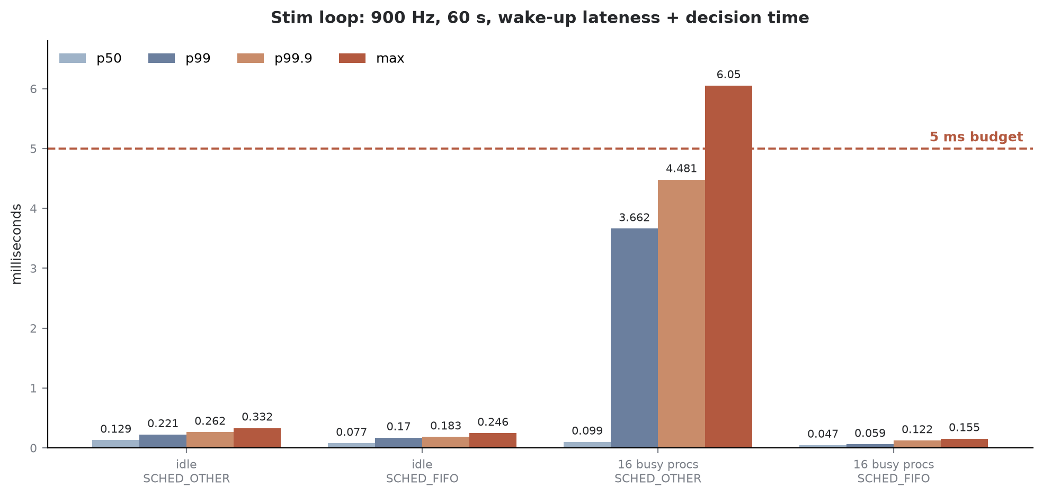
Tier 1 — making the reflex land on time
The detector's own compute never exceeds 0.09 ms. The entire problem was scheduler wake-up latency under load.
Under a 16-process load, real-time scheduling took the worst case from 6.05 ms to 0.155 ms, with zero missed deadlines and the full 900 Hz cadence restored.
reachAQ
6
Notes:
Adopted: SCHED_FIFO plus the performance CPU governor. Both a PREEMPT_RT kernel and core pinning were measured and declined — stock Linux already preempts SCHED_OTHER for SCHED_FIFO, and the result leaves roughly 32x headroom under a load harsher than real acquisition.

Slide 7
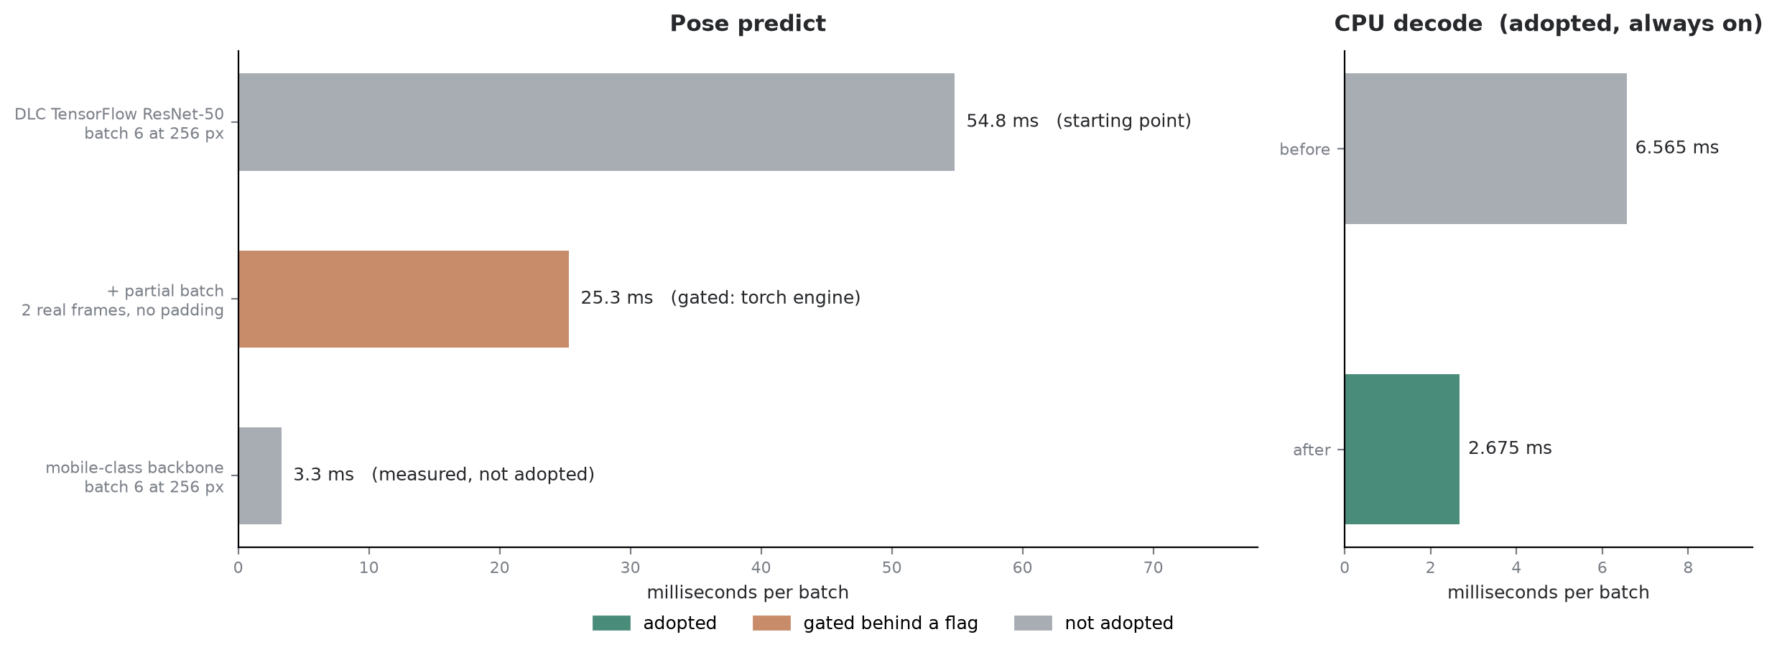
Tier 2 — where the milliseconds went
The speed came from removing our own overhead and choosing the right architecture.
Colour is status, not just result. The mobile-class backbone was measured at about 8x and deliberately not adopted — its confidence does not predict accuracy, which would break the 3D confidence gate.
reachAQ
7
Notes:
Partial batch — running the 2 real frames instead of a padded 6 — took 54.8 to 25.3 ms, and needs the PyTorch engine because the TensorFlow graph fixes its batch size. The decode rewrite, argmax instead of sort with cached column indices and numpy instead of pandas, is always on and model-independent. Also gated: an ROI crop from 256 to 128 px, worth about 2.6x on the forward pass, and a lean predict path worth about 1.2 ms per call. CUDA-graph capture, 7.4 to 3.6 ms, is YOLO-backend only. The engine migration to PyTorch is roughly neutral like-for-like — its value is unlocking newer GPUs, dynamic batching and everything above it.

Slide 8
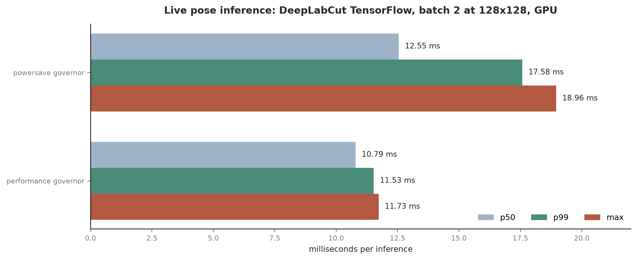
One OS setting was worth six more milliseconds
Same hardware, same model, same batch. Only the CPU governor changed.
powersave held the P-cores near 2700 MHz against a 5000 MHz ceiling. The installer now sets performance, because the default cost more than half the win.
reachAQ
8
Notes:
Worth pairing with the Tier 1 slide — the governor is one of the two always-on system settings, alongside real-time scheduling.

Slide 9
Running below camera rate is safe by design
The pose tier is allowed to be slower than the cameras, because it cannot hold them up.
Non-blocking backpressure — the 150 fps capture loop hands frames to inference on a separate queue from recording, so a slow pose stage can never stall acquisition or cost a recorded frame. Slowness costs inference work only
Freshness drain — inference always takes the newest queued frame and drops stale ones, so latency never grows into a backlog
That drain removed up to a full predict period of buffer-sitting: end-to-end went from 17.6 to 13.9 ms, and frames the loop could not hand over fell from 35.2% to 0.7%
Both are always on, and neither depends on which backend or model is configured
reachAQ
9
Notes:
This is the correctness property, not a speedup, and it is what makes "pose runs below camera rate" an accepted design point rather than a hazard. Worth saying out loud for an audience that will otherwise assume a slow model drops data.

Slide 10
Benchmarked, and not taken
Every acceleration knob was measured on the rig. Several gave nothing here.
fp16 / mixed precision — 3 to 4x slower on this card. The T1000 has no tensor cores, so the default stays fp32
torch.compile — about 0.99x, and slower on the larger model
ONNX Runtime on CUDA — matches PyTorch at 0.99x
TensorRT — a real 1.30 to 1.36x, the only external-runtime win, rejected on cost: per-model export, per-card engine builds, 6.4 GB of libraries, a second inference path and a CUDA-version reconciliation
The honest summary: the speed came from removing our own overhead and picking the right architecture, not from a magic runtime
reachAQ
10
Notes:
This slide is for the technical audience. If asked about INT8 — it could pay on Turing's DP4A, the route tried produced a broken engine, and the correct route is identified but not done. Figures throughout are rig measurements on this hardware; they are not claims about other cards.

Slide 11
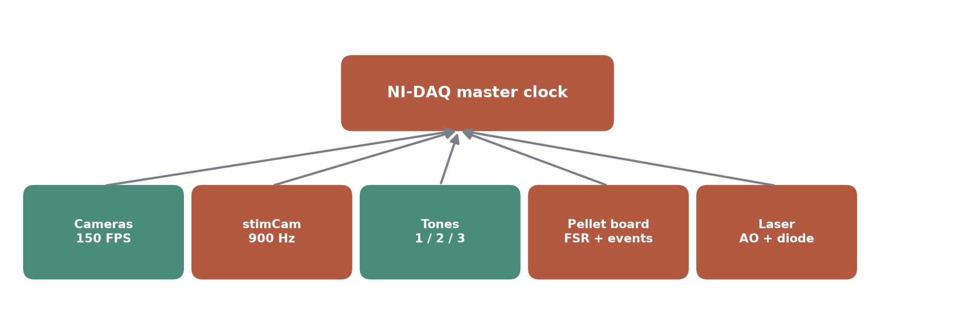
Everything lands on one timebase
Cameras, tones, pellet events and laser output are not separately timestamped and hoped to agree.
Camera frame edges are matched to NI-DAQ samples with a signed offset, a resolution, and a confidence — all written into alignment.json.
reachAQ
11
Notes:
Four sync modes: auto, backplane, external, independent. Compatible PXI cards share PXI_CLK10, a backplane start trigger and a routed master sample clock. Devices resolve by product and serial, so a changed NI-DAQmx alias never silently rebinds to the wrong card. Tone confirmation cross-checks commanded tones against the pulses actually observed.

Slide 12
Signals you can watch while the session runs
Everything is acquired continuously at 10 kHz and recorded unfiltered. The plot selection only changes what is drawn.
Tones 1, 2 and 3 as logic traces, with the commanded onset checked against the pulse the DAQ actually saw
Pellet FSR pressure — two sensors at about 83 Hz each, from firmware 2.1.0, on their own stream rather than mixed into the device log
Laser analog command alongside the diode readback, so what was asked for and what came out are on the same axis
Camera frame pulses and the barcode line, which are what tie video to samples
Closed-loop state: what the pose gate answered, when the cue fired, and whether the trial was cancelled
reachAQ
12
Notes:
The point for a new user is that this replaces post-hoc plotting. A decimated FSR trace is useless for behavioural analysis, so samples are forwarded unthrottled and an armed session gains roughly 166 rows a second. Worth flagging out loud: there is no microphone channel in the system today.

Slide 13
Experiments are composed, not copied
A phase shared by several experiments is written once.
A trial set is a reusable group of trials, saved on its own — trial content only, no epochs or blocks
An experiment is an ordered list of set appearances; each entry pins the set revision it was built against, can repeat, and can shuffle trial order within an appearance
Compiling flattens it into an ordinary protocol document, so the runner, the schedule and session evidence see nothing new
Each appearance becomes a named epoch, and the Sources column names the set every value came from
Shuffle seeds are stored on the entry, so a compile can always be repeated exactly
Editing a set never repins an existing row; a stale pin is visible, and a compile against a changed set is refused rather than silently different
reachAQ
13
Notes:
The pinning behaviour is the part worth dwelling on. It is what stops an edit to a shared phase from quietly changing an experiment that was already validated.

Slide 14
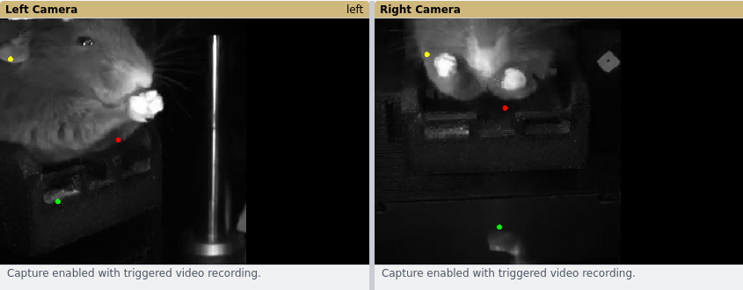
Demo — recorded video, everything else live
No animal today, so the camera frames are played from a recorded session. Exactly one stage is substituted.
Live 2D pose, per view, computed on the GPU from the played frames. Captured from the running application on the rig.
reachAQ
14
Notes:
Run order — launch with --demo or toggle Tools > Demo Mode while idle; show both camera panels carrying their own overlay; show the NI-DAQ signal stream; drive the pellet device by hand; open the protocol editor and the experiment sidebar; start a recording and let trials run; stop and show the session directory with its DEMO marker. Point at the red banner — it is there so nobody mistakes a demo session for data.

