Slide 1


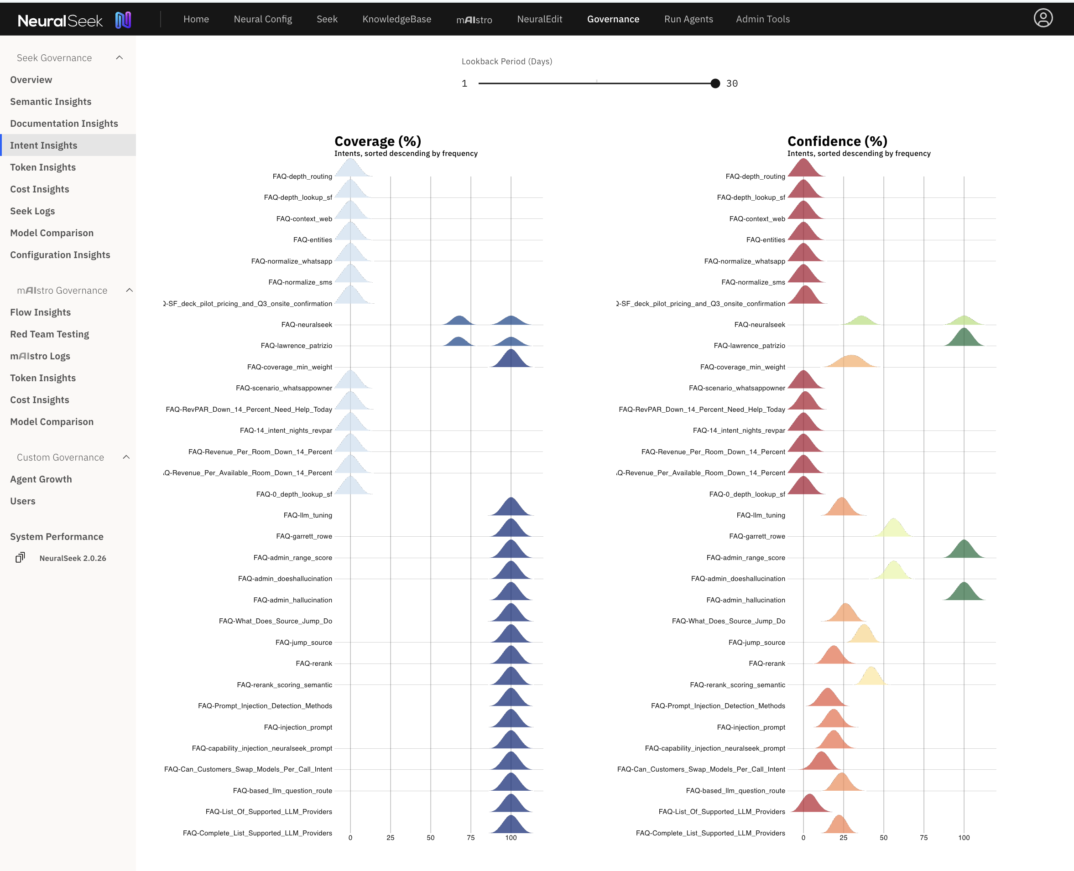
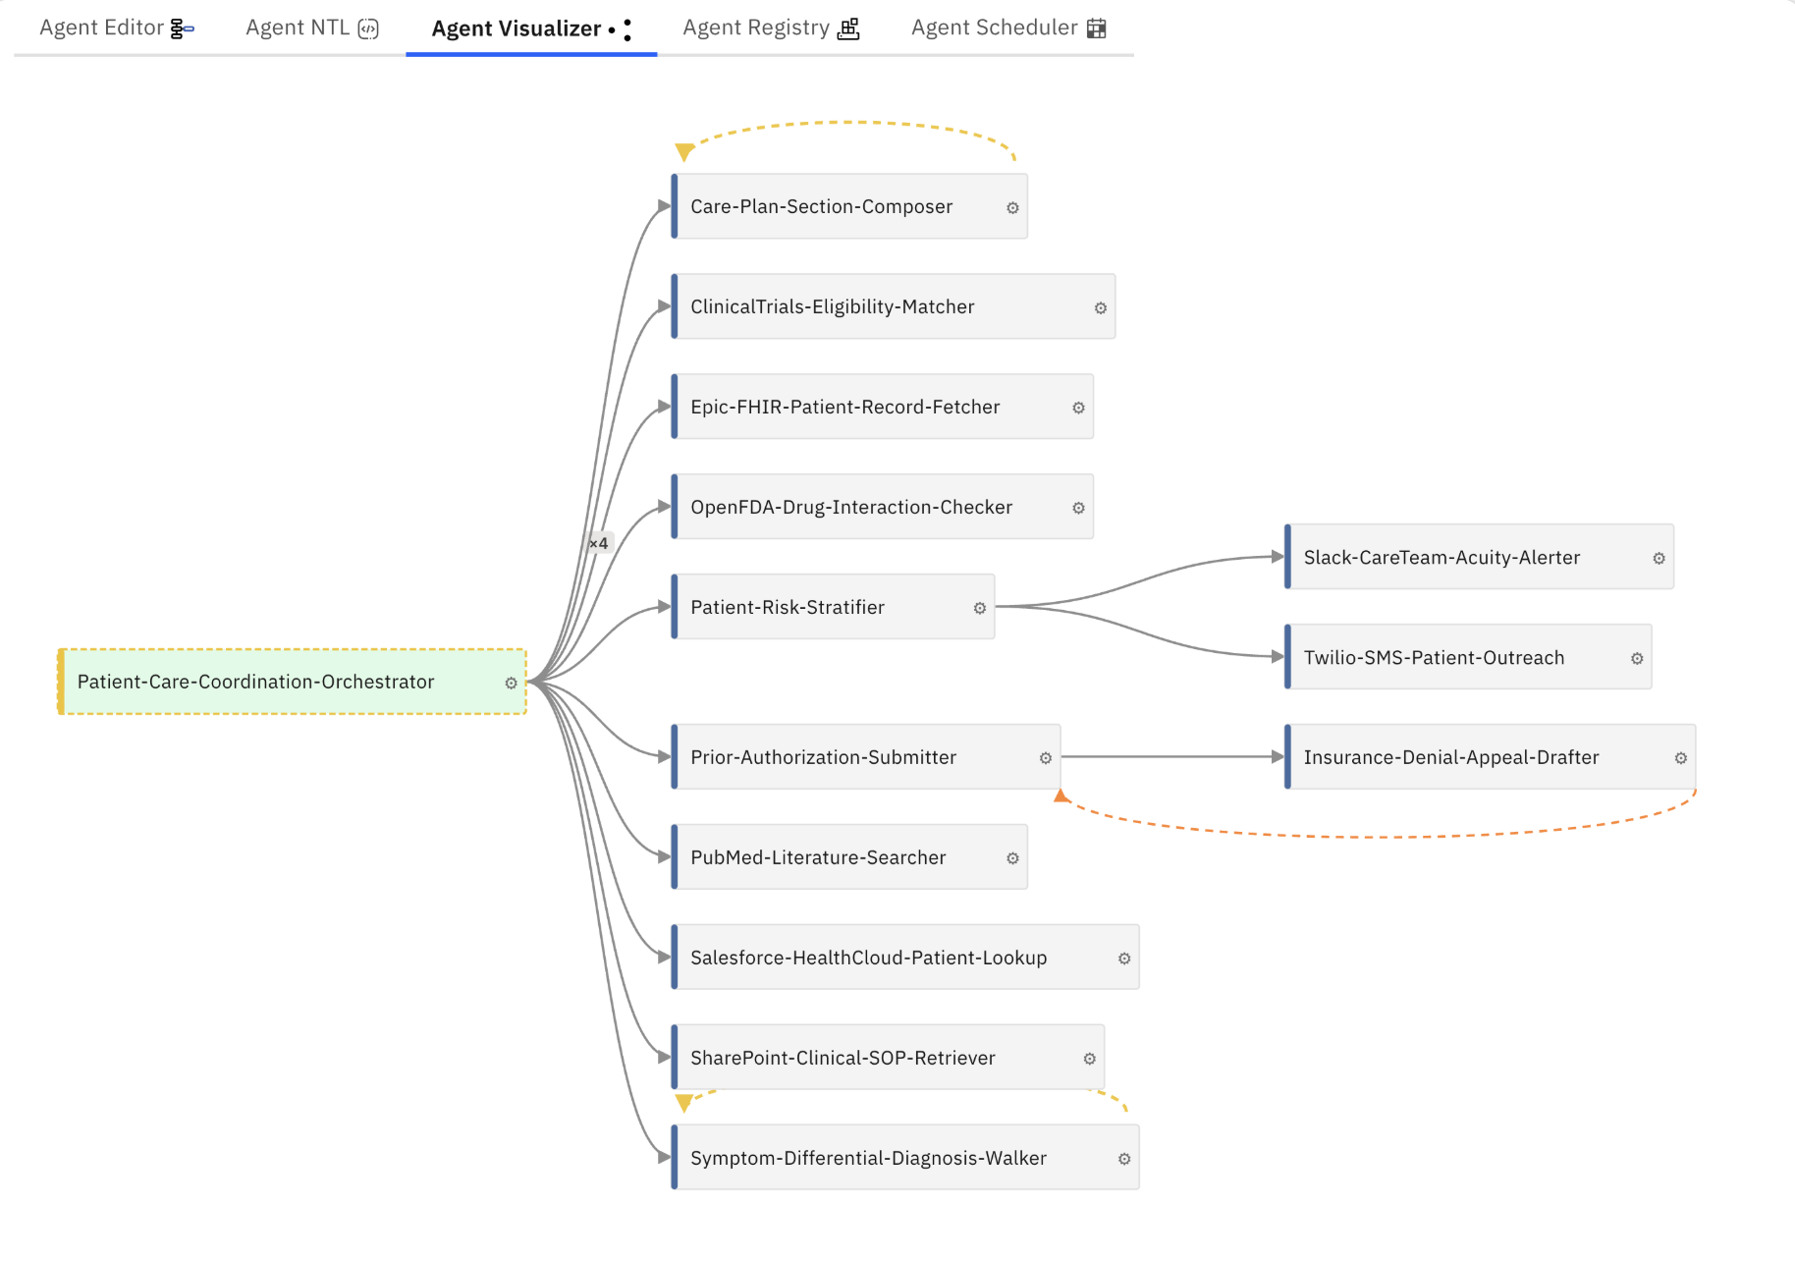
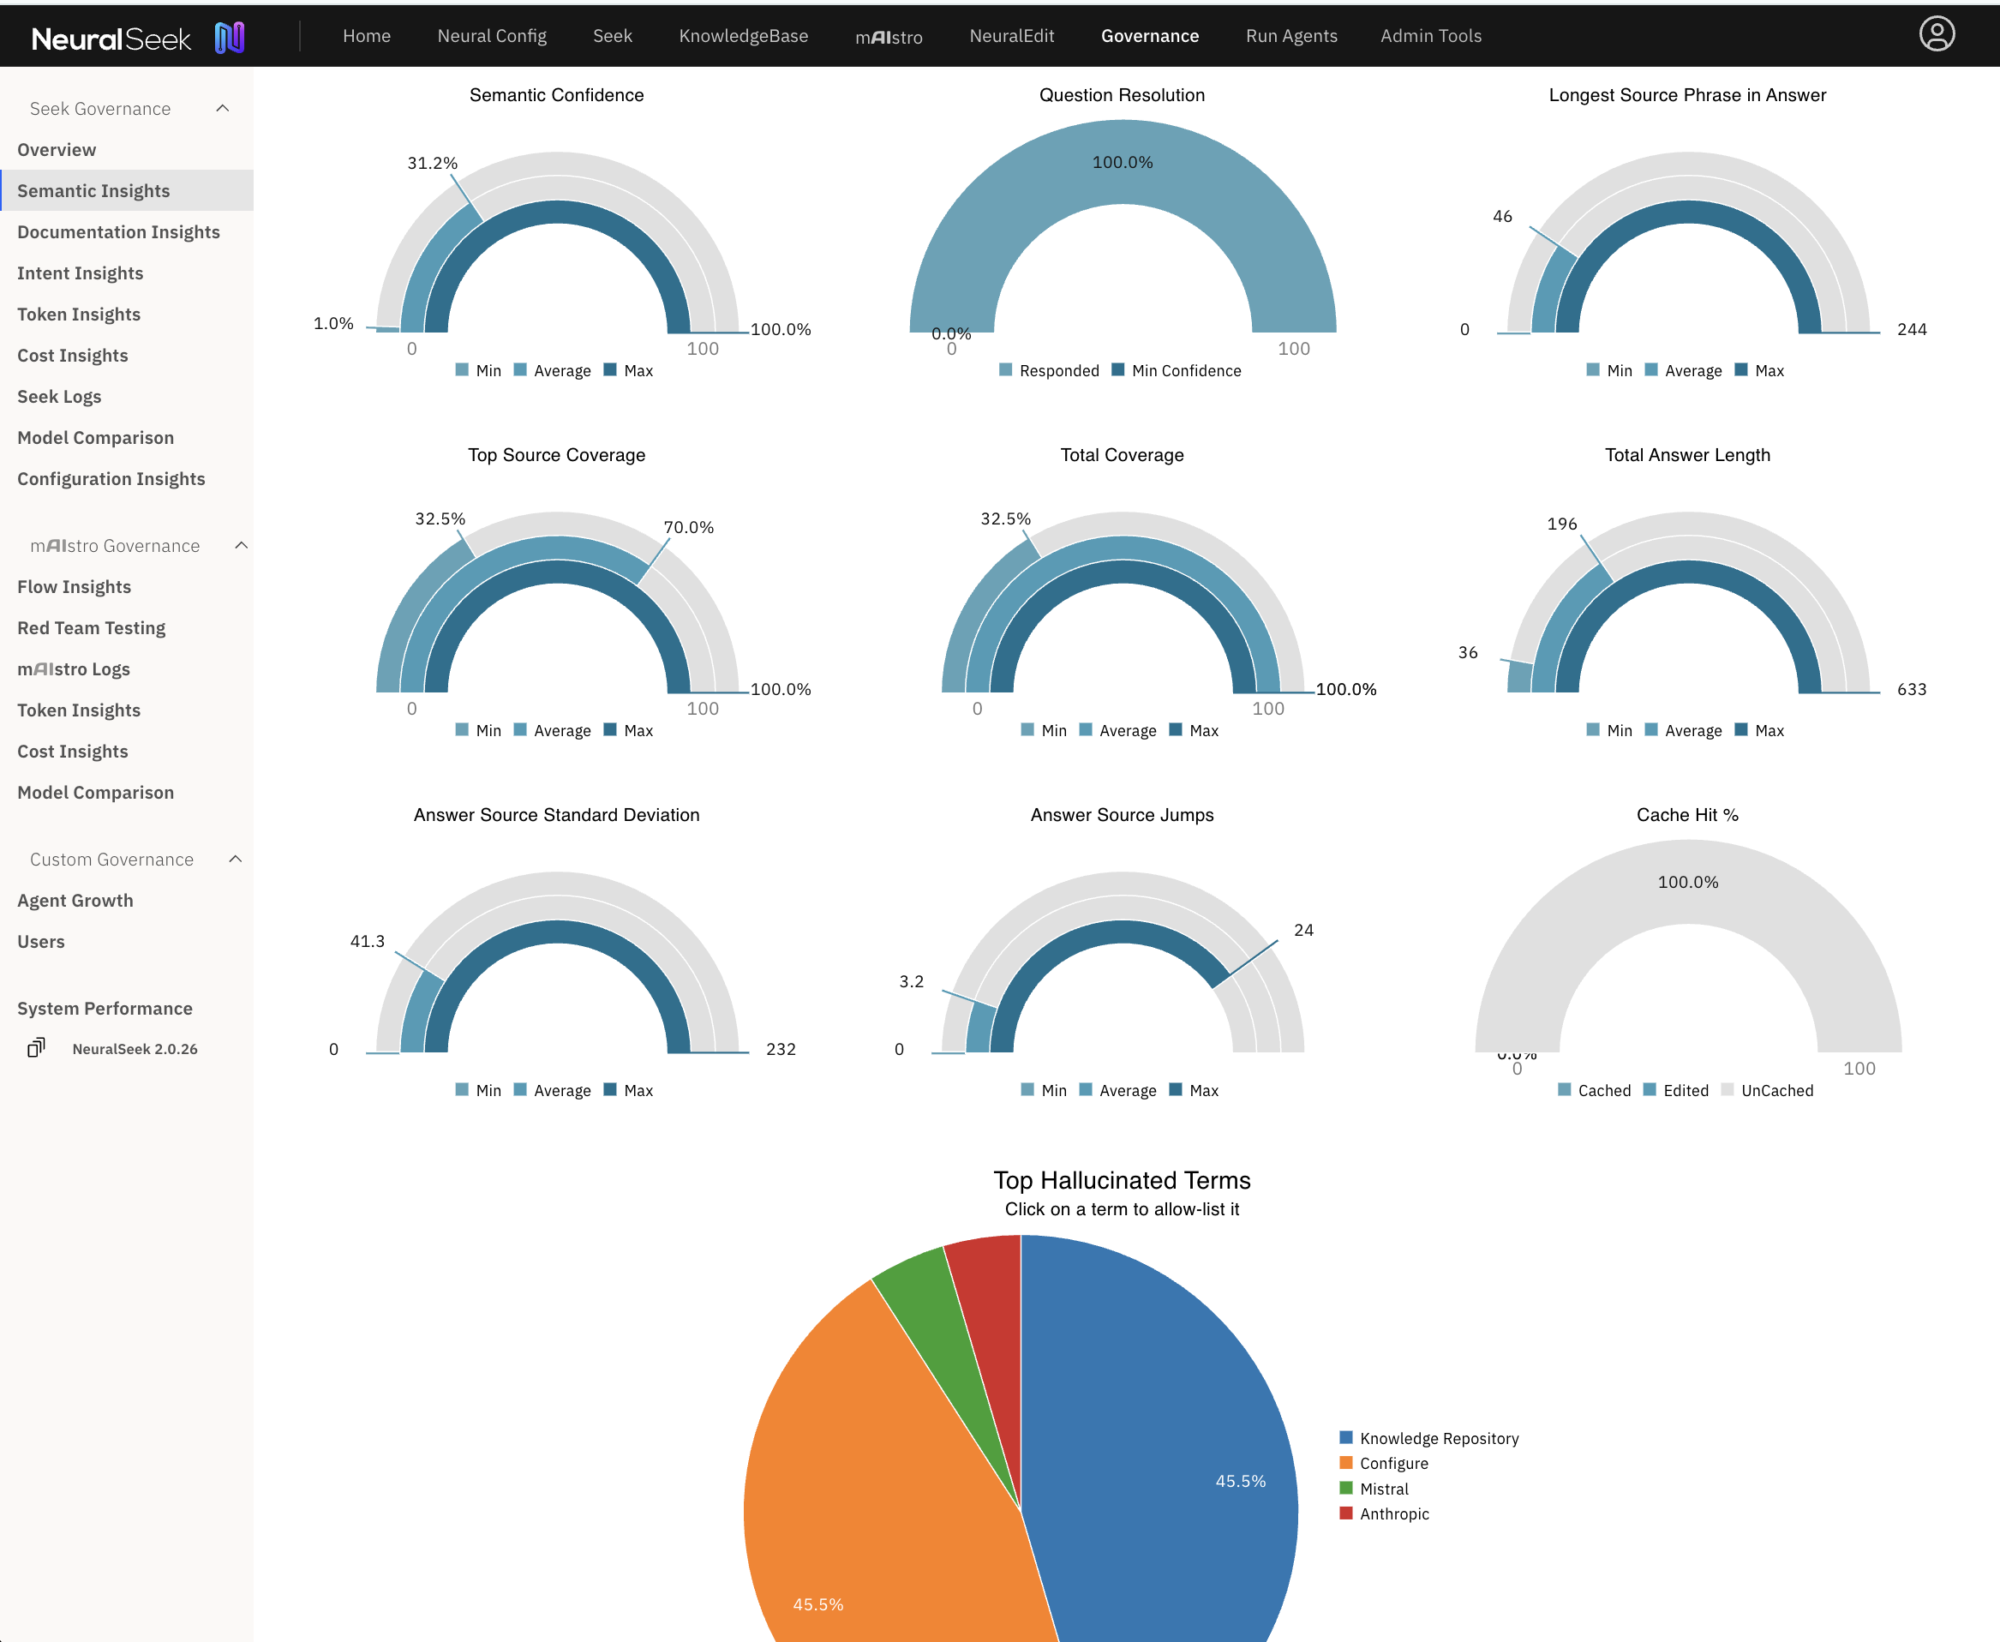
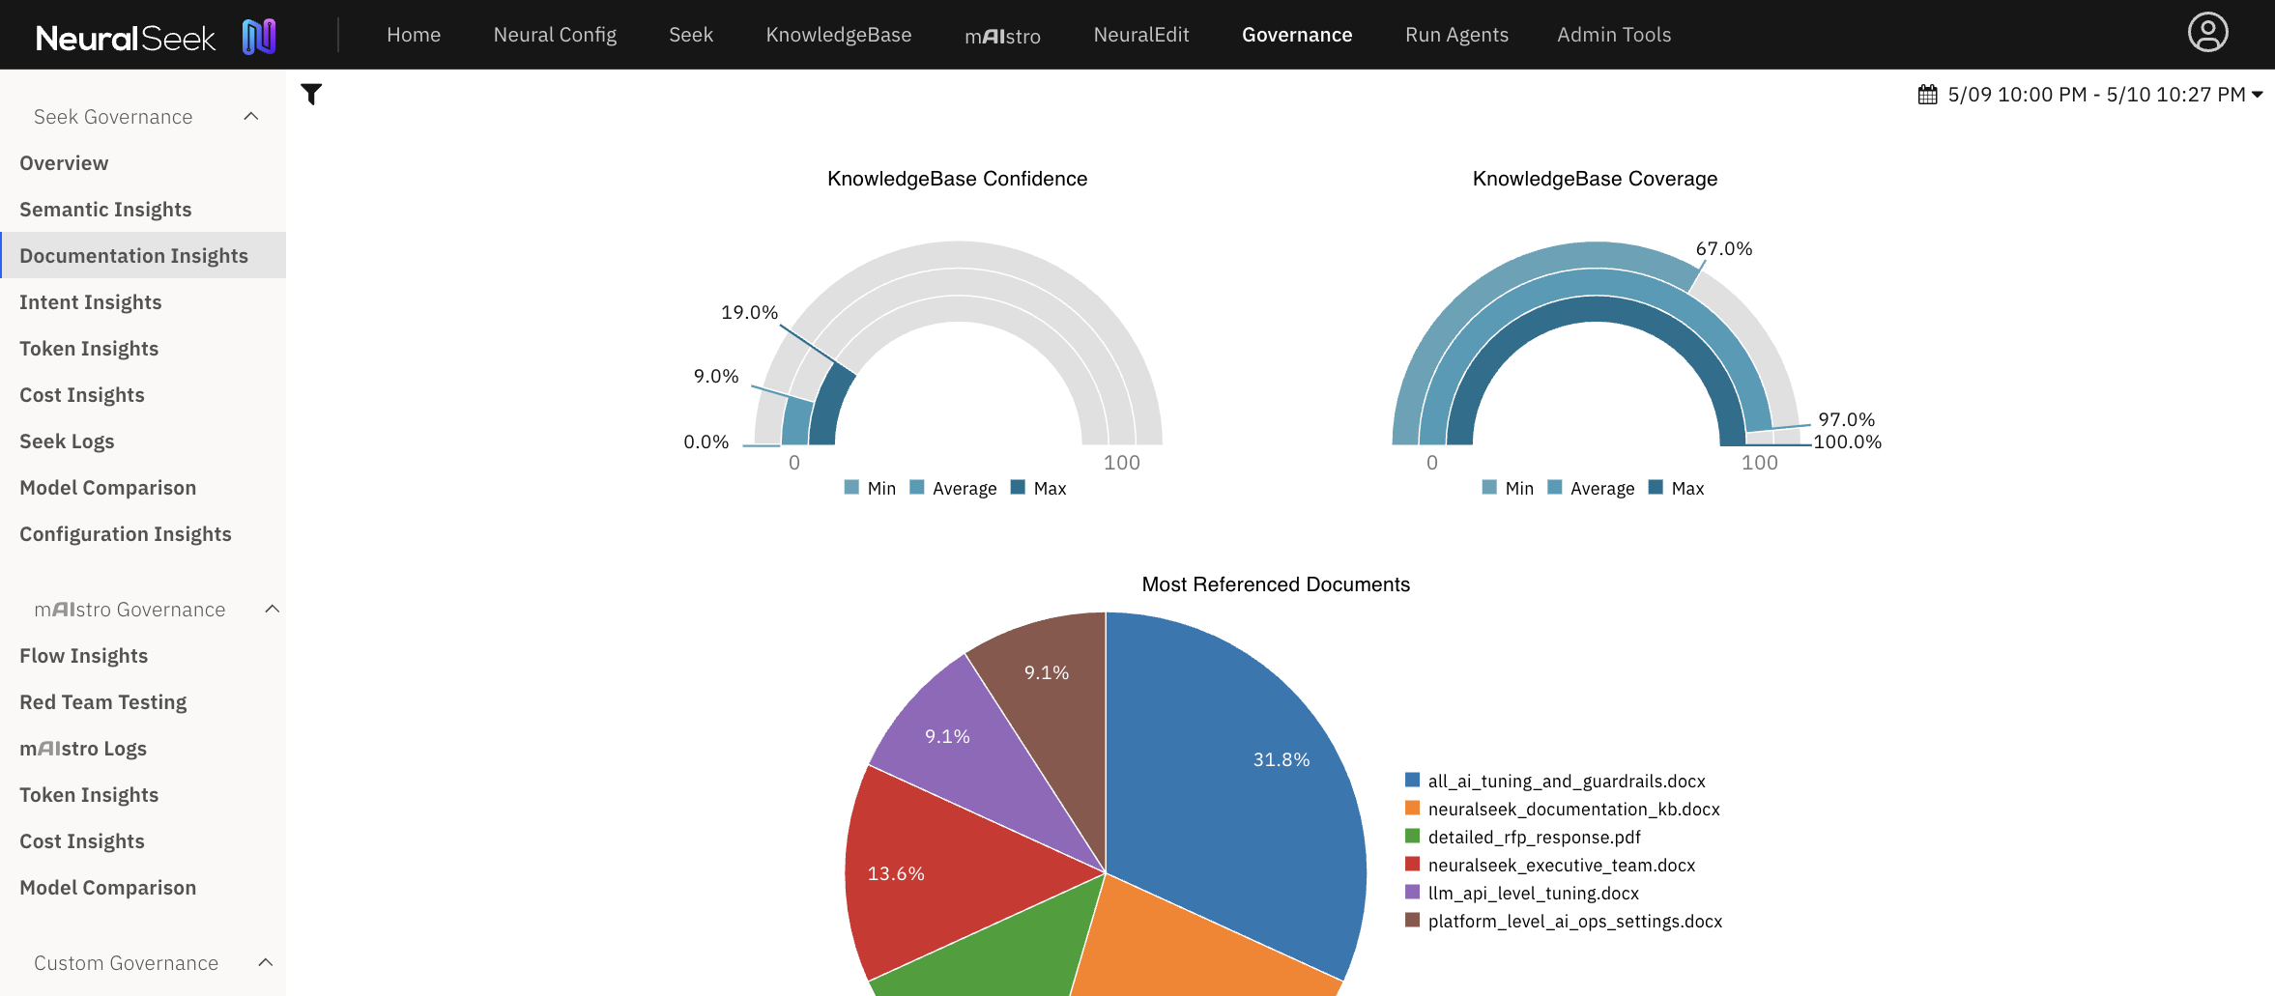

Every regulated enterprise needs AI governance. Do you have 118 Guardrails and LLM lineage?
Govern. Audit. Deploy.

Slide 2

Every regulated enterprise needs AI governance. Do you have 118 Guardrails and LLM lineage?
Govern. Audit. Deploy.

Slide 3



