Slide 1

End of Summer Presentation
Summer 2017
Davis Vaughan
Actuarial Development Intern
Asset Liability Management

Slide 2

Who am I?
Master’s student at UNC Charlotte
Mathematical Finance
ALM intern
Asset – Patrick Lokken
Liability – Wen Li
I really like R

Slide 3
What can r do for lincoln?
Dashboards
Analyzing portfolio book value and yield data
Visualizing cash flows
Speed
IRR calculations
Direct database connections
Predictive analytics
Predicting worst 10% of scenarios from 2000
Visualizations
Waterfall graph creator
Branded charts
MG-ALFA
Input efficiency
Atb2 file generation
Miscellaneous analyses
Copying / renaming 1500 files
Complex data manipulation

Slide 4
dashboards
Interactive reporting using R and Shiny
Project:
Visualize 50 years of forecasted book value and yield data for a set of 60 Lincoln portfolios
Create an automated process for cleaning, performing calculations, and loading the data into the dashboard
Make the analysis easy to run next quarter with new data

Slide 5
dashboards
Interactive reporting using R and Shiny
Project:
Visualize 50 years of forecasted book value and yield data for a set of 60 Lincoln portfolios
Create an automated process for cleaning, performing calculations, and loading the data into the dashboard
Make the analysis easy to run next quarter with new data
I could explain further, or…

Slide 6
dashboards
Interactive reporting using R and Shiny
Benefits:
Very little work – Raw output from ALFA is dumped in a folder each quarter
Maintain history – Compare multiple years of projections as opposed to just two
Fully reproducible – Easily step through the intermediate data cleaning steps.
Well-documented code, easy to understand
Not trying to understand a complex formula reference in an Excel document

Slide 7
dashboards
Visualizing cash flows
Project:
tbc

Slide 8
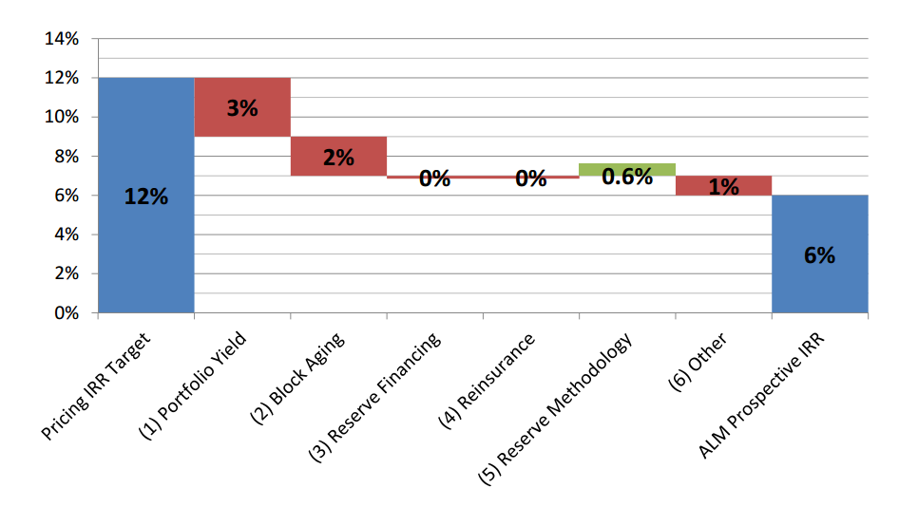
Visualizations
Waterfall graphs
Loved by senior management
Difficult to create
Not all that
appealing…

Slide 9
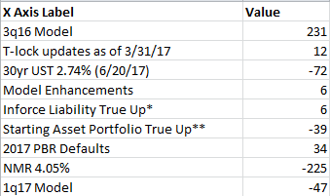
Visualizations
Waterfall graphs – Let R do the work for you
Pass in Excel data that looks like this:
Call the waterfall function: lfg_waterfall(data)

Slide 10
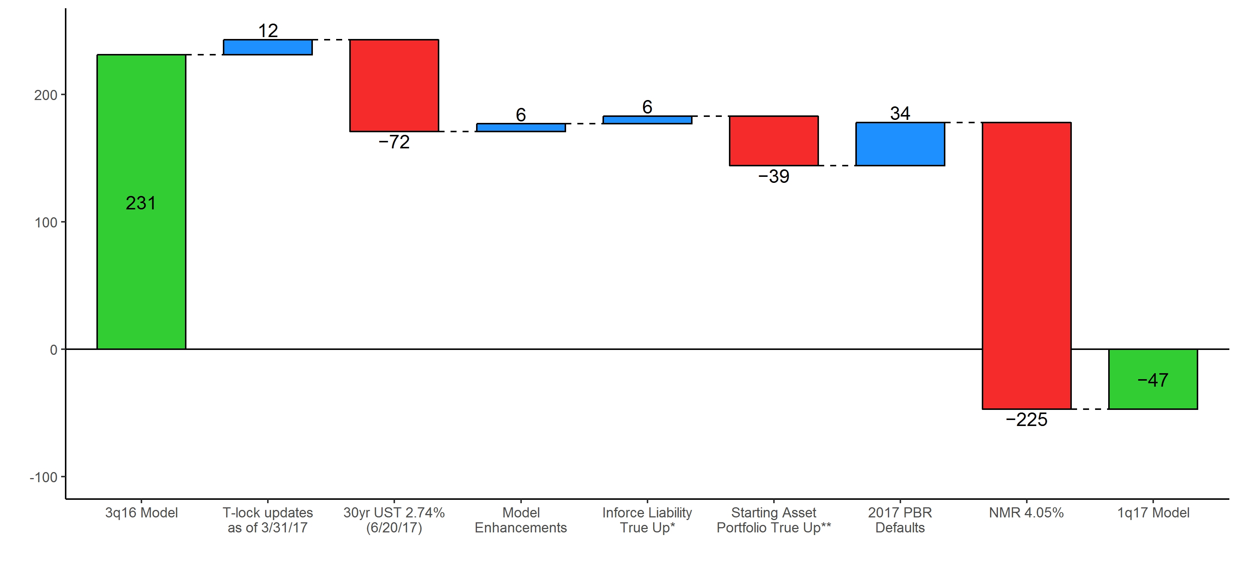
Visualizations
Waterfall graphs – Let R do the work for you
Instantly get results that look like this:

Slide 11
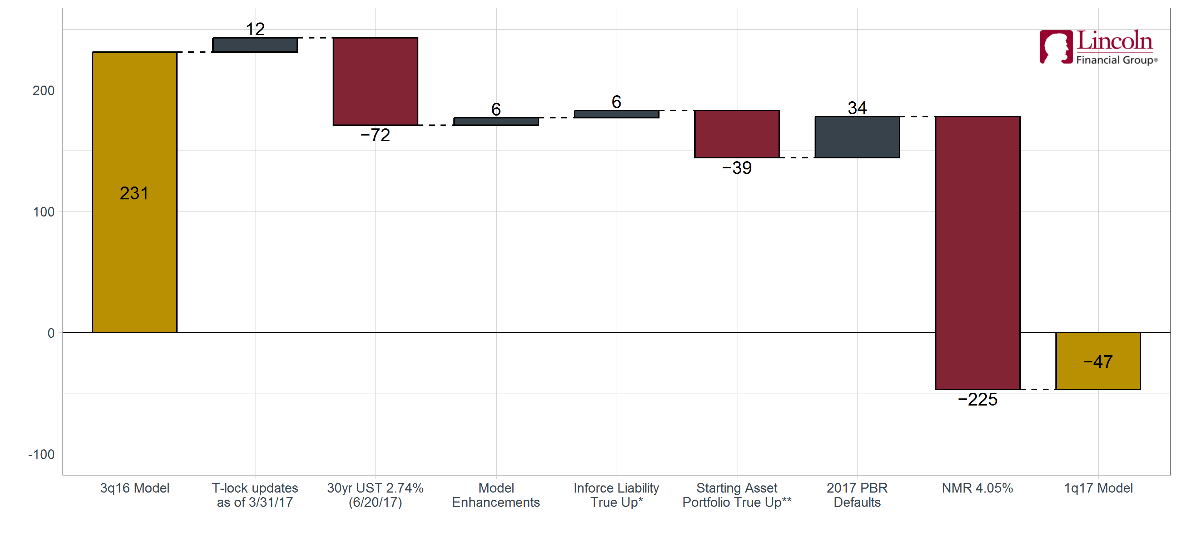
Visualizations
Waterfall graphs – Let R do the work for you
With a little more effort…

Slide 12
speed
IRR calculations
Project:
Calculate IRR for 2400 potential economic scenarios
12 Lincoln products, 200 scenarios each
40 years of predicted distributable earnings per scenario (cash flows)
1 GAAP Equity value per product (initial investment)
Calculation has too many conditions for Excel’s IRR function. Goal Seek needed.

Slide 13
speed
IRR calculations
Project:
Calculate IRR for 2400 potential economic scenarios
12 Lincoln products, 200 scenarios each
40 years of predicted distributable earnings per scenario (cash flows)
1 GAAP Equity value per product (initial investment)
Calculation has too many conditions for Excel’s IRR function. Goal Seek needed.
3 hours to run all 2400 scenarios
Can R do this faster?

Slide 14
speed
IRR calculations
Solution:
Optimization problem – For each of the 2400 scenarios, minimize:
PV(distributable earnings) – GAAP_equity
By varying the IRR to discount with
Use the R function, optimize()

Slide 15
speed
IRR calculations
Solution:
Optimization problem – For each of the 2400 scenarios, minimize:
PV(distributable earnings) – GAAP_equity
By varying the IRR to discount with
Use the R function, optimize()
3 hours -> 9 seconds in R
Calculations are vectorized and run in parallel
Report generated at the end of each run

Slide 16
MG-ALFA
Input efficiency
Project:
Efficiency – Each line of business has 1 atb2 file containing model assumptions
Some assumptions are updated regularly, others are never touched
Separate updated tables from static tables to make assumption updating easier
Flexibility
Needs to work for multiple lines of business
Iterative process

Slide 17
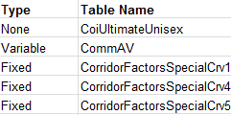
MG-ALFA
Input efficiency
Inputs
Excel atb2 files
Regularly Updated
Tables
R
Static
ALFA
Mapping
Not Used

Slide 18
MG-ALFA
Input efficiency
Inputs
Excel atb2 files
Regularly Updated
Tables
R
Static
ALFA
Mapping
Not Used

Slide 19
speed
Direct connections to databases
Project:
Tackling a problem we all have. Working with databases from Excel/VBA isn’t fun.
Great support in R for connecting to any type of database
There just needs to be a “SQL translation”
Added that SQL translation for Access
Let’s have some fun

Slide 20
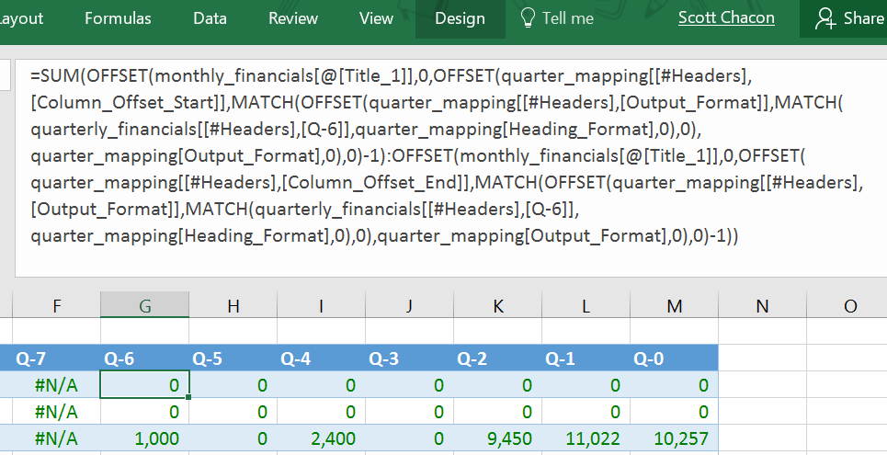

speed
Direct connections to databases
Benefits:

Slide 21
speed
Direct connections to databases
Benefits:
Please Don’t

Slide 22
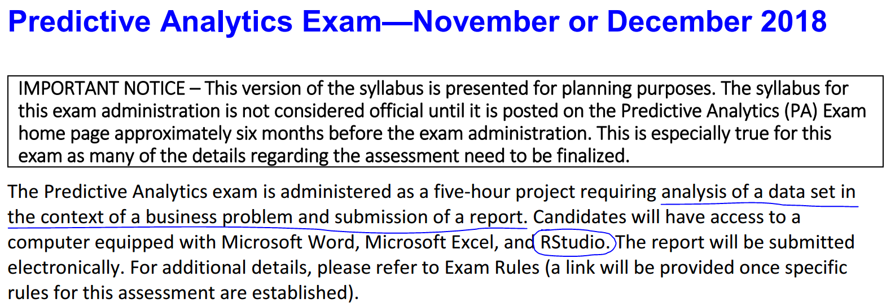
Why do I care so much?
SOA Predictive Analytics Exam for ASA’s
Big picture:
At Lincoln you are going to have an influx of interns with these skills!

