Slide 1

End of Summer Presentation
Summer 2017
Davis Vaughan
Actuarial Development Intern
Asset Liability Management

Slide 2

Who am I?
Master’s student at UNC Charlotte
Mathematical Finance
Exams
P & FM
ALM intern
Asset – Patrick Lokken
Liability – Wen Li
I really like R

Slide 3
What can r do for lincoln?
Dashboards
Analyzing portfolio book value and yield data
Visualizing cash flows
Speed
IRR calculations
Direct database connections
Visualizations
Waterfall graph creator
Branded charts
MG-ALFA
Input efficiency
Atb2 file generation

Slide 4
dashboards
Visualizing cash flows
Project:
Visualize ALFA cash flow projection data (a lot of it)
Many ways to slice the data
Resulting in >3 million rows for just 2 sets of projections (sorry Excel)
Year of projection | Line of business
Group | Scenario

Slide 5
dashboards
Visualizing cash flows
Solution:
Add new projections to a folder
Run this

Slide 6
dashboards
Interactive reporting using R and Shiny
Project:
Visualize 50 years of forecasted book value and yield data for a set of 60 Lincoln portfolios
Create an automated process for cleaning, performing calculations, and loading the data into the dashboard
Make the analysis easy to run next quarter with new data

Slide 7
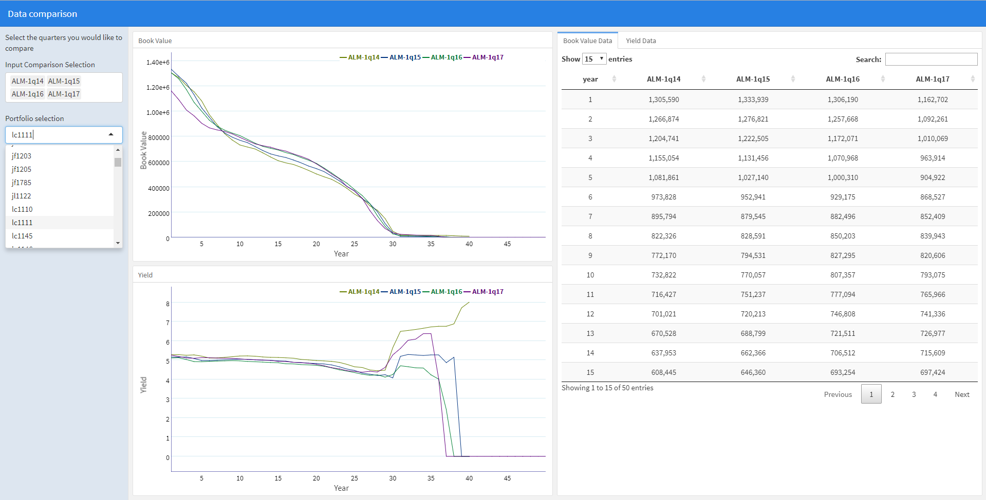
dashboards
Interactive reporting using R and Shiny

Slide 8
dashboards
Interactive reporting using R and Shiny
Benefits:
Very little work
Raw output from ALFA is dumped in a folder each quarter
Maintain history
Compare multiple years of projections as opposed to just two

Slide 9
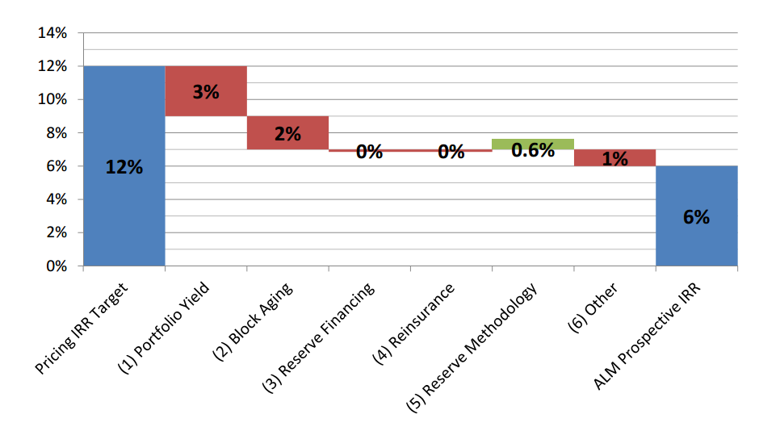
Visualizations
Waterfall graphs
Loved by senior management | Difficult to create

Slide 10
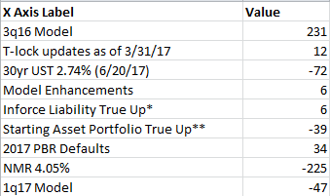
Visualizations
Waterfall graphs – Let R do the work for you
Pass in Excel data that looks like this:
Call the waterfall function: lfg_waterfall(excel_data)

Slide 11
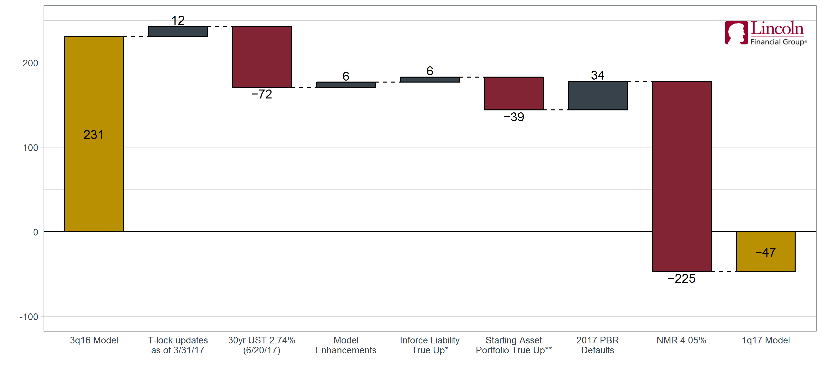
Visualizations
Waterfall graphs – Let R do the work for you
Instantly get results like this

Slide 12
speed
IRR calculations
Project:
Calculate IRR for 2400 potential economic scenarios
40 years of predicted distributable earnings per scenario (cash flows)
1 GAAP Equity value per product (initial investment)
Too many conditions for Excel’s IRR function. Goal Seek?
IRR
GAAP Equity Value
40 years of earnings

Slide 13
speed
IRR calculations
Project:
Calculate IRR for 2400 potential economic scenarios
40 years of predicted distributable earnings per scenario (cash flows)
1 GAAP Equity value per product (initial investment)
Too many conditions for Excel’s IRR function. Goal Seek?
3 hours to run all 2400 scenarios
Can R do this faster?
IRR
GAAP Equity Value
40 years of earnings

Slide 14
speed
IRR calculations
Solution:
Optimization problem – For each of the 2400 scenarios, minimize:
PV(distributable earnings) – GAAP_equity
By varying the IRR to discount with
Use the R function, optimize()

Slide 15
speed
IRR calculations
Solution:
Optimization problem – For each of the 2400 scenarios, minimize:
PV(distributable earnings) – GAAP_equity
By varying the IRR to discount with
Use the R function, optimize()
3 hours -> 9 seconds in R
Calculations are vectorized and run in parallel

Slide 16
MG-ALFA
Input efficiency
Project:
Efficiency – Each line of business has 1 atb2 file containing model assumptions
Some assumptions are updated regularly, others are never touched
Separate updated tables from static tables to make assumption updating easier
Flexibility
Needs to work for multiple lines of business
Iterative process

Slide 17
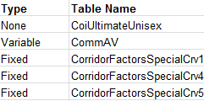
MG-ALFA
Input efficiency
Inputs
Excel atb2 files
Regularly Updated
Tables
R
Static
ALFA
Mapping
Not Used

Slide 18
speed
Direct connections to databases
Project:
Investigating a problem many of us have:
Working with databases from Excel/VBA isn’t fun or fast.
Great support in R for connecting to any type of database
“SQL translation” required
Added that SQL translation for Access

Slide 19
speed
Direct connections to databases
Project:
Investigating a problem many of us have:
Working with databases from Excel/VBA isn’t fun or fast.
Great support in R for connecting to any type of database
“SQL translation” required
Added that SQL translation for Access
Let’s have some fun

Slide 20
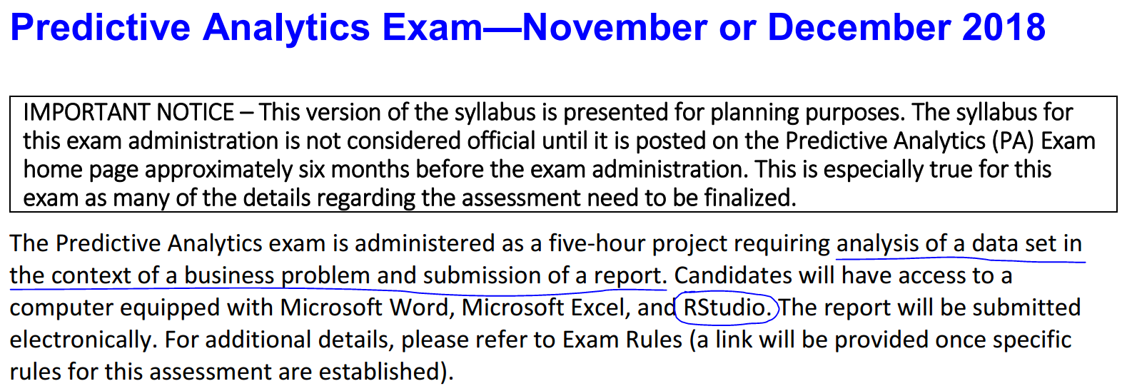
Why do I care so much?
SOA Predictive Analytics Exam for ASA’s
Big picture:
At Lincoln you are going to have an influx of interns with these skills!

Slide 21

To learn more
Resources
R Basics Talk – Import, Manipulate, Visualize
R 4 Data Science – http://r4ds.had.co.nz/

