Slide 1
Online Bidding Project
Ceren Altay
6 November 2017

Slide 2
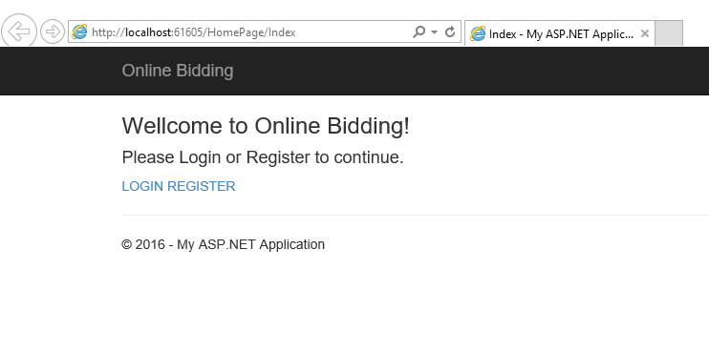
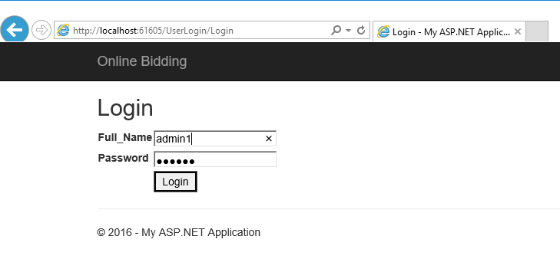
Home Page to login or register
Admin login with name and password

Slide 3
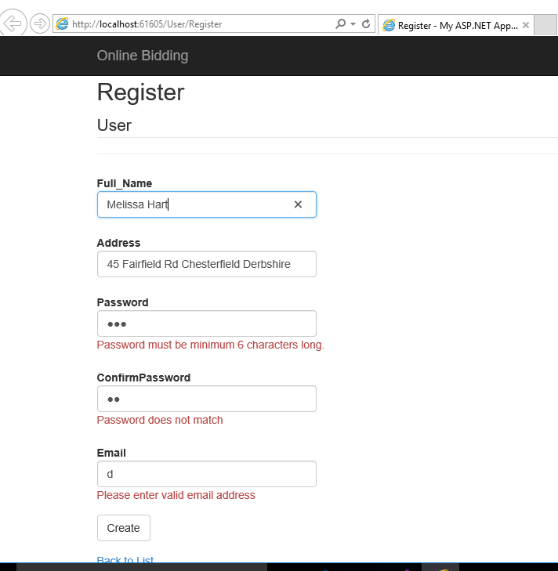
Registration page with validations.

Slide 4
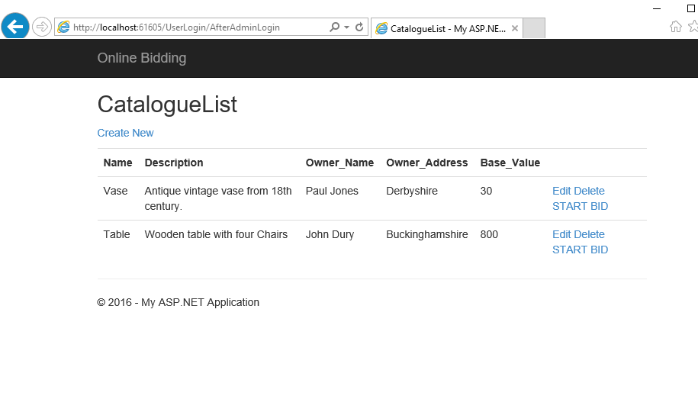
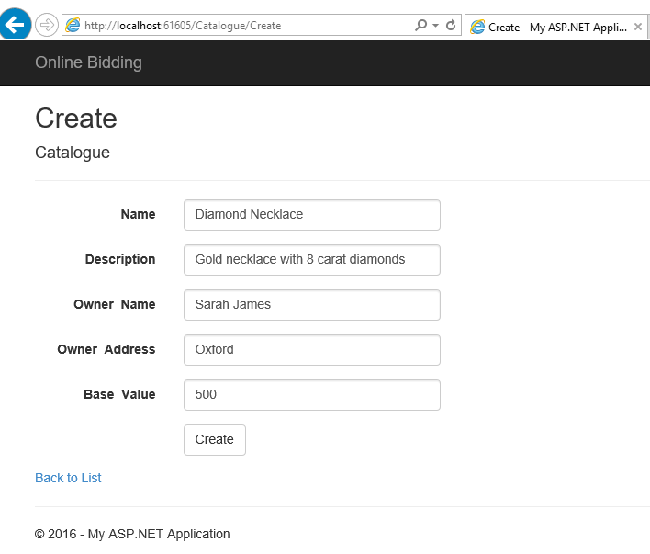
Catalogue List retrieved from the database, giving the options to create, edit or delete an item and also starting the bid for the item.
Adding a new item to the catalogue database

Slide 5
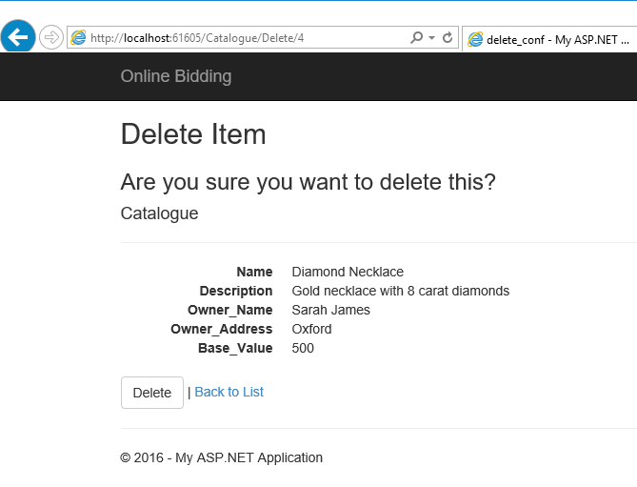
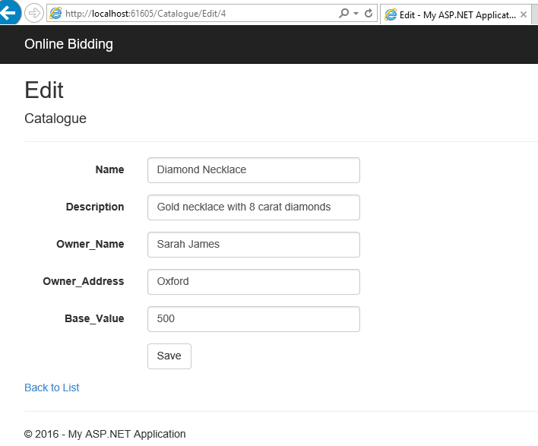
Editing the item and Back to List link Deleting an item an the confirmation message

Slide 6
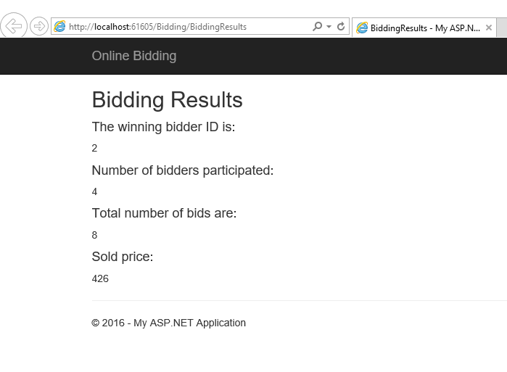
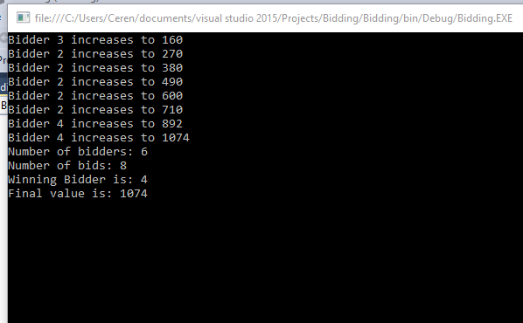
Bidding results are displayed on the web page
Execution of the program on console and the results showing the bidders and their bids as well as the final winner.

Slide 7
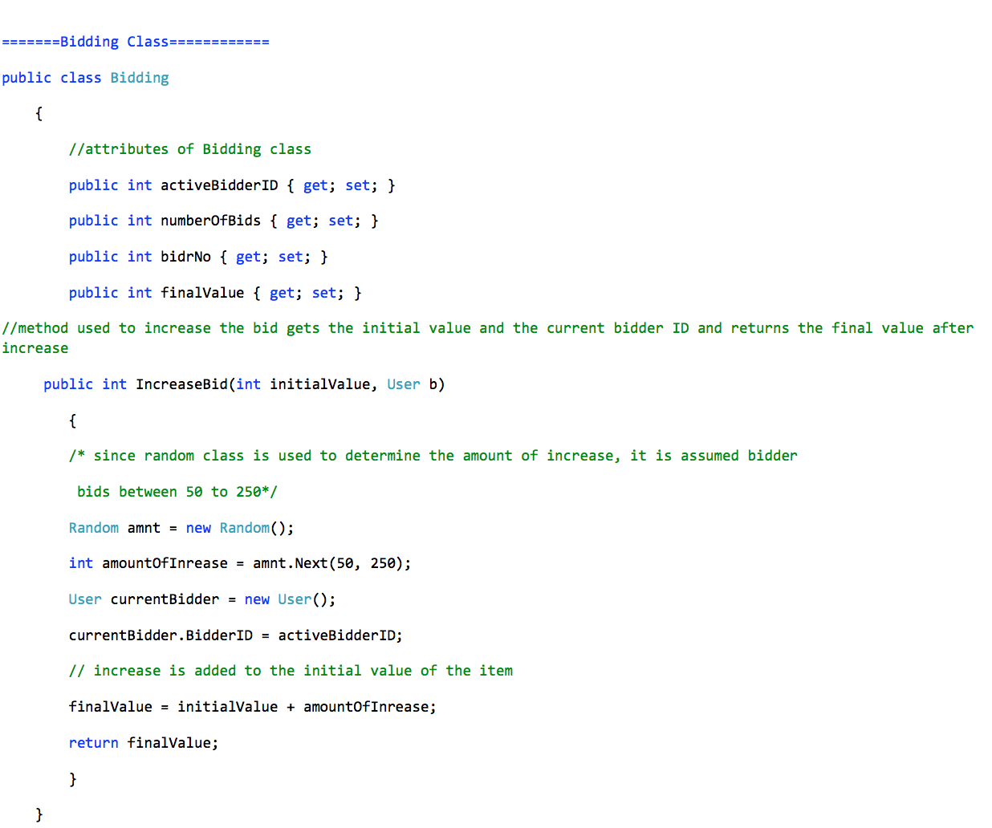
Bidding class in the model and IncreaseBid method.
Random method is used to simulate multiple bidders and random price increase.
AmountOfIncrease if assumed between 50-250
New CurrenBidder object with a BidderID is created and it is assigned to the activeBidderID
Method returns the final value of the bid.

Slide 8
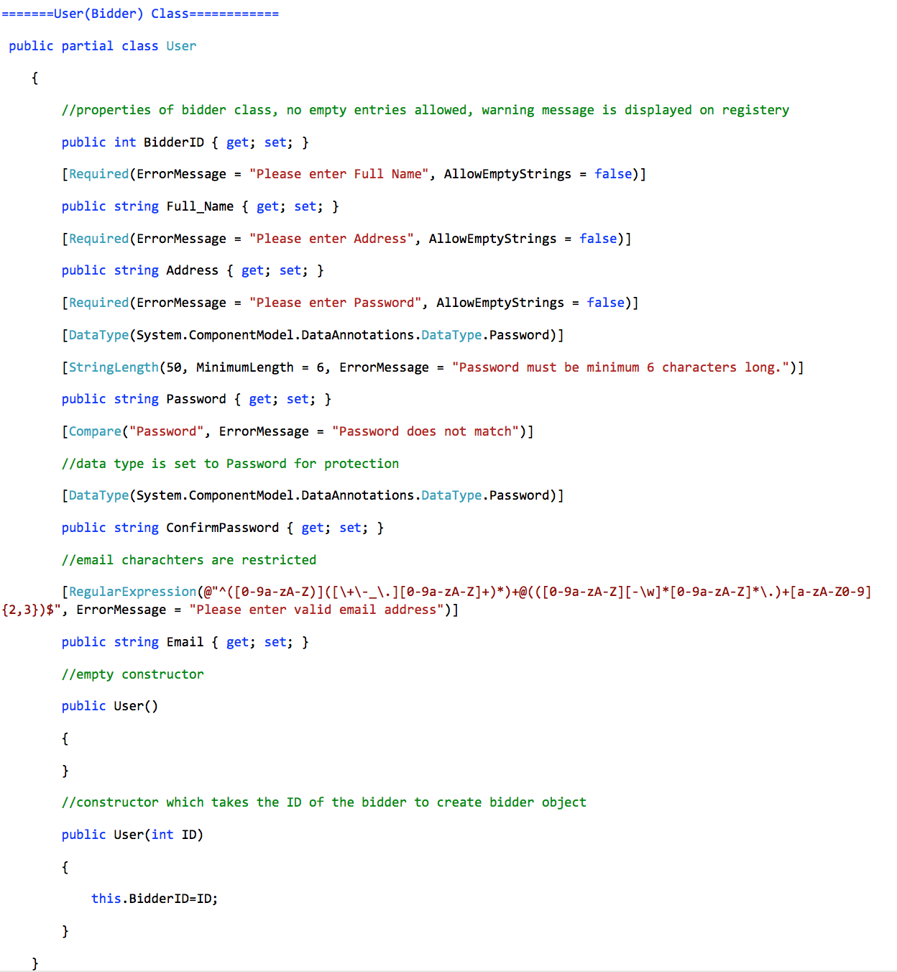
User class that contains the user details and validations
An empty constructor and a constructor that takes ID as a parameter for the BidderID to be used in the previous method

Slide 9
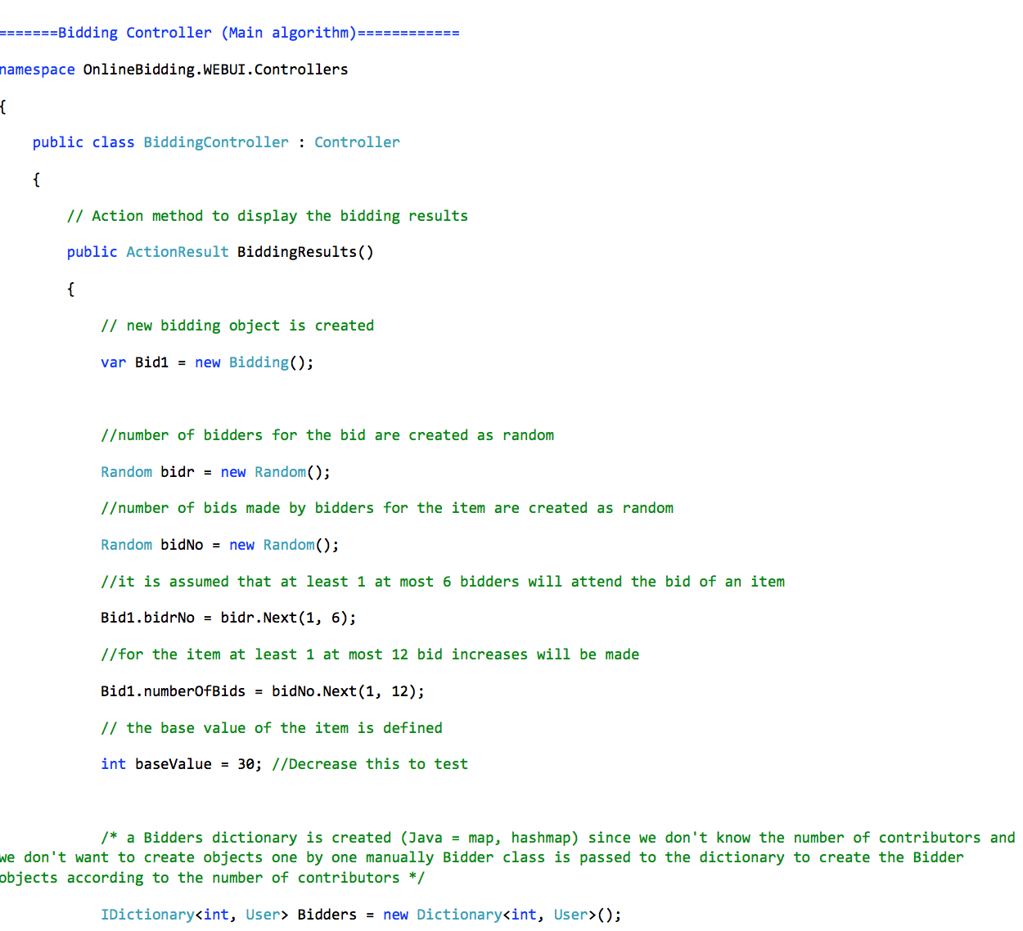
Bidding controller generates random number of bidders, random number of bids made by a bidder.
Assumptions:
At least 1, at most 6 number of bidders bidding for an item
At least 2, at most 12 bid increases will be made for an item.
Dictionary of users is used to store the information of bidders.

Slide 10
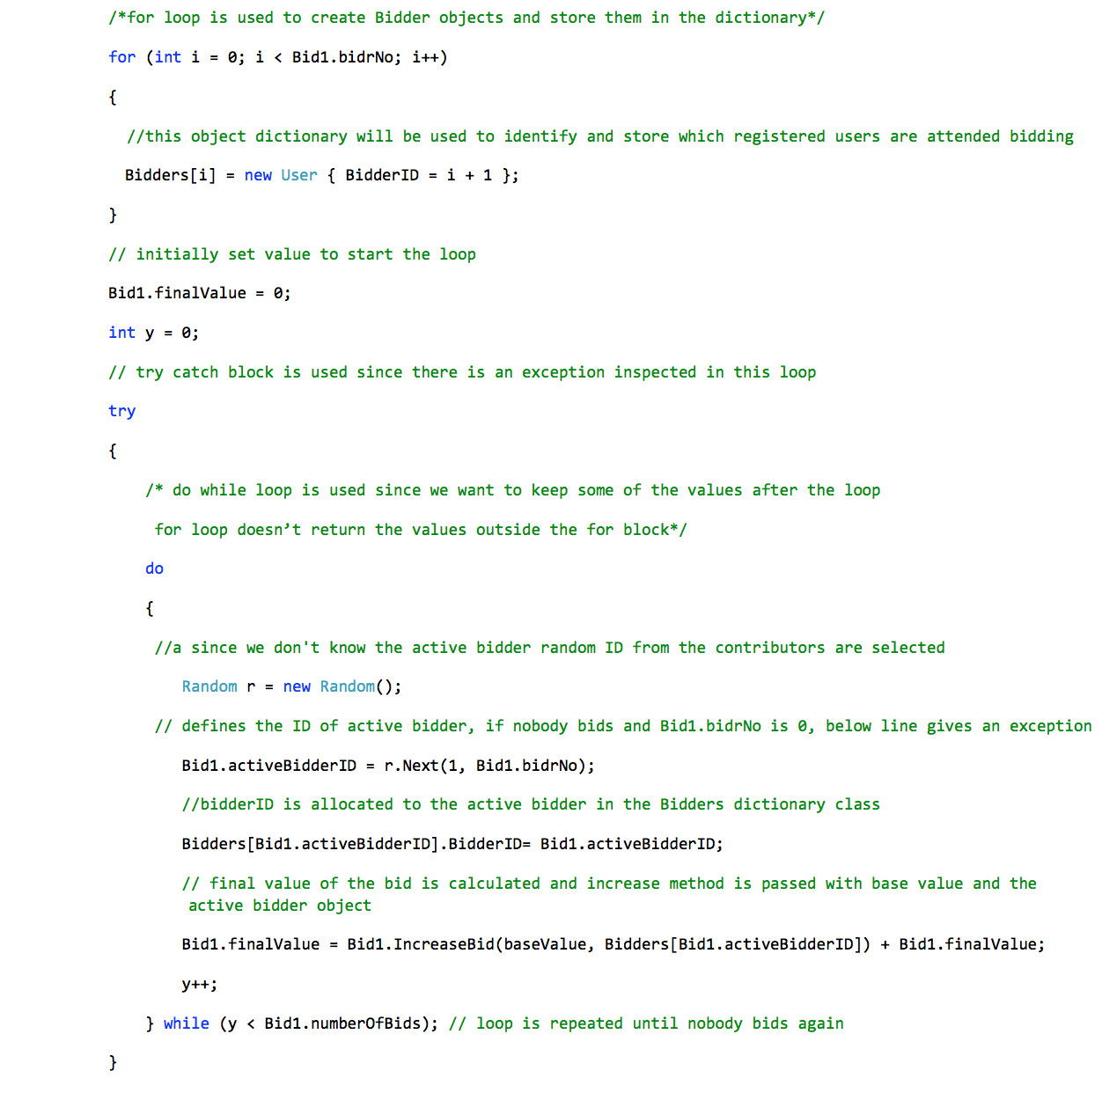
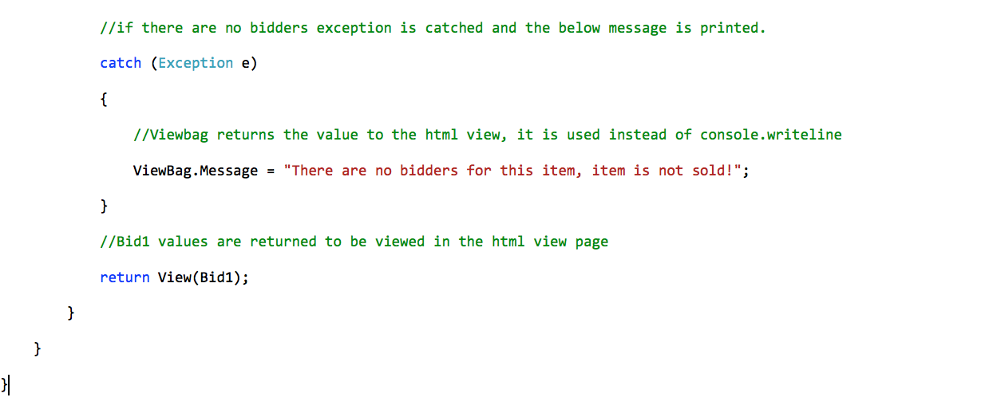
IncreaseBid method is called to calculate the finalValue.
Do while loop repeats the bid until nobody bids.
If nobody bids and Bid1.BidrNo system gives an exception.
Which is handled by try catch block.

Slide 11
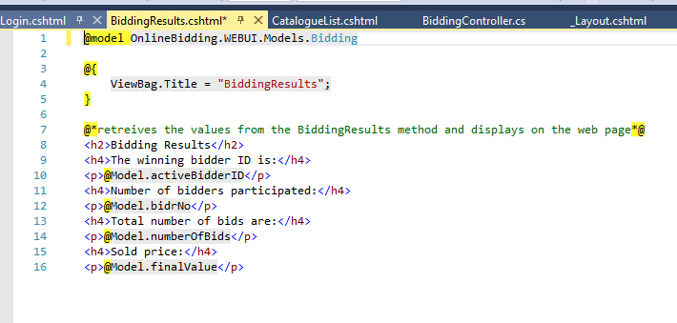
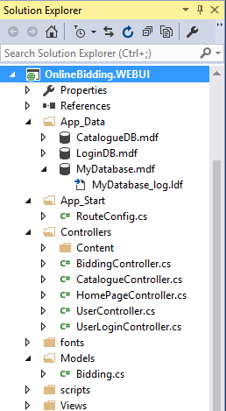
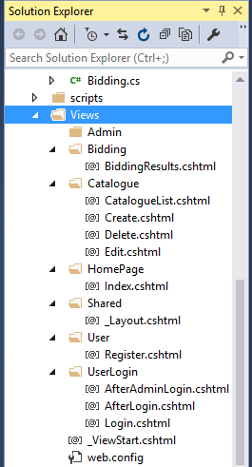
HTML view of the results page, shown to the admin.
MVC structure: Entity Framework database, controller, model, view folders

Slide 12
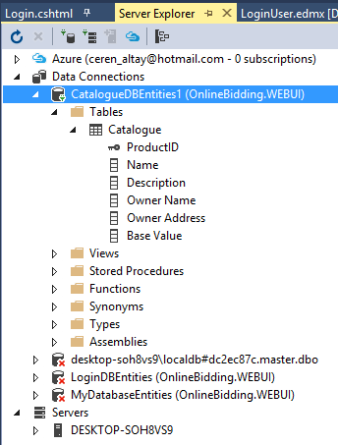
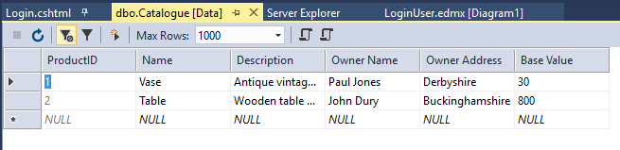
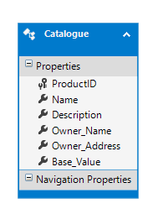
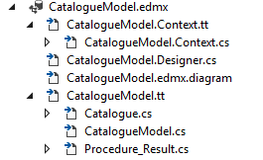
Databases
Catalogue table in MySql, table data, edmx folders and the table generated by the Entity framework.

Slide 13
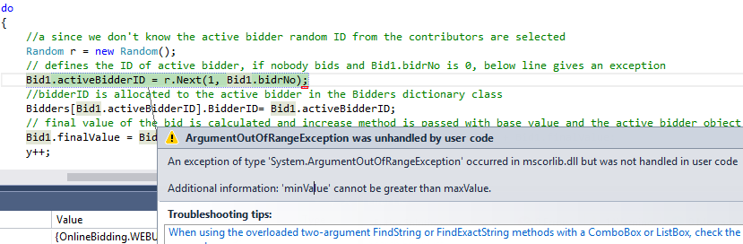
Error Handling
An exception situation is created and tried to be solved by exception handling. This situation happens when there are no bidders bidding. To illustrate random values are set to 0 to generate this situation.

Slide 14
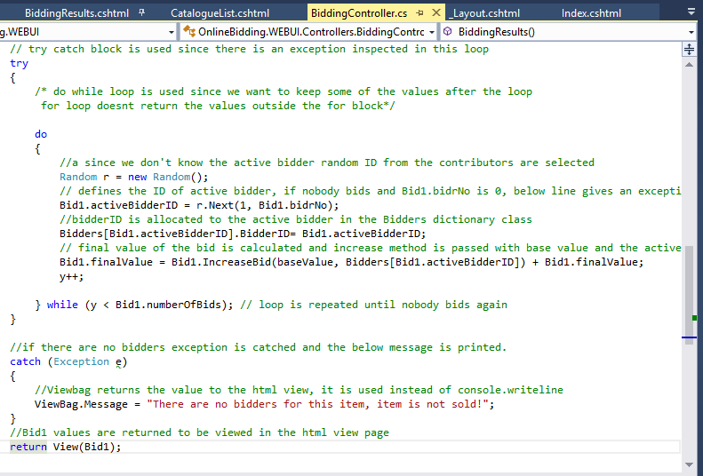
Exception is caught and an error message is sent to view stating that there are no bidders for the item.

Slide 15
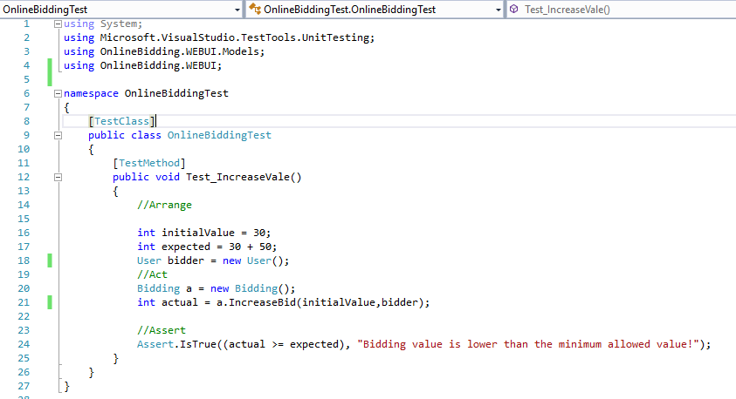

Unit Testing
This method uses AAA approach unit testing pattern uses Arrange, Act
In the Arrange stage, the values are set and in the assert stage the method is run. The program tests and compares the actual values in the program and expected values given on the test. Value 50 added to 30 is the minimum bidding amount in the Random method.

Slide 16
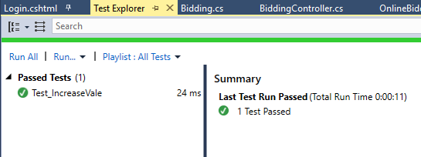
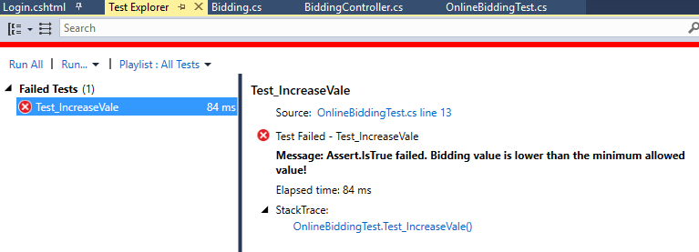

Successful test results
Failed test results
To fail the test in the main program the minimum bid amount is decreased to 5.

