Slide 1
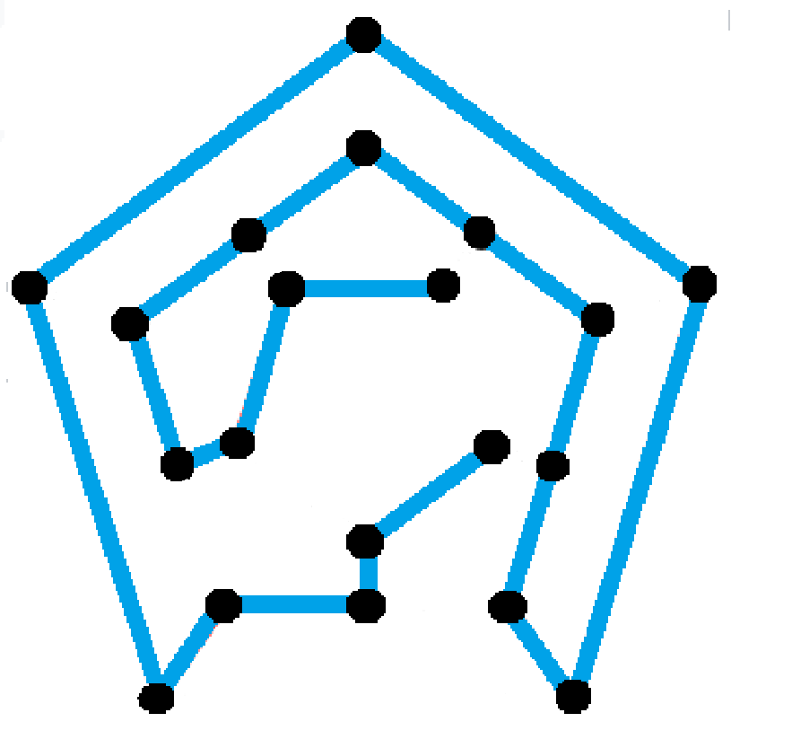
Hamiltonian Path
CS 301
Algorithms
Yiğit Tekinalp
Ege Toker Dinç
Ataberk Özbay
Ceren Anıl
Uğurcan Açıkalın

Slide 2
OUTLINE
Problem Description
Algorithm Description
Algorithm Analysis
Experimental Analysis
Testing
Conclusion

Slide 3

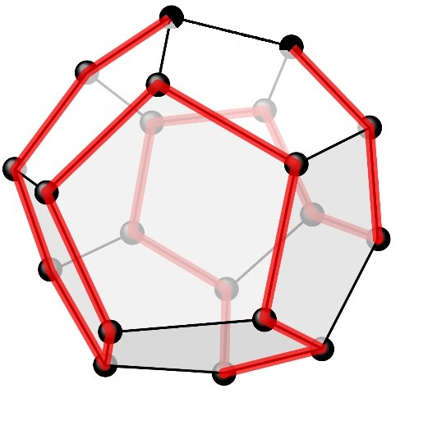
Problem Description
Hamiltonian Path in undirected graphs is a path that passes through every vertex exactly one time.
An n-node undirected graph G(V,E) where V is the set of vertices
V = {v₁, v₂, . . ., v_{m}} and E is the set of edges.
{v₁, v₂, . . ., v_{m}} = {1, 2, . . ., m} and
{(v₁, v₂),(v₂, v₃), . . . ,(v_{m-1}, v_{m})} ⊆ E.

Slide 4
About The Problem
In this Project, Hamiltonian Path will be examined, therefore our problem is expressed as follows.
On an n-node undirected graph G(V,E) with node set V and edge set E, is there a simple path of edge in G that contains every node in V, and thus contains exactly n-1 edge?

Slide 5
Application of Hamiltonian Path in Everyday Life
We can see the Hamiltonian Path problem in everyday life, especially where optimization problems are encountered. Such as GPS or Google Maps, finding the optimum root from one destination to another. Hamiltonian Path represents the efficiency of including every vertex every root¹.

Slide 6
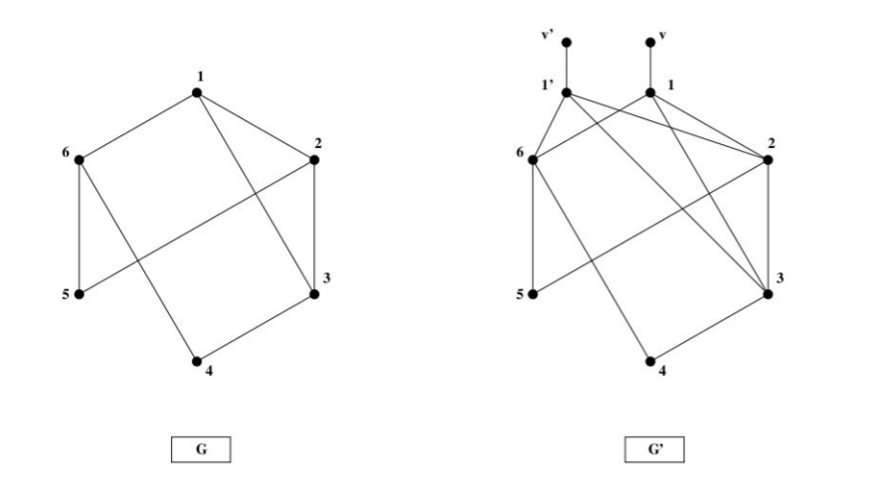
NP-completeness
Hamiltonian Path is a NP-complete problem.
It is a reduction of Hamiltonian Cycle problem.
These graphs represent that reduction of Hamiltonian Cycle to Hamiltonian Path.
(Steps of the reduction are explained in detail in our report)

Slide 7
Algorithm Description
Since, Hamiltonian Path is an NP-Complete problem, there is not an exact algorithm that solves Hamiltonian Path problem in polynomial time.
There is a solution that solves Hamiltonian Cycle problem in NP time by Sharon Christine. We use this algorithm as a base and modify it with greedy approach in our O(n³) heuristic Hamiltonian Path solution.
In this project, we will cover and analyze the performance of the greedy search algorithm for Hamiltonian Path.

Slide 8
Approximation of Hamiltonian Path Algorithm
The algorithm does the following step by step:
It takes the first node as the starting point.
It checks for all remaining vertices connected to this node.
If it is connected, add that to the path.
Then, it checks for the next node by repeating Step 2 and Step 3.

Slide 9
Algorithm Analysis
The algorithm we based on finds a Hamiltonian Cycle if it exists. So, we modified our code to finding a Hamiltonian Path. We compared our results with the DFS and backtracking algorithm which is O(N!) and analyzed the success rate this way in the experimental analysis part of our report.

Slide 10
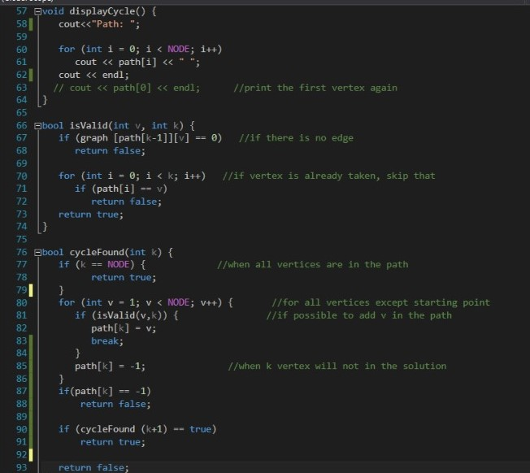
Running Time of the Algorithm
O(n)
O(n)
O(n²)
O(n)
O(n³)

Slide 11
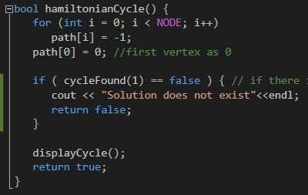
O(n)
Total running time: O(n) + O(n) + O(n³) + O(n) = O(n³)

Slide 12
Experimental Analysis
Success Rate
We compared our algorithm with the exact solution that DFS and backtracking algorithm gives out. Then, we analyzed the success rate according to the comparison result.
Number of random graphs | 5 Vertices | 10 Vertices | 15 Vertices | 20 Vertices | 25 Vertices | 40 Vertices
50 | 0.52 | 0.46 | 0.22 | 0.32 | 0.18 | 0.26
100 | 0.63 | 0.44 | 0.26 | 0.28 | 0.27 | 0.28
150 | 0.68 | 0.39 | 0.26 | 0.26 | 0.28 | 0.29
200 | 0.69 | 0.39 | 0.24 | 0.26 | 0.28 | 0.31
250 | 0.67 | 0.38 | 0.28 | 0.27 | 0.28 | 0.32
500 | 0.66 | 0.33 | 0.3 | 0.3 | 0.28 | 0.32
1000 | 0.67 | 0.33 | 0.3 | 0.3 | 0.29 | 0.33
Fig.3. Success rate table of randomly created graphs with different vertices

Slide 13
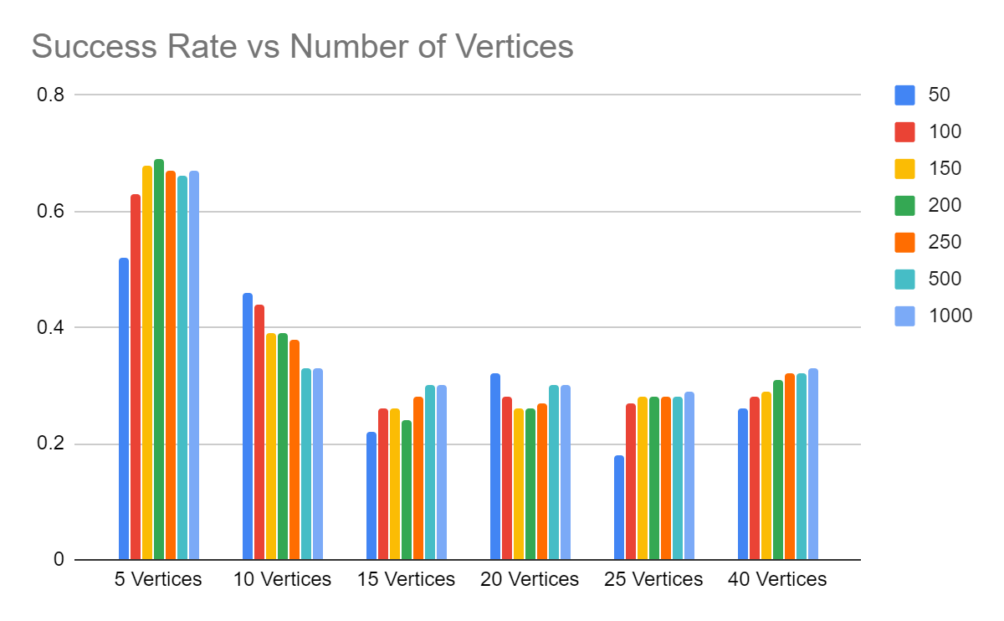
Success Rate
This graph shows how success rate varies depending on the number of vertices.
Fig.5. Success rate vs number of vertices graph

Slide 14
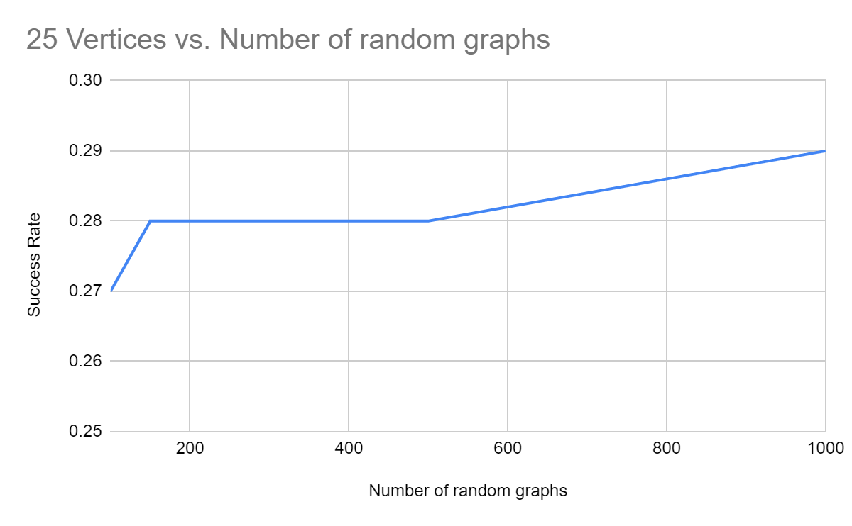
Success Rate
This graph shows the success rate of 25 Vertices in increasing number of randomly generated graphs.
Fig.4. Success rate of 25 vertices

Slide 15
Running Time Experimental Analysis
We use some functions in order to calculate some statistics such as sample mean, standard deviation, variance to experimentally analyze the running time of our algorithm.

Slide 16
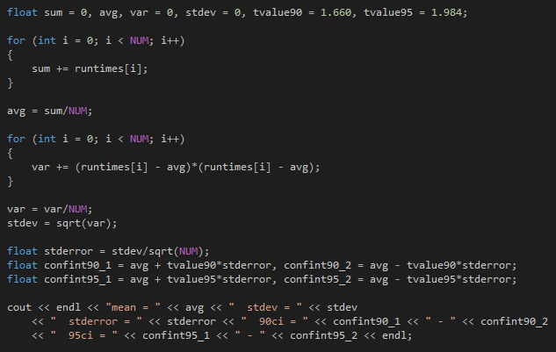
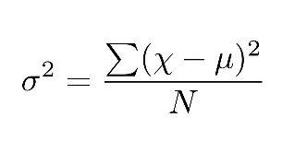
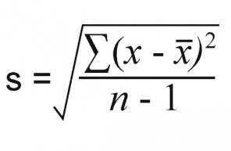
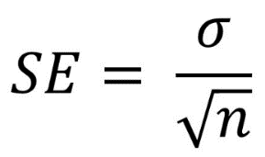
We used 90% and 95% confidence level internals in order to calculate the true means.

Slide 17
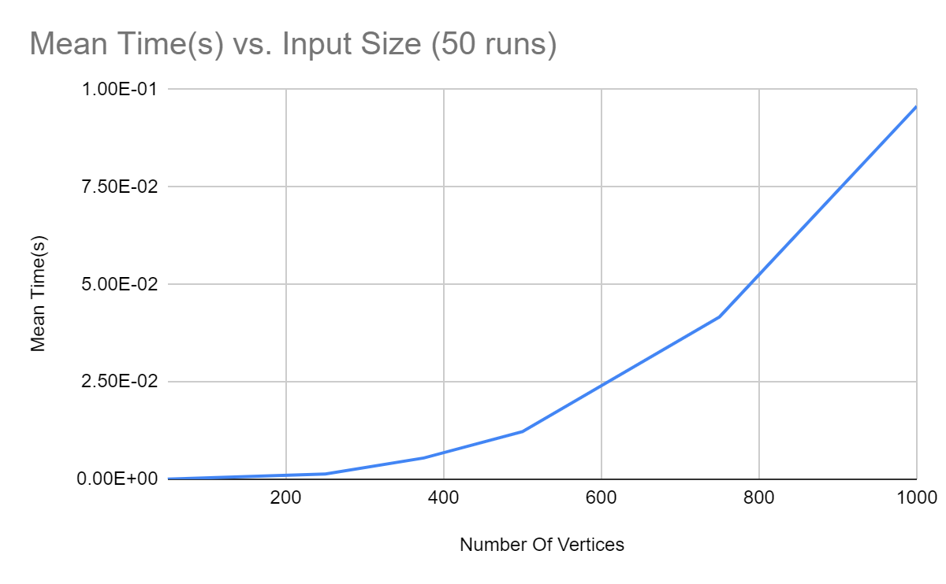
50 RUNS PER INPUT SIZE
Size | Mean Time(s) | Standard Deviation | Standard Error | %90 - CL | %95 - CL
50 | 2.00E-05 | 0.00014 | 1.98E-05 | 0.0000528663 - -1.28663e-005 | 5.92812e-005 - -1.92812e-005
250 | 0.00132 | 0.000524976 | 7.42E-05 | 0.00150324 - 0.00125676 | 0.0015273 - 0.0012327
375 | 0.00546 | 0.00585221 | 0.000827628 | 0.00683386 - 0.00408614 | 0.00710201 - 0.00381799
500 | 0.0122 | 0.00206882 | 0.000292575 | 0.0126857 - 0.0117143 | 0.0127805 - 0.0116195
750 | 0.04166 | 0.00636431 | 0.000900049 | 0.0431541 - 0.0401659 | 0.0434457 - 0.0398743
1000 | 0.0957 | 0.00440568 | 0.000623057 | 0.0967343 - 0.0946657 | 0.0969362 - 0.0944639
Fig.7. Running time graph of 50 run according to number of vertices
Fig.6. 50 Run for 50,250,375,500,750,1000 vertices and Mean times, Standard Deviation, Standart Error, Confidence Levels

Slide 18
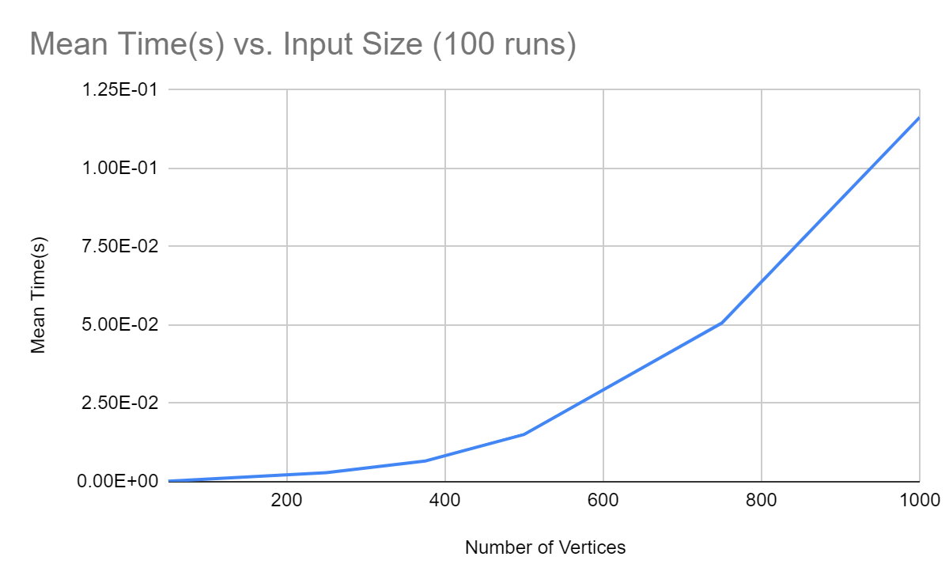
100 RUNS PER INPUT SIZE
Size | Mean Time(s) | Standard Deviation | Standard Error | %90 - CL | %95 - CL
50 | 1.50E-04 | 0.00149248 | 1.49E-04 | 0.000397752 - -9.77518e-005 | 0.000446108 - -0.000146108
250 | 0.00286 | 0.00563741 | 5.64E-04 | 0.00379581 - 0.00192419 | 0.00397846 - 0.00174154
375 | 0.00658 | 0.00403034 | 0.000403034 | 0.00724903 - 0.00591096 | 0.00737962 - 0.00578038
500 | 0.0151 | 0.00319531 | 0.000319531 | 0.0156304 - 0.0145696 | 0.015734 - 0.0144661
750 | 0.05064 | 0.00411709 | 0.000411709 | 0.0513234 - 0.0499566 | 0.0514568 - 0.0498232
1000 | 0.11628 | 0.00367173 | 0.000367173 | 0.11689 - 0.115671 | 0.117008 - 0.115552
Fig.8. 100 Run for 50,250,375,500,750,1000 vertices and Mean times, Standard Deviation, Standard Error, Confidence Levels
Fig.9. Running time graph of 100 run according to number of vertices

Slide 19
Testing
We used the black box testing method. We created some graphs with known Hamiltonian Paths, and checked whether our algorithm could successfully operate or not in certain situations.

Slide 20
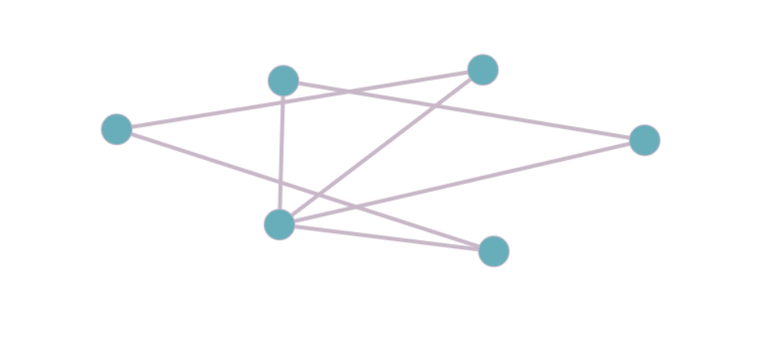
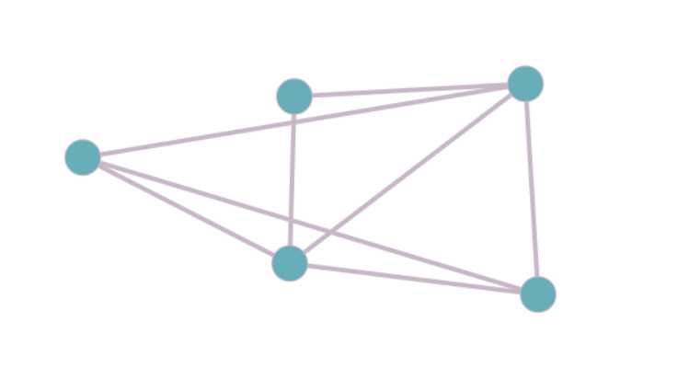
FAIL!
SUCCESS!
Fig.10. Has Hamiltonian Path
Fig.11. Has Hamiltonian Path

Slide 21
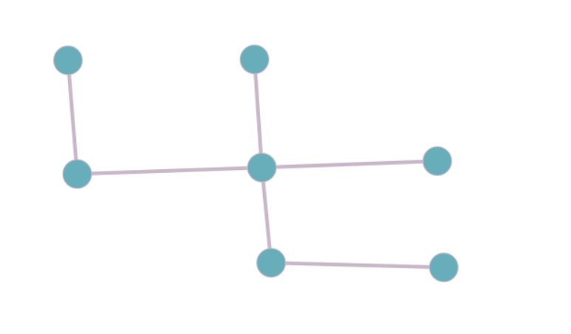
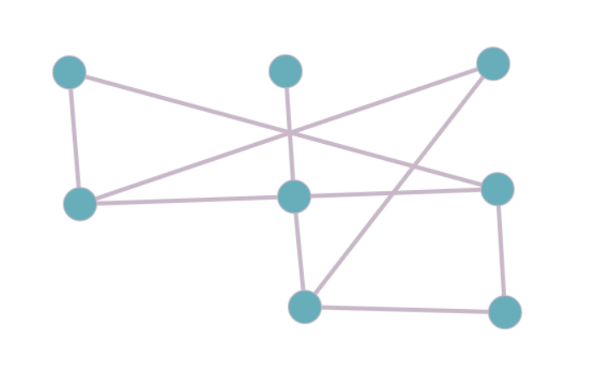
SUCCESS!
FAIL!
Fig.12. No Hamiltonian Path
Fig.13. Has Hamiltonian Path

Slide 22
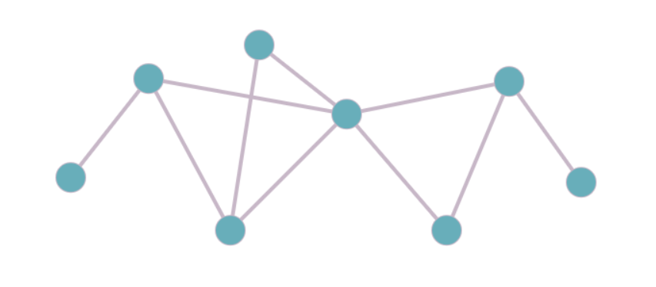
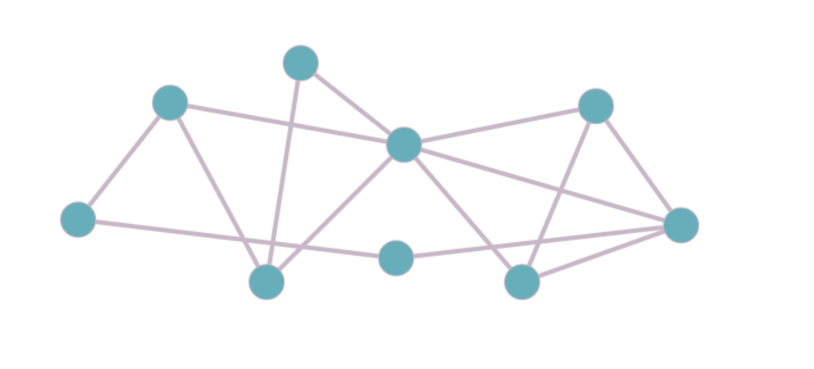
SUCCESS!
FAIL!
Fig.14. Has Hamiltonian Path
Fig.15. Has Hamiltonian Path

Slide 23
Conclusion
As a result, Hamiltonian Path is a NP-complete problem that is reduced from Hamiltonian Cycle.
Hamiltonian Path problem cannot be solved with an exact algorithm in polynomial time. However, with greedy search algorithm there are some approximate approaches.
Our Greedy Hamiltonian Path Search algorithm does not always find the Hamiltonian Path.
As the number of vertices increases, success rate of finding a Hamiltonian Path decreases. After 15 vertices, our success rate, approximately converges to 0.3 .
Mean running time shows a consistent trend which is a qubic type with our result obtained from running time calculation in experimental analysis part.

