Slide 1
Instructor Materials Chapter 3: Network Protocols and Communications
CCNA Routing and Switching
Introduction to Networks v6.0
Notes:
Cisco Networking Academy Program
Introduction to Networks v6.0
Chapter 3: Network Protocols and Communications

Slide 2
Instructor Materials – Chapter 3 Planning Guide
This PowerPoint deck is divided in two parts:
Instructor Planning Guide
Information to help you become familiar with the chapter
Teaching aids
Instructor Class Presentation
Optional slides that you can use in the classroom
Begins on slide # 14
Note: Remove the Planning Guide from this presentation before sharing with anyone.
Notes:
2

Slide 3
Introduction to Network v6.0
Planning Guide
Chapter 3: Network Protocols and Communications
Notes:
Course Planning Guide
Chapter 3: Network Protocols and Communications

Slide 4
Chapter 3: Activities
What activities are associated with this chapter?
Page # | Activity Type | Activity Name | Optional? Y/N
3.0.1.2 | Class Activity | Designing a Communications System | Optional
3.2.2.5 | Interactive Activity | Mapping the Protocols of the TCP/IP Suite | Optional
3.2.3.4 | Lab | Researching Networks Standards | Optional
3.2.4.5 | Interactive Activity | Identify Layers and Functions | Recommended
3.2.4.6 | Packet Tracer | Investigating the TCP-IP and OSI Models in Action | Optional
3.3.1.5 | Interactive Activity | Identify the PDU Layer | Recommended
3.4.1.1 | Lab | Installing Wireshark | Optional
3.4.1.2 | Lab | Using Wireshark to View Network Traffic | Optional
3.4.1.3 | Class Activity | Guaranteed to Work | Optional
The password used in the Packet Tracer activities in this chapter is: PT_ccna5
Notes:
4

Slide 5
Chapter 3: Assessment
Students should complete Chapter 3, “Assessment” after completing Chapter 3.
Quizzes, labs, Packet Tracers and other activities can be used to informally assess student progress.
Notes:
5

Slide 6
Chapter 3: Best Practices
Prior to teaching Chapter 3, the instructor should:
Complete Chapter 3, “Assessment.”
Many concepts will be explored further in subsequent chapters. Each layer of the OSI will be discussed in its own chapter.
Section 3.1
Use the mail analogy to introduce how data will be sent across a network.
Discuss the rules of addressing a letter and why the Post Office has these rules.
Notes:
6

Slide 7
Chapter 3: Best Practices (Cont.)
Section 3.2
Explain the role of protocols in facilitating interoperability in network communications.
Discuss protocols generally and how they are used in networking.
TCP/IP - Students need to memorize the layers, their functions, and what protocols are found at each layer.
Discuss the interaction between a user and a web server. Use the animation on page 3.2.2.4
Activity 3.2.2.5 - This is a good activity to reinforce information provided in this section.
Discuss the advantages and disadvantages of a standards-based protocol and a proprietary protocol.

Slide 8
Chapter 3: Best Practices (Cont.)
Section 3.2 (cont.)
Show some of the common RFCs used in networking (ex: RFC 1918, RFCs 1034 & 1035, and RFC 1178).
3.2.3.4 Lab - Researching Network Standards. Make this a class assignment and give each student one or two of the questions to research and report back to the rest of the class.
Discuss why we use a layered model.
Compare the OSI reference model to the TCP/IP protocol model.

Slide 9
Chapter 3: Best Practices (Cont.)
Section 3.2 (cont.)
Students need to know the layers of the OSI. Make sure each student develops his or her own mnemonic.
For High School students - Make 8 1/2 X 11 cards with each of the OSI model layers, hand them out randomly, and have the students line up in order without talking to each other.
Have students develop a chart with the TCP/IP layers and the OSI layers based on graphic 3.2.4.4. Have the students add definitions, protocols, and PDUs to it as they go through this and other chapters.

Slide 10
Chapter 3: Best Practices (Cont.)
Section 3.3
Illustrate, using Post-It notes, how data is passed down through the TCP/IP stack by adding encapsulation at each layer. Follow the flow back up through the stack on the destination by de-encapsulation.
Use Packet Tracer to demonstrate traffic at layers of the TCP/IP and/or have students complete Lab 3.2.4.6.
Demonstrate Wireshark using live traffic or previously captured traffic
http://wiresharkdownloads.riverbed.com/video/wireshark/introduction-to-wireshark/
OSI model shipping a bicycle analogy
http://www.tech.plymouth.ac.uk/spmc/staff/laanegekuh/Doc/OSIanalogy.pdf

Slide 11
Chapter 3: Best Practices (Cont.)
Section 3.3
Illustrate, using Post-It notes, how data is passed down through the TCP/IP stack by adding encapsulation at each layer. Follow the flow back up through the stack on the destination by de-encapsulation.
Use Packet Tracer to demonstrate traffic at layers of the TCP/IP and/or have students complete Lab 3.2.4.6.
Demonstrate Wireshark using live traffic or previously captured traffic
http://wiresharkdownloads.riverbed.com/video/wireshark/introduction-to-wireshark/
OSI model shipping a bicycle analogy
http://www.tech.plymouth.ac.uk/spmc/staff/laanegekuh/Doc/OSIanalogy.pdf

Slide 12
Chapter 3: Additional Help
For additional help with teaching strategies, including lesson plans, analogies for difficult concepts, and discussion topics, visit the CCNA Community at: https://www.netacad.com/group/communities/community-home
Best practices from around the world for teaching CCNA Routing and Switching. https://www.netacad.com/group/communities/ccna-blog
If you have lesson plans or resources that you would like to share, upload them to the CCNA Community in order to help other instructors.
Notes:
12

Slide 13


Slide 14
Chapter 3: Network Protocols and Communications
CCNA Routing and Switching
Introduction to Networks v6.0
Notes:
Cisco Networking Academy Program
Introduction to Networks v6.0
Chapter 3: Network Protocols and Communications

Slide 15
Chapter 3 - Sections & Objectives
3.1 Rules of Communication
Describe the types of rules that are necessary to successfully communicate.
3.2 Network Protocols and Standards
Explain why protocols are necessary in communication.
Explain the purpose of adhering to a protocol suite.
Explain the role of standards organizations in establishing protocols for network interoperability.
Explain how the TCP/IP model and the OSI model are used to facilitate standardization in the communication process.
3.3 Data Transfer in the Network
Explain how data encapsulation allows data to be transported across the network.
Explain how local hosts access local resources on a network.
Notes:
15

Slide 16
3.1 Rules of Communication
Notes:
Cisco Networking Academy Program
Introduction to Networks v6.0
Chapter 3: Network Protocols and Communications

Slide 17
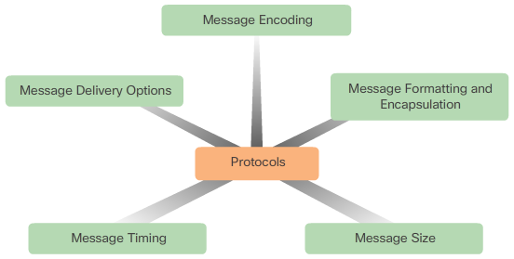
Rules of Communication The Rules
Rule Establishment
Identified sender and receiver
Common language and grammar
Speed and timing of delivery
Confirmation or acknowledgment requirements
Message Encoding
Process of converting information into another acceptable form
Message Formatting and Encapsulation
Message Size
Message Timing
Access method
Flow control
Response timeout
Message Delivery Options
Unicast
Multicast
Broadcast
Notes:
3.1 – Rules of Communication
3.1.1 – The Rules

Slide 18
3.2 Network Protocols and Standards
Notes:
Cisco Networking Academy Program
Introduction to Networks v6.0
Chapter 3: Network Protocols and Communications

Slide 19
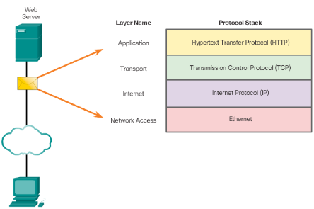
Network Protocols and Standards Protocols
Rules that Govern Communications
Network Protocols
The role of protocols
How the message is formatted or structured
The process by which networking devices share information about pathways with other networks
How and when error and system messages are passed between devices
The setup and termination of data transfer sessions
Protocol Interaction
Example: web server and client
Notes:
3.2 – Network Protocols and Standards
3.2.1 – Protocols

Slide 20
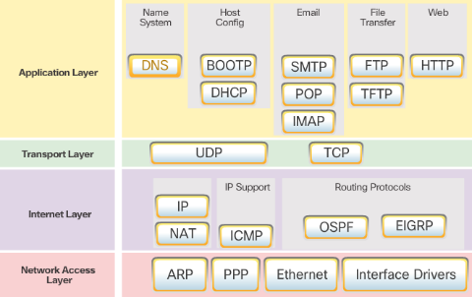
Network Protocols and Standards Protocol Suites
Protocol Suites and Industry Standards
TCP/IP is an open standard
Can you name other protocol suites?
TCP/IP Protocol Suites
Can you name some of the protocols from the TCP/IP protocol suite.
TCP/IP Communication Process
Can you describe the process?
Notes:
3.2 – Network Protocols and Standards
3.2.2 – Protocol Suites

Slide 21
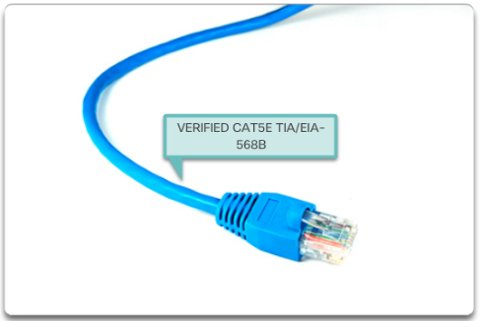
Network Protocols and Standards Standard Organizations
Open Standards
Name some advantages of open standards
Internet Standards
Name a few standard organizations
Electronics and Communications Standards Organizations
Name a few organizations
Notes:
3.2 – Network Protocols and Standards
3.2.3 – Standard Organizations

Slide 22
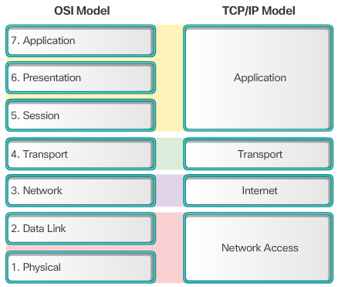
Network Protocols and Standards Reference Models
The Benefits of Using a Layered Model
Name some benefits
The OSI Reference Model
Provides list of functions
Describes interactions between layers
OSI Model and TCP/IP Model Comparison
Similar: transport and network layers
Contrast: relationship between layers
Notes:
3.2 – Network Protocols and Standards
3.2.4 – Reference Models

Slide 23
3.3 Data Transfer in the Network
Notes:
Cisco Networking Academy Program
Introduction to Networks v6.0
Chapter 3: Network Protocols and Communications

Slide 24
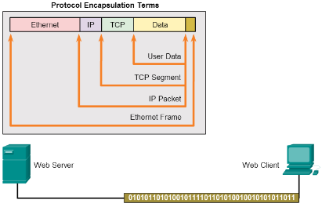
Data Transfer in the Network Data Encapsulation
Message Segmentation
Segmentation - Break communication into pieces
Multiplexing – interleaving the pieces
Protocol Data Units
What are PDUs called at each layer?
Encapsulation and de-encapsulation process
Notes:
3.3 – Data Transfer in the Network
3.3.1 – Data Encapsulation

Slide 25
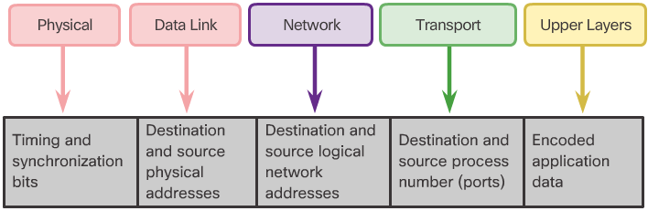
Data Transfer in the Network Data Access
Network Addresses
Source IP address
Destination IP address
Deliver the IP packet from the original source to the final destination, either on the same network or to a remote network.
Data Link Addresses
Source data link address
Destination data link address
Deliver the data link frame from one network interface card (NIC) to another NIC on the same network
Devices on the Same Network
Devices on a Remote Network
Notes:
3.3 – Data Transfer in the Network
3.3.2 – Data Access

Slide 26
3.4 Chapter Summary
Notes:
Cisco Networking Academy Program
Introduction to Networks v6.0
Chapter 3: Network Protocols and Communications

Slide 27
Chapter Summary Summary
Explain how rules are used to facilitate communication.
Explain the role of protocols and standards organizations in facilitating interoperability in network communications.
Explain how devices on a LAN access resources in a small to medium-sized business network.
Notes:
3.4.1.4 - Summary

Slide 29


Slide 30
Section 3.1 New Terms and Commands
access method
acknowledgement
broadcast
decoder
encapsulation
encoder
flow control
message
message delivery options
message encoding
message formatting
message formatting and encapsulation
message size
message timing
multicast
protocols
receiver
response timeout
segmenting
transmission medium
transmitter
unacknowledged
unicast
Notes:
New Terms and Commands

Slide 31
Section 3.2 New Terms and Commands
Advanced Research Projects Agency Network (ARPANET)
AppleTalk
application protocol
Electronic Industries Alliance (EIA)
Hypertext Markup Language (HTML)
IEEE 802.3
IEEE 802.11
Institute of Electrical and Electronics Engineers (IEEE)
International Corporation for Assigned Names and Numbers (ICANN)
International Telecommunications Union-Telecommunication Standardization Sector (ITU-T)
Internet Architecture Board (IAB)
Internet Assigned Numbers Authority (IANA)
Internet Engineering Task Force (IETF)
internet protocol
Internet Society (ISOC)
Internetwork Packet Exchange/Sequenced Packet Exchange (IPX/SPX)
Media Access Control (MAC)
network access protocols
network protocol suite
protocol model
protocol stack
proprietary protocol
reference model
Request for Comments (RFC)
standards organization
standards-based protocol
Telecommunications Industry Association (TIA)
Transmission Control Protocol/IP (TCP/IP)
transport protocol
Notes:
New Terms and Commands

Slide 32
Section 3.3 New Terms and Commands
Address Resolution Protocol (ARP)
bits
data
data encapsulation
data link address
de-encapsulation
default gateway
destination data link address
destination IP address
frame
Multiplexing
network address
packet
protocol data unit (PDU)
source IP address
source data link address
Segment
segmentation
Notes:
New Terms and Commands

