Slide 1
Instructor Materials Chapter 4: Network Access
CCNA Routing and Switching
Introduction to Networks v6.0
Notes:
Cisco Networking Academy Program
Introduction to Networks v6.0
Chapter 4: Network Access

Slide 2
Instructor Materials – Chapter 4 Planning Guide
This PowerPoint deck is divided in two parts:
Instructor Planning Guide
Information to help you become familiar with the chapter
Teaching aids
Instructor Class Presentation
Optional slides that you can use in the classroom
Begins on slide # 12
Note: Remove the Planning Guide from this presentation before sharing with anyone.
Notes:
2

Slide 3
Introduction to Networks v6.0
Planning Guide
Chapter 4: Network Access
Notes:
Course Planning Guide
Chapter 4: Network Access

Slide 4
Chapter 4: Activities
What activities are associated with this chapter?
Page # | Activity Type | Activity Name | Optional? Y/N
4.0.1.2 | Class Activity | Managing the Medium | Optional
4.1.2.4 | Lab | Identifying Network devices and Cabling | Optional
4.1.3.5 | Interactive Activity | Physical Layer Terminology | Recommended
4.2.1.7 | Interactive Activity | Copper Media characteristics | Recommended
4.2.2.6 | Interactive Activity | Cable Pinouts | Recommended
4.2.2.7 | Lab | Building an Ethernet Crossover Cable | Optional
4.2.3.7 | Interactive Activity | Fiber Optics Terminology | Recommended
4.2.4.4 | Packet Tracer | Connecting a Wired and Wireless LAN | Recommended
4.2.4.5 | Lab | Viewing Wired and Wireless NIC Information | Recommended
4.4.4.3 | Interactive Activity | Generic Frame Fields | Recommended
4.5.1.1 | Class Activity | Linked In! | Optional
The password used in the Packet Tracer activities in this chapter is: PT_ccna5
Notes:
4

Slide 5
Chapter 4: Assessment
Students should complete Chapter 4, “Assessment” after completing Chapter 4.
Quizzes, labs, Packet Tracers and other activities can be used to informally assess student progress.
Notes:
5

Slide 6
Chapter 4: Best Practices
Prior to teaching Chapter 4, the instructor should:
Complete Chapter 4, “Assessment.”
Section 4.1
You may want to use a wireless router for the demonstration.
Provide students with apps they can use at home to test download and upload speeds (for example: https://www.speakeasy.net/speedtest).
Provide an example of bandwidth in terms of a water pipe. The larger the pipe, more water that can flow through it.
Provide an example of throughput in terms of a water pipe. As a valve is opened, more water flows through.
Notes:
6

Slide 7
Chapter 4: Best Practices (Cont.)
Section 4.2
Show examples of different types of copper media. Hopefully you have saved some poorly made cables!
Ask students to give examples of electromagnetic interference (for example: home wireless phones, microwaves, vacuum cleaner, etc.)
Show that the wire pairs in UTP have a different number of twists to enhance cancellation.
Demonstrate the types of UTP cables using a cable tester to show the wiring map.
Use this video about undersea cable: https://www.youtube.com/watch?v=v1JEuzBkOD8
Use this video about how undersea cables are laid: https://www.youtube.com/watch?v=XQVzU_YQ3IQ
Make sure the students know that color matters in fiber optic cabling.
Notes:
7

Slide 8
Chapter 4: Best Practices (Cont.)
Section 4.3
“A Frame is like a bed frame. It has a headboard (header) and footboard (trailer).”
Begin an OSI Model Post-It Note exercise: Have each student take 10 post-it notes and write 5 key words for the physical layer and 5 key words for the data link layer. The words will be put in an envelope for later. Eventually, all 7 layers will be covered and students can exchange envelopes and properly align descriptions to the name of the layer.
Describe how the physical and data link layers of the OSI model interoperate together.
Explain that LLC and MAC work together as sublayers in the data link layer. LLC connects to Layer 3 and MAC connects to Layer 1.

Slide 9
Chapter 4: Best Practices (Cont.)
Section 4.4
Draw examples of common physical WAN topologies on the board and have students generate pros and cons for each type.
Full Mesh requires n*(n-1)/2 links for a full mesh (n=number of devices in full mesh).

Slide 10
Chapter 4: Additional Help
For additional help with teaching strategies, including lesson plans, analogies for difficult concepts, and discussion topics, visit the CCNA Community at: https://www.netacad.com/group/communities/community-home
Best practices from around the world for teaching CCNA Routing and Switching. https://www.netacad.com/group/communities/ccna-blog
If you have lesson plans or resources that you would like to share, upload them to the CCNA Community in order to help other instructors.
Notes:
10

Slide 11


Slide 12
Chapter 4: Network Access
CCNA Routing and Switching
Introduction to Networks v6.0
Notes:
Cisco Networking Academy Program
Introduction to Networks v6.0
Chapter 4: Network Access

Slide 13
Chapter 4 - Sections & Objectives
4.1 Physical Layer Protocols
Identify device connectivity options.
Describe the purpose and functions of the physical layer in the network.
Describe basic principles of the physical layer standards.
4.2 Network Media
Identify the basic characteristics of copper cabling.
Build a UTP cable used in Ethernet networks (scope – does not include cabling area discussion).
Describe fiber-optic cabling and its main advantages over other media.
Connect devices using wired and wireless media.
4.3 Data Link Layer Protocols
Describe the purpose and function of the data link layer in preparing communication for transmission on specific media.
4.4 Media Access Control
Compare the functions of logical topologies and physical topologies.
Describe the basic characteristics of media access control methods on WAN topologies.
Describe the basic characteristics of media access control methods on LAN topologies.
Describe the characteristics and functions of the data link frame.
Notes:
13

Slide 14
4.1 Network Access
Notes:
Cisco Networking Academy Program
Introduction to Networks v6.0
Chapter 4: Network Access

Slide 15
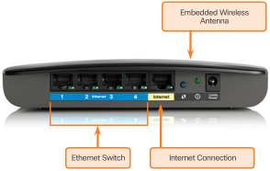
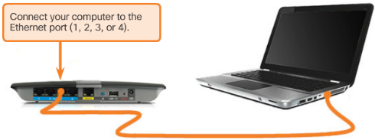
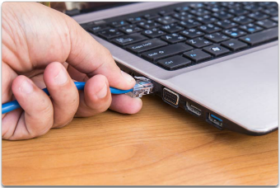
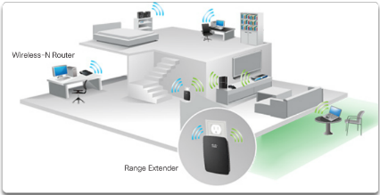
Physical Layer Protocols Physical Layer Connection
Types of Connections
Network Interface Cards
Notes:
4.1 – Physical Layer Protocols
4.1.1 – Physical layer Connection

Slide 16
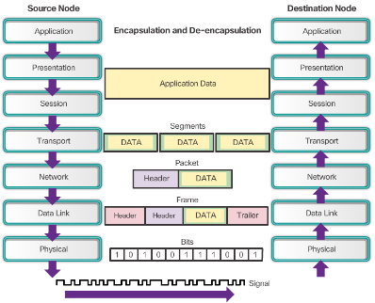
Physical Layer Protocols Purpose of the Physical Layer
The Physical Layer
Accepts a complete frame from the data link layer
Encodes it as a series of signals that are transmitted onto the local media
Physical Layer Media
Describe the media types
Physical Layer Standards
Notes:
4.1 – Physical Layer Protocols
4.1.2 – Purpose of the Physical Layer

Slide 17
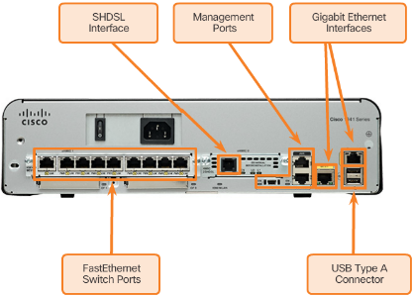
Physical Layer Protocols Physical Layer Characteristics
Functions
Physical components
Encoding
Signaling
Data Transfer
Bandwidth – capacity to a medium to carry data
Throughput - measure of the transfer of bits across the media
Types of Physical Media
Notes:
4.1 – Physical Layer Protocols
4.1.3 – Physical Layer Characteristics

Slide 18
4.2 Network Media
Notes:
Cisco Networking Academy Program
Introduction to Networks v6.0
Chapter 4: Network Access

Slide 19
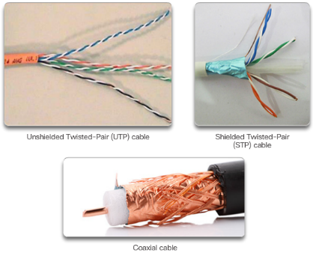
Network Media Copper Cabling
Characteristics of Copper Cabling
Inexpensive, easy to install, low resistance to electric current
Distance and signal interference
Copper Media
Unshielded Twisted-Pair Cable
Shielded Twisted-Pair Cable
Coaxial Cable
Copper Media Safety
Fire and electrical hazards
Notes:
4.2 – Network Media
4.2.1 – Copper Cabling

Slide 20
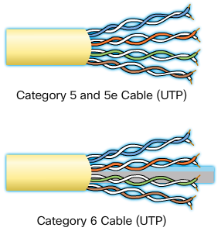

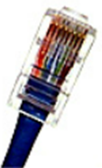
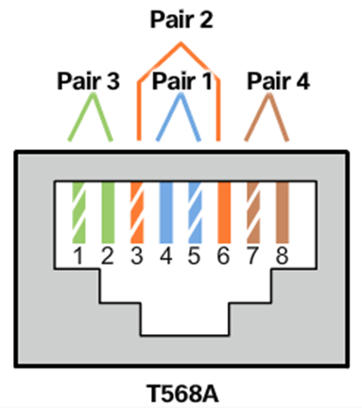
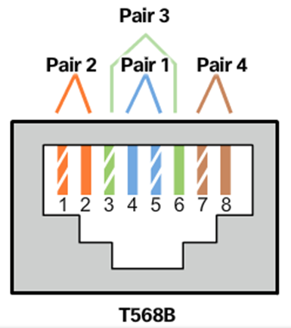
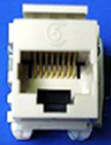
Network Media UTP Cabling
Properties of UTP Cabling
Cancellation of EMI and RFI signals with twisted pairs
UTP Cabling Standards
TIA/EIA-568
IEEE: Cat5, Cat5e, Cat6, Cat6e
UTP Connectors
Types of UTP Cable
Rollover
Crossover
Straight-through
Testing UTP Cables
Cable Pinouts
Notes:
4.2 – Network Media
4.2.2 – UTP Cabling

Slide 21
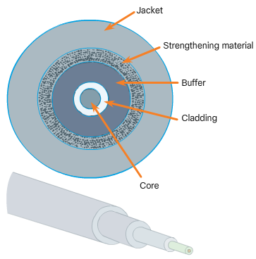
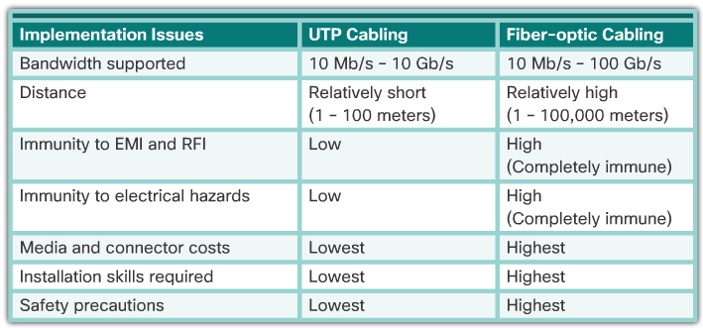
Network Media Fiber-Optic Cabling
Properties of Fiber-Optic Cabling
Transmits data over longer distances
Flexible, but thin strands of glass
Transmits with less attenuation
Immune to EMI and RFI
Fiber Media Cable Design
Types of Fiber Media
Single mode and multimode
Fiber-Optic Connectors
Testing Fiber Cables
Fiber versus Copper
Notes:
4.2 – Network Media
4.2.3 – Fiber-Optic Cabling

Slide 22
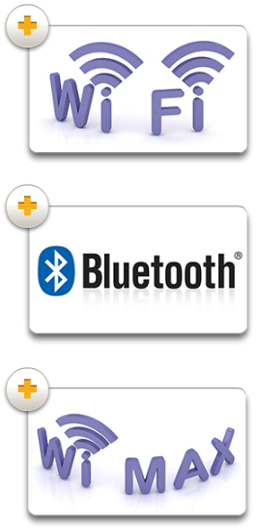
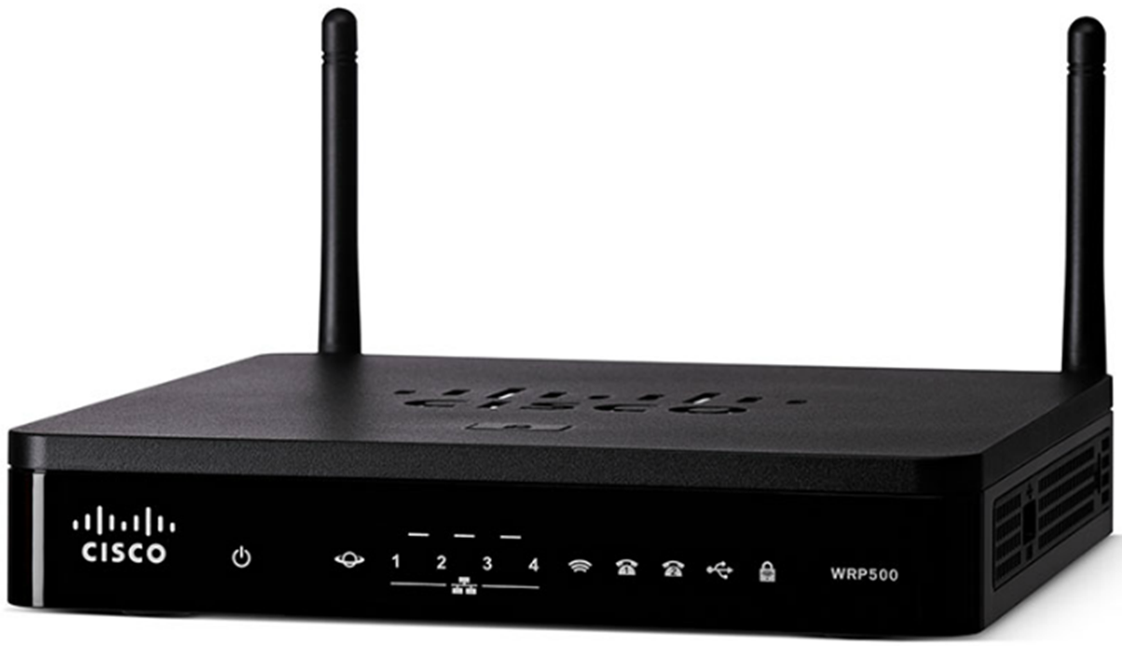
Network Media Wireless Media
Properties of Wireless Media
Data communications using radio or microwave frequencies
Types of Wireless Media
Wi-Fi, Bluetooth, WiMax
Wireless LAN
Wireless Access Point
Wireless NIC adapters
Notes:
4.2 – Network Media
4.2.4 – Wireless Media

Slide 23
4.3 Data Link Layer Protocols
Notes:
Cisco Networking Academy Program
Introduction to Networks v6.0
Chapter 4: Network Access

Slide 24
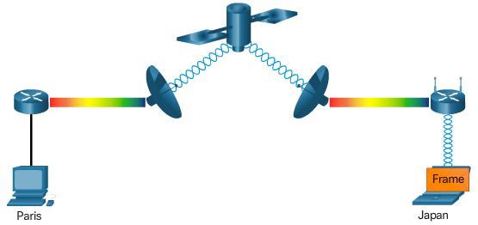
Data Link Layer Protocols Purpose of the Data Link Layer
The Data Link Layer
What is this layer responsible for?
Data Link Sublayers
LLC communicates with the network layer
MAC defines the media access processes
Providing Access to Media
Data Link Layer Standards
IEEE
ITU
ISO
ANSI
Notes:
4.3 - Data Link Layer Protocols
4.3.1 – Purpose of the Data Link Layer

Slide 25
4.4 Media Access Control
Notes:
Cisco Networking Academy Program
Introduction to Networks v6.0
Chapter 4: Media Access Control

Slide 26
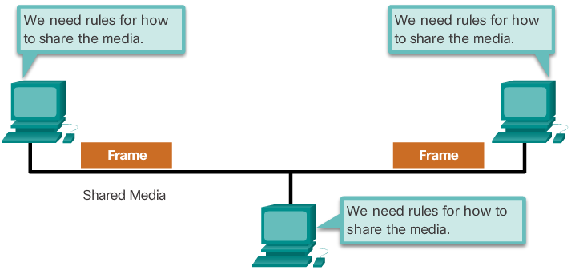
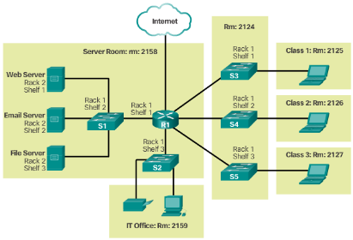
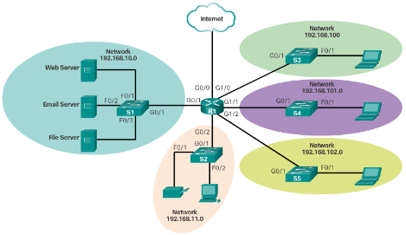
Media Access Control Topologies
Controlling Access to the Media
Physical and Logical Topologies
Notes:
4.4 – Media Access Control
4.4.1 - Topologies

Slide 27
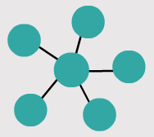
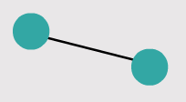
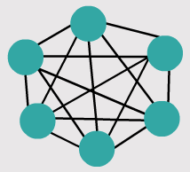
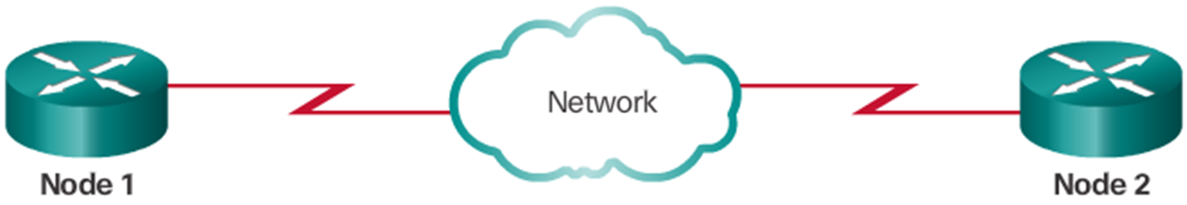
Media Access Control WAN Topologies
Common Physical WAN Topologies
Point-to-point
Hub and spoke
Mesh
Physical Point-to-Point Topology
Logical Point-to-Point Topology
Notes:
4.4 – Media Access Control
4.4.2 – WAN Topologies

Slide 28
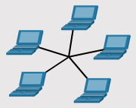
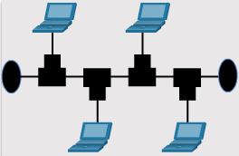
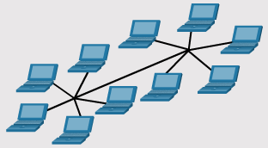
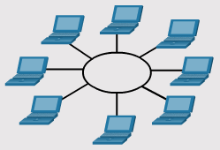
Media Access Control LAN Topologies
Physical LAN Topologies
Half and Full Duplex
Media Access Control Methods
Contention-Based Access
CSMA/CD vs. CSMA/CA
Notes:
4.4 – Media Access Control
4.4.3 – LAN Topologies

Slide 29
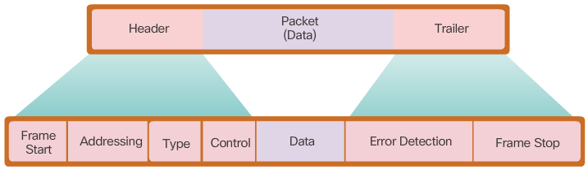
Media Access Control Data Link Frame
The Frame
Header
Data
Trailer
Frame Fields
Layer 2 Address
LAN and WAN Frames
802.11 Wireless Frame
PPP Frame
HDLC
Frame Relay
Ethernet Frame
Notes:
4.4 – Media Access Control
4.4.4 – Data Link Frame

Slide 30
4.5 Chapter Summary
Notes:
Cisco Networking Academy Program
Introduction to Networks v6.0
Chapter 4: Network Access

Slide 31
Chapter Summary Summary
Explain how physical layer protocols and services support communications across data networks.
Build a simple network using the appropriate media.
Explain how the Data Link layer supports communications across data networks.
Compare media access control techniques and logical topologies used in networks.
Notes:
4.5.1 - Summary

Slide 33


Slide 34
Section 4.1 New Terms and Commands
Access Point (AP)
American National Standards Institute (ANSI) Bandwidth
CENELEC (European Committee for Electrotechnical Standardization)
CSA (Canadian Standards Association)
Copper cable
European Telecommunications Standards Institute (ETSI) Encoding
Federal Communication Commission (FCC) in the USA
Fiber-optic cable
Gigabits per second (Gb/s)
Goodput
Institute of Electrical and Electronics Engineers (IEEE)
Integrated Service Router (ISR)
International Organization for Standardization (ISO)
International Telecommunication Union (ITU)
Internet Engineering Task Force (IETF)
JSA/JIS (Japanese Standards Association)
Kilobits per second (kb/s)
Latency
Manchester encoding
Megabits per second (Mb/s)
Modulation
Network Interface Cards (NICs)
OSI Physical Layer
Signaling
Telecommunications Industry Association/Electronic Industries Association (TIA/EIA)
Throughput
Wireless
Wireless Local Network (WLAN)
Notes:
New Terms and Commands

Slide 35
Section 4.2 New Terms and Commands
Cancelation
Category 5 cable (Cat 5)
Enhanced Category 5 cable (Cat5e)
Category 6 cable (Cat6)
Category 6a cable (Cat6a)
Category 7 cable (Cat7)
Cladding
Coaxial
Coaxial cabling
Core
Coverage area
Crosstalk
Dispersion
Duplex Multimode LC Connector
Electromagnetic interference (EMI)
End gap
End finish
Enterprise networks
Fiber-to-the-home (FTTH)
Institute of Electrical and Electronics Engineers (IEEE)
Interference
Jacket
Lasers
Light Emitting Diodes (LEDs)
Long-haul networks
Misalignment
Multi-mode fiber (MMF)
Optical fiber cable
Radio frequency interference (RFI)
RJ45 connector
Rollover
Shared medium
Shielded twisted pair cabling (STP)
Signal attenuation
Single-mode fiber (SMF)
ST, SC, and LC fiber-optic connectors
Submarine networks
TIA 568A
TIA 568B
TIA/EIA 568 standard
Unshielded twisted pair (UTP)
Wireless Access Point (AP)
Wireless NIC adapters
Notes:
New Terms and Commands

Slide 36
Section 4.3 New Terms and Commands
American National Standards Institute (ANSI)
Data link layer (layer 2)
Ethernet interface
Frames
Institute of Electrical and Electronics Engineers (IEEE)
International Organization for Standardization (ISO)
International Telecommunication Union (ITU)
Logical Link Control (LLC)
Media Access Control (MAC)
Serial interface
Notes:
New Terms and Commands

Slide 37
Section 4.4 New Terms and Commands
802.11 frame
802.11 Wireless
Bus
Carrier Sense Multiple Access with Collision Avoidance (CSMA/CA)
Carrier Sense Multiple Access/Collision Detection (CSMA/CD)
Collision
Contention-based access
Control
Controlled access
Cyclic Redundancy Check (CRC) value
Data
Error Detection
Ethernet
Extended Star
Frame Check Sequence (FCS) Frame Relay
Frame Relay
Frame start and stop indicator flags
Full-Duplex Communications
Half-Duplex Communications
HDLC
Header
Hub and Spoke
Logical Point-to-Point Topology
Logical Topology
Media Access Control
Media Sharing
Mesh
Physical Point-to-Point Topology
Physical Topology
Point-to-Point
Point-to-Point Protocol (PPP)
Quality of Service (QOS)
Ring
Star
Topology
Trailer
Type
Virtual circuit
Notes:
New Terms and Commands

