Slide 1
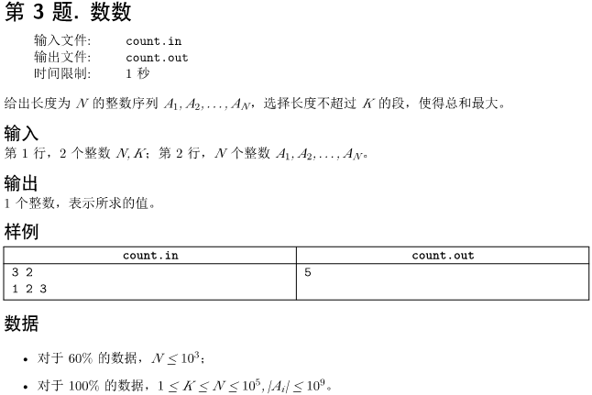

Slide 2
求长度不超过k的区间和的最大值
#include<iostream>
using namespace std;
int main(){
long n,k, i,j;
long a[100010], sum[100010]={0};
long long max,t;
cin>>n>>k;
sum[0]=0; max=0;
for(i=1; i<=n; i++){
cin>>a[i];
sum[i]=sum[i-1]+a[i]; //前缀和
}
for(i=1; i<=n; i++) //枚举终点
for(j=1; j<=k; j++){ //枚举区间长度
if(i>j) t=sum[i]-sum[i-j];
else continue;
if(t>max) max=t; //维护最大值max
}
cout<<max;
return 0;
}
直接模拟

Slide 3

双向队列deque
#include <algorithm>
#include <cstdio>
#include <deque>
#include <iostream>
using namespace std;
const int N = 100000;
const long long INF = 1000000000000000000LL;
int n, k;
long long sum[N + 1];
int main() {
scanf("%d%d", &n, &k);
sum[0] = 0;
long long result = -INF;
deque <int> queue; //定义双向队列
queue.push_back(0);
for (int i = 1; i <= n; ++ i) {
int a;
scanf("%d", &a);
sum[i] = sum[i - 1] + a; //前缀和
while (!queue.empty() && i - queue.front() > k) {//不空且长度不超过k
queue.pop_front(); //删除头部数据
}
result = max(result, sum[i] - sum[queue.front()]); //维护result
while (!queue.empty() && sum[queue.back()] >= sum[i]) {
queue.pop_back(); //删除最后一个数据
}
queue.push_back(i); //在尾部加入一个数据
}
cout << result << endl;
return 0;
}
6 2
1 2 3 -2 2 6
前缀和：1 3 6 4 6 12
i~j的和：s[i]-s[j-1]

