Slide 1
wxPython https://pythonspot.com/wxpython-window/
wxPython_applcation and frame.py,
wxPython_button.py,
wxPython_BMPbutton.py,
wxPython_Tab.py

Slide 2
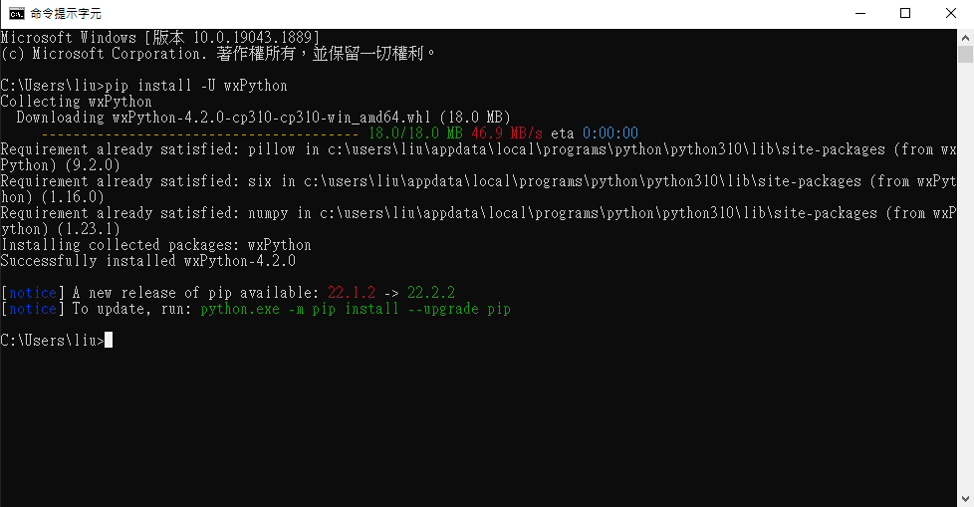
安裝wxPython
# install the library wxPython using "pip install -U wxPython" in console

Slide 3
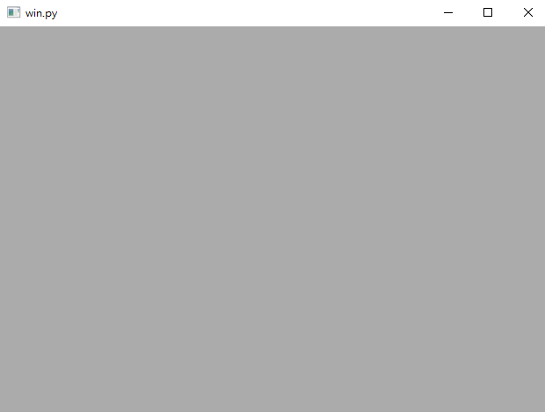
# build the app with a frame
Creating an app ➔ creating a frame ➔ set the property of the frame
➔ show the frame ➔ start the application loop
import wx
# creating an app
app = wx.App()
# creating a frame with 'win.py as the caption of the frame '
frame=wx.Frame(None, -1, 'win.py')
# set the size of the
frame.SetDimensions(0,0,640,480)
# put the frame in the center of the screen
frame.Center()
# show the frame
frame.Show()
#start to listen users' actions
app.MainLoop()

Slide 4
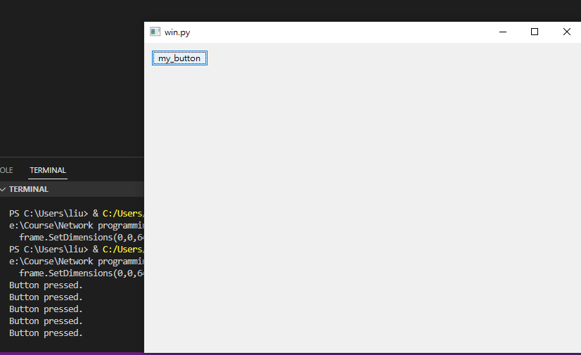
import wx
app = wx.App()
# creating a frame
frame=wx.Frame(None, -1, 'win.py')
# set the size of the frame
frame.SetDimensions(0,0,640,480)
# put the frame in the center of the screen
frame.Center()
# +++++ start of the button +++++++++++++++++++ def onButton(event):
print ("Button pressed.")
# creating a panel in frame
panel=wx.Panel(frame, wx.ID_ANY)
# creating a button in panel
button=wx.Button(panel, wx.ID_ANY, 'my_button', (10, 10))
# bind the event handler "onButton" to handle the press action
button.Bind(wx.EVT_BUTTON, onButton) # +++++++++++ button +++++++++++++++++++
# show the frame
frame.Show()
#start to listen users' actions
app.MainLoop()
Creating a frame ➔ Creating a panel in the frame
➔creating a button in the panel
specify the event handler of the button (pressed)
Implement the event handler
Show the frame
Start the app main loop

Slide 5
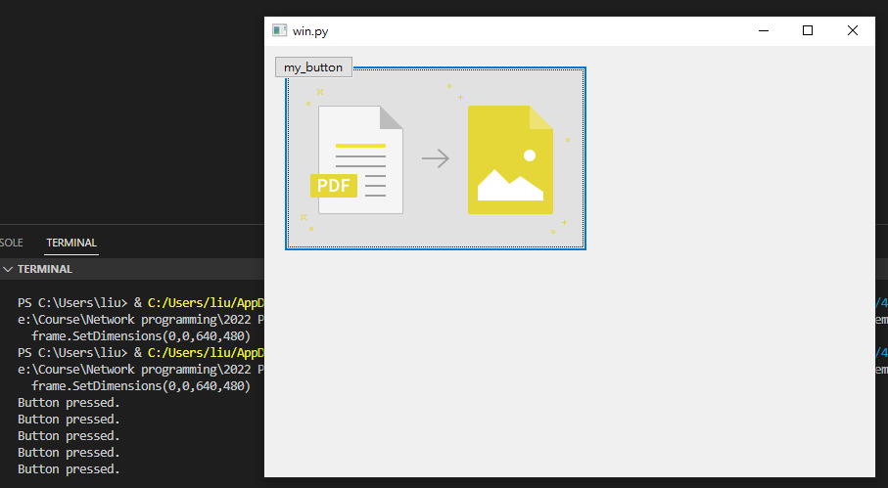
Build a BMP button
# 指定一個BMP檔案，記得反斜線要用另一反斜線來註明是反斜線
bmp=wx.Bitmap("E:\\Course\\Network programming\\2022 Python\\4. wxPython\\pdf.png", wx.BITMAP_TYPE_ANY)
#以BMP創一個button，並指定大小為BMP大小+10 pixel
button2=wx.BitmapButton(panel, id=wx.ID_ANY, bitmap=bmp, size=(bmp.GetWidth()+10, bmp.GetHeight()+10))
#綁定event handler
button2.Bind(wx.EVT_BUTTON, onButton)
#設定位置
button2.SetPosition((20, 20))

Slide 6
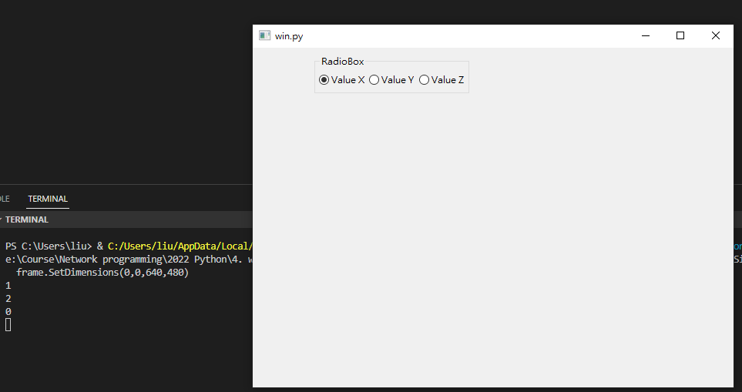
Build a Radio box
Creating a frame ➔ Creating a panel in the frame
➔creating a radio box in the panel with the choices
Specify the event handler of the radio box
Implement the event handler
with GetSelection() to get the choice
Rb.GetSelection() ➔ 第一個傳回0；第一個傳回1;…
Show the frame
Start the app main loop
# 取出使用者選的選項 by Rb.GetSelection() ➔ 第一個傳回0；第一個傳回1;…
def onRadioBox(event):
print (Rb.GetSelection()),
# creating a panel in frame
panel=wx.Panel(frame, wx.ID_ANY)
# creating a radiobox
# specifying the choices
lblList = ['Value X', 'Value Y', 'Value Z']
Rb=RadioBox(panel,label = 'RadioBox', pos = (80,10), choices = lblList ,
majorDimension = 1, style = wx.RA_SPECIFY_ROWS)
# bind the event handler "onRadioBox" to handle the selection
Rb.Bind(wx.EVT_RADIOBOX, onRadioBox)

Slide 7
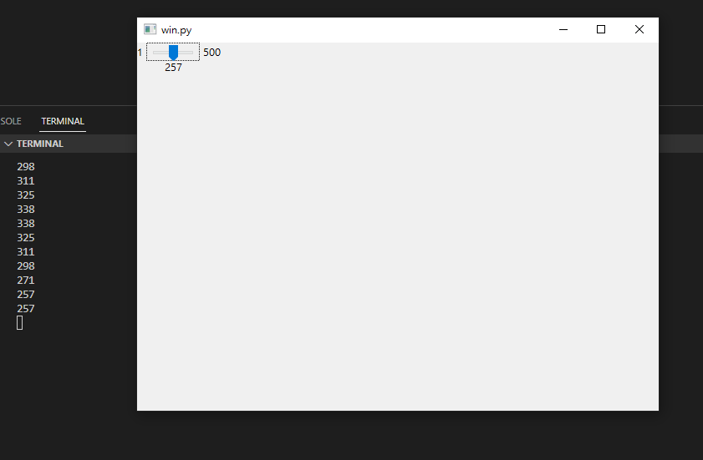
Build a slider
Creating a frame ➔ Creating a panel in the frame
➔creating a slider in the panel with the min and max value
Specify the event handler of the radio box
Implement the event handler
with slider.GetValue() to get the slider vaule
Show the frame
Start the app main loop
# 取出使用者拉動slider的值 by slider的GetValue()
def OnSliderScroll(event):
obj = event.GetEventObject()
val = obj.GetValue()
print (val)
# creating a panel in frame
panel=wx.Panel(frame, wx.ID_ANY)
# creating a slider in panel
sld = wx.Slider(panel, value = 200, minValue = 1, maxValue = 500,
style = wx.SL_HORIZONTAL|wx.SL_LABELS)
# bind the event handler " OnSliderScroll" to handle the selection
sld.Bind(wx.EVT_SLIDER, OnSliderScroll)

Slide 8
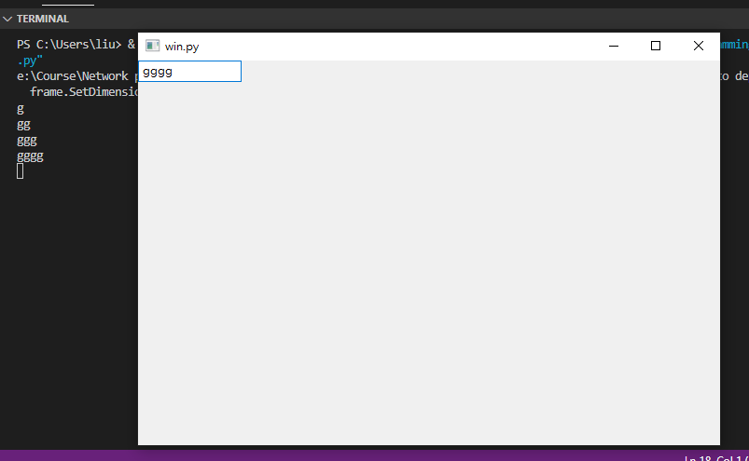
Build a textbox
Creating a frame ➔ Creating a panel in the frame
➔creating a textbox in the panel
Specify the event handler of the textbox
Implement the event handler
event的GetString() to get the input string
Show the frame
Start the app main loop
# 取出使用者輸入的字串 by event的GetString() def onKeyTyped(event):
print (event.GetString())
# creating a panel in frame
panel=wx.Panel(frame, wx.ID_ANY)
# creating a Textbox in panel
t1=wx.TextCtrl(panel)
# bind the event handler "onKeyTpyed" to handle the typing action
t1.Bind(wx.EVT_TEXT, onKeyTyped)

Slide 9
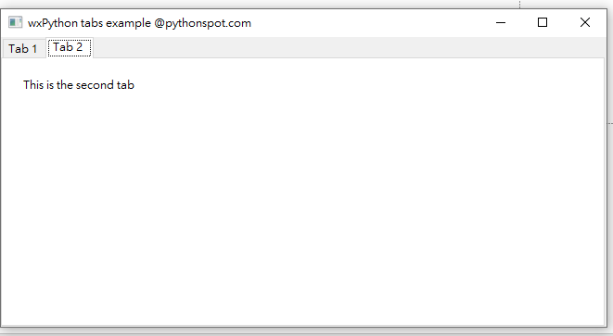
Setup tabs
# Creating the Tab holders: Panel and Notebook
# Creating subclass Tab windows from Panel class
# add Tabs to Notebook and give a name to the Tabs
#define two tabs from panel class with a static text
class TabOne(wx.Panel):
def __init__(self, parent):
wx.Panel.__init__(self, parent)
t = wx.StaticText(self, -1, "This is the first tab", (60,20))
class TabTwo(wx.Panel):
def __init__(self, parent):
wx.Panel.__init__(self, parent)
t = wx.StaticText(self, -1, "This is the second tab", (20,20))
class MainFrame(wx.Frame):
def __init__(self):
wx.Frame.__init__(self, None, title="wxPython tabs example @pythonspot.com")
# Creating the Tab holders: Panel and Notebook
p = wx.Panel(self)
nb = wx.Notebook(p)
#Creating the Tab windows
tab1 = TabOne(nb)
tab2 = TabTwo(nb)
# add Tabs to Notebook and give a name to the Tabs
nb.AddPage(tab1, "Tab 1")
nb.AddPage(tab2, "Tab 2")
# Set noteboook in a sizer to create the layout
sizer = wx.BoxSizer()
sizer.Add(nb, 1, wx.EXPAND)
p.SetSizer(sizer)

Slide 10
wxFormBuilder

Slide 11
wxFormBuilder
是一套設計 UI 的工具
輔助設計 wxPython 程式的介面
也Support 產生出 C++/ Python/ PHP 等等的 source code

Slide 12
wxFormBuilder
Download wxFormBuilder from
https://github.com/wxFormBuilder/wxFormBuilder

Slide 13
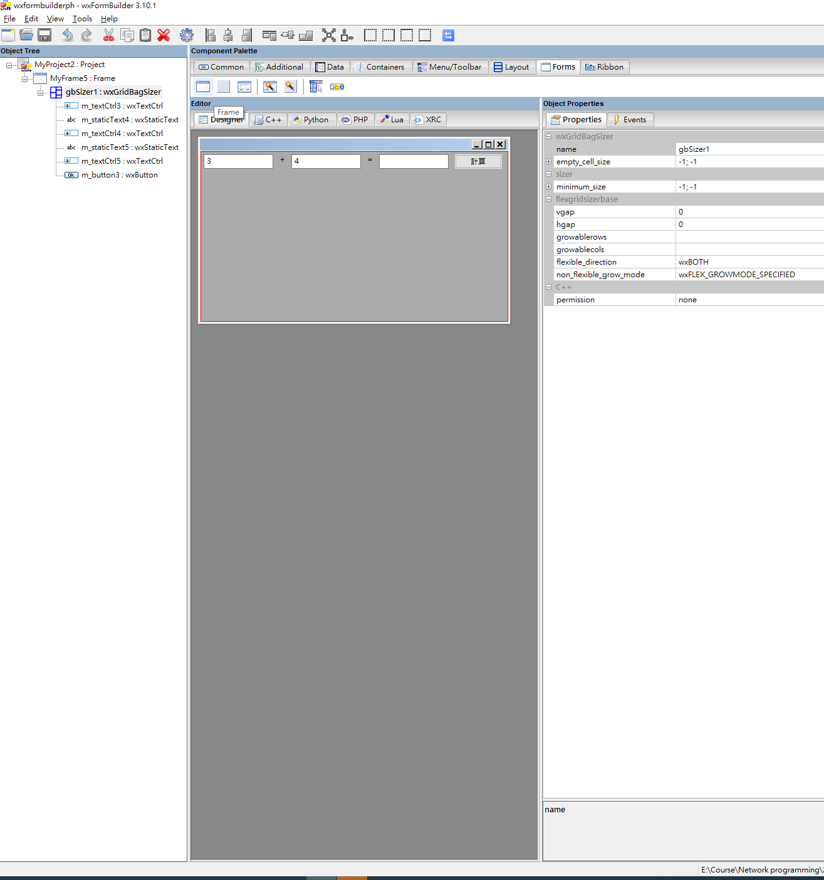
Design the GUI with wxFormBuilder
在Form中拉一個Frame
選Designer來檢視GUI

Slide 14
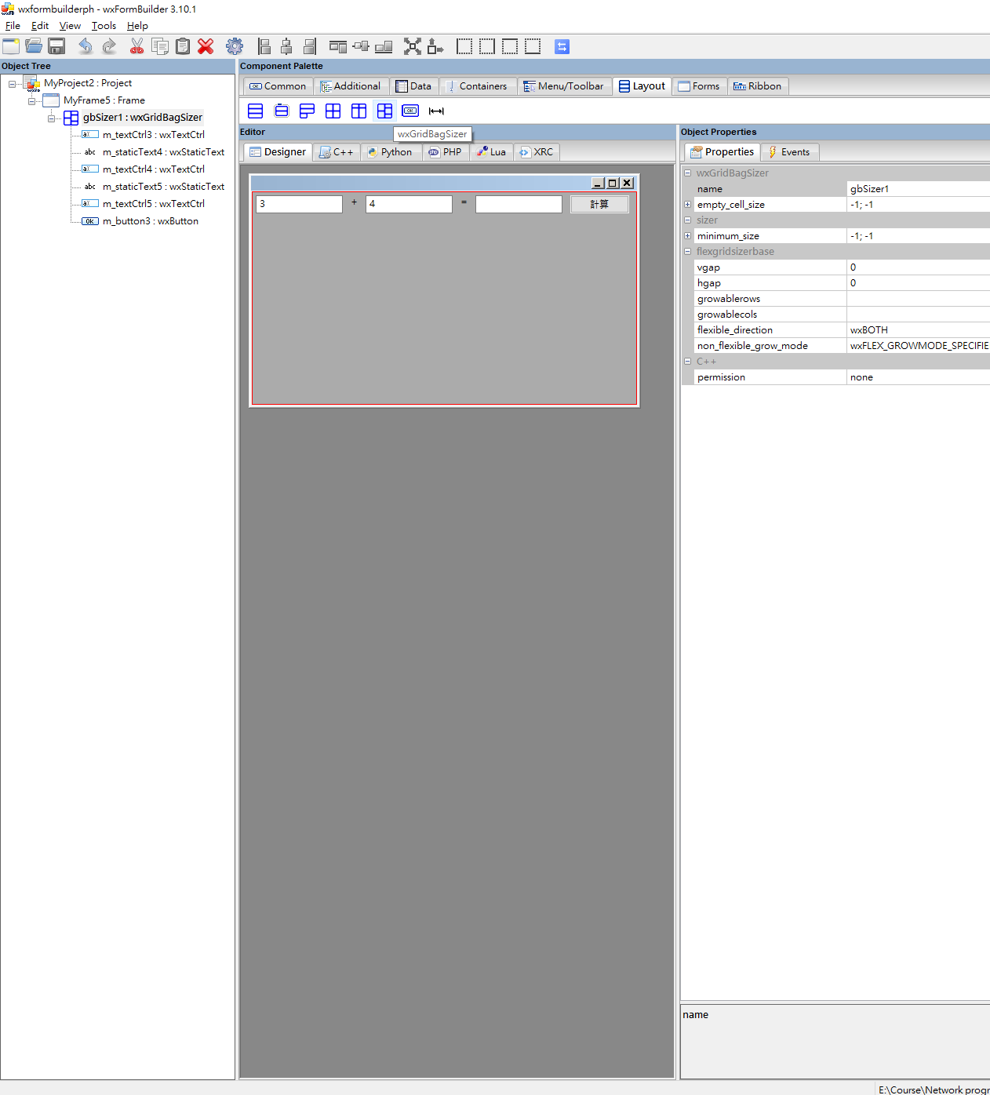
Design the GUI with wxFormBuilder
Add a sizer from Layout

Slide 15
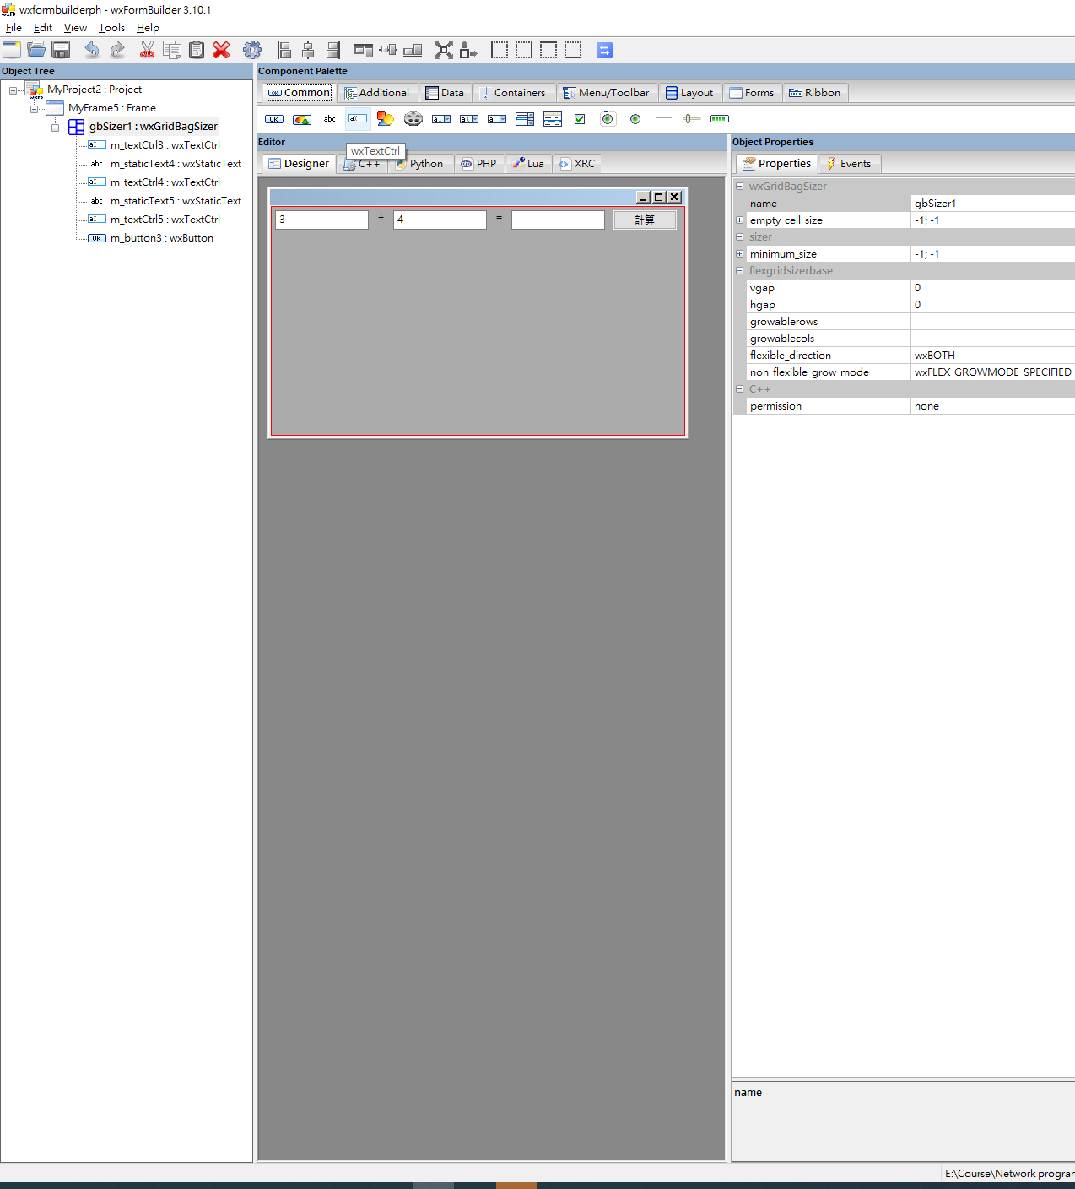
Design the GUI with wxFormBuilder
Add 3 textboxes in the Frame
from Common

Slide 16
Design the GUI with wxFormBuilder
Add static texts in the frame
Add button in the frame

Slide 17
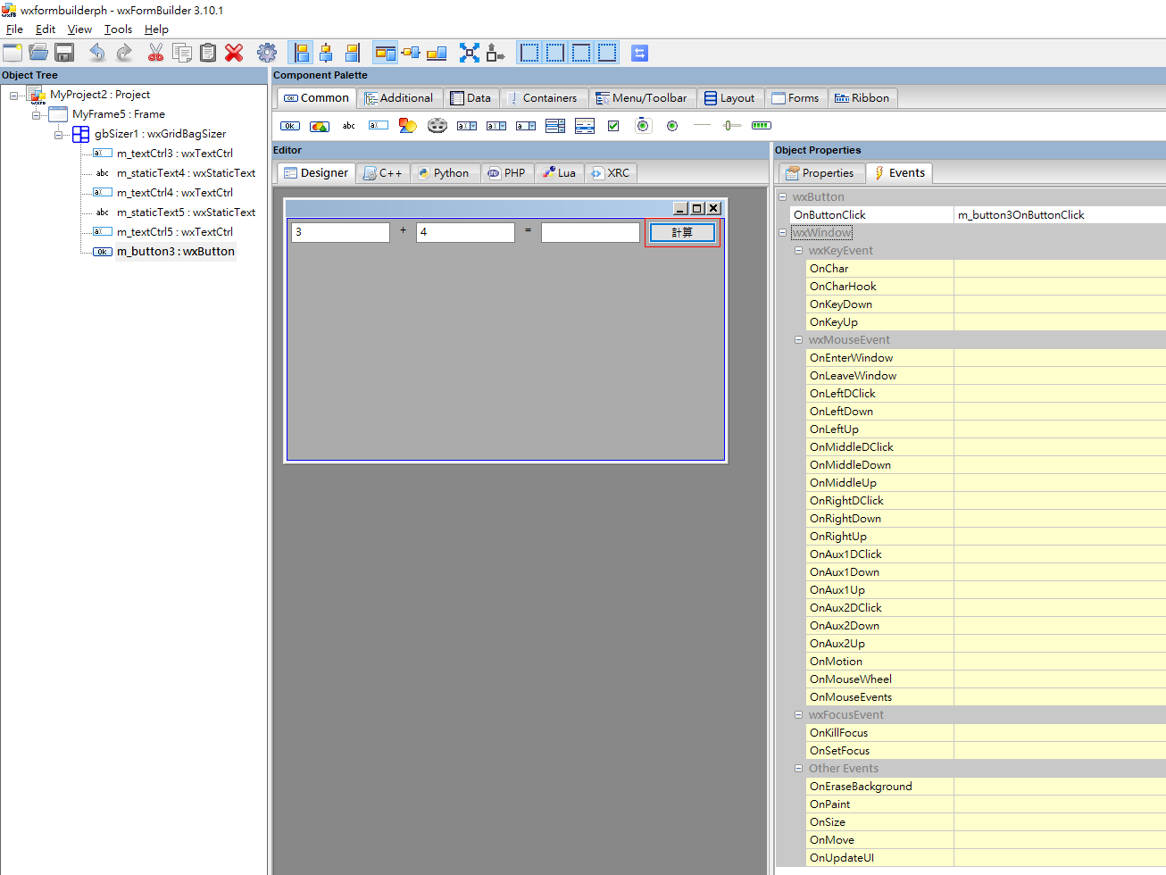
Design the GUI with wxFormBuilder
Check the event and event handler
Choose the button, and see the OnButtonclick event and its designated event handler “m_button3OnButtonClick”
This method will be used to handle the “button click” event

Slide 18
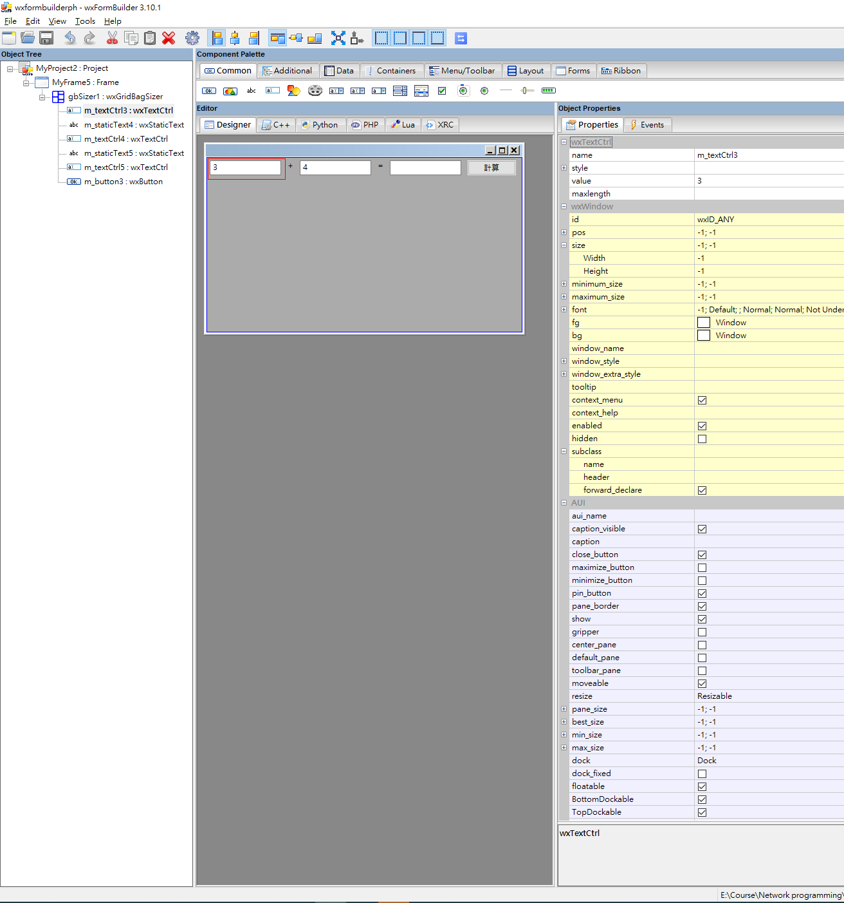
Design the GUI with wxFormBuilder
Check the property of the objects
Choose the text boxes and see the property “value”
This will be used to calculate the sum of the two operands

Slide 19
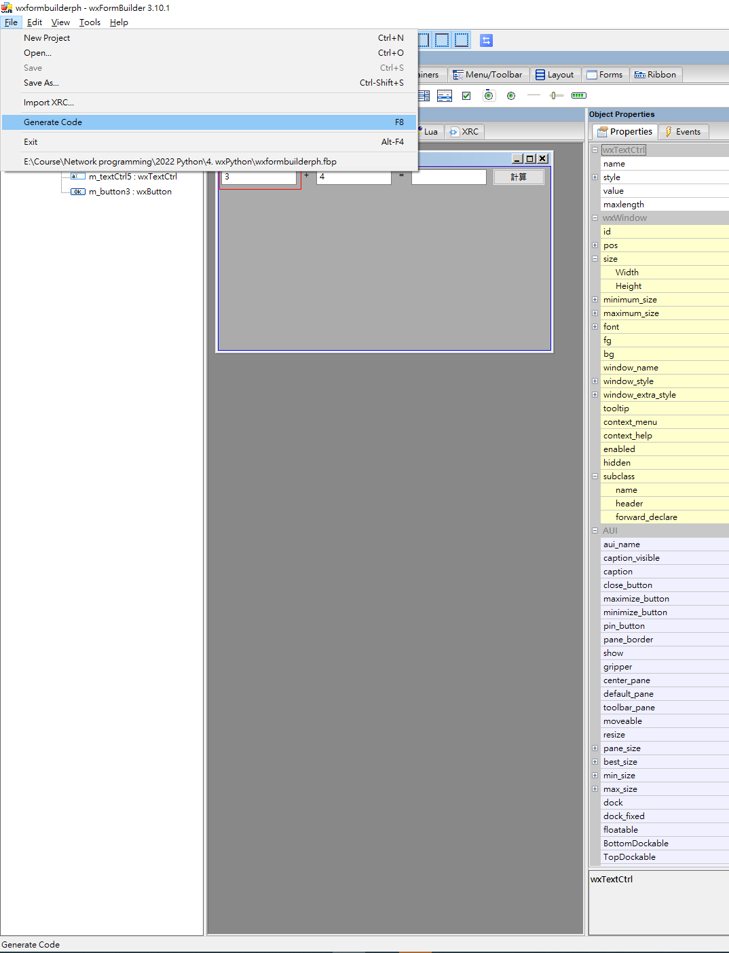
Design the GUI
Save the project
Generate Python codes for the GUI from File menu
Check the Directory, see the “noname.py” which is the Python code for the GUI
Implement the event handler

Slide 20
Implement the code
取得兩個textbox的value，轉成int，相加後，再轉成str
設定結果的textbox的value為兩值相加的結果
# Virtual event handlers, override them in your derived class
def m_button3OnButtonClick( self, event ):
frm.m_textCtrl5.Value=str(int(frm.m_textCtrl3.Value)+int(frm.m_textCtrl4.Value))

Slide 21
Implement the code
啟動Frame和app，加入以下的code
if __name__ == '__main__':
app = wx.App()
frm = MyFrame5(None)
frm.Show()
app.MainLoop()

Slide 22
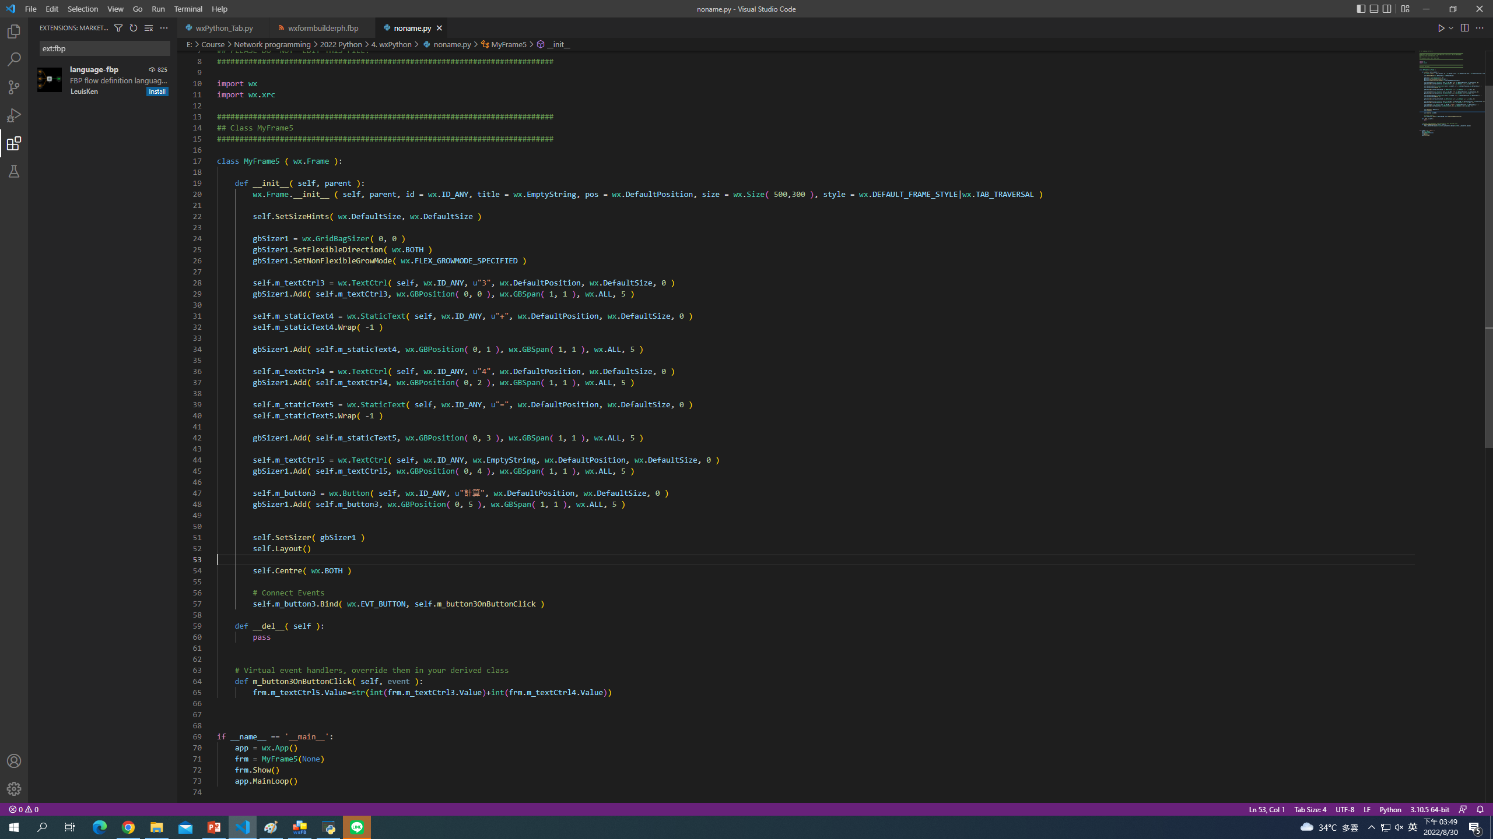

Slide 23
